Slide 1
Lecture 24
Maximum bipartite matching
& Dinic’s Algorithm
Maximum bipartite matching
The Dinic’s Algorithm

Slide 2

Maximum Matching in Bipartite Graphs
Bipartite graph G=(V,E): If V=L∪R, and L∩R=∅, and E=E(L, R), that is, each edge with one end in L and the other in R.
Matching: M⊆E, such that no elements in M share common end points.
Maximum matching M: for any other matching M’, there is |M|≥|M’|

Slide 3
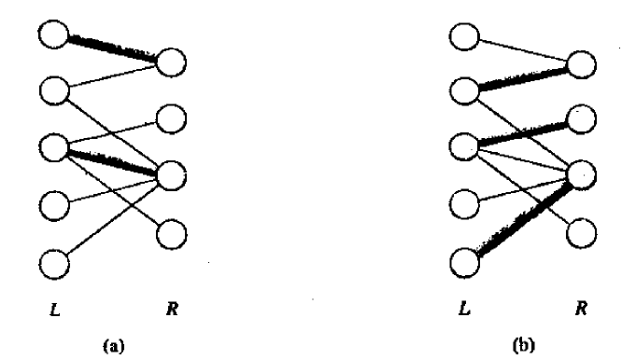
Matching and Maximum Matching

Slide 4
Maximum matching in bipartite graph
Problem:
  Input: a bipartite undirected graph G=(L∪R,E)
  Output: a maximum matching M of G.

Slide 5
How?
Solution: By using maximum flow algorithm.
Directed graph G’=(V’,E’):
  V’={s,t} ∪V
  E’={(s,u)|u∈L} ∪{(v,t)|v ∈R} ∪{(u,v)| u∈L, v ∈R, (u,v) ∈E}
Network: G’, with source s and sink t, and capacity function f:
  c(s,u)=1
  c(v,t)=1
  c(u,v)=1

Slide 6
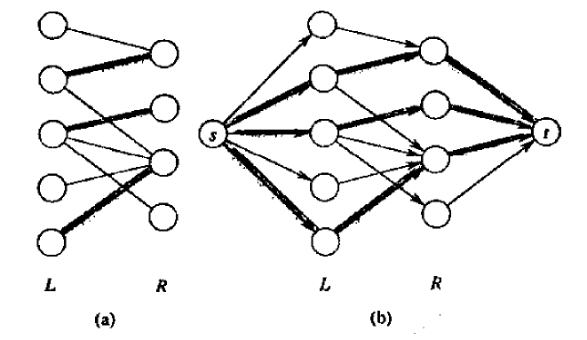

Slide 7
Max. matching VS Max. flow
Lemma 26.10
Let G=(V=L∪R, E) be a bipartite graph and G’=(V’,E’) be its corresponding flow network.
If M is a matching in G, then there is an integer-valued flow f in G’ with value |f|=|M|.
Conversely, if f is an integer-valued flow in G’ , then there is a matching M in G with cardinality |M|=|f|.

Slide 8
Proof of the Lemma
  (→) Define f: if (u,v) ∈ M, then f(s,u)= f(u,v)=f(v,t)=1 and f(u,s)= f(v,u)=f(t,v)=-1, otherwise f(u,v)=0. f is a flow.
  Each edge (u,v) ∈ M corresponds to 1 unit of flow in G’ that traverses the path s→u→v→t, and the paths are disjoint, except for s and t.
  Then |f|=f(L∪{s},R∪{t})=|M|

Slide 9
Proof of the Lemma
  (←) Define M={(u,v):u∈L,v∈R, and f(u,v)>0}. M is a matching.
  Each vertex u has at most one entering edge (s,u), c(s,u)=1. If one unit positive flow does enter, then one unit positive flow must leave. Since f is integer-valued, the one unit flow can enter and leave on at most one edge. Thus if f(s,u)=1, there is exactly one vertex v such that f(u,v)=1, and at most one edge leaving u carries positive flow.
  For every matched vertex u∈L, f(s,u)=1, and for every edge (u,v)∈E-M, f(u,v)=0.
  |M|= f(L,R) =f(L,V’) - f(L,L) - f(L,s) - f(L,t) = f(s,L) = f(s,V’)=|f|

Slide 10
Why integer-valued flow
Theorem 26.11
If the capacity function c takes on integral values, then the maximum flow produced by Ford-Fulkerson method has the property that |f| is integer-valued. Moreover all f(u,v) is an integer.

Slide 11
Correctness and Time Complexity
Corollary 26.12: |M|=|f|. From Lemma 26.10.
Time complexity: O(VE) why?

Slide 12
Dinic’s vs
Basic Ford-Fulkerson’s
The basic Ford-Fulkerson’s algorithm may not stop when the capacity is irrational, and even with integrate capacity, it needs O(Ef) time in the worst case where f is the maximum flow value
Dinic’s algorithm is an implementation of the Ford-Fulkerson’s method
Dinic’s algorithm needs O(V²E) time

Slide 13
The Ford-Fulkerson’s Method
Initialize the network with zero flow
Repeat the following until no augmenting path exists
  find an augmenting path
  Find the minimum Δ(e), for each edge e on the path
  Update the flow according to the minimum Δ
    If e is a forward edge, f(e) = f(e) + Δ
    If e is a backward edge, f(e) = f(e) - Δ
Output the value of the flow f.

Slide 14
Idea of Dinic’s Algorithm (1970)
Start with a legal flow, e.g., the zero-flow
Repeatedly find the augmenting path through a layered subgraph and update the current flow
Until no augmenting path exists
Call edge e = (u, v) saturated from u to v if f(e) = C(e) or saturated from v to u if f(e) = 0, otherwise, it is called unsaturated from u to v if f(e) < C(e) or unsaturated from v to u if f(e) > 0.
Note: the augmenting path found here is through a layered subgraph

Slide 15
The Layered Subgraph
The layers of the layered subgraph can be obtained from the following O(E) layer-algorithm according to current flow.
  Step 1: V₀ ←{s}, i←0.
  Step 2: T ← {v | v ∉ V_{j} for j ≤ i and there is an edge which is unsaturated from some vertex in V_{i} to vertex v}
  Step 3: If T = Φ, then Stop (the current flow is a maximum flow).
  Step 4: If t ∈ T, then L← i + 1, V_{L} ← {t}, Stop.
  Step 5: V_{i+1} ← T, i ← i +1, goto Step 2.

Slide 16
The Layered Subgraph
Each V_{i} (0 ≤ i ≤ L) formed in the layer-algorithm is called a layer.
Let E_{i} (1 ≤ i ≤ L) be the set of unsaturated edges from some vertex in V_{i-1} to some vertex in V_{i}, (both directions should be considered).
G_{f} = (V₀∪V₁∪…∪V_{L}, E₁∪E₂∪… ∪E_{L}) is called the layered subgraph of the network G according to a flow f on G. Define the capacity function C_{f} of G_{f}
  For each edge e = (u, v) ∈ E_{i} (1 ≤ i ≤ L), if u∈V_{i-1}, v∈V_{i}, then C_{f} (e) = C(e) – f(e).
  For each edge e = (u, v) ∈ E_{i} (1 ≤ i ≤ L), if u∈V_{i}, v∈V_{i-1}, then C_{f}(e) = f(e).
  Redirected all the edges in E_{i} (1 ≤ i ≤ L) from V_{i} to V_{i-1}.

Slide 17
A Key Lemma
If the layer-algorithm stops at Step 3, then the current flow in network G is a maximum flow.
  Proof: Suppose V₀, V₁, …, V_{i} are the layers formed when the algorithm terminates at Step 3. Let S = V₀∪V₁∪…∪V_{i}, then
    each edge e = (u, v) ∈(S, S^{C}) is saturated from u to v, i.e, f(e) = C(e)
      otherwise, e is an unsaturated edge from u to v and T can not be empty, a contradiction.
    each edge e = (v, u) ∈(S^{C}, S) is saturated from u to v, i.e., f(e) = 0
      otherwise, e is an unsaturated edge from u to v and T can not be empty, a contradiction.
    Thus, F = F(S, S^{C})-F(S^{C}-S)=C(S), indicating that f is a maximum flow.

Slide 18
Computes the G_{f}’s Maximal Flow
A maximal flow f_{f} of G_{f} satisfies that, for each path v₀v₁v₂…v_{L} where v_{i} ∈V_{i}, v₀ = s,and v_{L} = t, there is at least one edge e = (v_{i-1}, v_{i}) such that f_{f}(e) = C_{f}(e). //|f_{f}| >= any augmenting path
A maximal flow may not be maximum flow.
0/1
1/1
0/1
1/1
s
t
0/1
0/1
1/1

Slide 19
Computes the G_{f}’s Maximal Flow in O(VE) Time
Step 1: Mark each edge e in G_{f} as ‘unblocked’ and set f_{f}(e) ←0.
Step 2: v ←s, set Stack S←Φ
Step 3: If there is no edge (v, w) in G_{f} that is marked ‘unblocked’
Step 3.1: If s = v, then Stop. (current flow is maximal)
Step 3.2: Let e = (u, v) = Pop(S)
Step 3.3: Mark e ‘blocked’ and set v ←u
Step 3.4: Goto Step 3.
Step 4: Select an edge e = (v, w) that is marked ‘unblocked’ and w is in the next layer, Push(S, e) and set v ←w, if v ≠ t, then goto Step 3. If v=t, go to Step5.
Step 5: The edges in Stack S form an augmenting path e₁e₂…e_{L} from s to t
Step 5.1: Let Δ = min_{1≤i≤L}{C_{f}(e_{i})-f_{f}(e_{i})}
Step 5.2: For each i (1≤i≤L), set f_{f}(e_{i})←f_{f}(e_{i}) + Δ, and if f_{f}(e_{i}) = C_{f}(e_{i}), mark e_{i} ‘blocked’.
Step 5.3: Goto Step 2. // In the worst each iteration blocks one edge, needs O(E) iteration, each iteration needs O(V) time

Slide 20
The Dinic’s Algorithm
Step 1: Initialize the network flow as zero flow f.
Step 2: Compute the layered subgraph G_{f} according to current flow f.
Step 3: Compute the maximal flow f_{f} of G_{f}. If f_{f}=0, stop.
Step 4: Update the flow f:
Step 4.1: If e = (u, v) such that u∈V_{i-1}, v ∈V_{i}, then f(e) ←f(e) + f_{f}(e)
Step 4.2: If e = (v, u) such that u∈V_{i-1}, v ∈V_{i}, then f(e) ←f(e) - f_{f}(e)
Step 5: Goto Step 2.

Slide 21
An Example
a
18
b
19
16
5
s
8
4
8
t
18
3
20
c
13
d

Slide 22
Time Complexity
Initialization O(E)
Compute the layered subgraph O(E)
Compute the maximal flow of the layered subgraph O(VE)
Updating O(E)
Loops O(V), Why?
Total: O(V²E)!

Slide 23

Time Complexity
Why O(V) loops?
  Call Steps 2-4 a phase.
  Lemma: If the k+1st phase is not the last phase, then L_{k+1} > L_{k}. Proof: (See textbook Page104)
    There is a path P= s,v₁’,v₂’,…, t, in the k+1 st phase
    If all vertices in P are in the k st phase i.e., each v_{a}’ ∈V_{b,} then by induction proof, a ≥ b, hence, L_{k+1} ≥ L_{k}. L_{k+1} ≠ L_{k,} L_{k+1}>L_{k}
    If there is one v_{a+1}’is not in k st phase (so not t), suppose it is the first one. Then v_{a}’ ∈V_{b}, and a≥b. v_{a+1}’ is not in V_{b+1} implies that b+1=L_{k}. So, L_{k+1}> a+1 ≥ b+1=L_{k}.
  The lemma implies number of phases is at most |V|.

Slide 24
© 2007 SDU <number>

