Slide 1

Lecture 8
Applications of Depth-First Search
Strongly Connected Components Decomposing
-- (for directed graph)

Slide 2
Strongly Connected Components Decomposing
A strongly connected component of a directed graph G = (V, E) is a vertex induced sub-graph G’=(V’, E’) of G, such that :
  (1) Every pair of vertices in V’ are reachable from each other in G’;
  (2) Any other sub-graph that contains more vertices than G’ does not satisfy (1).
Is {1,2,3} a strongly connected component?
Is {1,2,3,4} a strongly connected component?
And {5}?
2
1
3
4
5

Slide 3
The Strongly Connected Components Decomposition Problem
The problem:
  Input: A directed graph G = (V, E).
  Output: All the strongly connected components of G.
Notes:
Sometimes, Strongly Connected Component is abbreviated as SCC, while Strongly Connected Components is abbreviated as SCCs.

Slide 4
An Example used to illustrate the procedure of SCCs Decomposing based on DFS algorithm
Give all the strongly connected components of the following graph.
Give the DFS forest of the following directed graph.
a
d
b
c
g
e
f

Slide 5
Observations
For each tree in a depth-first forest of a graph G:
  It contains all the vertices in the same SCC.
  But, it may also contain some that are not!
1/8
a
9/14
d
b
2/7
10/11
12/13
3/4
c
g
e
f
5/6
Observation: Running DFS algorithm on the original graph alone, we can’t find all SCCs correctly.

Slide 6
What happens if we reverse the edges of the original graph and depth-first search the new graph in decreasing f order?
9/14
12/13
10/11
1/8
g
c
a
b
2/7
f
d
5/6
3/4
e

Slide 7
Transpose of a directed graph G
Definition:
Given a directed graph G = (V, E), the transpose of G is the graph G^{T}=(V, E^{T}), where E^{T}={(v, u)| (u, v)∈E}.
Given an adjacency-list representation of G, the time to create G^{T} is O(V + E). Why?

Slide 8
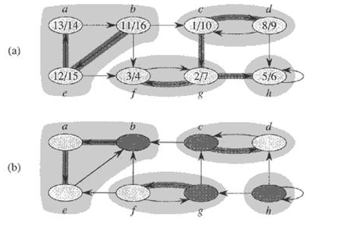
An Example
(a): The graph G with its SCCs shaded
(b): The transpose G^{T} of G with SCCs shaded

Slide 9
Relationship Between G and G^{T}
Given a directed graph G = (V, E)
  G and G^{T} have exactly the same strongly connected components, or in other words,
  u and v are reachable from each other in G if and only if they are reachable from each other in G^{T}.

Slide 10
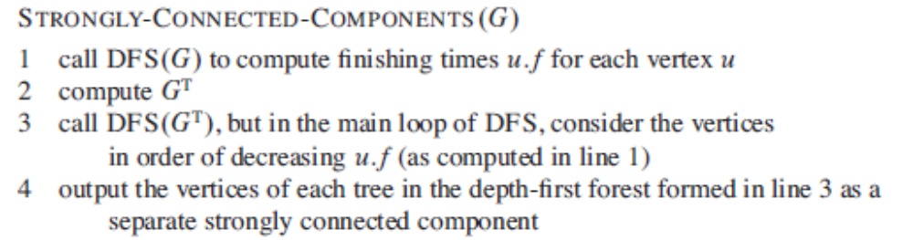
The Algorithm

Slide 11
An example

Slide 12

Time Complexity
Time Complexity:
line 1, line 2, line 3: Θ(V + E)
line 4: Θ(V)
total: Θ(V + E)

Slide 13
Preparations – Part 1
The Component Graph
The component graph G^{SCC} = (V^{SCC}, E^{SCC}) of a directed graph G = (V, E) is defined as follows:
  Suppose that G has strongly connected components C₁, C₂, …, C_{k}
  the vertex set V^{SCC} = {v_{i} | v_{i} corresponds to component C_{i} of G, i = 1,2, …, k}
  the edge set E^{SCC} = {(v_{i}, v_{j}) | G contains a directed edge (x, y) for some x ∈ C_{i} and some y ∈ C_{j} , i, j = 1, 2 , …, k, i≠ j }
Another way: Contracting edge with vertices in the same strongly connected component.

Slide 14
Preparations – Part 1
A Key Property of The Component Graph
Lemma 22.13 : Let C and C’ be distinct strongly connected components in directed graph G = (V, E), let u,v∈C, u’,v’ ∈C’, and suppose that G contains a path u→u’. Then G cannot also contain a path v’→v.
Proof:(by contradiction)
  If G contains a path v’→v, then it contains paths u→u’→v’ and v’→v→u. Thus, u and v’ are reachable from each other, thereby contradicting the assumption that C and C’ are distinct strongly connected components.

Slide 15
Preparations – Part 1
The component graph G^{SCC} = (V^{SCC}, E^{SCC}) is a directed acyclic graph.
Proof:(by contradiction)
  Suppose that G^{SCC} is cyclic, that is, there exist two vertices v₁, v₂ ∈V^{SCC} such that v₁ and v₂ are reachable from each other.
  Since v₁ and v₂ represent the two strongly connected components C₁ and C₂ of G respectively.
  Then according to the definition of component graph, vertices in C₁ and C₂ are reachable from each other, which contradicts the definition of strongly connected component.

Slide 16
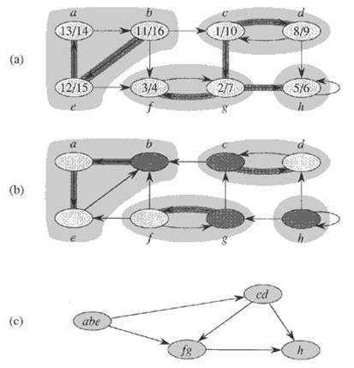
Preparations – Part 1
An Example
(a): The graph G with its SCCs shaded
(b): The transpose G^{T} of G with SCCs shaded
(c): The component graph G^{SCC} = (V^{SCC}, E^{SCC}) of G

Slide 17
Preparations – Part 2
Relationship between the SCCs and the f[]’s
Extension of the notation for d and f to sets of vertices
If U ⊆ V, define
  d(U) = min_{u∈U}{u.d}, the discovery time of vertex set U, that is, the earliest discovery time of any vertex in U;
  f(U) = max_{u∈U}{u.f}, the finishing time of vertex set U, that is, the latest finishing time of any vertex in U.

Slide 18
Preparations – Part 2
Relationship between the SCCs and the f[]’s
Lemma 22.14 Let C and C’ be two distinct strongly connected components in directed graph G = (V, E). Suppose that there is an edge (u, v) ∈ E, where u ∈ C and v ∈ C’. Then f(C) > f(C’).
  Proof:
u
v
x
y
C
C’
Case 1: d(C) < d(C’) Case 2: d(C) > d(C’)

Slide 19
Preparations – Part 2
Proof of Lemma 22.14 (continued)
Case 1: d(C) < d(C’)
Let x be the first vertex discovered in C. At time x.d, all vertices in C and C’ are white. There is a path in G from x to each vertex in C consisting only of white vertices. Because (u, v) ∈ E, for any w∈C’, there is also a path from x to w in G consisting only of white vertices. By the white-path theorem, all vertices in C and C’ become descendants of x in the depth-first tree. By Corollary 22.8, x.f=f(C)>f(C’).
u
v
x
y
C
C’

Slide 20
Preparations – Part 2
Proof of Lemma 22.14 (continued)
Case 2: d(C) > d(C’)
Let y be the first vertex discovered in C’. At time y.d, all vertices in C’ are white and there is a path in G from y to each vertex in C’ consisting only of white vertices. By white-path theorem, all vertices in C’ become descendants of y in the depth-first tree, and by Corollary 22.8, y.f=f(C’). At time y.d, all vertices in C are white. Since there is an edge (u, v) from C to C’, Lemma 22.13 implies that there cannot be a path from C’ to C. Hence, no vertex in C is reachable from y. At time y.f, therefore, all vertices in C are still white. Thus, for any vertex w∈C, we have w.f>y.f, which implies that f(C) > f(C’).
u
v
x
y
C
C’

Slide 21
Preparations – Part 2
A Corollary
Corollary 22.15：Let C and C’ be distinct strongly connected components in directed graph G = (V, E). Suppose that there is an edge (u, v) ∈ E^{T}, where u ∈ C and v ∈ C’. Then f(C) < f(C’).
E^{T}中的边都是从先结束(f小)的到后结束的(f大) 。
  Proof: (u, v) ∈ E^{T} ➔ (v, u) ∈ E, G and G’ has the same strongly connected components, Lemma 22.14 implies
  f(C) < f(C’).
Note: Here, the finishing times are got from the first depth-first search

Slide 22
Final Destination
Correctness Proof of the Algorithm
Theorem 22.16 ： STRONGLY-CONNECTED-COMPONENTS(G) correctly computes the strongly connected components of a directed graph G.

Slide 23
Proof (Continued)
T₂
C_{T1}
C_{T2}
……
C_{Tk}
T₁
T_{k}
T_{k+1}
?
C
u
……

Slide 24
Review the Example

Slide 25
Proof (continued)
Proof: we will prove that the vertices of each tree form a strongly connected component, by induction on the number k of depth-first trees found in the depth-first search of G^{T} in line 3.
  Basic step: k = 0, it is trivially true.
  Inductive hypothesis: the first k trees produced in line 3 are strongly connected components.
  Inductive step: Consider the (k+1)st tree produced.
    Let the root of the (k+1)st tree be vertex u, and let u be in strongly connected component C. By induction hypothesis, no vertices in C had been searched before, and since u has the biggest f among all the remaining vertices in G^{T}, u.f = f(C) > f(C’) for any strongly connected component C’ other than C that has yet not been visited.
    At time u.d, all other vertices of C are white. By the white-path theorem, all other vertices of C are descendants of u in its depth-first tree.
    Moreover, by induction hypothesis, Corollary 22.15 and f(C) > f(C’) got above, any edge in G^{T} that leaves C must point to SCCs that have already been visited. Thus, no vertex in any SCC other than C will be a descendant of u during the depth-first search of G^{T}.
  Thus, the vertices of the depth-first tree in G^{T} that is rooted at u form exactly one strongly connected component

Slide 26
Conclusion
Strongly Connected Components Decomposing
Algorithm-- (for directed graph)
  A key property of the component graph
  The relationship between the SCCs and the f’s
  Proof of the correctness of the algorithm

Slide 27
Semi-connected Graph
A directed graph G = (V, E) is semi-connected if for all pairs of vertices u, v ∈V, we have u ∼∼→ v (v is reachable from u) or v ∼∼→ u (u is reachable from v) or both.
How to determine whether or not a directed graph is semi-connected? (Exercise 22.5-7)

Slide 28
An Observation
Given a directed graph G = (V, E), its strongly connected component graph is denoted as G^{SSC} = (V^{SCC}, E^{SCC}). Then G is semi-connected if and only if for any pair of vertices u, v ∈V^{SSC}, either u is reachable from v or v is reachable from u ( notice that there can not be paths in both directions).

Slide 29
A Sketch
C1
C2
C3
C5
C4
Notice that if the above is a topological sort of G^{SCC}, then
edges can only point from the left to right. So, if G is semi-connected,
Path can only point from left to right,
then C1 must reach each C2…,C5, C2 must reach each C3,…,C5,
…, C4 must reach C5. Then the red edges must exist, Vice versa.

Slide 30
The Algorithm Outline
Compute the strongly connected components of G.
Construct the component graph G^{SCC} of G.
Topological Sort G^{SCC}.
Judge whether there is an edge from C_{i} to C_{i+1}, for 0<i<m, where C_{i} is indexed by topological sort, and m is the number of SCCs.
Time complexity: O(V + E)
 2004 SDU <number>

Slide 31
Another method
In step 3, generate topological sort by using the method that each time find a vertex of zero in-degree. Then G is semi-connected if and only if in each run, exactly one vertex of zero in-degree exist.
Proof?

Slide 32
Homework
22.4-2
22.5-3
22.5-7
Probem 22-3

Slide 33
Next Class
The Minimum Spanning Tree Problem
A Generic Algorithm
Kruskal’s Algorithm
Prim’s Algorithm

