Slide 1

Lecture 9
Minimum Spanning Tree
The Minimum Spanning Tree Problem
A Generic Algorithm
Kruskal’s Algorithm
Prim’s Algorithm

Slide 2
Tree and Its Properties
Tree is an acyclic, connected graph.
A tree of |V| vertices has |V|-1 edges.
There exists a unique path between any two vertices of a tree.
Adding any edge to a tree creates a unique cycle. Breaking any edge on this cycle restores a tree.
Deleting any edge on a tree increases the number of connected components by 1.

Slide 3
An Application
In the design of networking
Given n computers, we want to connect them so that each pair of them can communicate with each other.
Price of cable: $1/foot
We want the cheapest possible network.
8
7
b
c
d
4
2
9
11
4
14
e
a
i
7
6
8
10
h
g
f
1
2

Slide 4

The Definition of Minimum Spanning Tree
Spanning tree: Given a connected undirected graph G = (V, E), a spanning tree of G is an acyclic subgraph that connects all vertices of G.
Minimum spanning tree: Given a connected undirected graph G = (V, E) and an assignment of weights w(e) to the edges of G, a minimum spanning tree T of G is a spanning tree with minimum total edge weight
Note:
(1). A connected undirected graph may have many different spanning trees
(2). The minimum spanning tree may not be unique

Slide 5
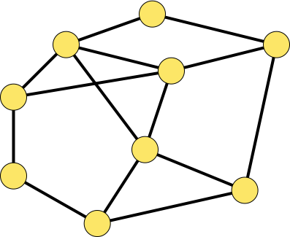
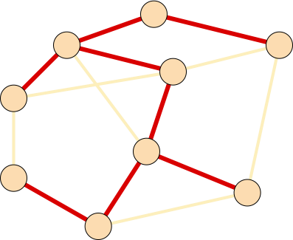
Minimum Spanning Tree Problem
The Problem:
  Input: A connected, weighted, undirected graph G = (V, E; W).
  Output: A minimum spanning tree T for G.
1
3
1
3
6
3
3
6
6
6
9
1
9
7
5
7
1
5
8
8
3
3
2
2
7
4
7
4

Slide 6
Idea of the Generic Algorithm
It grows the minimum spanning tree one edge at a time.
  What’s the foundation?: An edge set A that is a subset of some minimum spanning tree T;
  Which edge?: An edge (u, v) satisfying that A∪{(u, v)} is also a subset of some minimum spanning tree T’.
In other words, it maintains the following loop invariant:
  Prior to each iteration, A is a subset of some minimum spanning tree.
The edge (u, v) is called a safe edge for A if A∪{(u, v)} is also a subset of a minimum spanning tree, that is,
  (u, v) can be safely added to A without violating the above invariant

Slide 7
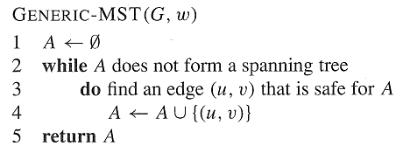
A Generic Algorithm
Kruskal’s and Prim’s algorithms are implementations of the generic algorithm on how to maintain A and find the safe edge (u, v) for A.

Slide 8
How to recognize Safe Edges for A Related Notions
A cut (X, Y) of a graph G = (V, E) is a partition of the vertex set V into two sets X and Y = V - X.
An edge (u, v)∈ E is said to cross the cut (X, Y) if u ∈ X and v ∈ Y.
A cut (X, Y) respects a set A of edges if no edge in A crosses the cut.
An edge is a light edge crossing a cut if its weight is the minimum of any edge crossing the cut.
8
7
b
c
d
9
4
2
X↑
a
11
i
14
e
↑ X
4
7
6
8
10
Y↓
h
g
f
↓ Y
1
2

Slide 9
How to recognize Safe Edges for A
Theorem 23.1 Let G = (V, E) be a connected, undirected graph with real-valued weight function w defined on E. Let A be a subset of E that is included in some minimum spanning tree for G, let (X, Y) be any cut of G that respects A, and let (u, v) be a light edge crossing (X, Y). Then, edge (u, v) is safe for A.
8
7
y
u
v
9
X↑
x
p
9
w
↑ X
8
8
Y↓
s
q
z
↓ Y

Slide 10
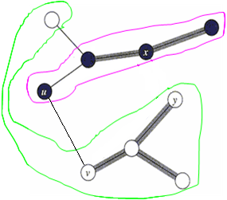
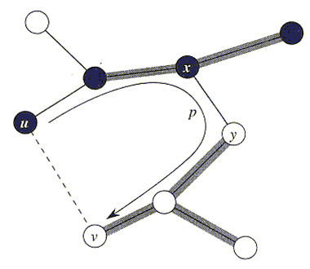
Proof of Theorem 23.1
Proof: Let T be a MST including A. It suffices to consider two cases:
Case 1: T contains the light edge (u, v). We are done;
Case 2: T does not contain the light edge (u, v). In order to show that (u, v) is a safe edge for A, we shall construct another MST T’ that includes A∪{(u, v)}.
The edge (u, v) forms a cycle with the edges on the path p from u to v in T. Since u and v are on opposite sides of the cut (X,Y), there is at least one edge in T on the path p that also crosses the cut. Let (x, y) be any such edge. Since (x, y) is on the unique path from u to v in T, removing (x, y) breaks T into two components. Adding (u, v) reconnects them to form a new spanning tree T’ = T-{(x, y)} ∪{(u, v)}.
It is easy to show that T’ is a minimum spanning tree.
It also is easy to show that T’ includes A∪{(u, v)}.
X
Y
X
Y

Slide 11
A better understanding
A is always acyclic. Why?
So, G_{A}=(V,A) is a forest, and each connected component of which is a tree.
Any safe edge (u, v) for A connects distinct connected component of G_{A}. Why?
The while-loop is executed |V|-1 times. Why?

Slide 12
A Corollary
Corollary 23.2: Let G = (V, E) be a connected, undirected graph with real-valued weight function w defined on E. Let A be a subset of E that is included in some minimum spanning tree for G, and let C = (V_{C}, E_{C}) be a connected component in the forest G_{A} = (V, A). If (u, v) is a light edge connecting C to some other component in G_{A}, then (u, v) is safe for A.
Proof: The cut (V_{C}, V-V_{C}) respects A, and (u, v) is a light edge for this cut. Therefore, (u, v) is safe for A.
8
7
y
u
v
9
X↑
x
p
9
w
↑ X
8
8
Note: Kruskal and Prim’s algorithms are based on the corollary.
Y↓
s
q
z
↓ Y

Slide 13
Idea of the Kruskal
Initialize the forest, each vertex as a tree, A← Φ.
Find the least weight edge (u, v) that connects any two trees in the forest.
Add (u, v) to A and union the two tree into one tree, number of trees in the forest decreases 1.
Repeat step 2 and 3 until A forms a spanning tree.

Slide 14
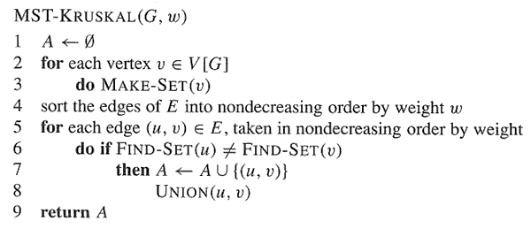
Kruskal’s Algorithm

Slide 15

9
a
1
b
3
d
4
c
(a, d):1 (h, i):1 (c, e):1 (f, h):2 (g, h):2
(b, c):3 (b, f):3 (b, e):4 (c, d):5 (f, g):5
(e, i):6 (d, g):8 (a, b):9 (c, f):12
5
e
1
3
12
8
6
f
5
i
2
g
2
1
h
9
a
1
b
3
d
4
c
5
(a, d):1 (h, i):1 (c, e):1 (f, h):2 (g, h):2
(b, c):3 (b, f):3 (b, e):4 (c, d):5 (f, g):5
(e, i):6 (d, g):8 (a, b):9 (c, f):12
e
1
3
12
8
6
f
5
i
2
g
2
1
h

Slide 16
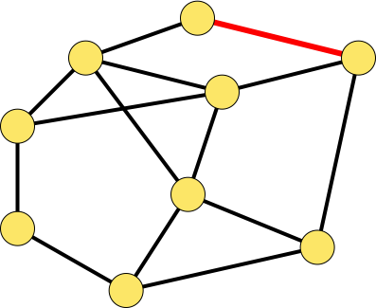
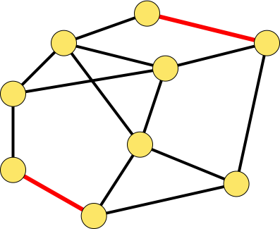
9
a
1
b
3
d
4
c
5
(a, d):1 (h, i):1 (c, e):1 (f, h):2 (g, h):2
(b, c):3 (b, f):3 (b, e):4 (c, d):5 (f, g):5
(e, i):6 (d, g):8 (a, b):9 (c, f):12
e
1
3
12
8
6
f
5
i
2
g
2
1
h
9
a
1
b
3
d
(a, d):1 (h, i):1 (c, e):1 (f, h):2 (g, h):2
(b, c):3 (b, f):3 (b, e):4 (c, d):5 (f, g):5
(e, i):6 (d, g):8 (a, b):9 (c, f):12
4
c
5
e
1
3
12
8
6
f
5
i
2
g
2
1
h

Slide 17
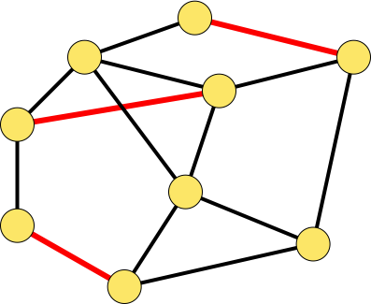
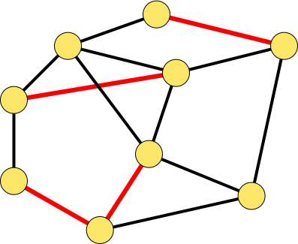
9
a
1
b
3
d
(a, d):1 (h, i):1 (c, e):1 (f, h):2 (g, h):2
(b, c):3 (b, f):3 (b, e):4 (c, d):5 (f, g):5
(e, i):6 (d, g):8 (a, b):9 (c, f):12
4
c
5
e
1
3
12
8
6
f
5
i
2
g
2
1
h
9
a
1
b
3
d
(a, d):1 (h, i):1 (c, e):1 (f, h):2 (g, h):2
(b, c):3 (b, f):3 (b, e):4 (c, d):5 (f, g):5
(e, i):6 (d, g):8 (a, b):9 (c, f):12
4
c
5
e
1
3
12
8
6
f
5
i
2
g
2
1
h

Slide 18
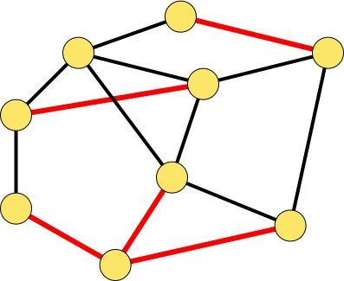

9
a
1
b
3
d
(a, d):1 (h, i):1 (c, e):1 (f, h):2 (g, h):2
(b, c):3 (b, f):3 (b, e):4 (c, d):5 (f, g):5
(e, i):6 (d, g):8 (a, b):9 (c, f):12
4
c
5
e
1
3
12
8
6
f
5
i
2
g
2
1
h
9
a
1
b
(a, d):1 (h, i):1 (c, e):1 (f, h):2 (g, h):2
(b, c):3 (b, f):3 (b, e):4 (c, d):5 (f, g):5
(e, i):6 (d, g):8 (a, b):9 (c, f):12
3
d
4
c
5
e
1
3
12
8
6
f
5
i
2
g
2
1
h

Slide 19
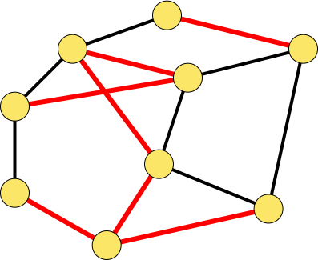
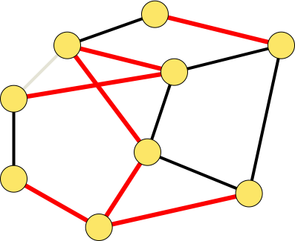
9
a
1
b
d
(a, d):1 (h, i):1 (c, e):1 (f, h):2 (g, h):2
(b, c):3 (b, f):3 (b, e):4 (c, d):5 (f, g):5
(e, i):6 (d, g):8 (a, b):9 (c, f):12
3
4
c
5
e
1
3
12
8
6
f
5
i
2
g
2
1
h
9
a
1
b
d
(a, d):1 (h, i):1 (c, e):1 (f, h):2 (g, h):2
(b, c):3 (b, f):3 (b, e):4 (c, d):5 (f, g):5
(e, i):6 (d, g):8 (a, b):9 (c, f):12
3
4
c
5
e
1
3
12
8
6
f
5
i
2
g
2
1
h

Slide 20
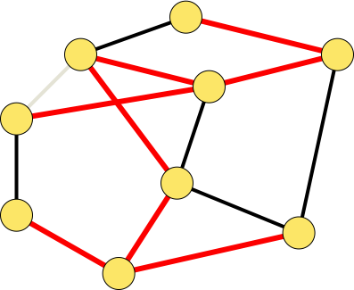
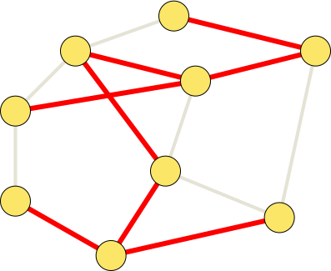
9
a
1
b
3
d
(a, d):1 (h, i):1 (c, e):1 (f, h):2 (g, h):2
(b, c):3 (b, f):3 (b, e):4 (c, d):5 (f, g):5
(e, i):6 (d, g):8 (a, b):9 (c, f):12
4
c
5
e
1
3
12
8
6
f
5
i
2
g
2
1
h
9
a
1
(a, d):1 (h, i):1 (c, e):1 (f, h):2 (g, h):2
(b, c):3 (b, f):3 (b, e):4 (c, d):5 (f, g):5
(e, i):6 (d, g):8 (a, b):9 (c, f):12
b
3
d
4
c
5
e
1
3
12
8
6
f
5
i
2
g
2
1
h

Slide 21
Correctness Proof of Kruskal
At any time, A is a subset of a MST
In the end, A is a MST
Proof of 1. (By induction on |A|)
  Basic step: |A|=0, A₀ (= ∅ ) of course is a subset of a MST.
  Inductive hypothesis: A_{k} is a subset of a MST.
  Inductive step: Let’s consider A_{k+1}. Suppose the (k+1)th edge added to A_{k} is e_{k+1}=(u,v). Without loss of generality, suppose u∈C, here C is a connected component of G_{k}=(V, A_{k}). Since (u,v) is the smallest remaining edge, it must be a light edge connecting C to some other component of G_{k}=(V, A_{k}), so it is safe for A_{k}. Hence A_{k+1} is subset of a MST.

Slide 22
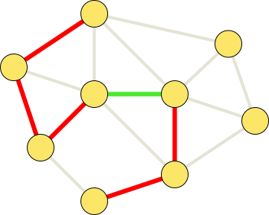
Correctness Proof
(Continued)
Proof of 2. By 1, in the end, A is a subset of a MST T.
By contradiction suppose that A is not a MST. Then, T-A≠ ∅.
Suppose e_{i}∈T-A. e_{i} must have larger weight than each edge in A, since
otherwise e_{i} should have been added to A. Then, after all the
edges in A have been chosen , since e_{i}∪A do not contain a cycle, there must be a time that e_{i} is considered. e_{i} should be added to A at that time.
A contradiction.
e_{i}

Slide 23
Idea of the Prim
Start from a vertex r, add r to a vertex set U which is initialized to empty.
Find the least weight edge (u,v), u∈U, v∈V-U, add (u,v) to A, and add v to U.
Repeat 2 until A forms a spanning tree or U = V.

Slide 24
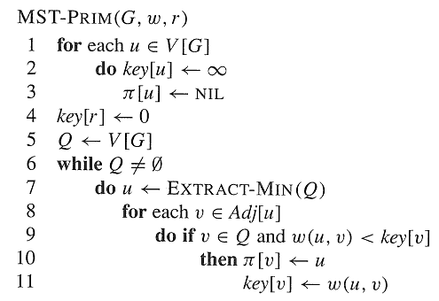
Prim’s Algorithm

Slide 25
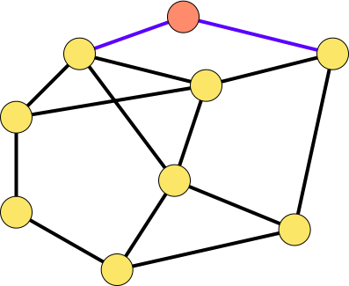
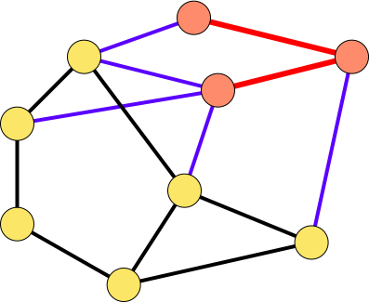
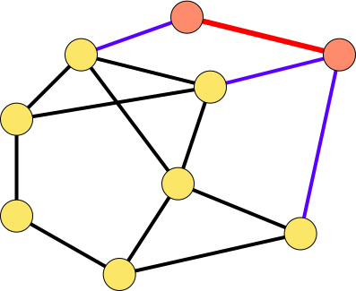
9
r
1
9
r
1
b
3
d
b
3
d
4
c
5
4
c
5
e
1
e
1
3
12
8
3
12
8
6
6
f
5
f
5
i
i
2
g
2
g
1
2
h
1
h
2
9
r
1
9
r
1
b
3
d
b
3
d
4
c
5
4
c
5
e
1
e
1
3
12
8
3
12
8
6
f
6
f
5
5
i
2
g
i
2
2
2
g
1
h
1
h

Slide 26
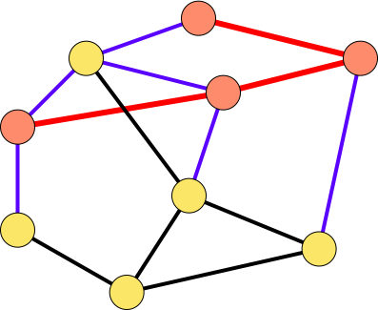
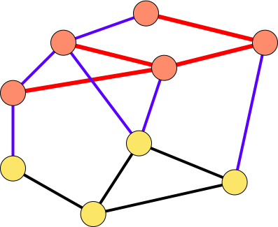
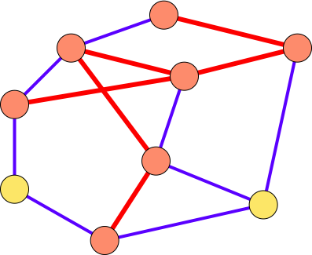
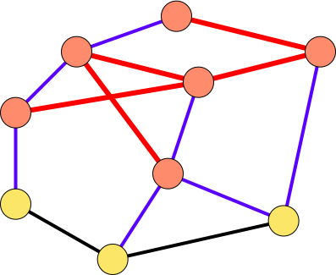
r
r
9
a
1
9
1
b
d
b
3
d
3
4
4
c
c
5
5
e
e
1
1
12
3
12
8
3
8
6
f
6
f
5
5
i
i
2
2
g
2
g
2
1
1
h
h
9
r
1
9
r
1
b
3
d
b
3
d
4
c
5
4
c
5
e
1
e
1
3
12
8
3
12
8
6
f
6
f
5
5
i
2
i
2
g
2
g
2
1
h
1
h

Slide 27
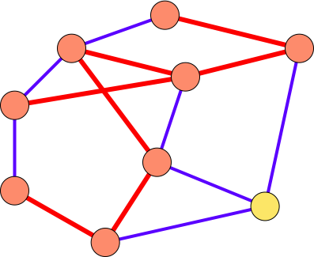
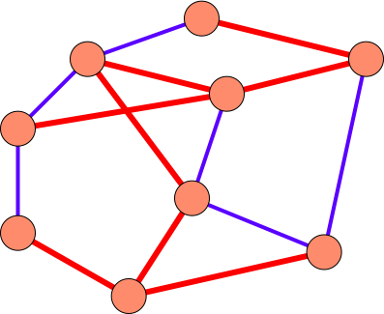
9
r
1
9
r
1
b
3
d
b
3
d
4
c
5
4
c
5
e
1
e
1
3
12
8
3
12
8
6
f
6
f
5
5
i
2
i
2
2
g
2
g
1
h
1
h

Slide 28
Loop invariant
Key[u] is the minimum weight of the edges connect a vertex u in Q to vertices in U=V-Q.
π[u] is right such a vertex in U.
The three loop invariant:
  A={(v,π[v])| v∈V-{r}-Q}
  The vertices already placed into the MST are those in U=V-Q
  For all vertices v ∈Q, if π[v]≠NIL, then key[v]<∞ and key[v] is the weight of a light edge (v,π[v]) connecting v to some vertex already placed into the MST.

Slide 29
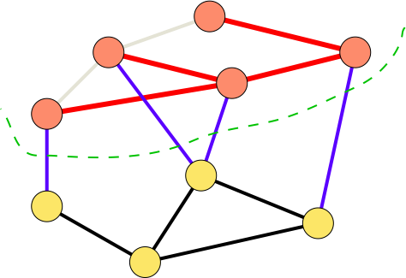
Correctness Proof
Similar to that of Kruskal’s.
1: each time we add a safe edge (a light edge crossing (U, Q)).
2: in the end, if A is not a MST, then Q is not empty, and (U, Q)
is a cut that respects A. Since G is connected, we can find a light edge
crossing (U, Q), which is safe for A. A contradiction.

Slide 30
Conclusion
The Minimum Spanning Tree Problem
A Generic Algorithm
Kruskal’s Algorithm
Prim’s Algorithm

Slide 31
Homework
23.1-5, 23.2-1, 23.2-8.
Problem 23-3, 23-4(not compulsory)

Slide 32
Next Class
Single-Source Shortest Paths Problems
Related Notions
Properties of Shortest-Paths and Relaxation
Variants of Shortest-Paths Problems
The Bellman-Ford Algorithm

