Slide 1
EYE GAZE TRACKING USING WEBCAM
(APPLIED ON AUTISM DETECTION)
Mentor: Prof. Anupam Agrawal
Presented by:
Ankita Nasipuri LIT2015012
Puja Kumari LIT2015017
Samriddhi Niranjan LIT2015021
Kajol LIT2015022

Slide 2
PROBLEM OBJECTIVE
To develop a software system which takes visual gaze patterns as input.
The software should predict whether the visual gaze patterns belongs to autistic patient or not
Three different approaches are used and comparison has been done between them.
The output given by the system will be autistic or non-autistic.

Slide 3
LITERATURE SURVEY

Slide 4
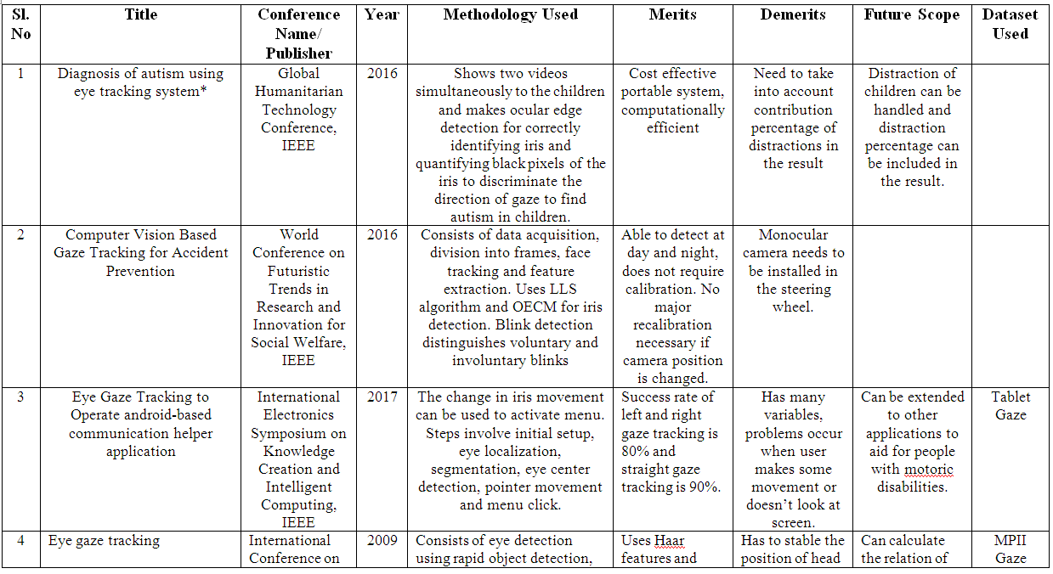

Slide 5
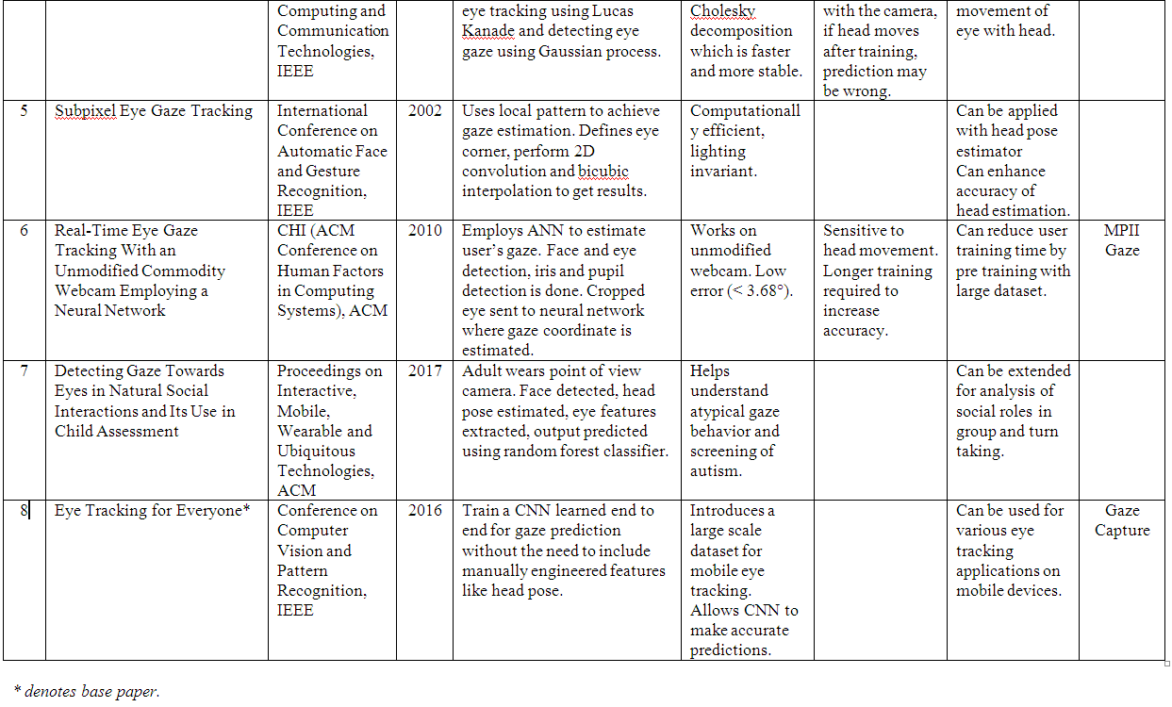

Slide 6
METHODOLOGY

Slide 7
FLOWCHART
Eye Gaze Tracking
Visual Pattern Generation
Dataset Augmentation
Classification
CNN
DNN
Non NN
(SVM, Random Forest)

Slide 8
Eye Gaze Tracking
A one-minute video was shown to the subject and the gaze coordinates recorded using iTracker.
The gaze coordinates are obtained as follows:
Face and eye detection done on the input video stream using Opencv.
Face, left eye and right eye images cropped and a face mask generated.
Face Mask: A binary mask with the face area black and remaining area white.
Cropped face, left eye and right eye images resized to 64*64 pixels and the face mask to 25*25 pixels.
These are provided as input to the iTracker which generates the estimated gaze coordinates as output.

Slide 9



FACE
FACE MASK
LEFT EYE
RIGHT EYE
EYE GAZE TRACKING
Coordinate File

Slide 10
Visual Pattern Generation
A line drawn for each transition from position [x(t), y(t)] to [x(t+1), y(t+1)]
The change in colour across the line used to represent the dynamics of eye movements.
The RGB values set as the velocity, acceleration and jerk respectively.
Obtained image provided as input to the classification model.
Implementation done using Matplotlib in Python.

Slide 11
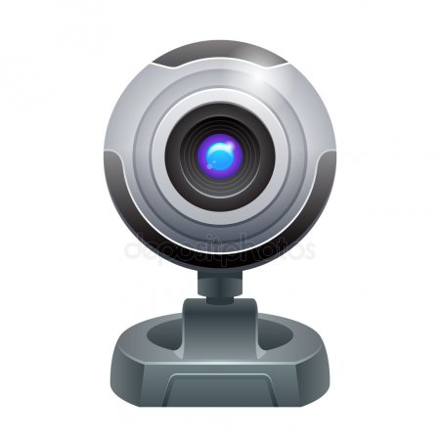
End of file reached?
Read coordinates from file
No
Set threshold of coordinates count (100)
Calculate velocity as change in Euclidean distance
Yes
Remove margin and axes from plot
Read input video to collect coordinates
Calculate acceleration as change in velocity
Save the plot as output image
No. of coordinates > 100
Calculate jerk as change in acceleration
No
Set RGB values as velocity, acceleration and jerk
Yes
Store coordinates in a file
Draw line between two coordinates
Flowchart for Visual Pattern Generation

Slide 12
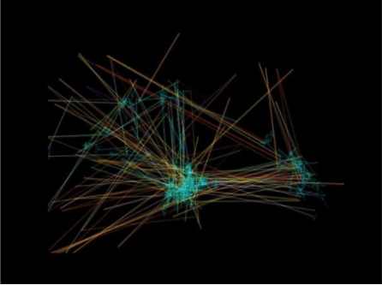
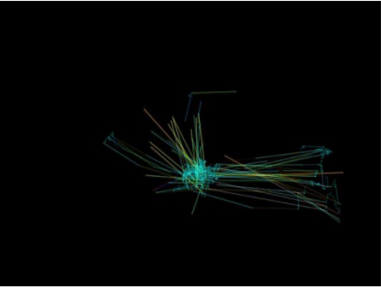
SAMPLE INPUT IMAGE
Visualization of eye-tracking paths for participant Visualization of eye-tracking paths for a
diagnosed with ASD non-ASD participant

Slide 13
Classification
We use image classification to classify eye gaze patterns as autistic or non-autistic.
Can be done using either neural network approaches (CNN, DNN etc.)or non neural network approaches (SVM, Bayesian etc.)
We have used two neural network based methods and two non-neural network approaches
SVM
Random Forest Classifier

Slide 14
CONVOLUTIONAL NEURAL NETWORK
A CNN consists of an input layer, an output layer and multiple hidden layers.
The hidden layers consist of convolutional layers, pooling layers, fully connected layers and normalisation layers.
Basic architecture of our CNN
Has two convolutional layers followed by MaxPooling layer, two fully connected layer and an output layer.
The convolutional layers deal with input images seen as 2-D matrices.
32 nodes in each of the convolutional layers. 2 x 2 filter matrix used as kernel. Activation function used is ReLU and shape of each input image is 200 x 200.

Slide 15
MaxPooling layer used with pool size of 2 X 2 .
Next, a flatten layer is used to connect convolutional layer and dense layers. The output is flattened to enter the Fully Connected Layers.
First, we specify 64 nodes each activated by reLU function. The next layer uses sigmoid function with binary classification to give the final output layer which consists of two nodes, one for each class.
Model has been compiled using Adam optimizer with learning rate of 0.005 and binary crossentropy as loss function.
The model was trained for 1000 epochs with batch size 16.
The ratio of training data and testing data was 70% and 30% respectively.

Slide 16
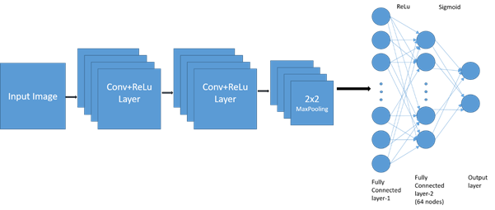
Architecture of CNN

Slide 17
DEEP NEURAL NETWORK
A deep neural network (DNN) is an artificial neural network (ANN) with multiple layers between the input and output layers.
Basic architecture of our DNN
Consists of four hidden layers and an output layer.
The first ,second ,third and fourth hidden layer consists of 500,200,100 and 50 nodes respectively and uses RELu as activation function.
The next layer uses sigmoid activation function with binary classification to give final output layer which consists of two nodes,one for each class.

Slide 18
Our model has been compiled on same parameters, i.e., using Adam optimizer with learning rate of 0.005 and binary crossentropy as loss function.
The model was trained for 1000 epochs with batch size 16.
The ratio of training data and testing data was 70% and 30% respectively.

Slide 19
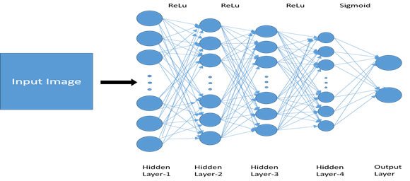
Architecture of DNN

Slide 20
NON NEURAL NETWORK METHODS
We have used two non-neural methods to train and classify eye gaze patterns.
The first method used was SVM to classify the eye gaze patterns as autistic or non-autistic.
The second method used was Random Forest Classifier.
Both of these are supervised machine learning algorithms

Slide 21
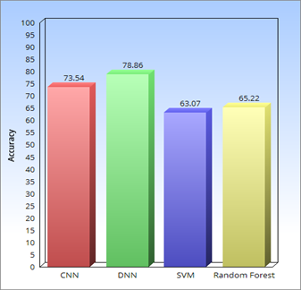
RESULTS
Fig. Bar chart showing accuracy of the four methods

Slide 22
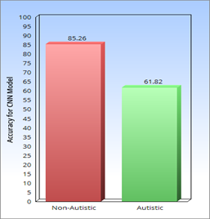
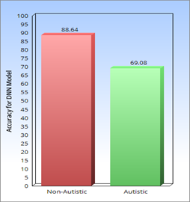
Fig. Bar Chart showing accuracy of the two classes for CNN model
Fig. Bar Chart showing accuracy of the two classes for DNN model

Slide 23
CONFUSION MATRIX OBTAINED USING CNN
 | NON-AUTISTIC | AUTISTIC
NON-AUTISTIC | 85.26% | 14.74%
AUTISTIC | 38.18% | 61.82%
CONFUSION MATRIX OBTAINED USING DNN
 | NON-AUTISTIC | AUTISTIC
NON-AUTISTIC | 88.64% | 11.36%
AUTISTIC | 30.92% | 69.08%

Slide 24
Accuracy obtained using Convolutional Neural Network was 73.54% and Deep Neural Network was 78.86% .
For non neural network methods ,the accuracy of SVM was 63.07% and Random Forest Classifier was 65.22%.
The accuracy of neural network methods were better than that of non neural network methods.
DNN performed better than CNN.
The accuracy for autistic class is less than that of non-autistic class for both CNN and DNN because of lack of data from autistic subjects.

Slide 25
SOFTWARE & HARDWARE REQUIREMENTS
Operating System Used : Ubuntu 16.04LTS
Implementation Language: Python 3
Libraries: Tensorflow, Keras, Matplotlib, OpenCV
Hardware Requirements: 64 bit environment, intel core i5 CPU @ 2.60 GHz with 8GB of RAM.

Slide 26
CONCLUSION
Trained three machine learning models for autism detection using eye gaze patterns.
The methods used were CNN, DNN and two non-neural network methods, SVM and Random Forest Classifier.
An accuracy of 73.54% was obtained using CNN, 78.86% using DNN and 63.07% and 65.22% for SVM and Random Forest Classifier respectively.
Implemented a functionality for transforming gaze coordinates into visual representation.
Specialists (e.g. psychologists) can make use of such visual paths to assist the diagnosis.

Slide 27
FUTURE SCOPE
The trained models can be integrated with an app or website to enable parents to get a pre-clinical diagnosis for autism in infants so that proper intervention can be provided for development of autistic children.
Accuracy of the eye gaze tracking module needs to be improved.
Accuracy of classification can be improved by training on a larger dataset.

Slide 28
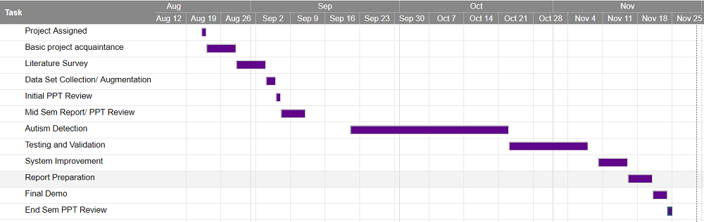
GANTT CHART

Slide 29
THANK YOU

