Slide 1
VADERE

Slide 2
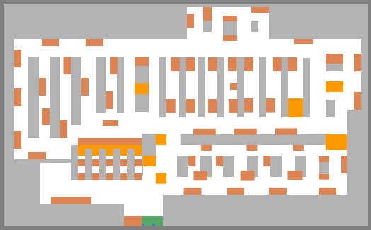
About VADERE
I run the supermarket scenario and take the output trajectory file.
I try to deal with these trajectories + the scene image (as a background) on another software such as MATLAB

Slide 3
Samples from the trajectory file
pedestrianId | simTime | endTime_PID1 | startX_PID1 | startY_PID1 | endX_PID1 | endY_PID1 | targetId_PID2
1 | 0 | 0.847410383 | 21.701 | 0.701 | 21.65449167 | 1.2770107 | 98
2 | 0 | 1.05973114 | 20.201 | 0.701 | 20.17407475 | 1.300180194 | 99
3 | 0.4 | 1.980764826 | 22.103 | 0.701 | 22.45900109 | 1.121065119 | 98
4 | 0.4 | 1.516153657 | 20.603 | 0.701 | 20.95030872 | 1.168348089 | 99
1 | 0.847410383 | 1.694820765 | 21.65449167 | 1.2770107 | 21.65449167 | 1.85489594 | 98
2 | 1.05973114 | 2.11946228 | 20.17407475 | 1.300180194 | 20.17407475 | 1.89996505 | 99
4 | 1.516153657 | 2.632307313 | 20.95030872 | 1.168348089 | 20.95030872 | 1.750617427 | 99
1 | 1.694820765 | 2.542231148 | 21.65449167 | 1.85489594 | 21.74265034 | 2.426017117 | 98
3 | 1.980764826 | 3.561529651 | 22.45900109 | 1.121065119 | 22.26736315 | 1.618097094 | 98
2 | 2.11946228 | 3.17919342 | 20.17407475 | 1.89996505 | 20.17407475 | 2.499749905 | 99
1 | 2.542231148 | 3.389641531 | 21.74265034 | 2.426017117 | 21.74265034 | 3.003902357 | 98
4 | 2.632307313 | 3.74846097 | 20.95030872 | 1.750617427 | 21.18240762 | 2.248542622 | 99
2 | 3.17919342 | 4.23892456 | 20.17407475 | 2.499749905 | 20.17407475 | 3.099534761 | 99
Notes:
1- If the time step is T (T=0.4), a new pedestrian start at m*T
2- But time, of the next start or end of moving, is continuous, not defined at discrete values (m*T), Pedestrians do not start move at the same times
3- pedestrians Id are not defined at all times, but only the start and end times for each moving

Slide 4
Create simulation video on MATLAB
The size of this scene in VADERE is (Width=52.5, hight =32.5)
I save this scene as an image with (Width=525, hight =325 pixels), so every 1 step of x or y equal 10 pixels in the saved image.

Slide 5
Create simulation video on MATLAB
The step time in this example is 0.4 sec (a new pedestrian start at m*0.4)
But during moving its time is continuous
First, I multiply the time column with 2.5, then round values to the nearest integer.
pedestrianId | simTime | pedestrianId | New-simTime
1 | 0 | 1 | 0
2 | 0 | 2 | 0
3 | 0.4 | 3 | 1
4 | 0.4 | 4 | 1
1 | 0.847410383 | 1 | 2
2 | 1.05973114 | 2 | 3
4 | 1.516153657 | 4 | 4
1 | 1.694820765 | 1 | 4
3 | 1.980764826 | 3 | 5
2 | 2.11946228 | 2 | 5
1 | 2.542231148 | 1 | 6
4 | 2.632307313 | 4 | 7
2 | 3.17919342 | 2 | 8
So, I consider the new simTime as a frame No.

Slide 6
pedestrianId | simTime (Frame) | endTime_PID1 | startX_PID1 | startY_PID1 | endX_PID1 | endY_PID1 | targetId_PID2
1 | 1 |  | 21.701 | 0.701 | 21.65449 | 1.277011 | 98
1 | 2 |  | 21.701 | 0.701 | 21.65449 | 1.277011 | 98
1 | 3 |  | 21.65449 | 1.277011 | 21.65449 | 1.854896 | 98
1 | 4 |  | 21.65449 | 1.277011 | 21.65449 | 1.854896 | 98
1 | 5 |  | 21.65449 | 1.854896 | 21.74265 | 2.426017 | 98
1 | 6 |  | 21.65449 | 1.854896 | 21.74265 | 2.426017 | 98
1 | 7 |  | 21.74265 | 2.426017 | 21.74265 | 3.003902 | 98
1 | 8 |  | 21.74265 | 2.426017 | 21.74265 | 3.003902 | 98
1 | 9 |  | 21.74265 | 3.003902 | 21.74265 | 3.581788 | 98
1 | 10 |  | 21.74265 | 3.003902 | 21.74265 | 3.581788 | 98
Secondly, because pedestrian locations are not defined at every time but only at the moving time, I repeat pedestrian rows so every frame contains all pedestrian locations. (The created video)
Note that it is not exact like the origin of Vadere due to the time rounding
click

Slide 7

Learning VADERE
I did not find a tool for learning the GUI of Vadere, so I try to know what the purpose of every item by observation the included examples.
Basic blocks:
Source: green (we have to assign a target Id)
Target: orange ("absorbing" : true or false)
Target changer: gold (I think it must contain a target block)

Slide 8
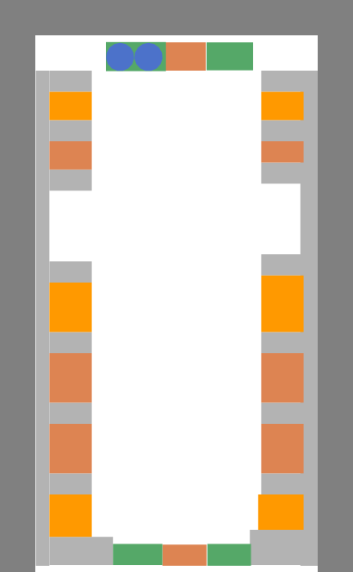
I try to build my code
This is a shopping street with two entrances top and bottom.
Shops are simulated by right and left blocks
The problem that sometimes pedestrians are created and other times, do not appear (no pedestrians)
Although the same code lines are used!

Slide 9


Then, I created many simple examples to understand code lines (because there is no a reference yet)
Sometimes the code run properly and others not (such as in second simple example)
i.e, no pedestrian get out from the entrance block.

Slide 10
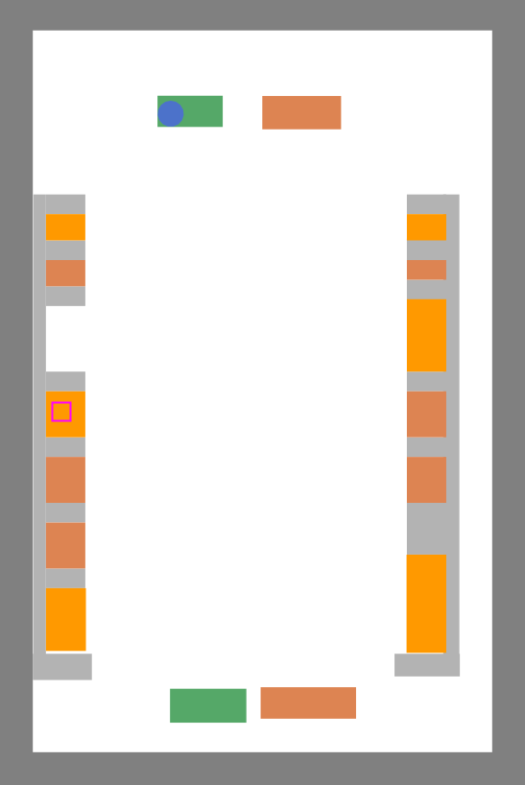
After try and error, I am not sure, but I solved the problem by increasing block size of entrance block (green)
The code is run, but the pedestrian moving is not as expect

Slide 11
Finally after man try, I think the problem is related to the scene size, I should use large size so people can move easy.
I work on this issue now.

Slide 12

THANK YOU

