Slide 1
Nigiwai indicator

Slide 2
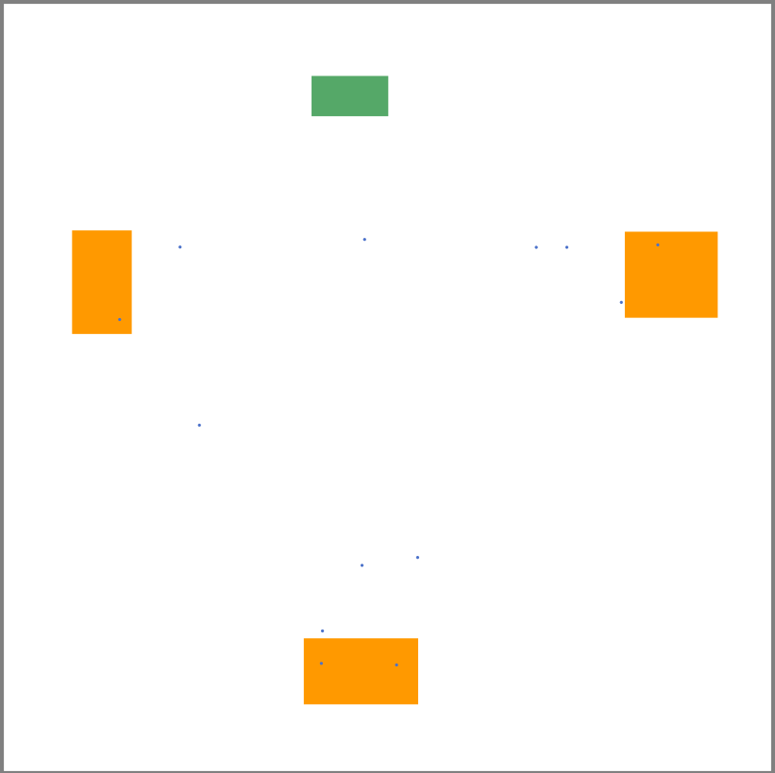

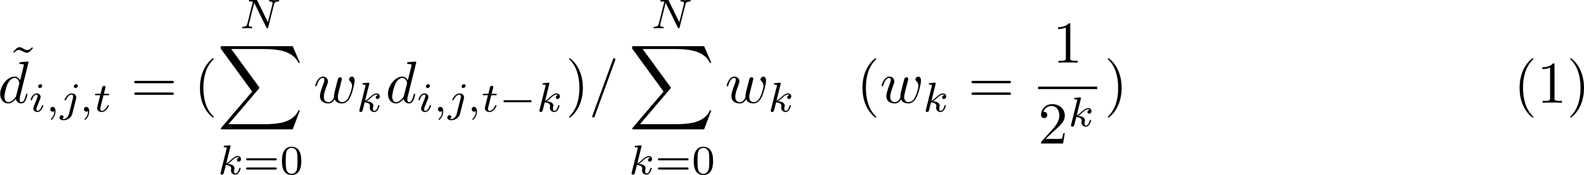
Simple scenario
I created a simple scenario in the Vadere.
This scenario includes 13 pedestrians.
Then I created a Nigiwai indicator for each pedestrian:
1- compute the moving average of d_{ijt}
Note: trajectories are not started together,
so for trajectories i and j, the common frames maybe < N.
In my code, I applied eq 1 for the only common frames (≤N), maybe this is not the optimum

Slide 3
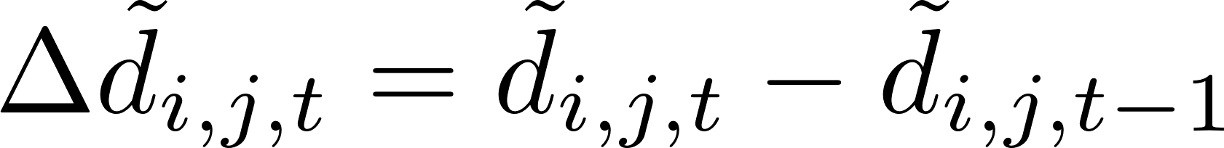
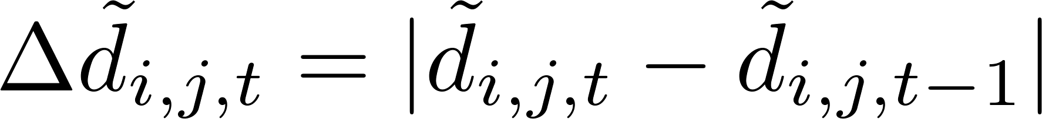
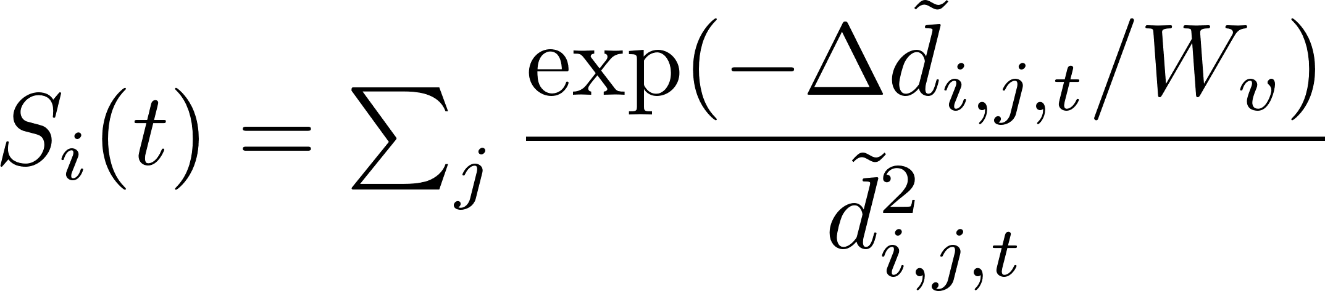


2- compute signed relative velocity
Also, I compute the absolute relative velocity
3- Nigiwai indicator
I select Wv as
Where Hs, Ws are the hight and width of the scene.
1- nigiwai score video using absolute relative velocity
2- nigiwai score video using signed relative velocity
(I multiply the nigiwai score by 10000 for displaying)

Slide 4
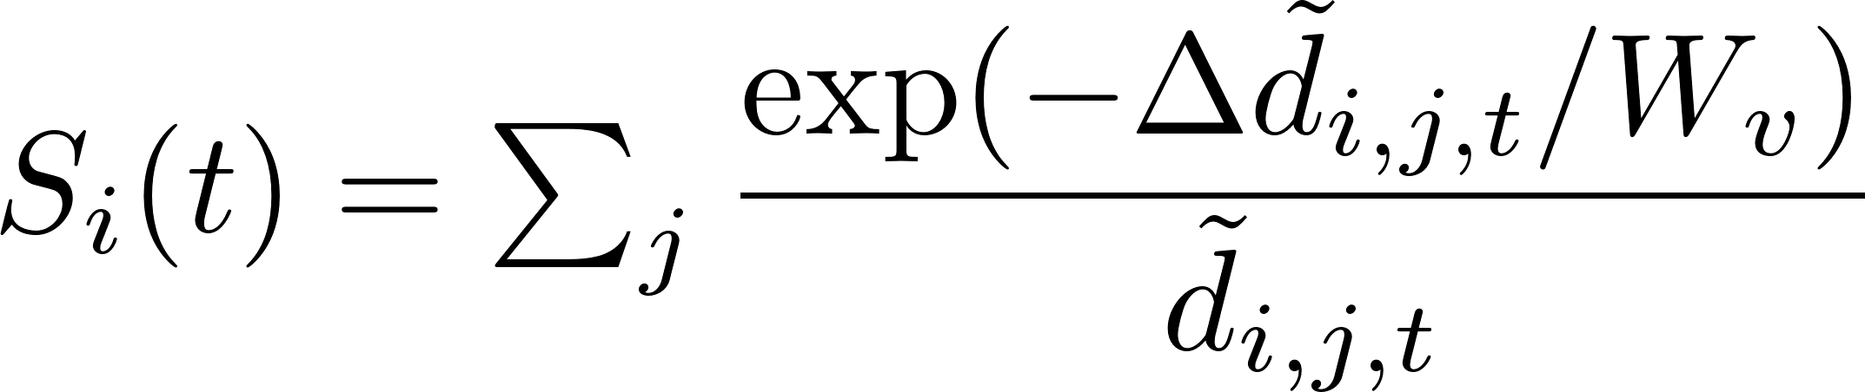
Absolute vs signed relative velocity
To study the effect of using absolute or not on the relative velocity also I used d_{ij} instead of d_{ij}^{^2}
A comparison between the nigiwai score in case using absolute and signed relative velocity is reported (excel files )
I think there is no big difference.

Slide 5
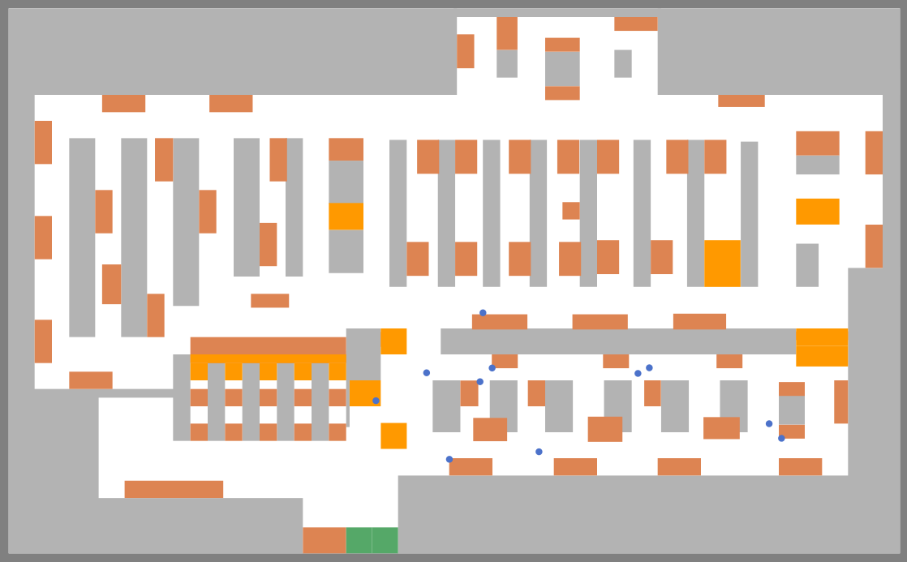
Supermarket scenario
A Nigiwai indicator is computed for each pedestrian.
Note: in this scenario, there many obstacles
in my code, obstacle effects are not consider in determining the distances
This video have 118 pedestrians
nigiwai score using signed
relative velocity

Slide 6
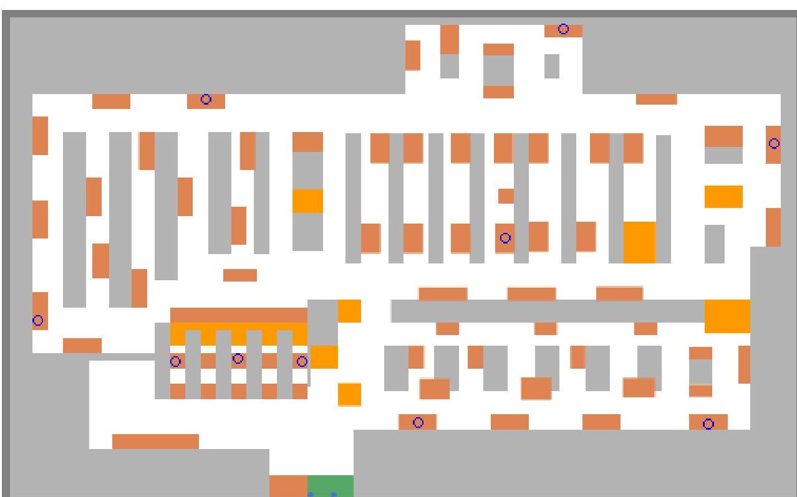
Nigiwai for shops.
I select fixed point on the targets (10 points)
Then, compute Nigiwai score only at these points due to the movement of the pedestrians (118).
1- nigiwai score using absolute
2- nigiwai score using signed

Slide 7
notes
The distance is computed for all pedestrians (not the nearest only)
I think to select the K-nearest ones, all distances have to be computed first, which is also a high computational
In my code, I computed score in each frame, in addition to the N previous frames (N=10). Maybe this is not practical with a large number of pedestrians.
Comparing absolute to sign for the relative velocity, I do not know what is the better.
I still do not know how to evaluate the our Nigiwai score, is it acceptable to make a subjective GT for each pedestrian?

Slide 8
Analysis of the Nigiwai score in the “simple” video
Showing the Nigiwai score rate with time for 13 pedestrain

Slide 9

THANK YOU

