Slide 1
Nigiwai detection

Slide 2
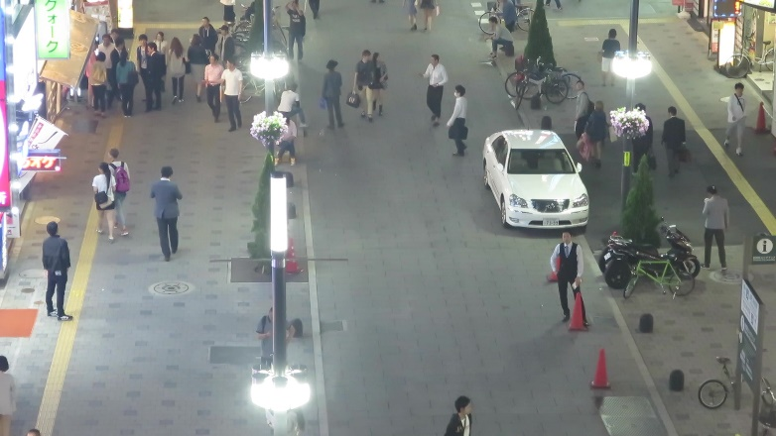
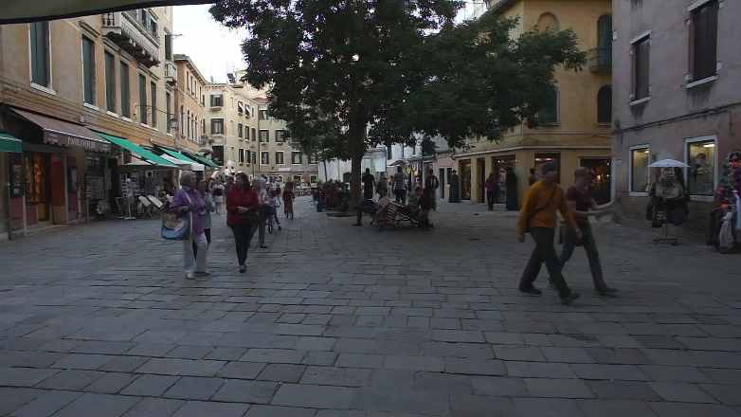

Dataset
Because cameras are not installed yet in the project studying area, I tried to apply my algorithm to some available videos.
I used Multi-Object Tracking MOT16 dataset, specifically three videos (02,04 and 09) as they represent fixed camera.

Slide 3
Nigiwai detection
Try to find a score for Nigiwai events in two ways:
1- by giving a dynamic score for each pedestrian.
2- by giving a dynamic score for each pixel or region of pixels

Slide 4
Create a score for each pedestrian
For each person i, initially, I suggest to give a score S_{i} :
Where N_{nigh} is the number of neighbor people, v_{i} is velocity of the person, W_{N} and W_{v} are weights
So, stopping people (v=0) have a high score.
S_{i} is re-computed every a number of frames (15 for example)

Slide 5
Compute number of neighbors
To consider another person to be a neighbor there are two criteria:
Euclidean distance < Th_{Eq}
Speed difference <Th_{Speed}
these distances are computed between two trajectories moving from a frame to the next.
The number of frames achieving these criteria should > a threshold (CoFr)
For example if we take decision every 15 frames, we can take CoFr=8

Slide 6
Compute number of neighbor (Euclidean distance )
for every two trajectories (Tr)s:
1- determine common frames (frames in which both Tr exist)
2- compute distances between them in these common frames.
3- Compute number of frames that D^{t}< Th_{Eq} , this number should>= CoFr, (e.g CoFr=8)

Slide 7

Show video sample
In this example, a number of neighbors are given to each pedestrian.
The decision is re-computed every 15 frames.
The condition is: only Euclidean distance < 100 for 8 frames at least.
Click to watch the video

Slide 8
Compute a score related to the pedestrian movement
Let us examine the only velocity term
Click to watch the video
In this video, only 6 persons are selected (4 are stopping and 2 are moving).
We note that instance velocity does not change smoothly.

Slide 9
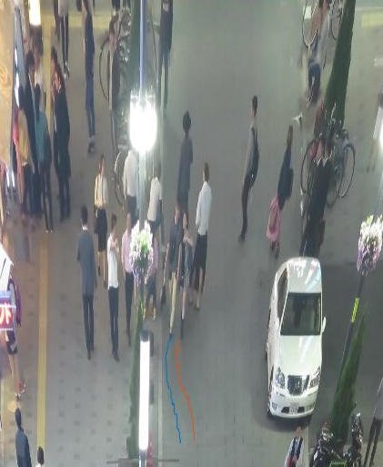
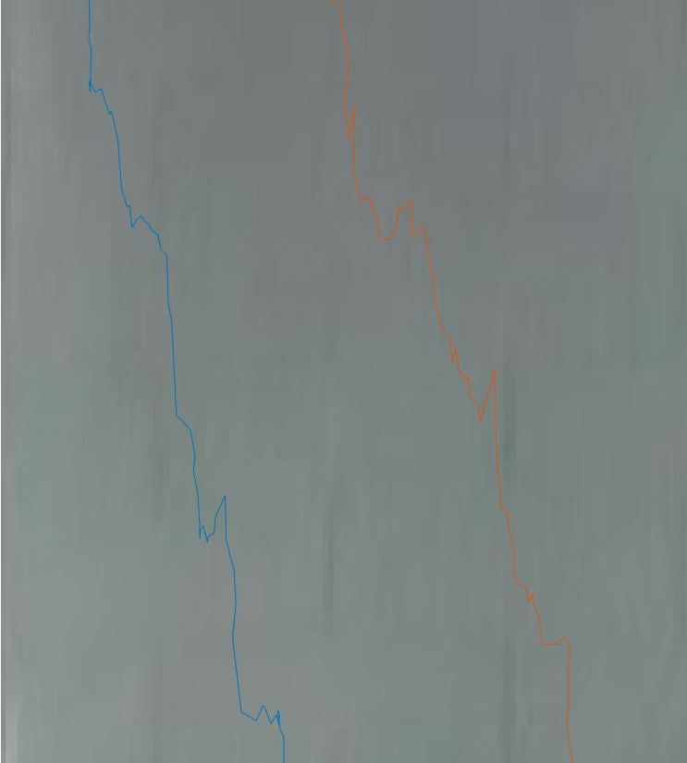
Results analysis
Now we will analyze results to know why abrupt changes occur in velocity.
I note that the detection of pedestrian positions does not change smoothly.
For example:
By zooming a small region for only two trajectories,
We note that the displacement from one frame to another is not in one direction but have some randomness

Slide 10
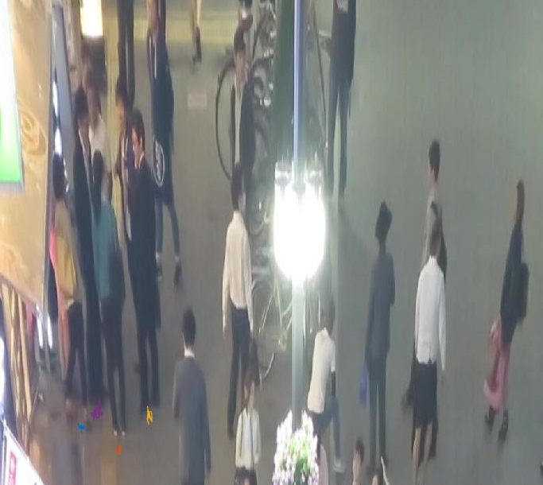
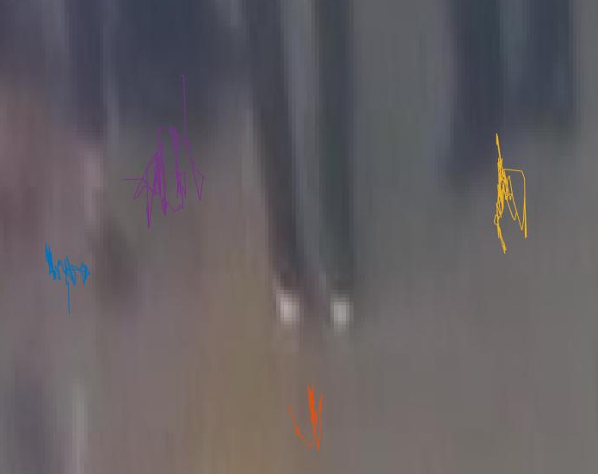
Example2: Static group
Although the 4 people are not moving but their trajectories move around fixed positions
From previous examples, I think it is not accurate to take velocity difference in measuring N_{nigh}.

Slide 11
Compute a score related to the pedestrian movement
About the 2nd term in the above Eq., I think to measure the movement of a person, it is better to replace the velocity (v_{i}) by:
(X_{max}-X_{min})+(Y_{max}-Y_{min}) or
std(x)+ std(y), during a part of frames (15)
Compare results of (1) and (2), I found (2) is better to distinguish between moving and stopping people.
By increasing the number of frames (part), the distinguishing is clearer
This video use form (2) for part=15 frames
Click to watch the video

Slide 12
Let try to measure Nigiwai by:
N_{nigh} is taken only by Euclidean distance
v_{i} is reprented by (std(x_{i})+std(y_{i}))
W_{N}=1, W_{v}=10
Click to watch the video

Slide 13
Giving a dynamic score for each region
The idea is:
For each region in a frame, scores of all people moving in this region are summed every frame.
This value is accumulated through frames i.e, it continue increases as long as people (having a score >0) are moving through it.
This accumulated value is divided by a function of time, so it is decayed as long as no people come.
Click to watch the video

Slide 14

THANK YOU

