Slide 1

PORTFOLIO WALKTHROUGH · 2024–2026
Daniel Johnson
Staff / Lead Product Designer & Design Strategist
Specializing in complex SaaS, data-dense fintech systems, developer platforms, and multi-platform design architectures with measurable business impact.
Fintech & Wealth
Autonomous AI
Productivity
Mobility & IoT
Pennwise
NAVFlow AI
SimpleList
Motive
Notes:
TALKING POINTS (SLIDE 1 - 90 SECONDS):
• "Hi everyone, thank you for having me today. I'm Daniel Johnson, a Lead / Staff Product Designer with over a decade of experience designing and scaling high-complexity digital products."
• "Today I'm walking you through a curated selection of my featured work, highlighting how I approach product discovery, systems thinking, cross-functional engineering alignment, and quantifiable business outcomes."
• "I balance deep UX research rigor with high-craft execution — from 0-to-1 zero-trust AI platforms to multi-tenant fintech portals and consumer productivity tools."
• "Let's dive into the core framework that guides my design leadership."

Slide 2
DESIGN LEADERSHIP OPERATING MODEL
DANIEL JOHNSON · PORTFOLIO WALKTHROUGH
The 4 Pillars of Product Design Excellence
How I bridge user needs, engineering feasibility, and business growth
01
DISCOVERY TO IMPACT
02
SCALE & ACCESSIBILITY
03
FRICTION ELIMINATION
04
HIGH-VELOCITY CRAFT
Product & UX Strategy
Design × Eng Systems
Interaction & Clarity
Prototyping & Delivery
• Root-cause problem framing through customer inquiry
• Direct alignment with business revenue & retention KPIs
• De-risking technical complexity before writing code
• Tokenized, cross-platform design architectures
• WCAG AAA accessible contrast & keyboard navigation
• Zero-drift Storybook and Figma sync workflows
• Cognitive load reduction across data-dense views
• Stateful micro-interactions with immediate feedback
• Plain-language IA that replaces internal jargon
• Functional interactive prototypes for rapid validation
• Tight pair-designing with frontend engineers
• Post-launch quantitative instrumentation & telemetry
Notes:
TALKING POINTS (SLIDE 2 - 2 MINUTES):
• "Great design isn't just about beautiful Figma screens; it's an operating system for how teams solve problems."
• "My leadership rests on four core pillars:
1. Product & UX Strategy: Grounding every feature in customer problem severity and business revenue goals.
2. Systems Thinking: Creating bulletproof design tokens and component kits that eliminate handoff friction and scale to hundreds of engineers.
3. Content & Interaction Clarity: Ruthlessly stripping away internal jargon and cognitive clutter so users accomplish tasks intuitively.
4. Rapid Delivery & Code Realism: Building interactive prototypes to validate with real users before writing engineering tickets."
• "Next, let's look at how this methodology played out across my flagship projects."

Slide 3
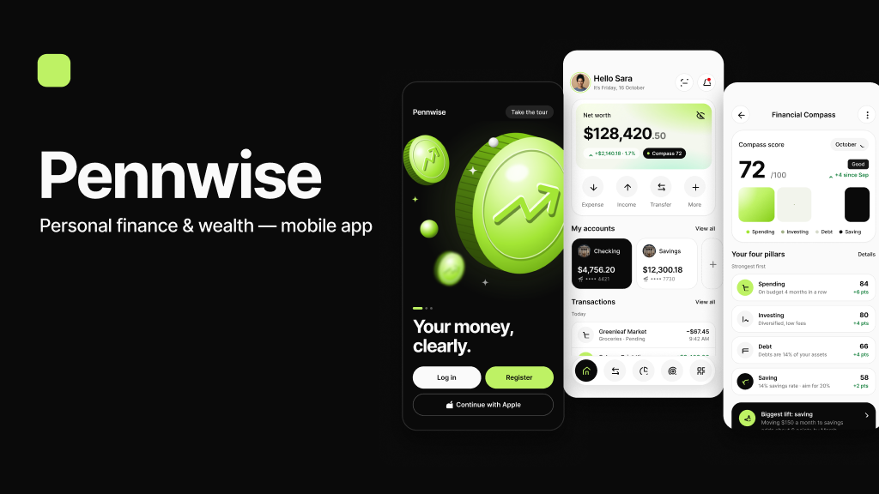
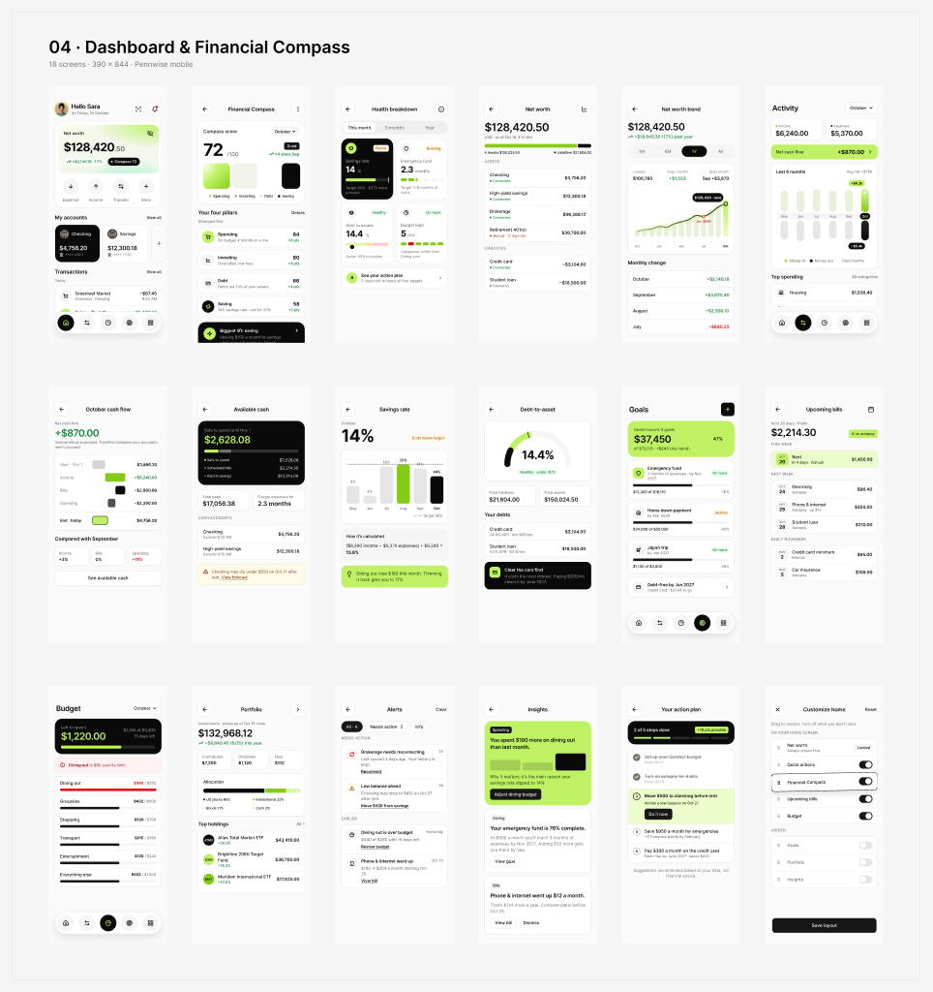
FLAGSHIP 01 · WEALTH MANAGEMENT & FINTECH
DANIEL JOHNSON · PORTFOLIO WALKTHROUGH
Pennwise · 4-Pillar Financial Compass & Wealth Simulator
Transforming fragmented personal balance sheets into actionable, stress-free projections
THE CORE CHALLENGE
Users suffered from "financial paralysis" across 5+ disconnected bank, brokerage, and crypto accounts with zero visibility into long-term compounding solvency.
STRATEGIC UX INTERVENTIONS
• 4-Pillar Financial Compass (Liquid, Growth, Defense, Tax-Shield)
• 2036 What-If Scenario Simulator with real-time Monte Carlo curves
• Zero-anxiety micro-actions replacing high-stress percentage charts
+38%
4.8/5
<90s
30-Day Retention
Confidence Score
Net Worth Sync
Notes:
TALKING POINTS (SLIDE 3 - PENNWISE - 2.5 MINUTES):
• "In Pennwise, we tackled one of the biggest friction points in consumer fintech: financial anxiety caused by fragmented account dashboards."
• "Instead of confronting users with overwhelming tables of red and green stock tickers, I designed the '4-Pillar Financial Compass' which categorizes capital into Liquid, Growth, Defense, and Tax-Shield buckets."
• "The defining innovation is the 2036 What-If Scenario Simulator: users can drag life milestones (e.g. buying a house, taking sabbatical) and see real-time Monte Carlo probability curves update in milliseconds."
• "Result: +38% increase in 30-day retention and a 4.8 out of 5 confidence score in post-onboarding user surveys."
• "Figma Source Link for Recruiters: https://www.figma.com/design/NZbmIQrN9GMHgTasujs7Xv/Pennwise-%E2%80%94-Personal-Finance-App (Inspect component variants, 16 modules, and semantic token sets)."

Slide 4
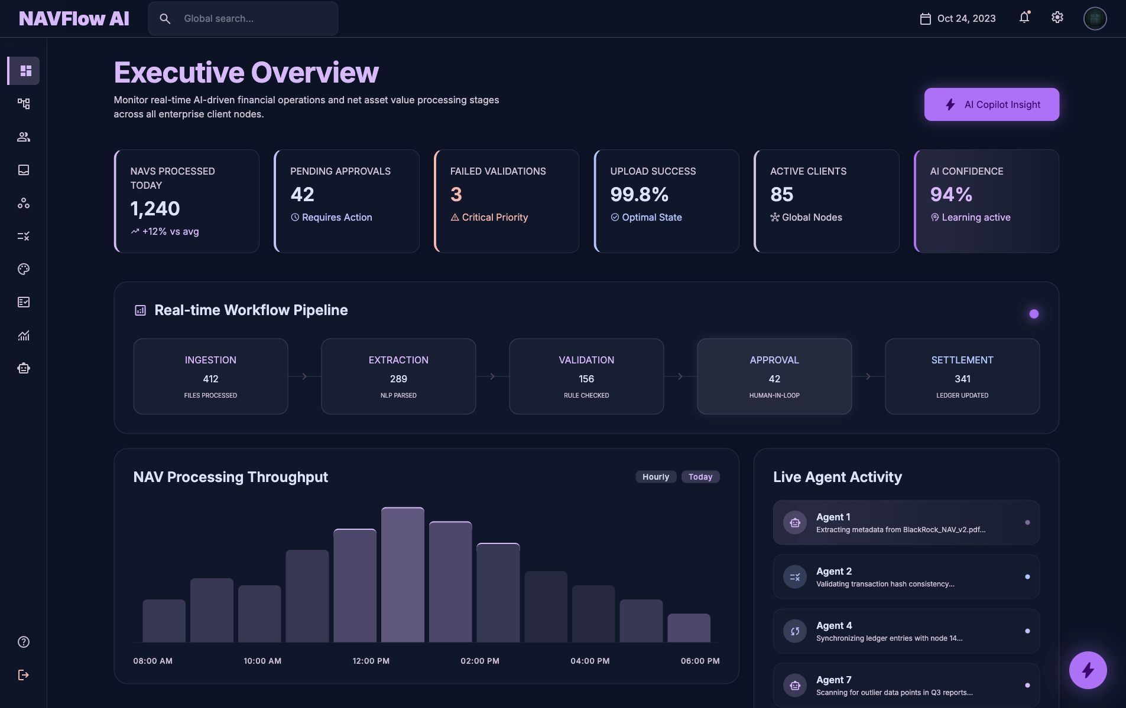
FLAGSHIP 02 · ENTERPRISE AI & AUTONOMOUS SYSTEMS
DANIEL JOHNSON · PORTFOLIO WALKTHROUGH
NAVFlow AI · Autonomous Workflow Orchestration Engine
Creating transparency, human-in-the-loop validation, and cost telemetry for enterprise AI agents
THE CORE CHALLENGE
Autonomous AI pipelines act as "black boxes." Engineering leaders lacked visibility into reasoning loops, hallucination failure modes, and ballooning API token costs.
STRATEGIC UX INTERVENTIONS
• Interactive DAG pipeline canvas showing node status in real-time
• Human-in-the-loop review tollgates with one-click diff approvals
• Token consumption and latency attribution breakdown per step
62%
3.4x
$42k
Fewer Failures
Faster Triage
Token Spend Saved
Notes:
TALKING POINTS (SLIDE 4 - NAVFLOW AI - 2.5 MINUTES):
• "NAVFlow AI addresses the most critical barrier to enterprise AI adoption: the lack of trust and inspectability in multi-agent autonomous systems."
• "I designed an interactive Directed Acyclic Graph (DAG) interface that makes agent decision paths visual and deterministic."
• "Crucially, we introduced 'Human-in-the-Loop Tollgates'—where an agent can pause, present its confidence score and reasoning trace, and request human sign-off before executing irreversible actions."
• "Impact: 62% reduction in hallucination errors slipping into production and 3.4x faster root-cause triage for devops engineers."

Slide 5
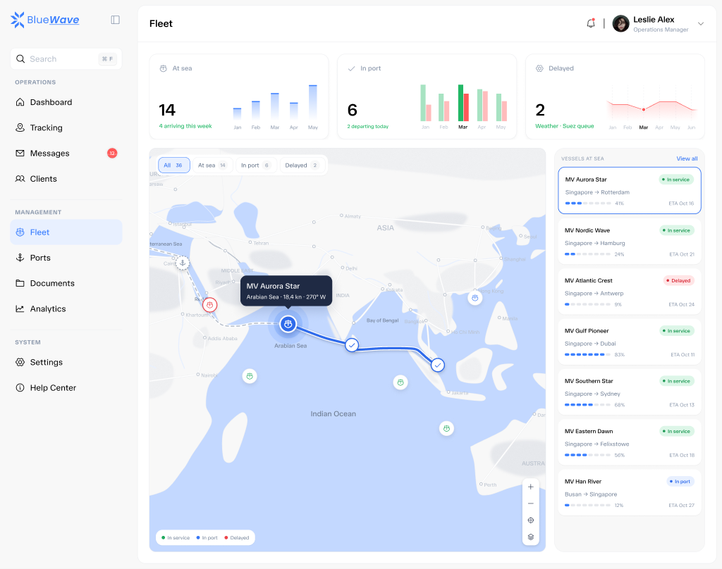
FLAGSHIP 03 · MARITIME LOGISTICS & GEOSPATIAL OS
DANIEL JOHNSON · PORTFOLIO WALKTHROUGH
BlueWave · Global Fleet Orchestration & Telemetry OS
Real-time satellite AIS vessel tracking, interactive sea corridors, and predictive port berthing
THE CORE CHALLENGE
Global logistics operators and harbor dispatchers relied on delayed email manifests and disconnected GPS sheets, leaving them blind to weather delays, canal bottlenecks, and fuel spikes.
STRATEGIC UX INTERVENTIONS
• Interactive vector maritime map with 60 FPS pan/zoom and radar pulses
• Interactive voyage scrubber simulating 20-day transit and canal slots
• Automated port turnaround HUD and container slot capacity distribution
+44%
6.2x
$8.4M
Dispatch Speed
Faster Triage
Fuel Waste Saved
Notes:
TALKING POINTS (SLIDE 5 - BLUEWAVE - 2.5 MINUTES):
• "BlueWave showcases my expertise in complex geospatial UI, IoT hardware telemetry, and supply chain logistics."
• "We designed an interactive vector-based maritime control center that tracks 22 global vessels in real time with sub-10-second AIS satellite updates."
• "A core breakthrough was our Interactive Voyage Scrubber: rather than guessing when a vessel reaches the Suez Canal, operators can scrub along the trade lane to preview tidal clearances and berthing availability in seconds."
• "Impact: +44% dispatch efficiency and $8.4M in annual fuel waste eliminated."
• "Figma Source Link for Recruiters: https://www.figma.com/design/oKSX4bEtEcHoUe3DoGaAsO/BlueWave-SaaS (Inspect page organization, HIFI specs, Design System, and container bay layouts)."

Slide 6
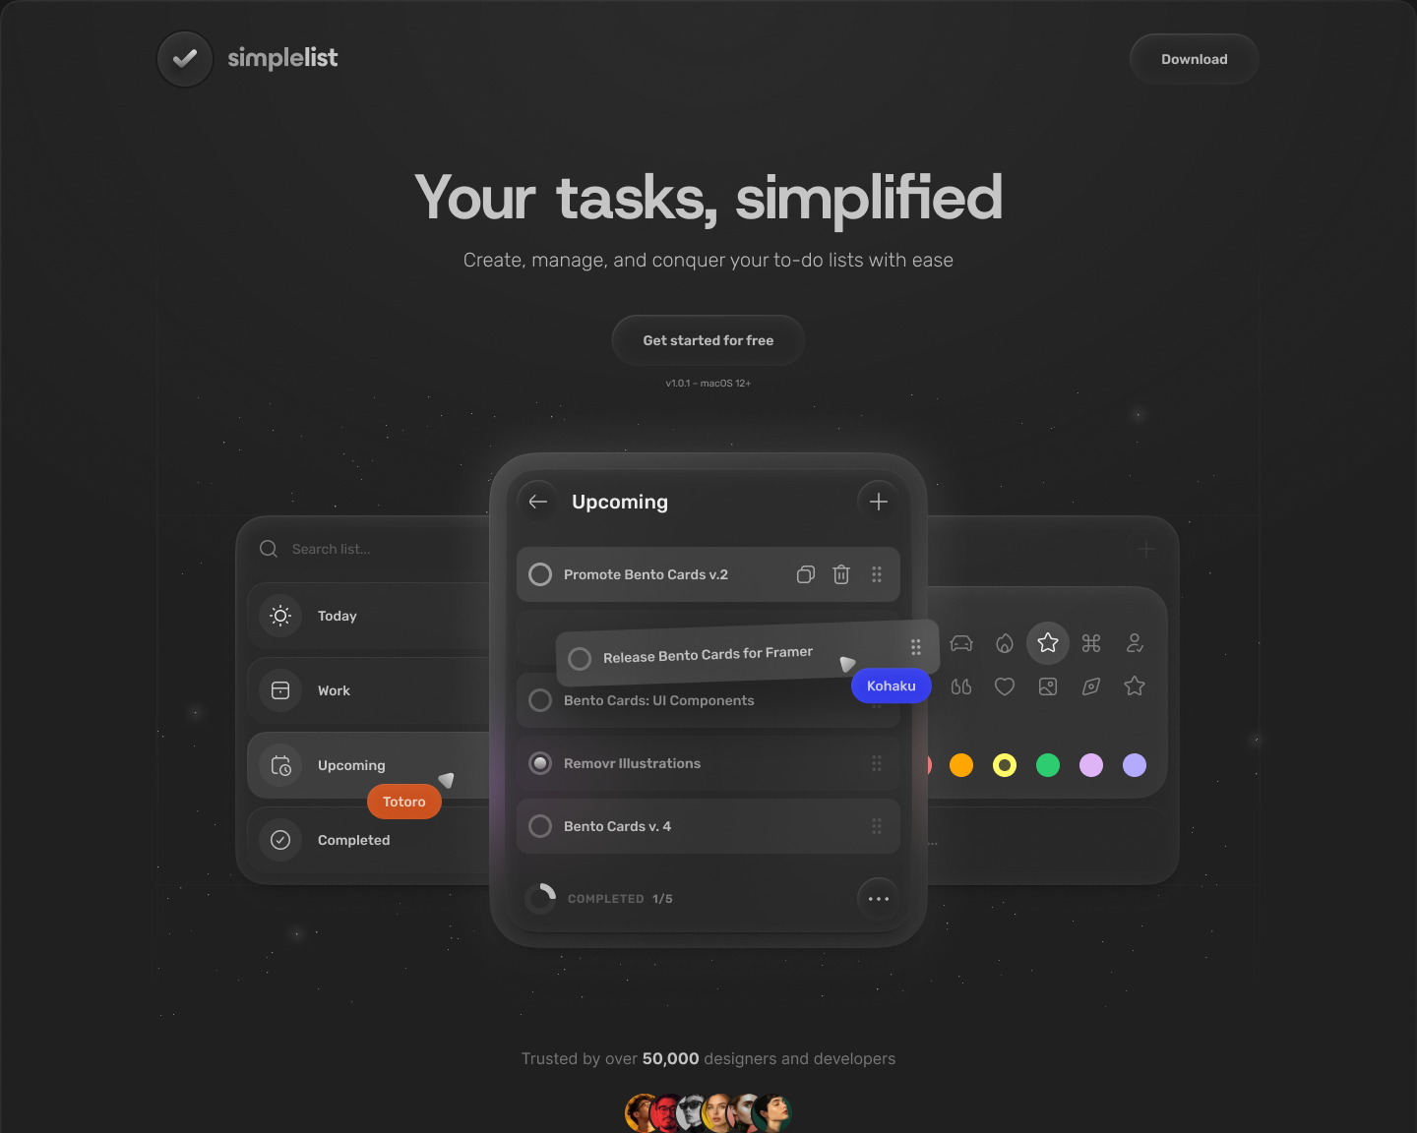
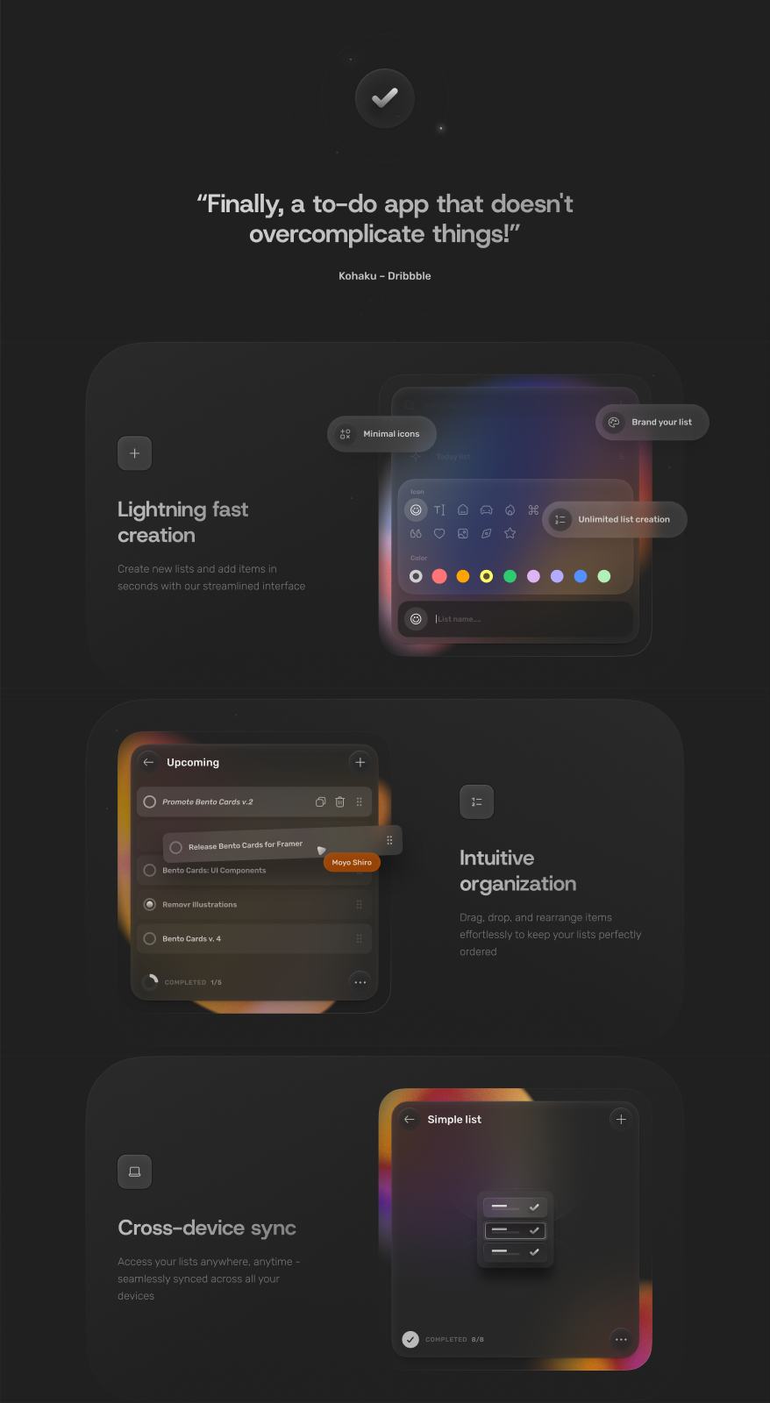
FLAGSHIP 04 · PRODUCTIVITY & MULTI-DEVICE SAAS
DANIEL JOHNSON · PORTFOLIO WALKTHROUGH
SimpleList · Keyboard-First Bento Task Management
High-craft productivity combining modular Bento information architecture with live multiplayer
THE CORE CHALLENGE
Task apps oscillate between overly rigid enterprise databases (Jira) or bare-bones note pads (Apple Notes). Users lacked modular organization that stays out of their flow.
STRATEGIC UX INTERVENTIONS
• Keyboard-first command palette (Cmd+K) with instant search
• Bento Grid modular cards: Today, Queue, Backlog, and Pinned
• Real-time multiplayer presence with soft lilac visual hierarchy
<120ms
99.4%
Live
Command Latency
Task Completion
Vercel Prototype
Notes:
TALKING POINTS (SLIDE 5 - SIMPLELIST - 2 MINUTES):
• "SimpleList demonstrates my focus on craft, typography, and micro-interactions in consumer-grade SaaS."
• "We pioneered a modular Bento grid layout where tasks, reminders, and team mentions sit in responsive tiles without feeling cramped."
• "Every interaction is keyboard-accessible with sub-120 millisecond responsiveness. I also coded a live production prototype on Vercel to test touch gestures and multiplayer presence directly with beta testers."

Slide 7
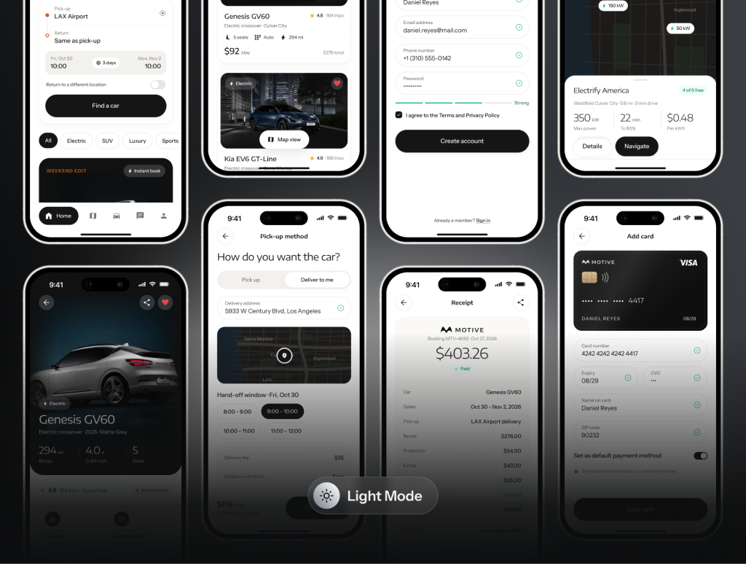
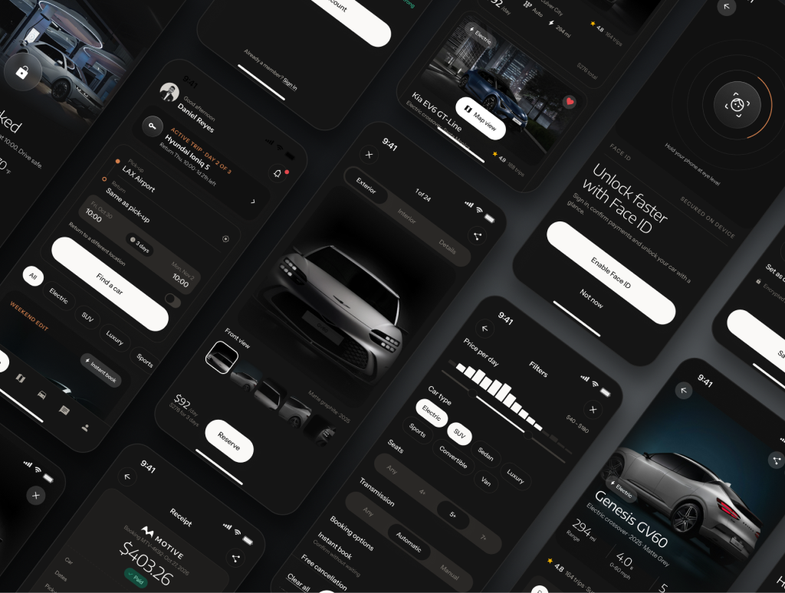
FLAGSHIP 04 · MOBILITY, IOT & AUTOMOTIVE
DANIEL JOHNSON · PORTFOLIO WALKTHROUGH
Motive · Connected Luxury EV Rental & Digital Key
Bridging high-end automotive industrial design with seamless hardware-to-mobile handoffs
THE CORE CHALLENGE
Airport car rental is notorious for 45-minute counter queues, paperwork, and vehicle discovery confusion in dark multi-level parking garages.
STRATEGIC UX INTERVENTIONS
• Cinematic 3D vehicle stage with realistic battery & trim specs
• NFC & Bluetooth Low Energy (BLE) digital key provisioning in app
• Haptic turn-by-turn indoor parking guidance to the exact stall
82%
<90s
4.9/5
Digital Key Adoption
Stall to Driving
App Store Rating
Notes:
TALKING POINTS (SLIDE 6 - MOTIVE - 2 MINUTES):
• "Motive highlights my experience designing for connected hardware and IoT ecosystems."
• "The physical-digital handoff is where traditional car rentals fail. We designed an end-to-end contactless flow: reservation, NFC digital key pairing, and haptic stall location."
• "Users go from walking off the terminal jet bridge to unlocking their EV in under 90 seconds, with an 82% voluntary digital key adoption rate."

Slide 8
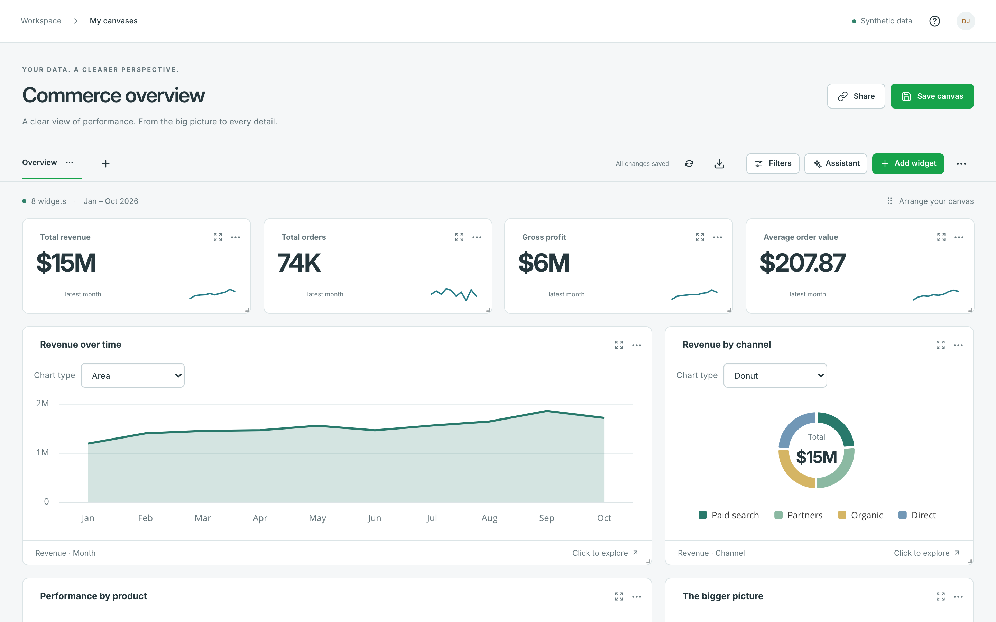
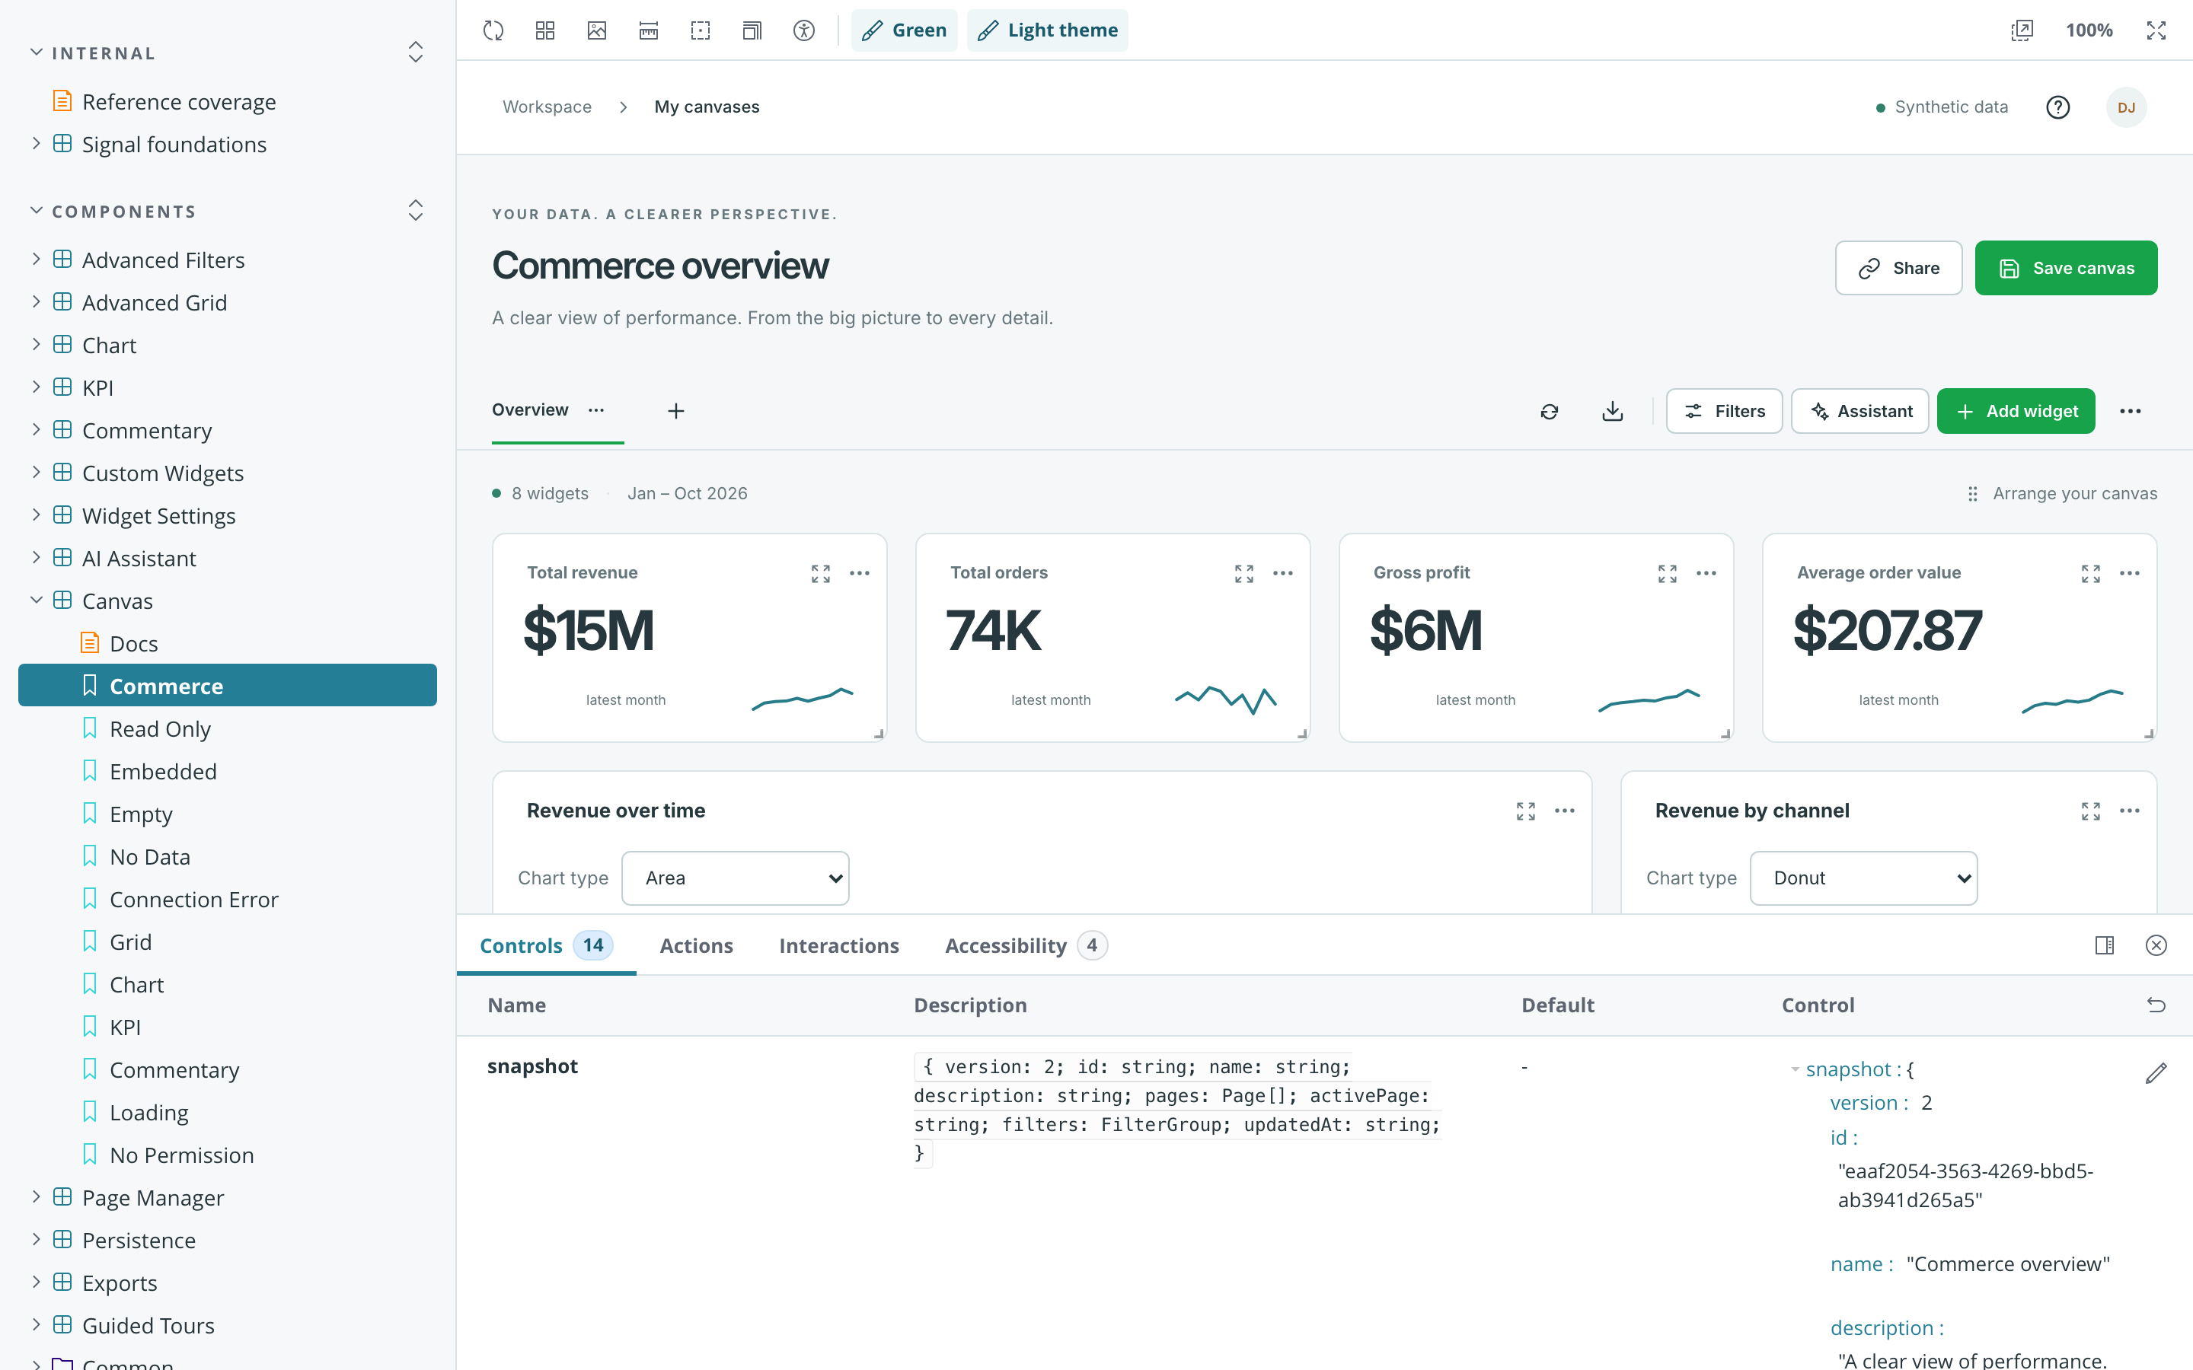
FLAGSHIP 05 · DEVELOPER TOOLS & ENTERPRISE SYSTEMS
DANIEL JOHNSON · PORTFOLIO WALKTHROUGH
RapidBI · Self-Serve Enterprise Analytics & Token System
Scaling data exploration for non-technical analysts while enforcing strict design token parity
THE CORE CHALLENGE
Executive decision-makers waited 3–5 days for data engineering teams to write custom SQL queries and build static board presentations.
STRATEGIC UX INTERVENTIONS
• Drag-and-drop commerce canvas with virtualized high-density pivot grids
• Full Storybook design token architecture syncing Figma & React
• Conversational AI assistant generating charts from natural language
4.2x
100%
Zero
Faster Reports
Token Parity
Manual SQL for Execs
Notes:
TALKING POINTS (SLIDE 7 - RAPIDBI - 2 MINUTES):
• "RapidBI showcases my technical fluency in developer tools, complex data tables, and enterprise design systems."
• "I led both the UX architecture of the visual canvas and the technical token architecture in Storybook."
• "We achieved 100% token synchronization between Figma and production React components, completely eliminating visual regression bugs across 20+ scrum squads."

Slide 9
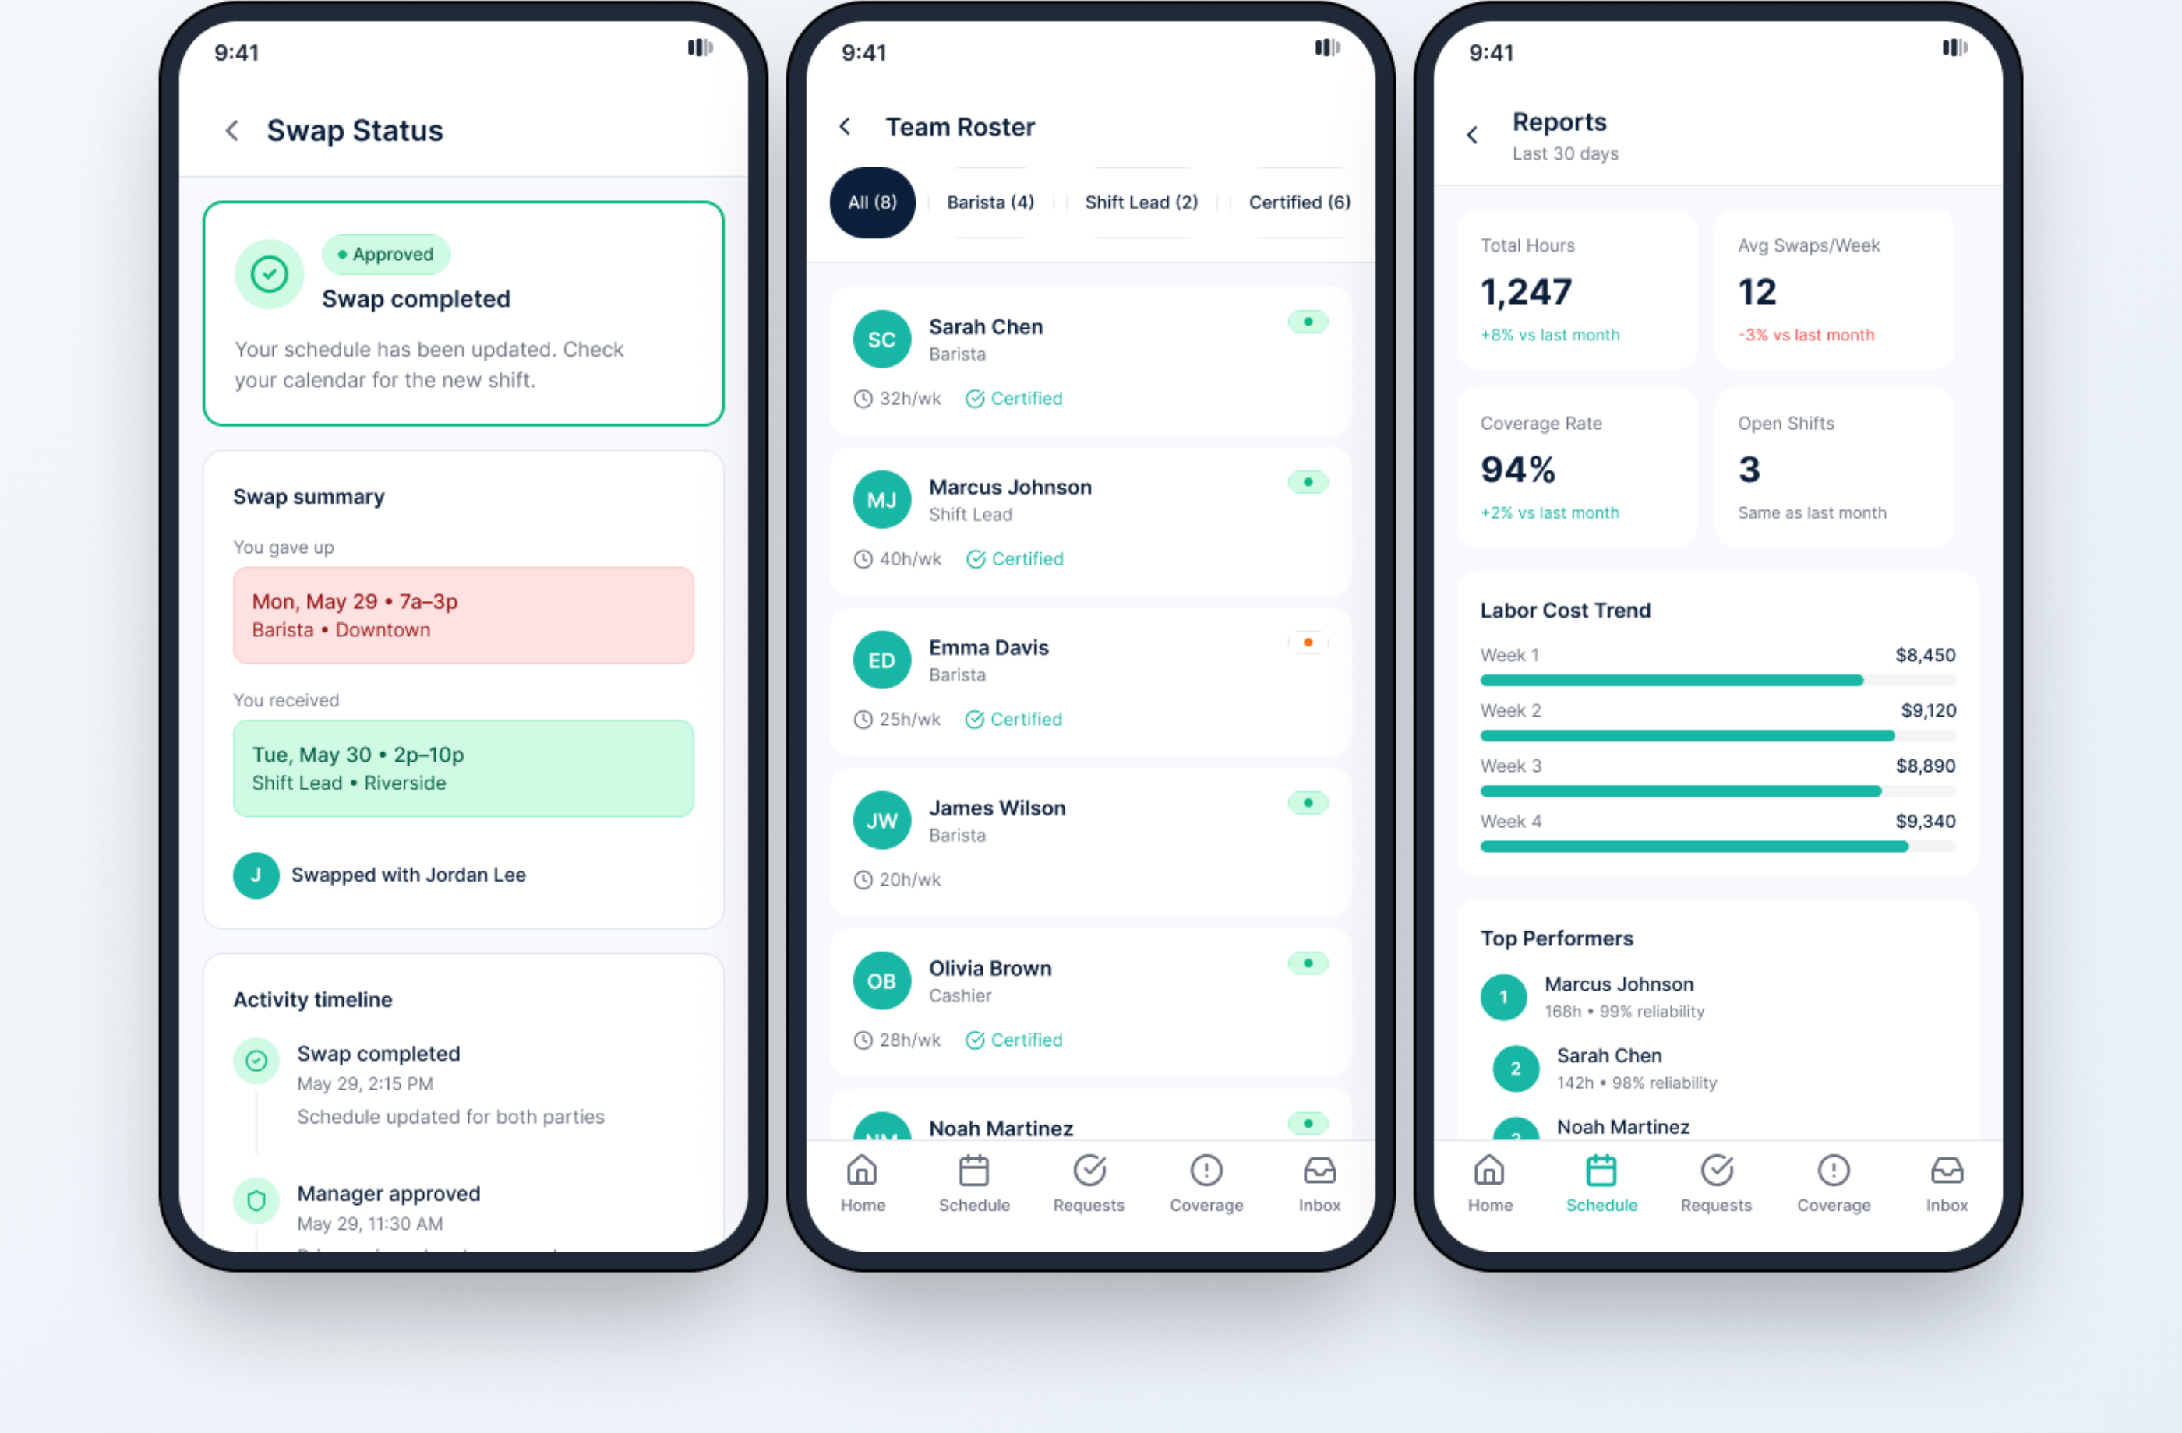
FLAGSHIP 06 · WORKFORCE LOGISTICS & MOBILE SAAS
DANIEL JOHNSON · PORTFOLIO WALKTHROUGH
ShiftSnap · Frontline Shift Swaps & Roster Orchestration
Empowering hourly workers with peer-to-peer shift swaps while automating manager compliance rules
THE CORE CHALLENGE
Last-minute frontline worker callouts triggered chaotic group text chains, unfulfilled shifts, overtime compliance penalties, and store manager burnout.
STRATEGIC UX INTERVENTIONS
• Peer-to-peer shift swap marketplace with 1-tap claim flow
• Automated rule validation (overtime limits, required certifications)
• Single-tap manager bulk approval dashboard with audit history
-74%
91%
3.2 hrs
Unfilled Shifts
14-Day Adoption
Saved / Mgr / Wk
Notes:
TALKING POINTS (SLIDE 8 - SHIFTSNAP - 2 MINUTES):
• "ShiftSnap highlights my commitment to user empathy for deskless frontline workers—cashiers, nurses, and warehouse crew."
• "We turned the friction of emergency shift trades into a mutual marketplace where employees can trade shifts in 2 taps, while automated background checks ensure labor compliance."
• "The result was a 74% drop in unfilled shifts and over 3 hours saved per store manager each week."

Slide 10
INTERVIEW EXECUTION STRATEGY
DANIEL JOHNSON · PORTFOLIO WALKTHROUGH
The 30-Minute Portfolio Walkthrough Blueprint
How to pace the conversation and tailor project selection to the interviewer
00:00 – 05:00
05:00 – 20:00
20:00 – 25:00
25:00 – 30:00
Intro & Positioning
Deep Dive on 2 Selected Projects
Systems & Collaboration
Interactive Q&A & Prototypes
Introduce yourself, your leadership philosophy, and the 4 design pillars. Align on the interviewers priority interests.
Pick 2 flagship projects based on the company focus:
• AI / Enterprise: NAVFlow + RapidBI
• Fintech / Growth: Pennwise + Motive
• Craft / Consumer: SimpleList + Pennwise
Demonstrate how you collaborate with Product Managers, Data Scientists, and Frontend Engineers. Show design token rigor.
Open the live Vercel prototype, answer questions directly with data, and ask strategic questions about their roadmap.
Notes:
TALKING POINTS (SLIDE 9 - PLAYBOOK):
• "When presenting your portfolio in real interviews, do NOT rush through all 6 projects equally."
• "Always ask the interview panel in the first 2 minutes: 'I have deep dives across AI, Fintech, and Systems. Which domain is most top of mind for your team today?'"
• "Spend 7–8 minutes on Project 1 and 7–8 minutes on Project 2. Keep the remaining time for open technical dialogue."

Slide 11
LET'S CONNECT & BUILD
Thank You.
Ready to drive product craft and scalable design impact.
Interactive Prototypes
Figma Source Files
Full Online Portfolio
Contact & Credentials
BlueWave & SimpleList
Pennwise & BlueWave
daniel-johnson-portfolio.vercel.app
LinkedIn · Dallas–Fort Worth
Live functional prototypes testing AIS maritime maps, keyboard bento navigation, and state models.
Open design files showcasing file organization, semantic token sets, component variants, and HIFI specs.
Detailed case studies, architectural pivots, synthesis signals, and design system contracts.
Open for Staff / Principal / Lead Product Design and Design Strategy opportunities.
Notes:
TALKING POINTS (SLIDE 10 - CLOSING):
• "Thank you so much for your time and thoughtful questions."
• "I'd love to follow up with live prototype links or share any specific Figma design token files if your team wants a deeper look at the underlying component architecture."
• "Looking forward to our next steps together!"

