Slide 1
INTERVIEW PORTFOLIO · AETNA
Content and experience design
Three projects that show how I make complex work clear, usable, and scalable.
Sendory · Meridian · Forma
Problem → Action → Result → Collaboration
Daniel Johnson
Product design · Content design · Systems

Slide 2
THE THROUGH-LINE
Three projects, one way of working
I start with the user decision, make the content structure visible, and design the interaction around it.
01
02
03
Sendory
Meridian
Forma
Structured content and reusable templates
Technical information and workflow clarity
Scalable patterns and content variability
The story I will use for each project
Problem → Action → Result → Collaboration
DANIEL JOHNSON · INTERVIEW PORTFOLIO
02

Slide 3
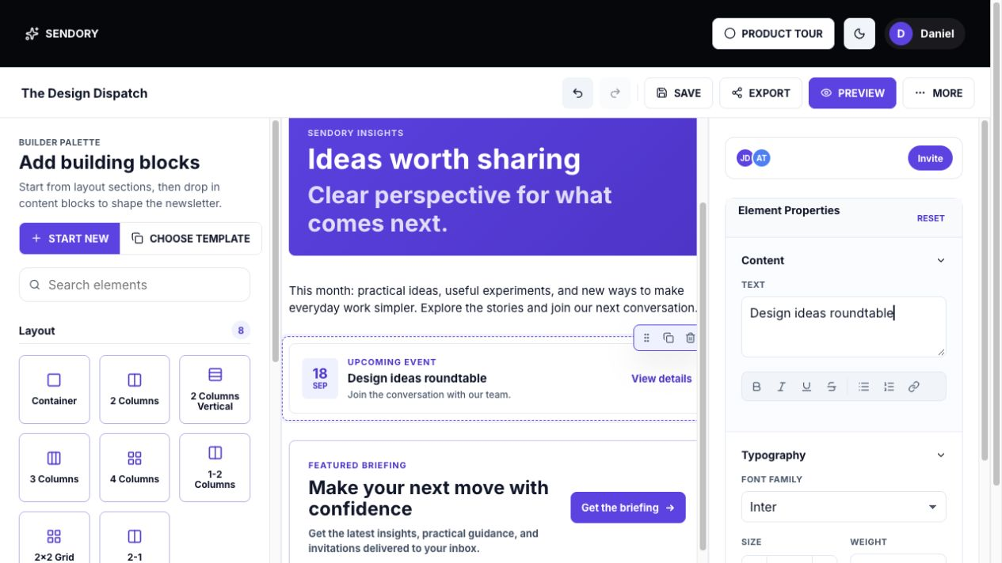
3 / CONTENT DESIGN · REUSABLE AUTHORING
Sendory
How I combine content and experience design
PROBLEM
Authors had to turn a message into a polished newsletter without starting every edition from a blank canvas or losing control of the layout.
DISCOVERY
I looked at the work as an end-to-end authoring journey: choose a starting point, structure the story, make edits safely, check the hierarchy, and confirm the final output. The recurring issue was not a lack of features; it was the number of small decisions an author had to make alone.
ACTION
I led the work from discovery through design and prototype. I defined the content model, separated layout primitives from content blocks, designed templates and the component palette, then built the canvas, contextual inspector, preview, and editing states.
RESULT
The authoring workflow became easier to enter, easier to refine, and easier to reuse. Templates provided structure while blocks stayed editable, giving the author a clear starting point without removing creative control.
COLLABORATION
I worked across content, product, and engineering decisions: what should be reusable, which fields were required, how long content should behave, and how the authored newsletter should render in desktop and mobile preview.
DANIEL JOHNSON · INTERVIEW PORTFOLIO
03

Slide 4
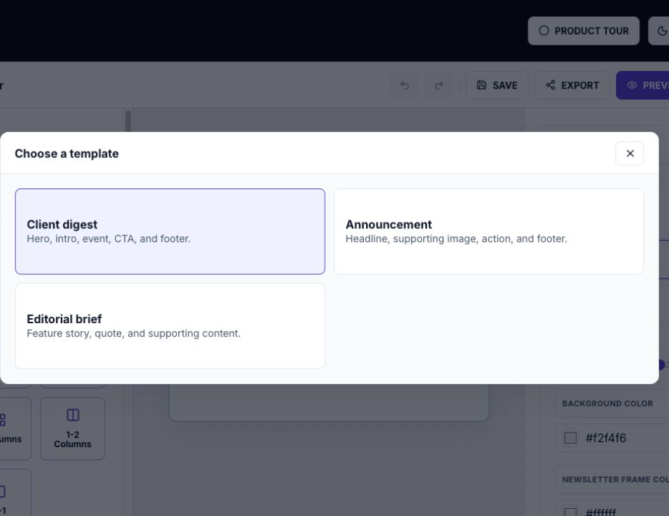
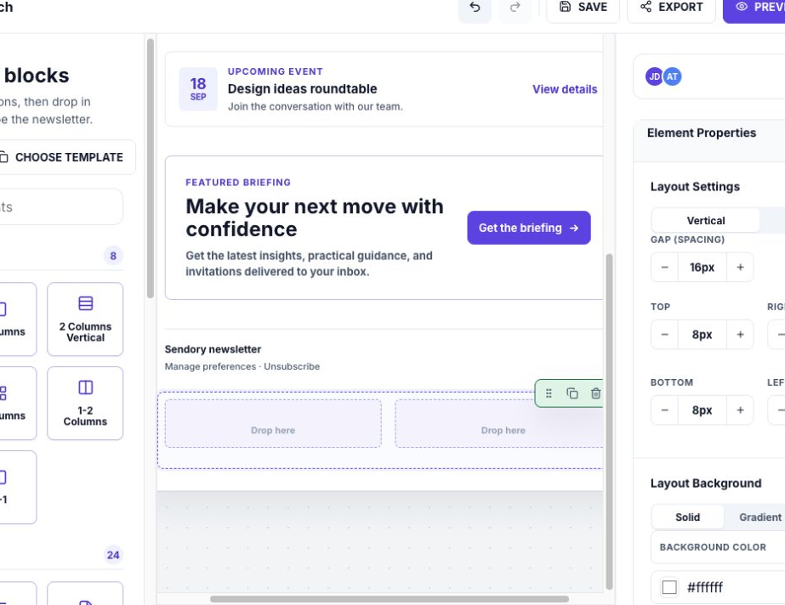
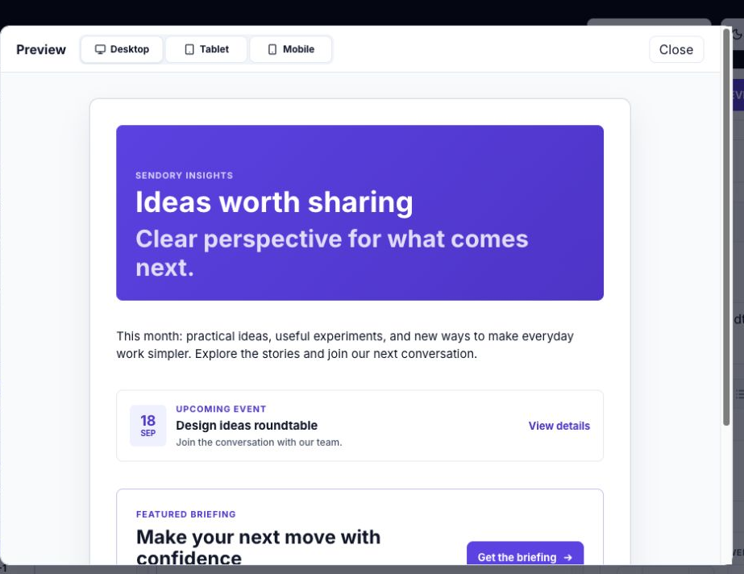
SENDORY
The content model shaped the interface
I designed the system around the author’s decisions: start, assemble, refine, review.
WHAT I WOULD SAY
“I treated content structure as part of the product design. The template, block, and preview model determined how the author moved through the work.”
DANIEL JOHNSON · INTERVIEW PORTFOLIO
04

Slide 5
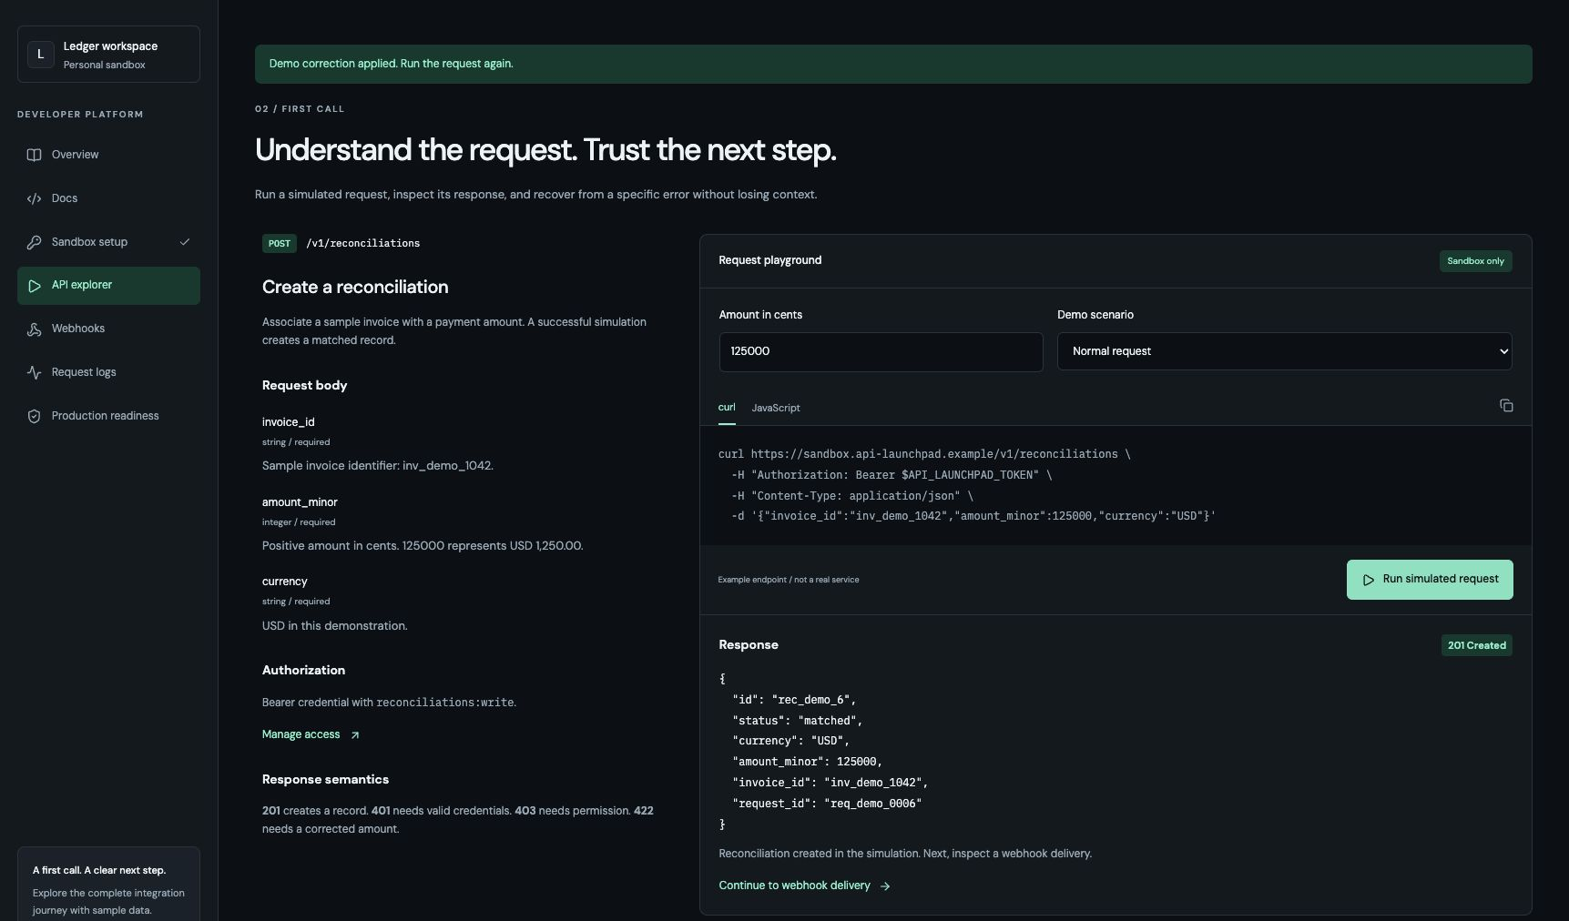
5 / DEVELOPER EXPERIENCE · TECHNICAL CONTENT
Meridian
How I combine content and experience design
PROBLEM
Developers had to move between documentation, authentication, request setup, error handling, and production readiness. The gap between understanding an API and making a successful call created friction.
DISCOVERY
I traced the moments where a developer could lose confidence: finding the right endpoint, knowing what access was required, interpreting a response, recovering from an error, and deciding whether an integration was ready to ship.
ACTION
I mapped the journey around developer intent: evaluate, configure access, make the first call, understand the response, recover from failure, and prepare for production. I placed guidance beside execution and wrote the flow so errors explain both the cause and the next action.
RESULT
The experience connects documentation, runnable requests, response semantics, error recovery, webhooks, and launch readiness in one coherent path. It preserves technical depth while making the next decision easier to find.
COLLABORATION
I aligned the information architecture with product and engineering constraints around authentication, permissions, request and response behavior, IDs, delivery state, and production controls. I would validate the language with developers and research partners.
DANIEL JOHNSON · INTERVIEW PORTFOLIO
05

Slide 6
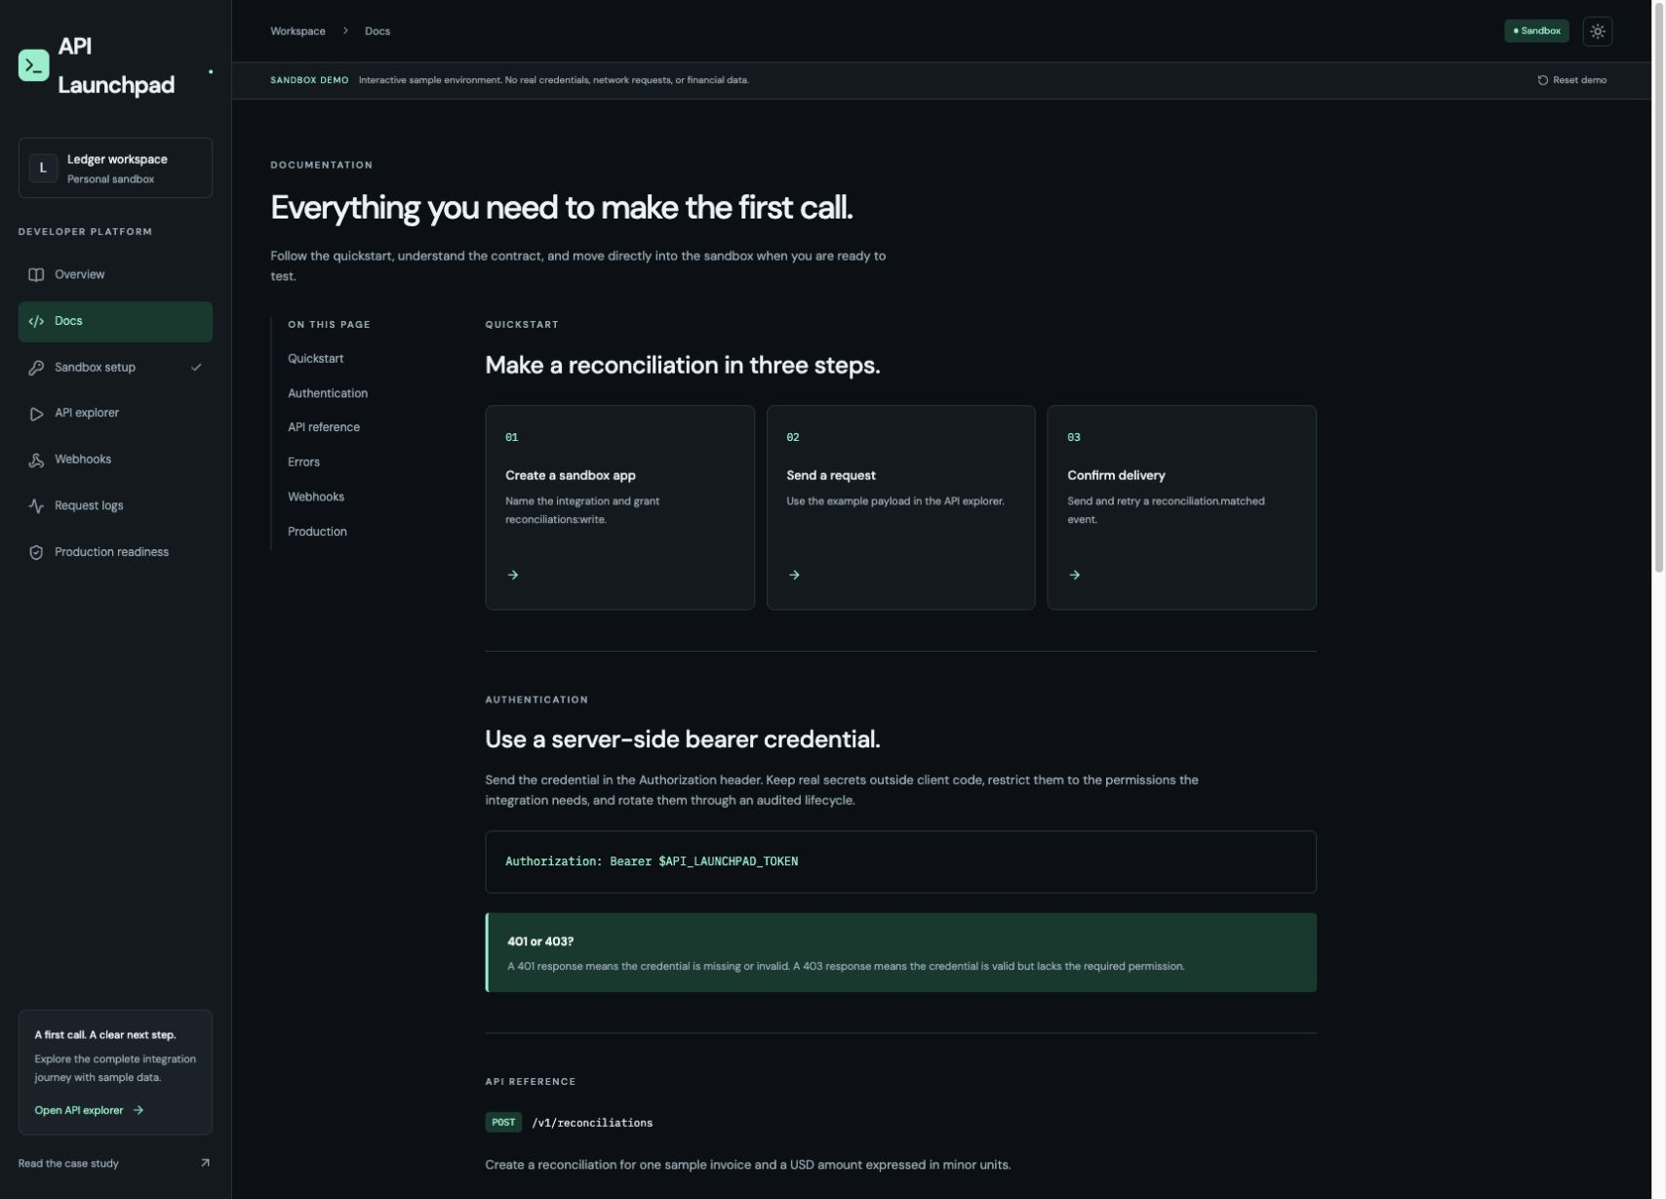
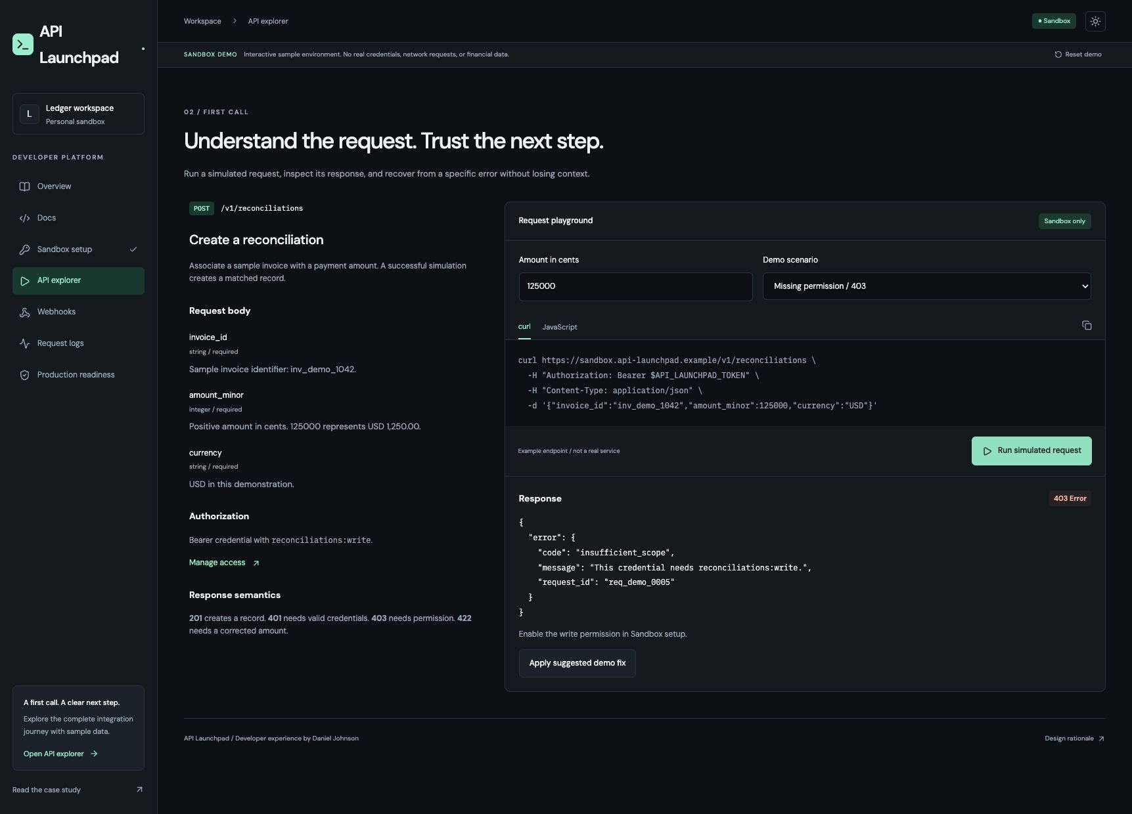
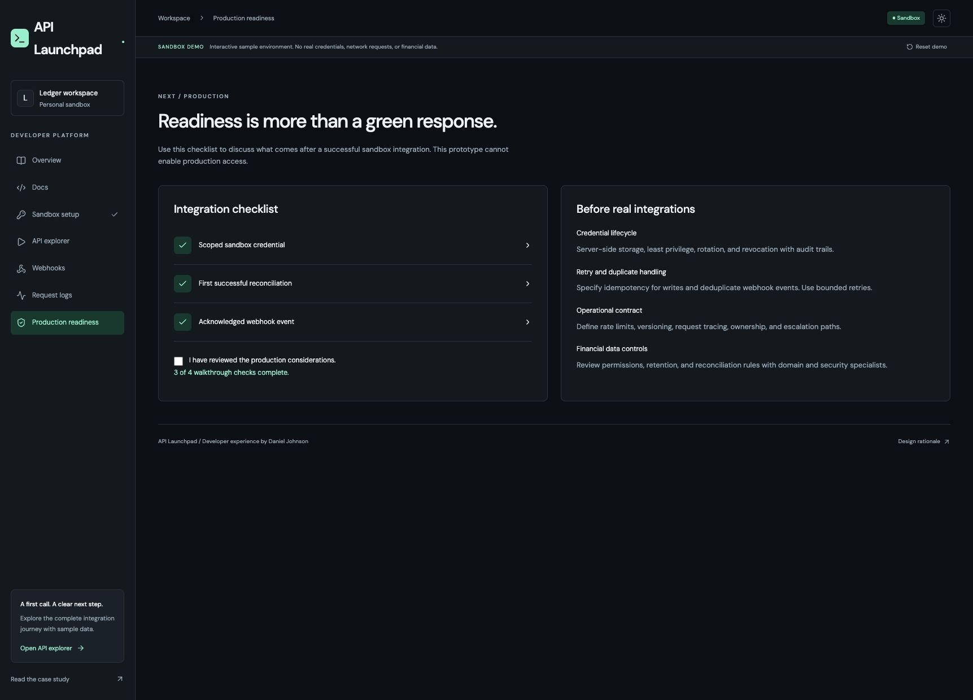
MERIDIAN
Content belongs beside the decision
The words are useful because they help the developer take the next safe action.
WHAT I WOULD SAY
“I was not trying to make the API less technical. I was making the technical information easier to understand and act on.”
DANIEL JOHNSON · INTERVIEW PORTFOLIO
06

Slide 7
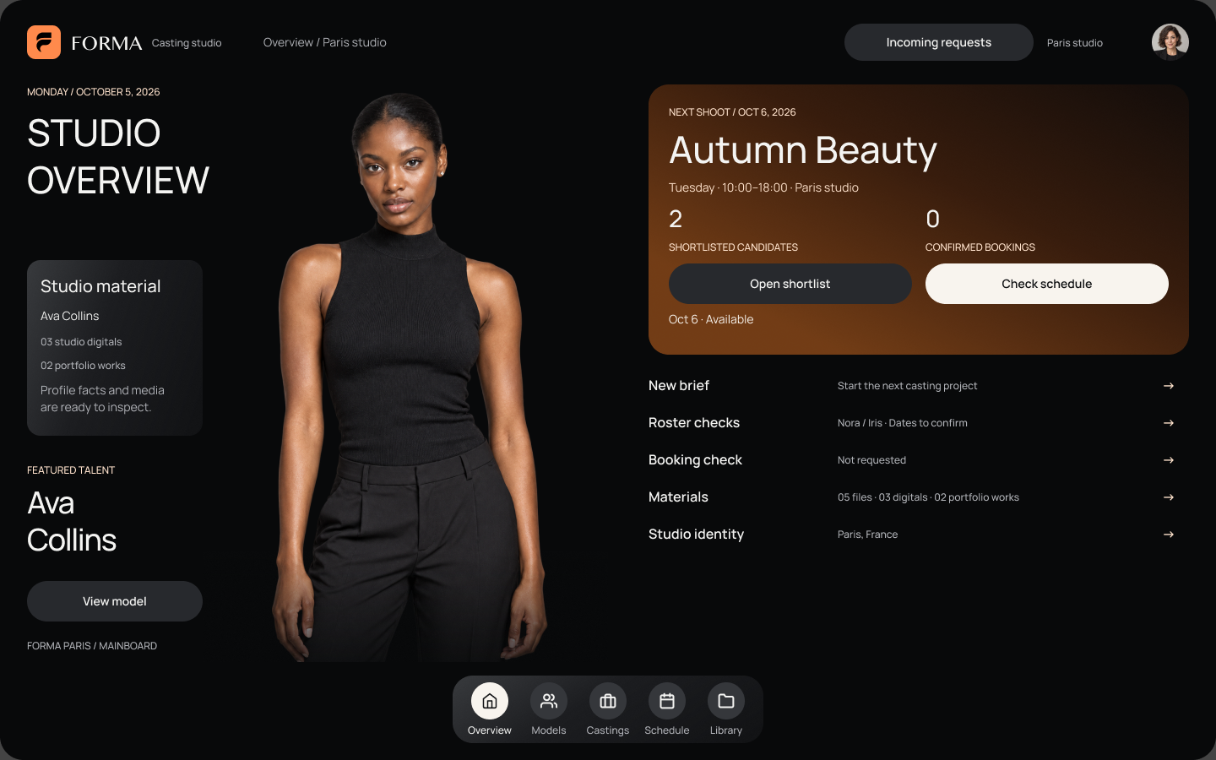
7 / DESIGN SYSTEM · CONTENT VARIABILITY
Forma
How I combine content and experience design
PROBLEM
A multi-surface product needed consistent patterns, but content length, device, state, and user context changed from one experience to the next.
DISCOVERY
I reviewed the recurring interface decisions that create drift: what belongs in navigation, how records are summarized, how states are named, how content expands on smaller screens, and where accessibility or localization changes the layout.
ACTION
I defined reusable patterns for navigation, forms, records, dialogs, media, status, and responsive layouts. I worked through longer labels, empty and error states, accessibility labels, localization, and the difference between required and flexible content.
RESULT
The system gave design and engineering a shared language for behavior, not just appearance. Repeated decisions became easier to make while the product could still support specific user contexts.
COLLABORATION
I collaborated across design, product, engineering, accessibility, and content to align on component behavior, content rules, responsive states, and implementation guidance.
DANIEL JOHNSON · INTERVIEW PORTFOLIO
07

Slide 8
CLOSING THREAD
What connects the work
I use content to clarify the decision a person is making, and interaction design to help them complete it.
01
Make complexity understandable
02
Design content and interaction together
03
Build patterns teams can reuse
Thank you

