Slide 1
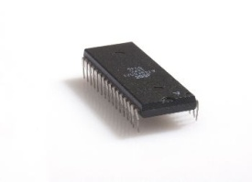
TX Path
RX Path
MessagePack
Decoder
MessagePack
Encoder
CheckSum
UART RX
CheckSum
UART TX
WBS
WBM
5
WBM
Host
(Matlab)
A
D
WBM – Wishbone Master
WBS – Wishbone Slave
Wishbone
INTERCON
WBS
4
Display
Controller
1
WBS
WBM
Pixel Manger
VGA
Display
Mem Ctrl Wr
Mem Ctrl Rd
VESA
Ctrl.
WBS
E
WBM
WBM
B
C
2
Dual Clk FIFO
SDRAM Arbiter
- 133 MHz
- 40 MHz
WBS
Image Manipulation
6
Memory
Management
ImgMan Manger
Addr Calculator
3
WBS
F
Biliniar Interpulation
SDRAM Controller
WBM
IS42S16400 SDRAM
Param Reg

Slide 2
RX Path
TX Path
WBS
WBM
WBM
Host
(Matlab)
WBM – Wishbone Master
WBS – Wishbone Slave
Wishbone
INTERCON
WBS
WBS
Display
Controller
Memory
Management
VGA
Display
WBM
WBS
WBM
WBS
WBS
SDRAM Controller
Image Manipulation
IS42S16400 SDRAM
WBM

Slide 3
Intput image
Output image

Slide 4
Intput image
Output image

Slide 5
Address Calculator
input
output
Coordinate(x,y) in output image
4 addresses (SDram) of input image

Slide 6

(x_start,y_start)
Input image
Output image

Slide 7
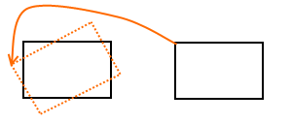

Y
Y’
X’
X
Source
Output
R1
(X,Y)
R2

Slide 8
I1
I2

Slide 9
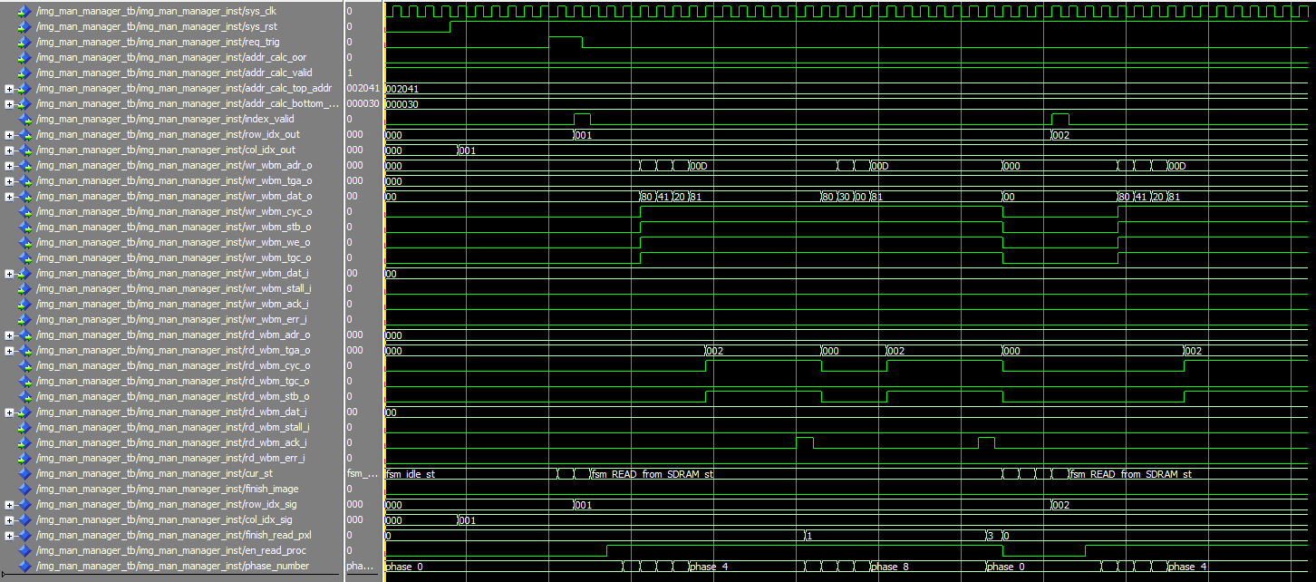
ack
ack

Slide 10
RX Path
TX Path
CRC ERR
EOF ERR
UART_SE
UART_PE
CheckSum
Rd Burst Len
DBG Command
CheckSum
TYPE Reg
8 bit
RAM 2
8 bit
MP Enc
UART TX
UART RX
MP Dec
RAM 1
WBS
8 bit
OR
8 bit
WBM
5
WBM
Host
(Matlab)
A
D
Z
INTERCON
4
Display Controller
X
WBS
INTERCON
1
WBS
Pixel Manager
(Req for Data)
req_ln_trig
& Pixels, VSync
TYPE
Reg
INTERCON
Synthetic
Pic. Gen
Hsync,
VSync
Mem Ctrl Wr
Mem Ctrl Rd
Flush
DBG ADDR
Reg
wr_cnt
wr_cnt_en
WBS
WBM
R2
FIFO
R1
WBM
8 bit
Frame
Reg
VGA
Display
WBM
C
Y
E
Flush
B
2
MUX
VESA
Ctrl.
SDRAM Arbiter
8 bit
Dual Clk FIFO
Disp. Reg
- 133 MHz
- 40 MHz
wr_rd_bank
WBS
Image Manipulation
Memory
Management
R1 – Ram 8→16 bits
R2 – Ram 16→8 bits
Addr Calculator
3
Param Registers
WBS
WBM
Biliniar
TYPE
Reg
SDRAM Controller
IS42S16400 SDRAM
ImgMan Manger
WBM – Wishbone Master
WBS – Wishbone Slave
ReadProc
WriteProc
WBM
RAM

Slide 11
TOP FSM
Coordinate Process
Address Calculator Process
Read FSM
Write FSM
Bilinear Process
Generic RAM
(1024 Bytes)

