Slide 1
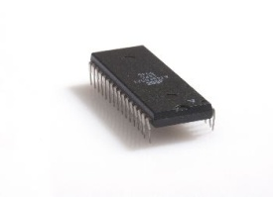
RX Path
TX Path
CRC ERR
EOF ERR
UART_SE
UART_PE
CheckSum
Rd Burst Len
DBG Command
CheckSum
TYPE Reg
8 bit
RAM 2
8 bit
MP Enc
UART TX
UART RX
MP Dec
RAM 1
WBS
8 bit
OR
8 bit
WBM
5
WBM
Host
(Matlab)
A
D
Z
INTERCON
4
Display Controller
X
WBS
INTERCON
1
WBS
Pixel Manager
(Req for Data)
req_ln_trig
& Pixels, VSync
TYPE
Reg
INTERCON
Synthetic
Pic. Gen
Hsync,
VSync
Mem Ctrl Wr
Mem Ctrl Rd
Flush
DBG ADDR
Reg
wr_cnt
wr_cnt_en
WBS
WBM
R2
FIFO
R1
WBM
8 bit
Frame
Reg
VGA
Display
WBM
C
Y
E
Flush
B
2
MUX
VESA
Ctrl.
SDRAM Arbiter
Rd/Wr ctrl
8 bit
WBM
WBS
Dual Clk FIFO
Disp. Reg
- 133 MHz
- 40 MHz
wr_rd_bank
7
WBS
Image Manipulation
Memory
Management
R1 – Ram 8→16 bits
R2 – Ram 16→8 bits
6
3
ImgMan Manger
WBS
Param Registers
SDRAM Controller
IS42S16400 SDRAM
F
WBM
Addr Calculator
Biliniar
WBM – Wishbone Master
WBS – Wishbone Slave

