Slide 1


7월 3주차 미팅
Literature Review
장승훈
박사과정
조천식모빌리티대학원, KAIST
2025. 7. 17. (금)

Slide 2
Two-level optimization strategy for vehicle speed and battery thermal management in connected and automated Evs
Electric Vehicle Battery Thermal and Cabin Climate Management Based on Model Predictive Control

Slide 3
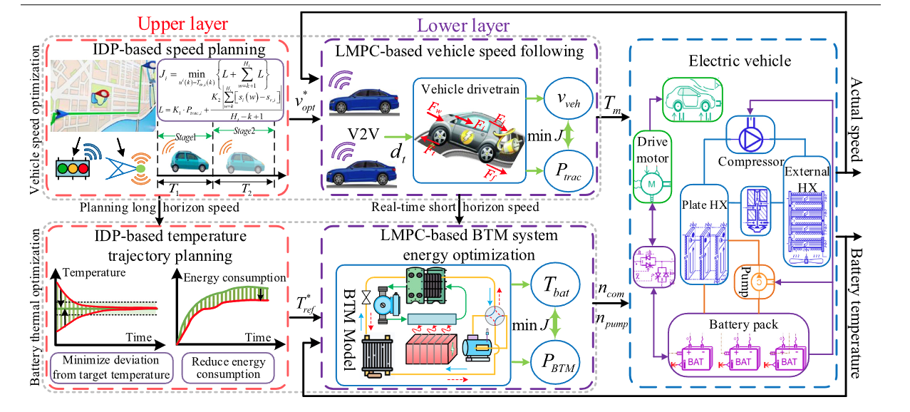
Main Contributions
[1] Two-level optimization strategy for vehicle speed and battery thermal management in connected and automated Evs
Two-level Optimization Framework
Target: 에너지 효율 및 배터리 온도 유지를 위한 차량 속도, BTM (battery thermal management) 최적화
First level
Second level
1. Upper layer
Iterative dynamic programming
(IDP)
→ 속도, 온도 지령
[1] Ma, Yan, et al. "Two-level optimization strategy for vehicle speed and battery thermal management in connected and automated EVs." Applied Energy 361 (2024): 122928.

Slide 4
Main Contributions
[1] Two-level optimization strategy for vehicle speed and battery thermal management in connected and automated Evs
Two-level Optimization Framework
Target: 에너지 효율 및 배터리 온도 유지를 위한 차량 속도, BTM (battery thermal management) 최적화
First level
Second level
Gaussian process (GP) 모델을 MPC에 적용하여 학습기반의 MPC로 REALTIME implementation
1. Upper layer
Iterative dynamic programming
(IDP)
→ 속도, 온도 지령
LMPC → learning-based MPC
[1] Ma, Yan, et al. "Two-level optimization strategy for vehicle speed and battery thermal management in connected and automated EVs." Applied Energy 361 (2024): 122928.

Slide 5
Main Contributions
[1] Two-level optimization strategy for vehicle speed and battery thermal management in connected and automated Evs
Two-level Optimization Framework
Target: 에너지 효율 및 배터리 온도 유지를 위한 차량 속도, BTM (battery thermal management) 최적화
First level
Second level
Gaussian process (GP) 모델을 MPC에 적용하여 학습기반의 MPC로 REALTIME implementation
1. Upper layer
Iterative dynamic programming
(IDP)
→ 속도, 온도 지령
LMPC → learning-based MPC
Traffic 정보를 기반으로 파워트레인의 에너지 소비 최적화
→ BTM 시스템의 열동역학 기반으로 최적의 배터리 온도 경로를 최적화된 속도에 대하여 도출
하위단에서는 MPC 기반의 제어기로 최적화된 속도, 온도 지령을 tacking하기 위한 최적의 토크 결정 (에너지 효율 고려하여)
[1] Ma, Yan, et al. "Two-level optimization strategy for vehicle speed and battery thermal management in connected and automated EVs." Applied Energy 361 (2024): 122928.

Slide 6
Main Contributions
[1] Two-level optimization strategy for vehicle speed and battery thermal management in connected and automated Evs
Two-level Optimization Framework
배터리 열관리 (BTM) , 차량 속도 동시 최적화하여 에너지 소비 감소 & 배터리 온도 유지
Upper layer(상위 제어기): CAV 기반 최적 속도 및 온도 경로 계획
Lower layer(하위 제어기): 주어진 지령을 LMPC 기반 추종하여 에너지 최적화 극대화
Iterative Dynamic Programming (IDP) 기반 long term 최적 경로 생성 (상위 제어기)
교통 정보를 활용하여 DP를 통해 최적의 차량 속도와 배터리 온도 경로를 구하고 하위 제어기 지령으로 전달
Intelligent connected information을 활용하여 DP 수행 → 일반 DP보다 연산량 감소
Learning-based MPC로 real-time implementation
MPC 모델 오차를 줄이기 위해 모델 학습 → Gaussian process model 사용
[1] Ma, Yan, et al. "Two-level optimization strategy for vehicle speed and battery thermal management in connected and automated EVs." Applied Energy 361 (2024): 122928.

Slide 7
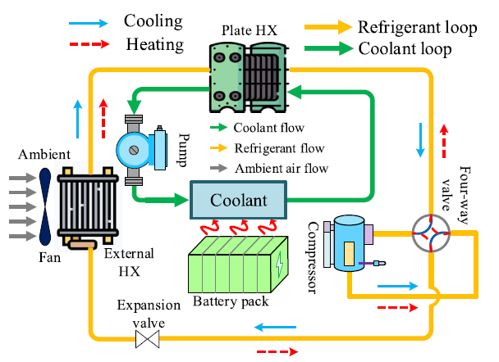
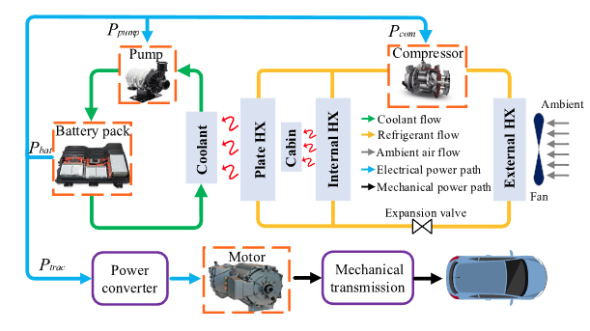


Energy consumption and thermal model
[1] Two-level optimization strategy for vehicle speed and battery thermal management in connected and automated Evs
System model
BTM 시스템
CAEV energy flow
차량 동역학 관련 비선형 함수
배터리 열 관련 비선형 함수
[1] Ma, Yan, et al. "Two-level optimization strategy for vehicle speed and battery thermal management in connected and automated EVs." Applied Energy 361 (2024): 122928.

Slide 8
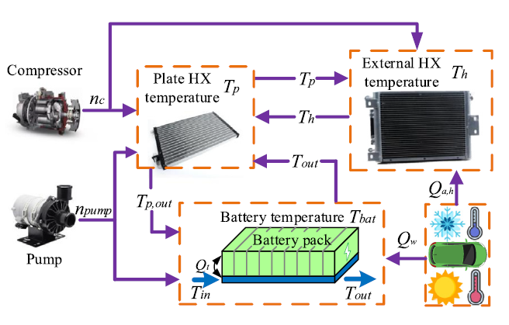
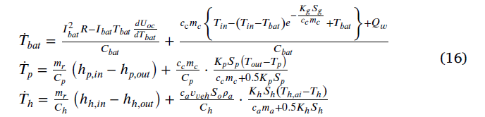
Energy consumption and thermal model
[1] Two-level optimization strategy for vehicle speed and battery thermal management in connected and automated Evs
System model
배터리에 대한 모델 정보 필요?
BTM 시스템 모델의 파라미터는
논문에서는 constant한 coefficient 사용
배터리 열 변화
Plate HX 열 변화
External HX 열 변화
[1] Ma, Yan, et al. "Two-level optimization strategy for vehicle speed and battery thermal management in connected and automated EVs." Applied Energy 361 (2024): 122928.

Slide 9
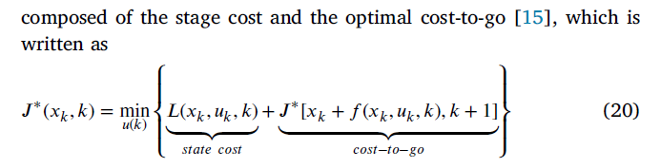
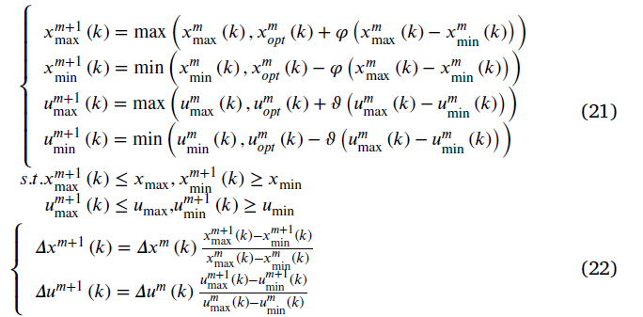
Energy consumption and thermal model
[1] Two-level optimization strategy for vehicle speed and battery thermal management in connected and automated Evs
Two-level optimization strategy
DP → optimal control input의 solution
최적의 제어 입력과 온도 궤적을 DP를 통해 matrix에 저장
하지만 모든 영역에 대하여 DP를 풀면 과도한 연산이 필요 하므로 state 와 제어 입력의 boundary 를 min, max로 정하고 그 영역에 대하여 축소된 DP를 매 iterative마다 구함
[1] Ma, Yan, et al. "Two-level optimization strategy for vehicle speed and battery thermal management in connected and automated EVs." Applied Energy 361 (2024): 122928.

Slide 10
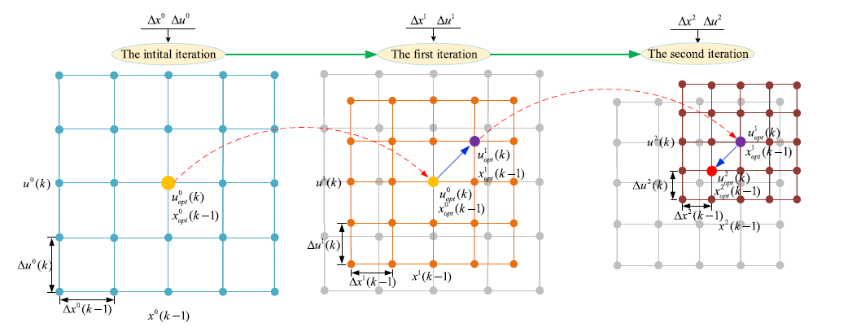
Energy consumption and thermal model
[1] Two-level optimization strategy for vehicle speed and battery thermal management in connected and automated Evs
Two-level optimization strategy
[1] Ma, Yan, et al. "Two-level optimization strategy for vehicle speed and battery thermal management in connected and automated EVs." Applied Energy 361 (2024): 122928.

Slide 11
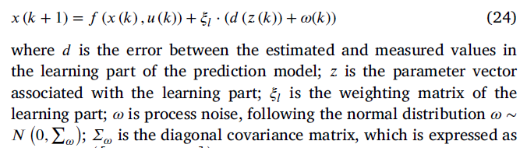
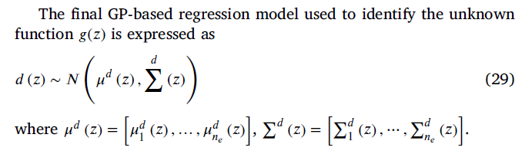
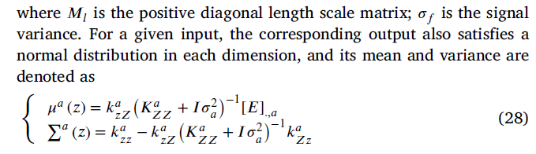
Energy consumption and thermal model
[1] Two-level optimization strategy for vehicle speed and battery thermal management in connected and automated Evs
Two-level optimization strategy
Gaussian process-based model learning
가중치 매트릭스
기존 모델
노이즈
학습 예측 오차
measurement
parameter
Regression model을 설계하고
학습을 통해서 unknown function g를 추정하겠다!
[1] Ma, Yan, et al. "Two-level optimization strategy for vehicle speed and battery thermal management in connected and automated EVs." Applied Energy 361 (2024): 122928.

Slide 12
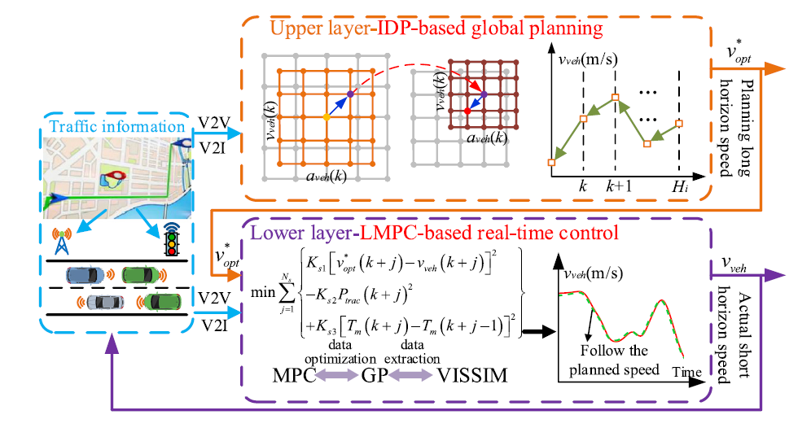
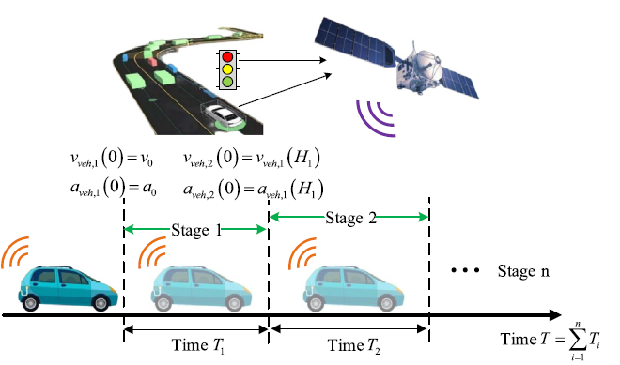
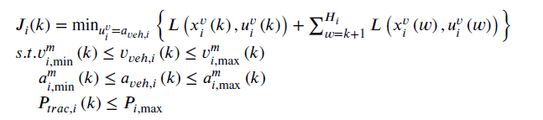
Energy consumption and thermal model
[1] Two-level optimization strategy for vehicle speed and battery thermal management in connected and automated Evs
Structure of the vehicle speed optimization (Upper layer)
[1] Ma, Yan, et al. "Two-level optimization strategy for vehicle speed and battery thermal management in connected and automated EVs." Applied Energy 361 (2024): 122928.

Slide 13
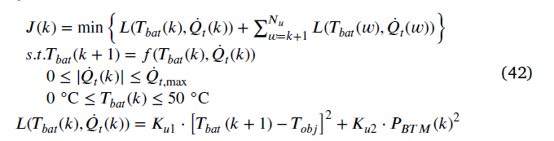
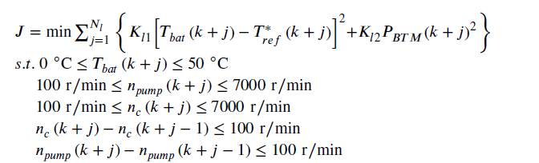
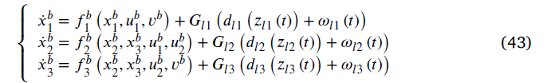
Energy consumption and thermal model
[1] Two-level optimization strategy for vehicle speed and battery thermal management in connected and automated Evs
BTM system optimization for temperature trajectory planning (Upper layer)
System energy optimization based on the LMPC
[1] Ma, Yan, et al. "Two-level optimization strategy for vehicle speed and battery thermal management in connected and automated EVs." Applied Energy 361 (2024): 122928.

Slide 14
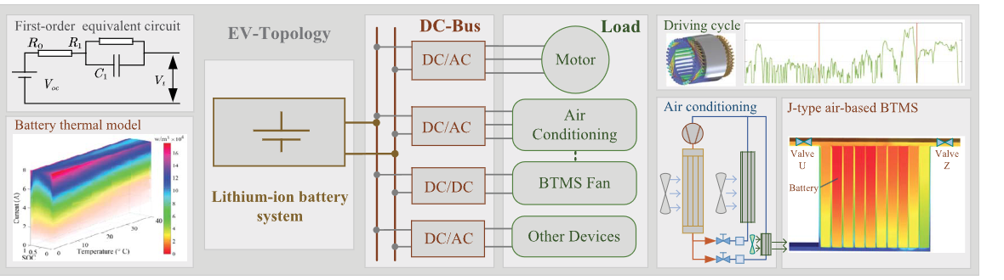
Main Contributions
[2] Electric Vehicle Battery Thermal and Cabin Climate Management Based on Model Predictive Control
전기차의 에너지 효율 향상을 위해, MPC 기반 에너지 최적화 전략
BTMS(배터리 열관리 시스템) & 공조 시스템(AC)을 최적화하여 동시 제어
MPC 기반으로 배터리 operation과 방전 최적화하며 BTMS와 AC의 제약조건을 동시에 고려하여 최적 제어 수행
[1] Liu, Yuanzhi, and Jie Zhang. "Electric vehicle battery thermal and cabin climate management based on model predictive control." Journal of Mechanical Design 143.3 (2021): 031705.

Slide 15
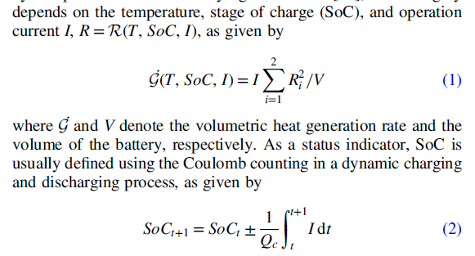
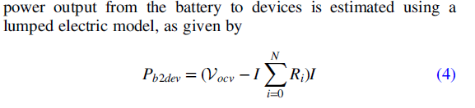
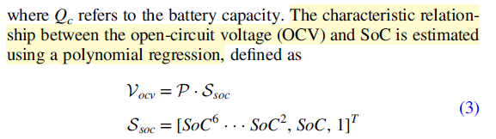
Electric Vehicle System Modeling
[2] Electric Vehicle Battery Thermal and Cabin Climate Management Based on Model Predictive Control
Battery system modeling
배터리 열 모델링
배터리 SOC 동역학
배터리 power 함수
SOC와 OCV 관계를 polynomial regression으로 모델 추정
[1] Liu, Yuanzhi, and Jie Zhang. "Electric vehicle battery thermal and cabin climate management based on model predictive control." Journal of Mechanical Design 143.3 (2021): 031705.

Slide 16
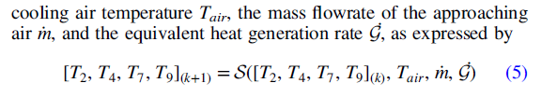
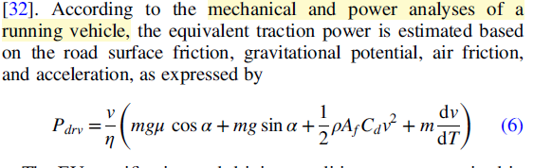
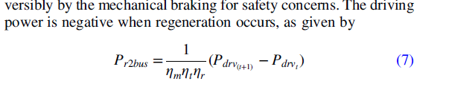
Electric Vehicle System Modeling
[2] Electric Vehicle Battery Thermal and Cabin Climate Management Based on Model Predictive Control
Battery Thermal-Fluid model
Dynamic Driving Model
차량 동역학의 기계적 power
회생제동에 의한 braking power
[1] Liu, Yuanzhi, and Jie Zhang. "Electric vehicle battery thermal and cabin climate management based on model predictive control." Journal of Mechanical Design 143.3 (2021): 031705.

Slide 17
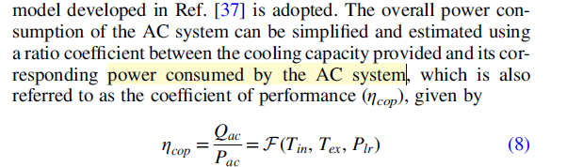
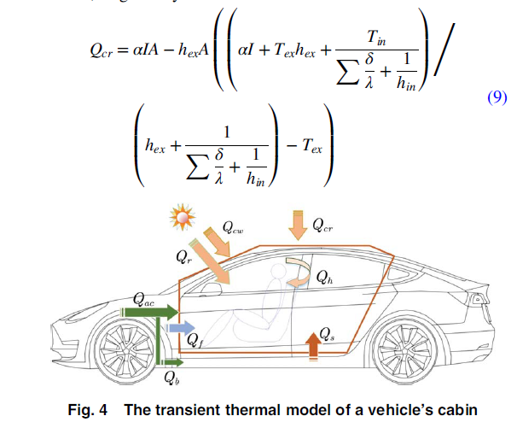
Electric Vehicle System Modeling
[2] Electric Vehicle Battery Thermal and Cabin Climate Management Based on Model Predictive Control
Air Conditioning System Model
Heat conduction
공조 시스템에서 소비한 power
[1] Liu, Yuanzhi, and Jie Zhang. "Electric vehicle battery thermal and cabin climate management based on model predictive control." Journal of Mechanical Design 143.3 (2021): 031705.

Slide 18
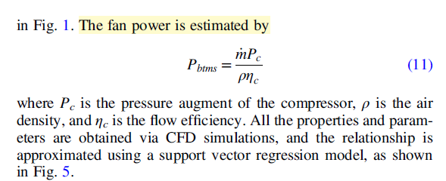
Electric Vehicle System Modeling
[2] Electric Vehicle Battery Thermal and Cabin Climate Management Based on Model Predictive Control
BTMS Energy Consumption Model (배터리 열관리 시스템을 위한 cooling system)
[1] Liu, Yuanzhi, and Jie Zhang. "Electric vehicle battery thermal and cabin climate management based on model predictive control." Journal of Mechanical Design 143.3 (2021): 031705.

Slide 19
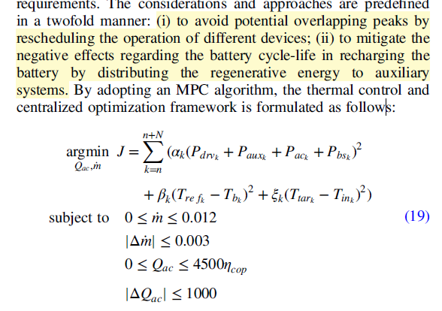
The Thermal Control Framework and Energy Management Strategy
[2] Electric Vehicle Battery Thermal and Cabin Climate Management Based on Model Predictive Control
BTMS Energy Consumption Model (배터리 열관리 시스템을 위한 cooling system)
[1] Liu, Yuanzhi, and Jie Zhang. "Electric vehicle battery thermal and cabin climate management based on model predictive control." Journal of Mechanical Design 143.3 (2021): 031705.

Slide 20
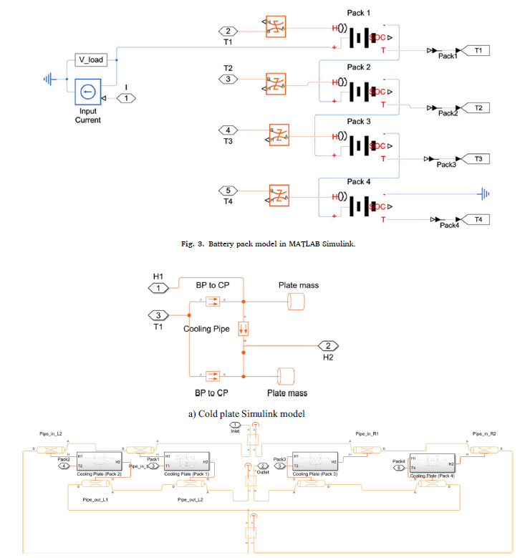
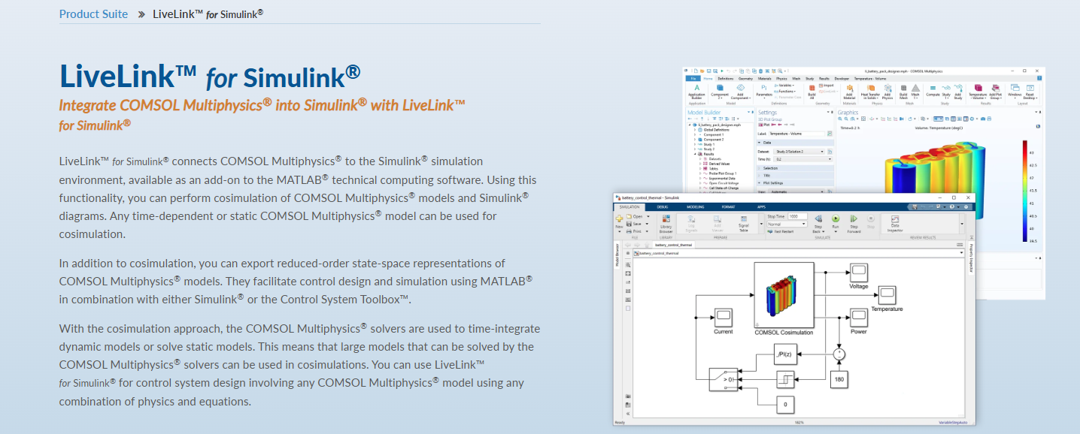
Discussion
시뮬레이션 환경 구축
MATLAB/SIMULINK: BTMS + COMSOL 기반 배터리 모델
BTMS 및 에너지 최적화 (EV 또는 HEV) 를 위한 문제 정의와 검증을 통합 시뮬레이션에서 구현

