Slide 1


7월 5주차 미팅
-
장승훈
박사과정
조천식모빌리티대학원, KAIST
2025. 7. 31. (목)

Slide 2
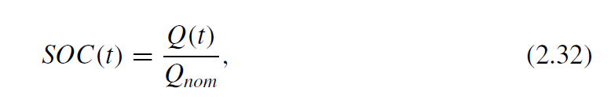
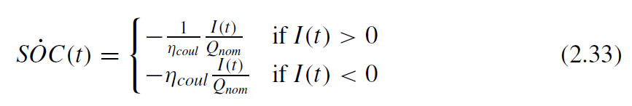
Powertrain Components for HEV [1]
The state of charge (SOC)
The SOC dynamics
Amount of charge currently stored
Nominal charge capacity
Coulombic efficiency
Battery current ( discharge)
Battery current ( charge)
[1] Onori, Simona, Lorenzo Serrao, and Giorgio Rizzoni. Hybrid electric vehicles: Energy management strategies. Vol. 13. London, UK: Springer, 2016.

Slide 3
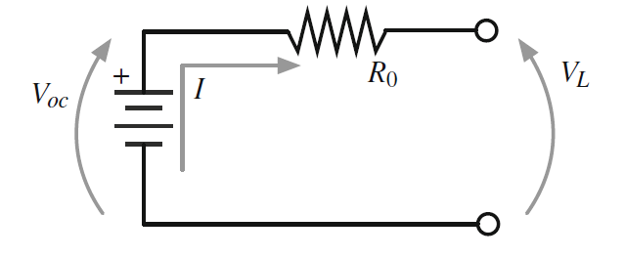
Powertrain Components for HEV [1]
Battery equivalent circuit
Terminal에 load가 연결되었을 때 current direction, SOC, temperature에 따라 C, R 달라짐
→ maps (rule-based) table 사용
→ e.g., R0 = f(SOC, T, I), C0 = g(SOC, T, I)
The battery circuit model w/o voltage dynamics
Terminal power
[1] Onori, Simona, Lorenzo Serrao, and Giorgio Rizzoni. Hybrid electric vehicles: Energy management strategies. Vol. 13. London, UK: Springer, 2016.

Slide 4
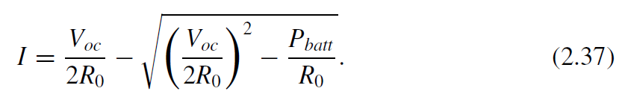
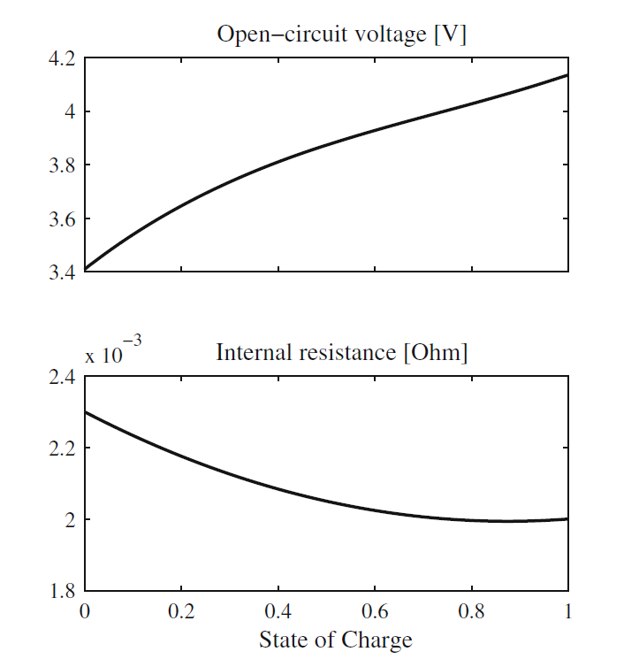
Powertrain Components for HEV [1]
An explicit expression of the current as a function of power
Open circuit voltage Voc → a function of the SOC, temperature i.e., Voc = f(SOC, T, I,…)
[1] Onori, Simona, Lorenzo Serrao, and Giorgio Rizzoni. Hybrid electric vehicles: Energy management strategies. Vol. 13. London, UK: Springer, 2016.

Slide 5
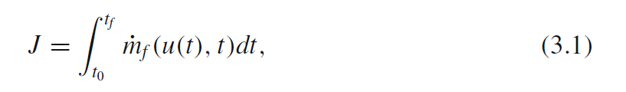
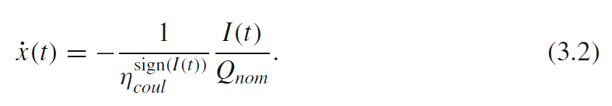

Powertrain Components for HEV [1]
Problem Formulation
System Dynamics
Mass flow rate of fueled in HEV
[1] Onori, Simona, Lorenzo Serrao, and Giorgio Rizzoni. Hybrid electric vehicles: Energy management strategies. Vol. 13. London, UK: Springer, 2016.

Slide 6
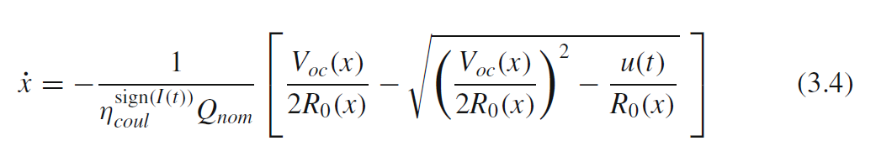

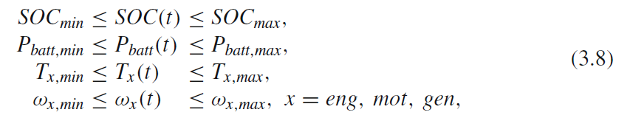
Powertrain Components for HEV [1]
System Dynamics
General form
[1] Onori, Simona, Lorenzo Serrao, and Giorgio Rizzoni. Hybrid electric vehicles: Energy management strategies. Vol. 13. London, UK: Springer, 2016.

Slide 7

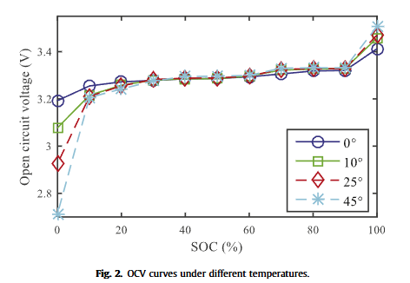
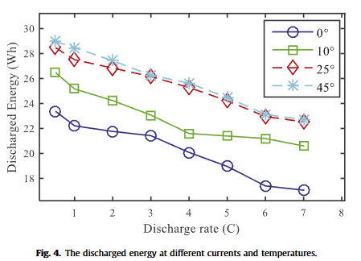
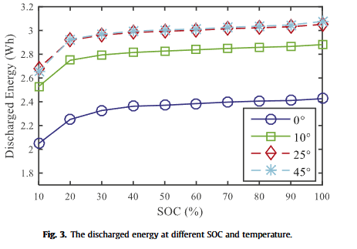
State of energy estimation of batteries w/ neural network model [2]
The state of Energy (SOE)
Effective battery power
Nominal total energy
T, SOC에 따라 SOE 변한다
[2] Dong, Guangzhong, et al. "A method for state of energy estimation of lithium-ion batteries based on neural network model." Energy 90 (2015): 879-888.

Slide 8


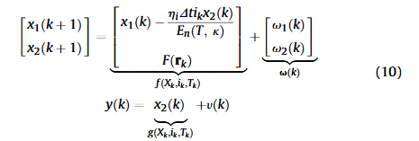
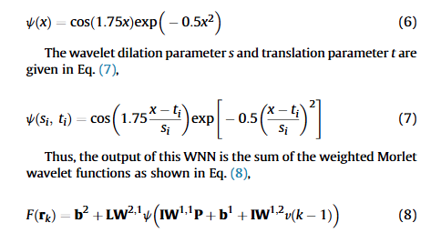
State of energy estimation of batteries w/ neural network model [2]
State-space model
Augmented State-space model
[2] Dong, Guangzhong, et al. "A method for state of energy estimation of lithium-ion batteries based on neural network model." Energy 90 (2015): 879-888.

Slide 9
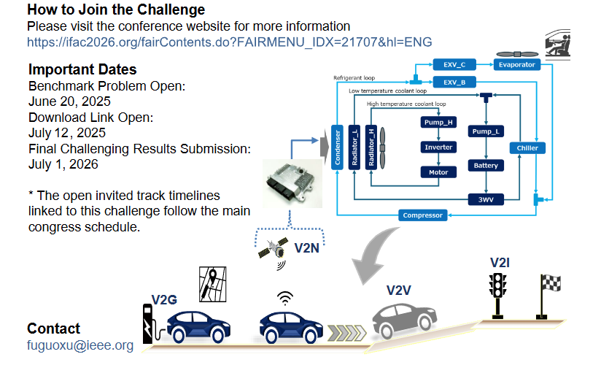
IFAC2026 Benchmark Challenge: Thermal Management Strategy Design for Electric Vehicles under Connectivity

