Slide 1
Regular Meeting
Mar. 03
Dongmin, Kim

Slide 2
BSL Meeting
Contents
01
Research Proceeding
Co-simulation study based on VISSIM-MATLAB-COMSOL: Predictive speed control for energy minimization and battery degradation
- Previous Work
- On-going Work

Slide 3

BSL Meeting
Research Proceeding
Previous Work
What has done
Optimization framework
Problem Definition
Literature Review
Methodology Development
Simulation
Analysis
$$π^{∗}=\min_{v_{k},…,v_{k+N_{p}}}{\sum_{k=1}^{N_{p}}{α∙l\left(v_{k},a_{k}\right)+(1−α)∙Q_{loss}∙V_{nom}∙Q_{nom}}}$$
$$l\left(v_{k},a_{k}\right)=P_{batt,k}\left(v_{k}\right)+P_{batt,cool,k}\left(v_{k}\right)$$
$$Q_{loss}=\left(p_{1}SOC+p_{2}\right)e^{\frac{−31700+163.3 I_{c−rate}}{RT}}∙Ah^{0.57}$$
$$s.t$$
$${\underline{v}}_{k}≤v_{k}≤{\overline{v}}_{k}$$
$${\underline{a}}_{k}≤a_{k}≤{\overline{a}}_{k}$$
$$P_{batt,k}(v_{k})≤P_{max}$$
$${\dot{Q}}_{batt,k}(v_{k})≤{\dot{Q}}_{max}$$

Slide 4
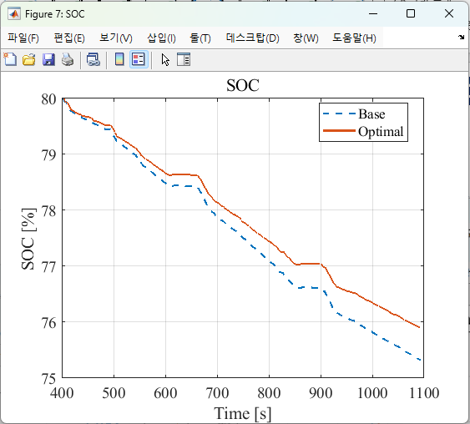
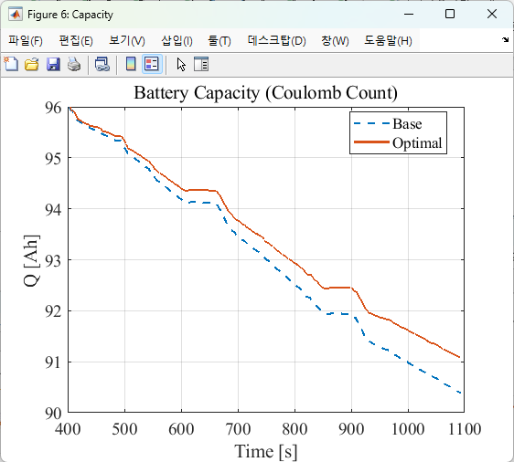
BSL Meeting
Research Proceeding
Previous Work
What has done
Problem Definition
Literature Review
Methodology Development
Simulation
Analysis
Optimization problem solution is solved
The simulations were conducted across a wide range of environmental settings (Traffic volume and weight)

Slide 5
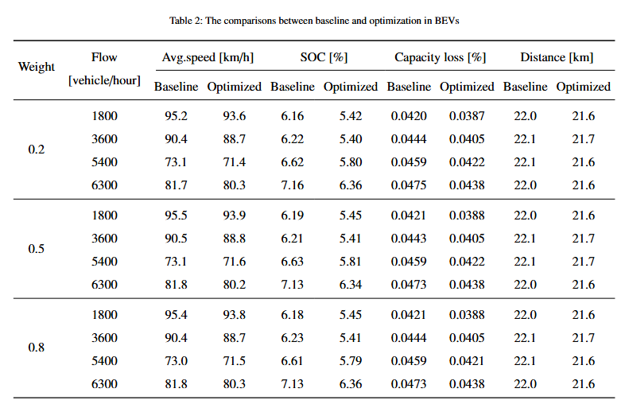
BSL Meeting
Research Proceeding
Previous Work
What has done
$$α∙l\left(v_{k},a_{k}\right)+(1−α)∙Q_{loss}∙V_{nom}∙Q_{nom}$$
Problem Definition
Literature Review
Methodology Development
Simulation
Analysis

Slide 6
BSL Meeting
Research Proceeding
On-going Work
What has done
Problem Definition
Literature Review
Methodology Development
Simulation
Analysis
Analysis I
(Issue) Alpha range needs to be extended (over 5)
(Insight) The optimization results show that the optimized battery current for driving increases along with average speed

Slide 7
BSL Meeting
Research Proceeding
On-going Work
What has done
Problem Definition
Literature Review
Methodology Development
Simulation
Analysis
Analysis I
(Issue) Alpha range needs to be extended (over 5)
(Insight) The optimization results show that the optimized battery current for driving increases along with average speed

Slide 8
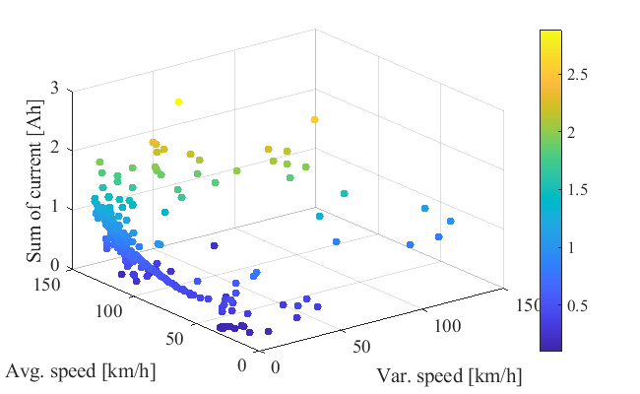
BSL Meeting
Research Proceeding
On-going Work
What has done
Problem Definition
Literature Review
Methodology Development
Simulation
Analysis
Analysis II
(Insight) The higher deviation in speed range consumes the more driving battery current

Slide 9
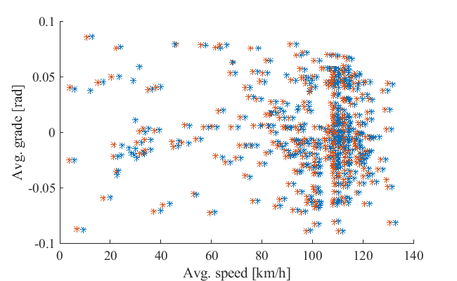
BSL Meeting
Research Proceeding
On-going Work
What has done
Problem Definition
Literature Review
Methodology Development
Simulation
Analysis
Analysis II
(Insight) The higher deviation in speed range consumes the more driving battery current
(Insight) It tends to reduce average speed at the same grade

Slide 10
BSL Meeting
Research Proceeding
On-going Work
What has done
Problem Definition
Literature Review
Methodology Development
Simulation
Analysis
Analysis II
(Insight) However, the degree of grades is not proportionally related to the optimization margin

Slide 11

BSL Meeting
Research Proceeding
Future Work
To be done
Optimization framework
Problem Definition
Literature Review
Methodology Development
Simulation
Analysis
$$π^{∗}=\min_{v_{k},…,v_{k+N_{p}}}{\sum_{k=1}^{N_{p}}{α∙l\left(v_{k},a_{k}\right)+(1−α)∙abs(Q_{loss})∙V_{nom}}}$$
$$l\left(v_{k},a_{k}\right)=P_{batt,k}\left(v_{k}\right)+P_{batt,cool,k}\left(v_{k}\right)$$
$$Q_{loss}=\left(p_{1}SOC+p_{2}\right)e^{\frac{−31700+163.3 I_{c−rate}}{RT}}∙Ah^{0.57} →$$
$$Q_{loss}=−\frac{Q_{0}}{100}\left(p_{1}SOC+p_{2}\right)e^{\frac{−31700+163.3 I_{c−rate}}{RT}}∙Ah^{0.57−1}∙0.57∙\frac{|I_{batt}|}{3600}$$
Allam et al. @ TTE (2015)

Slide 12
Thank You

