Slide 1
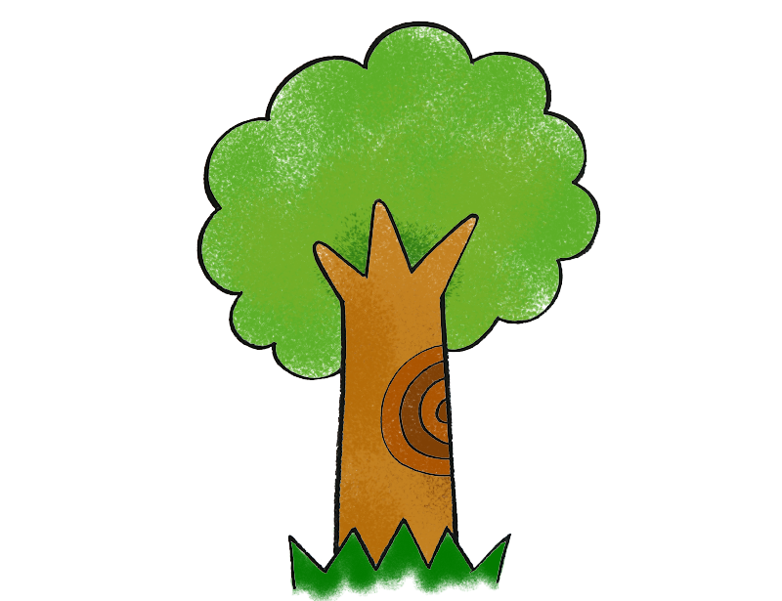

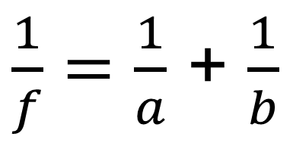
$\frac{1}{f}=\frac{1}{a}$ + $\frac{1}{b}$
a > b (f = 1)
a
b

Slide 2
$\frac{1}{f}=\frac{1}{a}$ + $\frac{1}{b}$
a = b (f = 1)
culling
a
b

Slide 3
$\frac{1}{f}=\frac{1}{a}$ + $\frac{1}{b}$
a < b (f = 1)
culling
a
b

Slide 4
$\frac{1}{f}=\frac{1}{a}$ + $\frac{1}{b}$
a > b (f = 1)
a
b

Slide 5
$\frac{1}{f}=\frac{1}{a}$ + $\frac{1}{b}$
a > b (f = 4)
a
b

Slide 6

$\frac{1}{f}=\frac{1}{a}$ + $\frac{1}{b}$
a > b (f = 0.5)
a
b

Slide 7
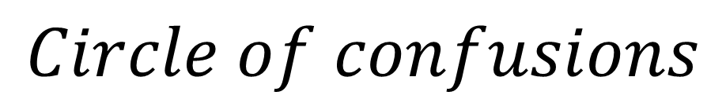

$$Circle of confusions$$
$$image plane$$

Slide 8

$$Circle of confusions$$
$$image plane$$

Slide 9
$$Circle of confusions$$
$$image plane$$

Slide 10
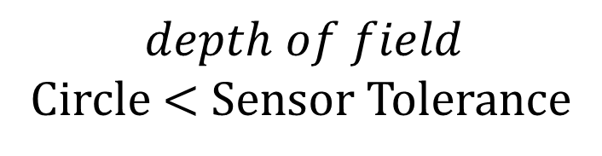
$$Circle of confusions$$
$$depth of field$$
Circle < Sensor Tolerance
$$image plane$$

Slide 11
$$Circle of confusions$$
$$image plane$$

Slide 12
$$Circle of confusions$$
$$image plane$$

Slide 13
$$Circle of confusions$$
$$image plane$$

Slide 14
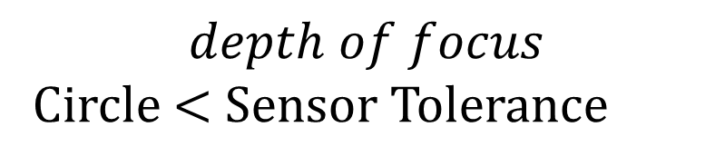
$$Circle of confusions$$
$$image plane$$
$$depth of focus$$
Circle < Sensor Tolerance

Slide 15
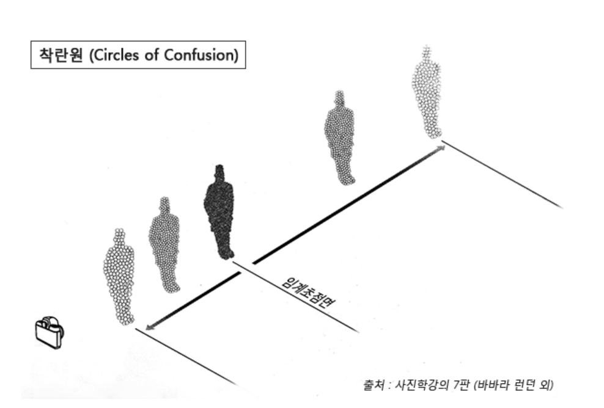
$$image plane$$
$$depth of focus$$
Circle < Sensor Tolerance

Slide 16



$초$점을 근접해 맞추면
$$image plane$$
blur
심도
$$image plane$$

Slide 17



$초$점을 멀리 맞추면
$$image plane$$
$$image plane$$

Slide 18
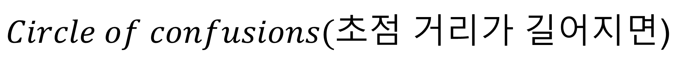


$Circle of confusions(초점$ 거리가 길어지면)
$$image plane$$
$$image plane$$

Slide 19


$Circle of confusions(초점$ 거리가 길어지면)
$$image plane$$
$$image plane$$

Slide 20


$Circle of confusions(초점$ 거리가 길어지면)
$$image plane$$
blur
심도
$$image plane$$

Slide 21
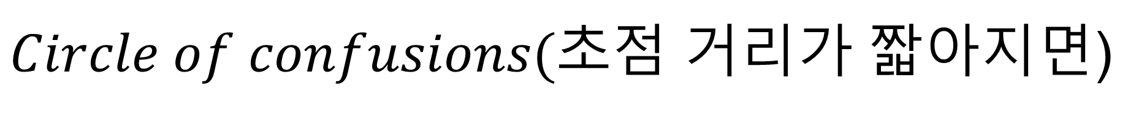
$Circle of confusions(초점$ 거리가 짧아지면)
$$image plane$$
$$image plane$$

Slide 22


$Circle of confusions(초점$ 거리가 짧아지면)
$$image plane$$
$$image plane$$

Slide 23

$Circle of confusions(초점$ 거리가 짧아지면)
$$image plane$$

Slide 24





$IRIS 구$경이 크면
$$image plane$$
$$IRIS$$
$$image plane$$
$$IRIS$$

Slide 25



$IRIS 구$경이 작으면 심도가 깊다.
$$image plane$$
$$IRIS$$
$$image plane$$
$$IRIS$$

Slide 26

같은 크기를 같은 해상도로 본다면
해상도가 큰놈이 넓게 보는 것이다.
저해상도
고해상도

Slide 27


$$Afocal Zoom System$$

Slide 28

2.8mm
$$Afocal Zoom System$$
6mm

Slide 29


2.8mm
$$Afocal Zoom System$$
$$focus lens$$
6mm

Slide 30
30mm
30mm

Slide 31
$$Afocal Zoom System$$

