Slide 1
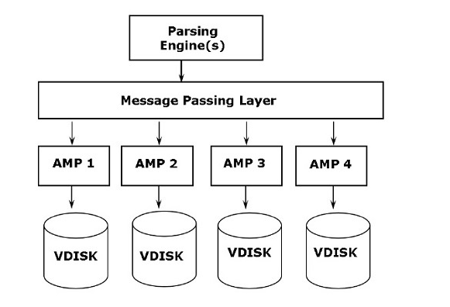
Disk Level Protection

Slide 2
RAID Technology
RAID stands for Redundant array of independent disks.
RAID is a technology that uses multiple physical disk drives to protect data from a single disk failure.
The purpose of RAID is to ensure that at the time of failure, there should be one copy of data which should be available for immediate use.

Slide 3
RAID Configuration Levels
There are 6 RAID configuration levels:
RAID 0
RAID 1
RAID 2
RAID 3
RAID 4
RAID 5
Teradata supports only RAID 1 and RAID 5.The recommended level is RAID 1 as it provides the highest level of data protection.

Slide 4
RAID 1 Level
In RAID 1,every disk will have another copy of disk to protect the data. This is known as data mirroring.
The main disadvantage is that storage space increases as data is duplicated and stored twice.
Advantage:
Incase of any failure, access to data does not get affected, as copy of data is available

Slide 5
RAID 1 Architecture
When a drive is down, the system writes to the functional drives, but not to the failed drive.
After you replace the failed disk, the disk array controller automatically reconstructs the data on the new disk.
Parsing Engine
Message Passing Layer
AMP1
AMP2
AMP3
1
4
1
4
2
5
2
5
3
6
3
6

Slide 6
RAID 5
In RAID 5,data is not duplicated but spread across multiple disks.
In addition to this, there is another important information that is called Parity which is evenly spread across all disks.
Raid 5 performs parity calculation on the data and store only important data with which data can be rebuilt incase of any failure of disk.

Slide 7
RAID 5 Architecture
When a drive is down, the system writes to the functional drives, but not to the failed drive.
After you replace the failed disk, the disk array controller automatically reconstructs the data on the new disk.
Data Block
Block A1
Block B2
Block C1
Parity D
Block A2
Block B2
Parity C
Block D1
Block A3
Parity B
Block C2
Block D2
Parity A
Block B3
Block C3
Block D3

