Slide 1

Sprocket Central Pty Ltd
Data analytics approach
[Division Name] - [Engagement Manager], [Senior Consultant], [Junior Consultant]

Slide 2
Agenda
Introduction
Data Exploration
Model Development
Interpretation

Slide 3
Introduction
Customer Analysis:
We have to find the attributes that are highly dependent and can be used for data modeling and interpretation. These factors Should be taken under consideration while targeting the new customers.
Number of bike purchases in 3 years / percentages purchases
Age distributions
Job industry category.
Wealth segments
Number of cars own on each states.

Slide 4
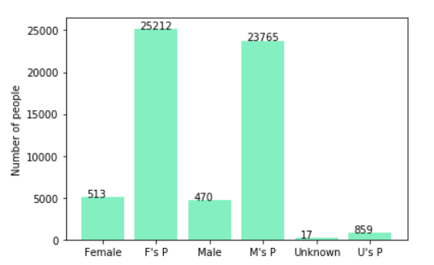
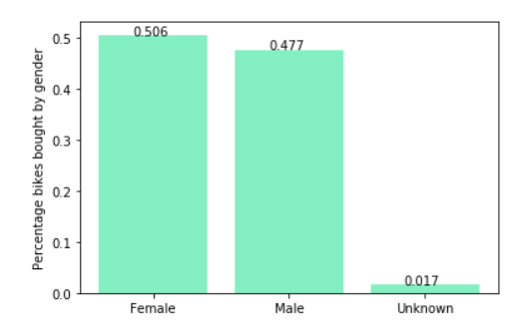
Model Development
Bike Related Purchases in last 3 years: Data is taken from New customers list.
As we can see, our new customers are consist of larger number of Females with 50.6% purchases with total of 25,212 bike related purchases.
Males contribute to 47.7% purchases with 23,765 bike related purchases.
So we should focus slightly more on advertising Female customers than Male customers.
P denotes no of items Purchased in bar plot. On y axis no. of people denoted should be scaled down by factor of 10 for actual data.
Place any supporting images, graphs, data or extra text here.

Slide 5
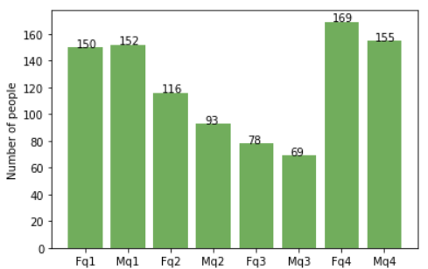
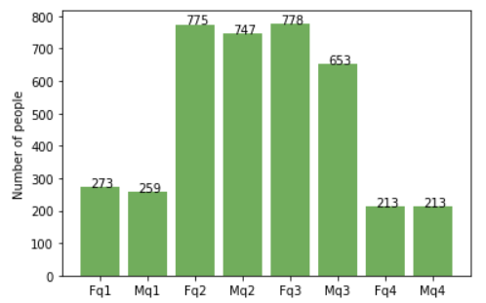
Data Exploration
Age: q1<40, 40<q2<49, 49<q3<58, q4>58
Customers Age Distribution:
New Cust.
As we can see, mostly our new customers are under 40 and above 58 years old.
Number of new customers from 40 to 58 years old has consistent drops on percentages.
There is a steep increase in number of new customers over 59 years old in term of percentages
It looks like the percentages of under 25 years old not really change of old customers.
Mostly old customers are between ag of 26 to 60.
In general the trends between Old and New customers are opposite.
Place any supporting images, graphs, data or extra text here.
Old Cust.
Age: q1<26, 26<q2<43, 43<q3<60, q4>60

Slide 6
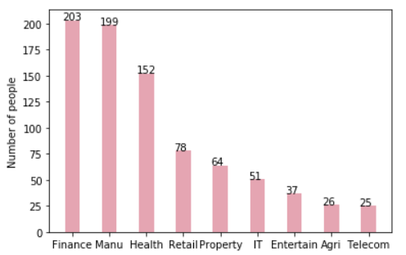
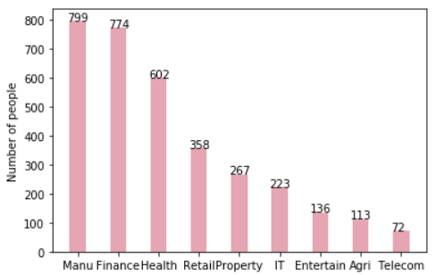
Interpretation
Customer Job Sectors:
New Cust.
Majorly customers are in Finance , Manufacturing and Health sector. Firm should target these sectors primarily.
Finance industry has most number of new customers and Manufacturing industry has most number of old customers.
Old and New customers almost follow same trend through out all job sectors.
Place any supporting images, graphs, data or extra text here.
Old Cust.

Slide 7
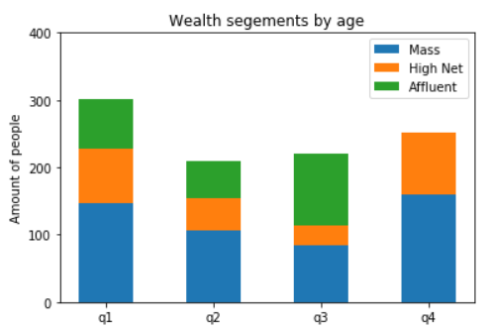
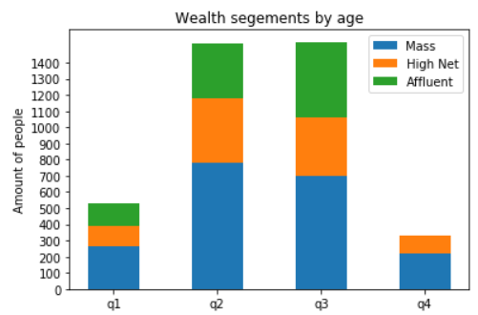
Interpretation
Age: q1<40, 40<q2<49, 49<q3<58, q4>58
Wealth Segment:
New Cust.
In all age groups, the number of Mass Customers is the highest so we should focus more on this social class.
After that, we should focus on High Net Customer.
Then Affluent Customers but mostly second and third quadrant.
Old Cust.
Age: q1<26, 26<q2<43, 43<q3<60, q4>60

Slide 8
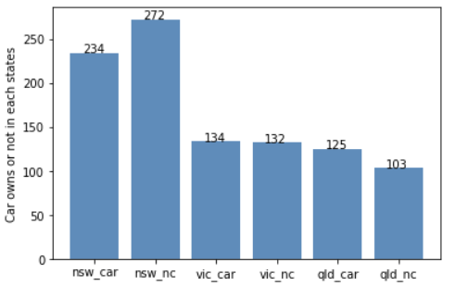
Interpretation
Numbers of cars owned:
nsw_car denotes number of car owners nsw_nc denotes how many doesn’t own a car
State NSW should be considered the most since large number of customers don’t own cars is significantly larger than that own.
VIC and QLD has more customers that own car but we can try to have something so that those who owns car will make bike related purchases.
Place any supporting images, graphs, data or extra text here.

Slide 9
Appendix

Slide 10
Appendix
This is an optional slide where you may place any supporting items.

