Slide 1



Develop GenAI Applications with Java
By
Shabab Koohi
Dec-11&12
Develop GenAI Applications with Java by Shabab Koohi

Slide 2
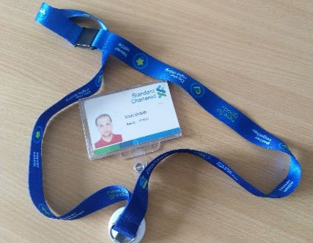

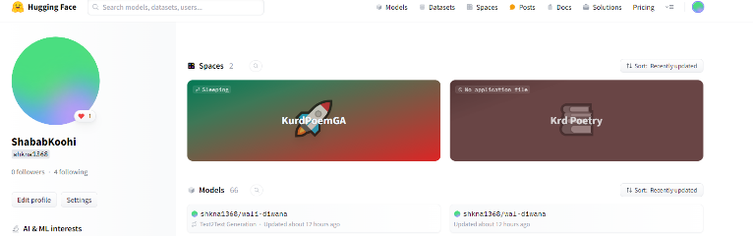
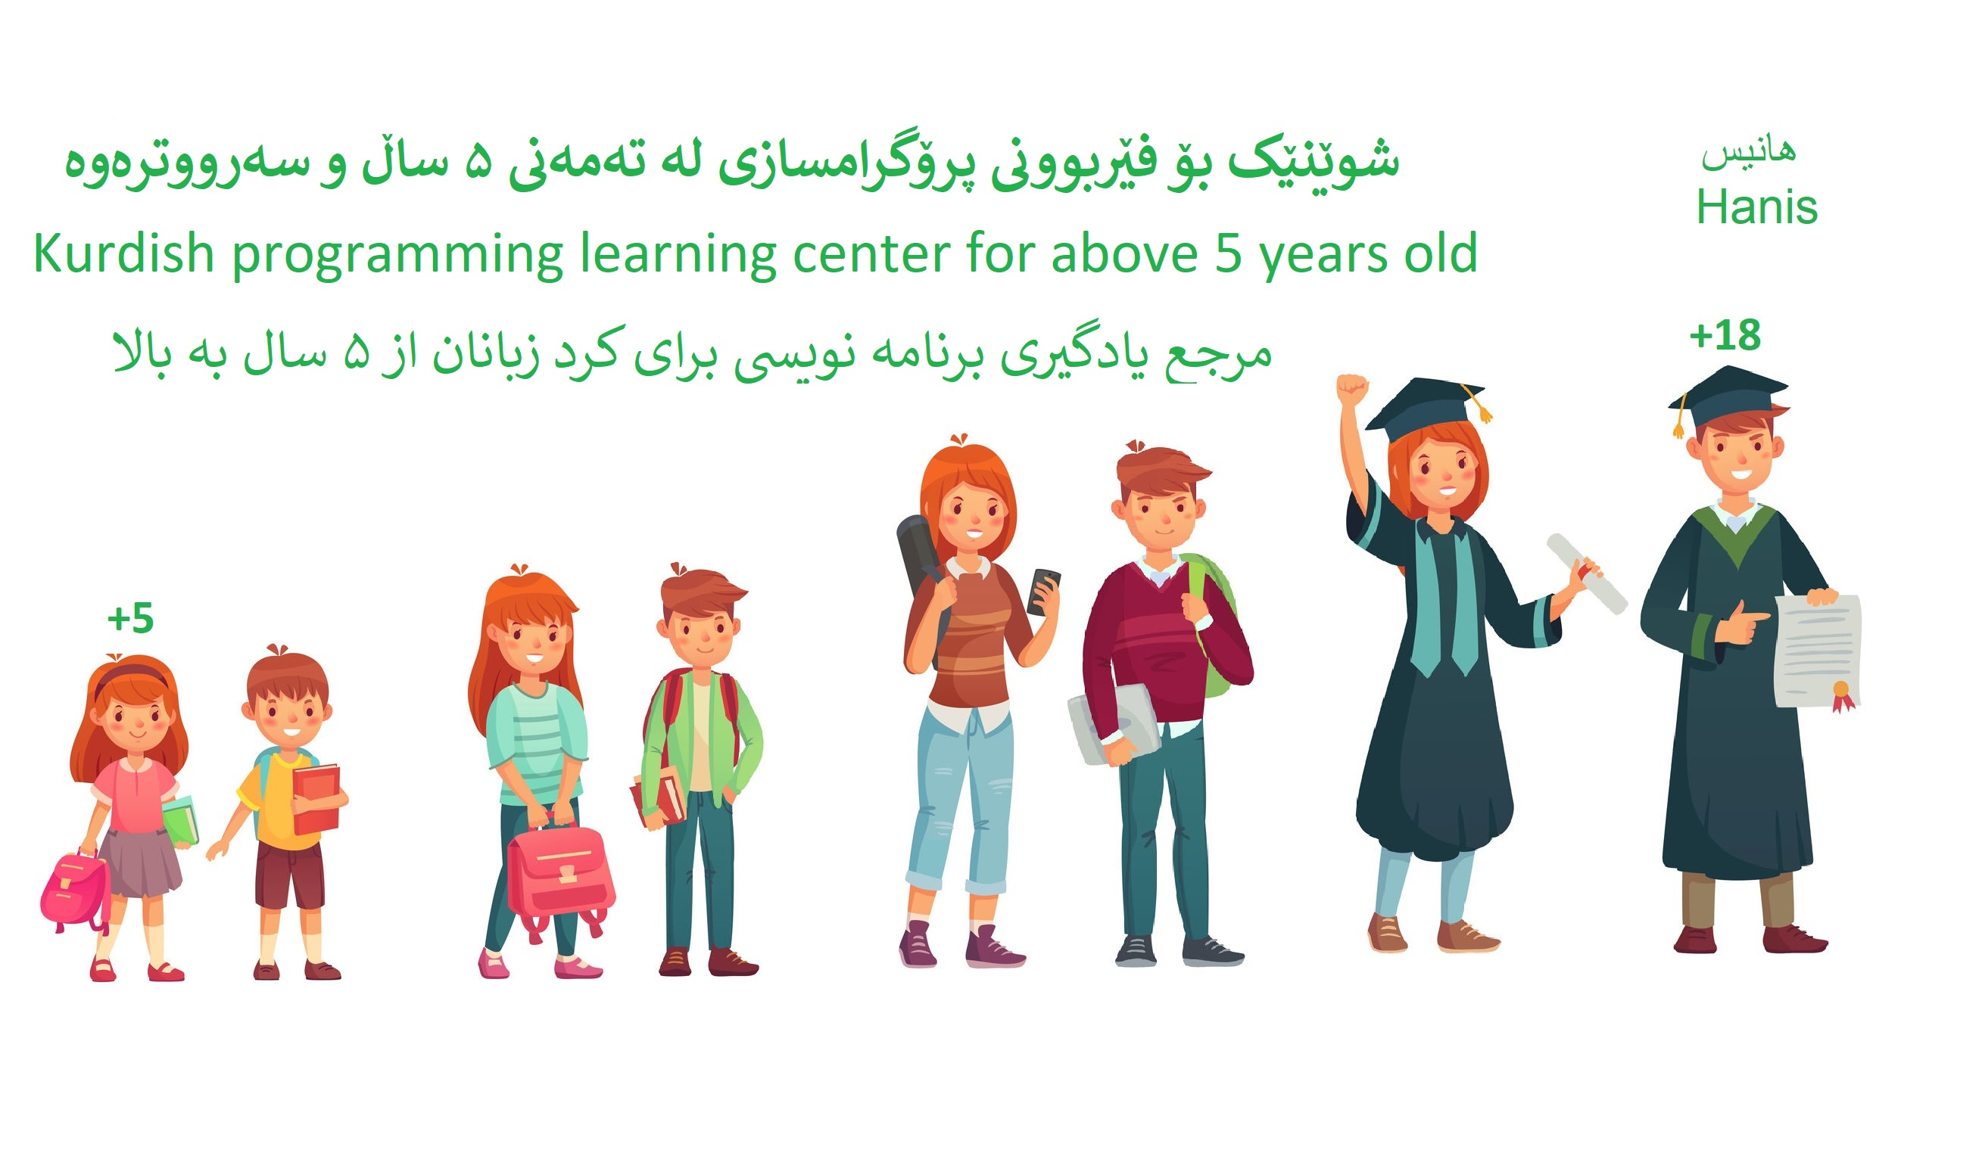
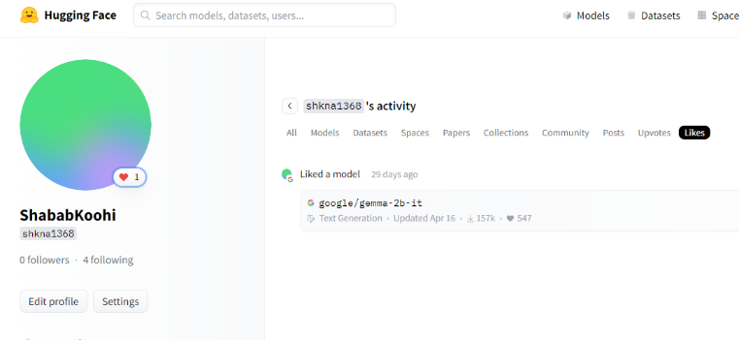
Who am I?
12 years : backend-mobile-team lead(banking-iptv-fintech)
6 years : mentoring - training - Youtube(from +5)
2 years : GenAI developer
Develop GenAI Applications with Java by Shabab Koohi

Slide 3
What do we want to do?
Basic: Java-spring boot
Advance: LLM-Spring AI
Final project: full AI banking
Improving technical knowledge of generative AI programming in Kurdistan
Develop GenAI Applications with Java by Shabab Koohi

Slide 4
Table of content
Java
Basic concept
Variable
Operator
Control statement
Loop
Function
Class
OOP
final
Generics
Stream
Record
Wrapper class
Collections
Optional
Exceptions
Threads
Maven
Spring boot
Rest api
Controller-service-repository
Crud
UI
Gen AI
HuggingFace
Ollama
Langchain4j
Spring ai
Text generation
Image generation
Audio generation
Rag
Function calling
Final
Full AI Banking
Develop GenAI Applications with Java by Shabab Koohi

Slide 5
Java-Spring boot
Java
Basic concept
Variable
Operator
Control statement
Loop
Function
Class
OOP
final
Generics
Stream
Record
Wrapper class
Collections
Optional
Exceptions
Threads
Maven
Spring boot
Rest api
Controller-service-repository
Crud
UI(vaadin)
Tools
JDK v-21
IntelliJ IDEA
Postgres
Develop GenAI Applications with Java by Shabab Koohi

Slide 6
Complete Java-Spring boot Reference
@HanisCoding
Develop GenAI Applications with Java by Shabab Koohi

Slide 7
Generative AI(GenAI)
Generative AI is a form of artificial intelligence that creates new text, images, video, audio, or other content based on the vast amounts of data that the generative model was trained on.
Examples of generative AI tools
Text generation tools include GPT, Jasper, AI-Writer and Lex.
Image generation tools include Dall-E 2, Midjourney and Stable Diffusion.
Music generation tools include Amper, Dadabots and MuseNet.
Code generation tools include CodeStarter, Codex, GitHub Copilot and Tabnine.
Voice synthesis tools include Descript, Listnr and Podcast.ai.
Develop GenAI Applications with Java by Shabab Koohi

Slide 8
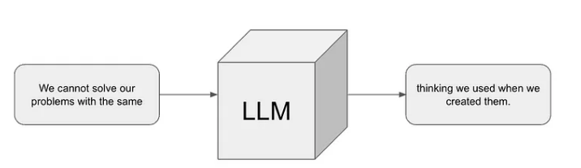
LLM(large language model)
Large language models are a form of AI that focuses on understanding text inputs (using natural language processing) and creating human-like text based on a given input. LLMs are a subset of generative AI and focus primarily on language-related tasks.
Develop GenAI Applications with Java by Shabab Koohi

Slide 9
LLM main concepts:
llama
Mistral
Llava
Falcon
Bert
Phi
Develop GenAI Applications with Java by Shabab Koohi

Slide 10
Prompt
An LLM prompt is an instruction you give a language model to guide it to a desired response
Prompt engineering is the process of structuring an instruction that can be interpreted and understood by a generative artificial intelligence (AI) model.
As for writing the prompts themselves, a well-structured prompt typically includes three key components:
Instruction: This is the core directive or question to be addressed by the model. Clear instructions are important, as ambiguity can lead to unpredictable or irrelevant outputs. ‍‍
Context: Various background details that help the model understand the instruction better. Context means everything when it comes to complex queries or when specific knowledge is required. ‍‍
Examples (optional) : Sample inputs and outputs that illustrate the expected response. While optional, examples — often referred to as few-shot prompts — are especially useful in guiding the model to produce outputs in a desired format or style.
Develop GenAI Applications with Java by Shabab Koohi

Slide 11
Prompt samples
Create a Python class for a simple calculator that can add and subtract numbers.
You are a customer support representative for a tech company. Respond to the following customer inquiry:
"My laptop won't turn on. I've tried charging it, but nothing happens. What should I do?"
Write a short poem in the style of these examples:
Example 1: "The sun sets gently, painting the sky with hues of orange and pink, a masterpiece of the night."
Example 2: "The rain whispers secrets to the leaves, a soft symphony of nature's voice, soothing the soul."
Develop GenAI Applications with Java by Shabab Koohi

Slide 12

Huggingface
Hugging Face is an open-source platform for machine learning (ML) and data science that helps users build, train, and deploy models
Develop GenAI Applications with Java by Shabab Koohi

Slide 13

Ollama
Run LLM locally
Command : ollama run mistral
Develop GenAI Applications with Java by Shabab Koohi

Slide 14
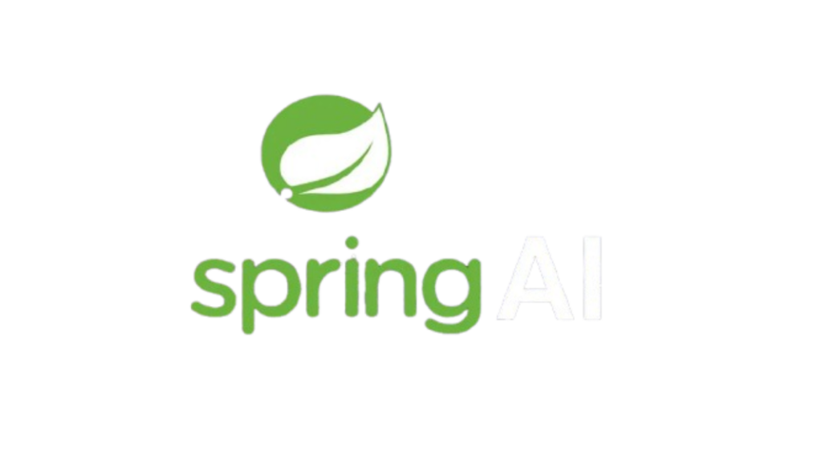

Generative ai in Java
Spring AI
Langchain4j
Develop GenAI Applications with Java by Shabab Koohi

