Slide 1

Resilience4j
A lightweight fault tolerance library

Slide 2

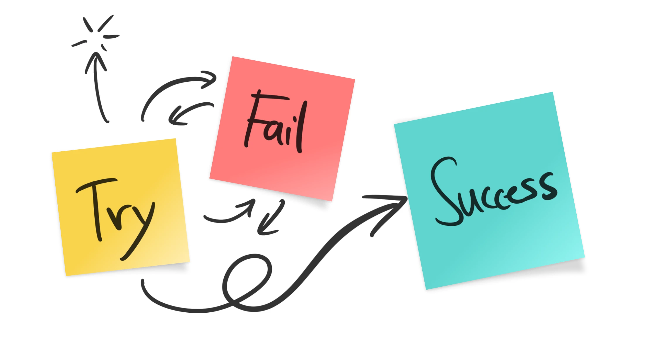
Fault tolerance
Fault-tolerance is the process of working of a system in a proper way in spite of the occurrence of the failures in the system.

Slide 3
Need For Resiliency
Microservices are distributed in nature
When you work with distributed systems, always remember this number one rule – anything could happen.
Dealing with network issues, service unavailability, application slowness
Ability of the system to recover from such failures and remain functional makes the system more resilient
It also avoids any cascading failures to the downstream services

Slide 4
Resilience4j
A lightweight fault tolerance library designed for functional programming
Core modules:
resilience4j-circuitbreaker: Circuit breaking
resilience4j-ratelimiter: Rate limiting
resilience4j-bulkhead: Bulkheading
resilience4j-retry: Automatic retrying (sync and async)
resilience4j-cache: Result caching
resilience4j-timelimiter: Timeout handling

Slide 5
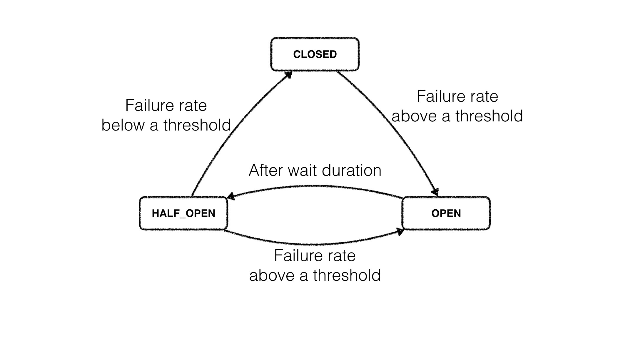
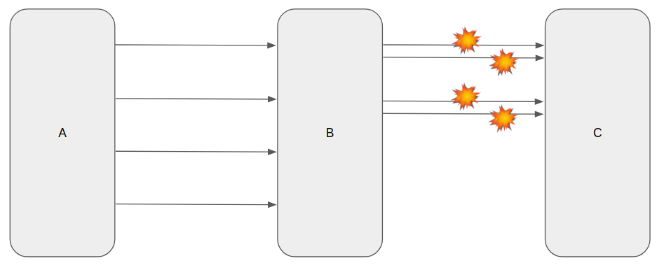
CircuitBreaker
The CircuitBreaker is implemented via a finite state machine with three normal states:
CLOSED, OPEN and HALF_OPEN and two special states DISABLED and FORCED_OPEN.
At home a circuit breaker protects the home and electrical appliances by breaking the circuit and stopping the flow of electricity when there is excess current. The same pattern can be applied in software to protect the system and individual microservices from huge failures.
The CircuitBreaker uses a sliding window to store and aggregate the outcome of calls.
count-based sliding window vs Time-base sliding window
The count-based sliding window aggregrates the outcome of the last N calls
The time-based sliding window aggregrates the outcome of the calls of the last N seconds.

Slide 6
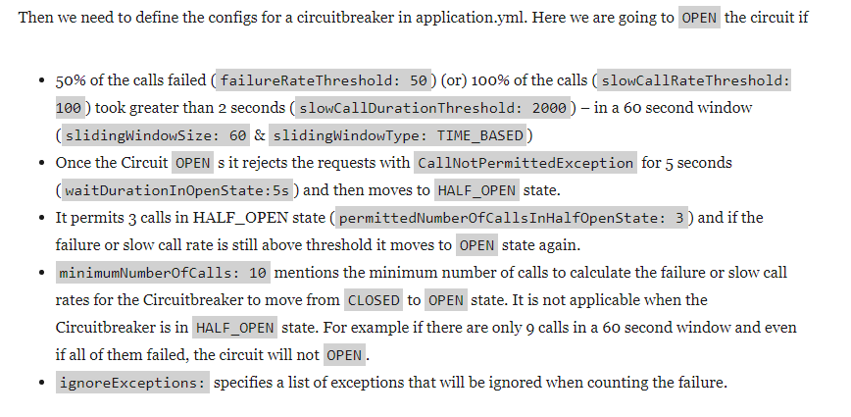
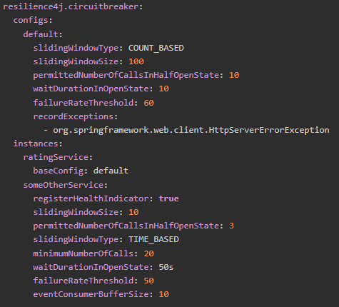
CircuitBreaker configs

Slide 7

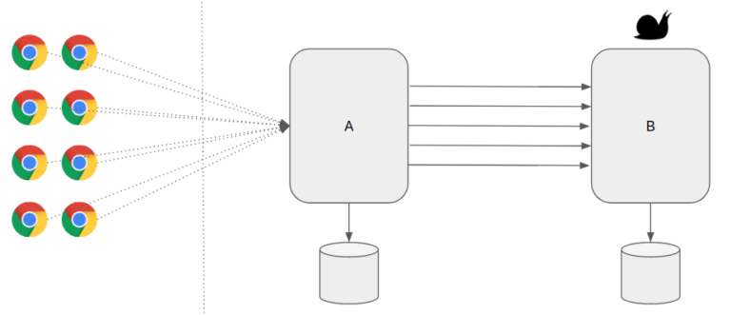
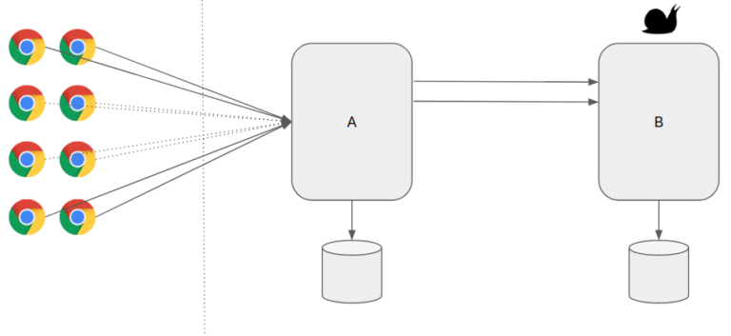
Bulkhead
A ship is split into small multiple compartments using Bulkheads.
Bulkheads are used to seal parts of the ship to prevent entire ship from sinking in case of flood.
The application should be split into multiple components and resources should be isolated in such a way that failure of one component is not affecting the others.
Two implementations of a bulkhead:
a SemaphoreBulkhead which uses Semaphores:work well across a variety of threading and I/O models.
It is up to the client to ensure correct thread pool sizing that will be consistent with bulkhead configuration.
a FixedThreadPoolBulkhead which uses a bounded queue and a fixed thread pool.
Bulkhead Pattern helps us to allocate limit the resources which can be used for specific services

Slide 8
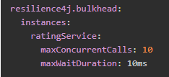
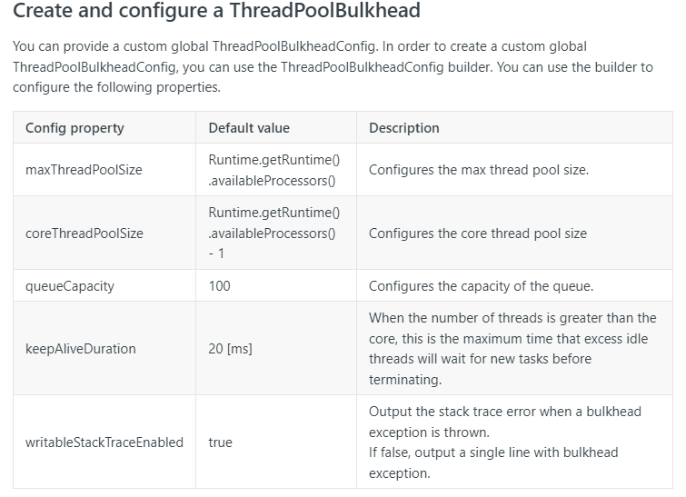
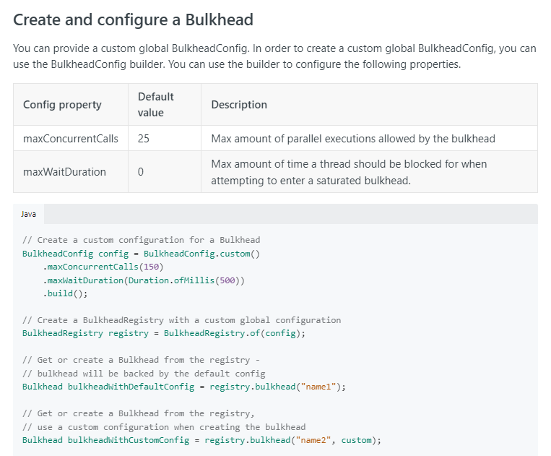
Bulkhead configs
maxConcurrentCalls: max number of concurrent calls allowed to rating-service.
maxWaitDuration: any additional requests will wait for the given duration. Otherwise it will go with default/fallback method.

Slide 9
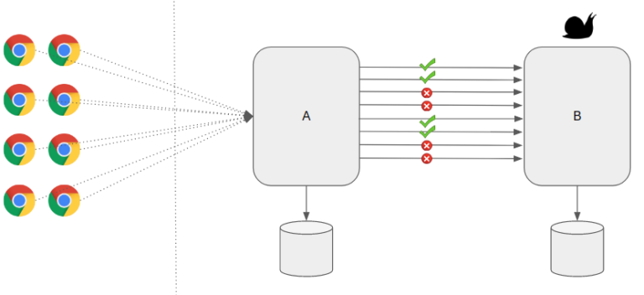
Rate limiter
Helps us to make our services highly available just by limiting the number of calls we could make/process in a specific window.
In other words, It helps us to control the throughput.
When we receive too many requests, the Service might simply reject the call. The client has to retry at a later time or can go with some default/cached values.

Slide 10
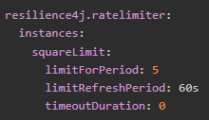
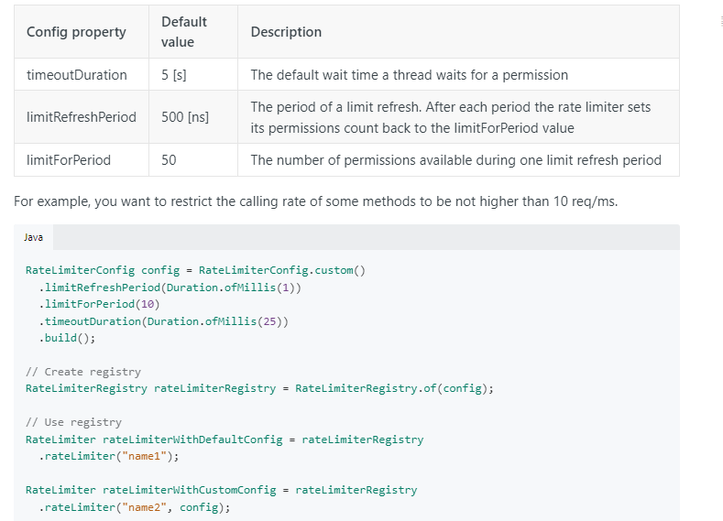
Rate limiter configs
Our compute service might have multiple endpoints. However we would like to limit the max number of calls for certain end points. For example, I would like to limit the calls for calculating squares to 5/minute.

Slide 11
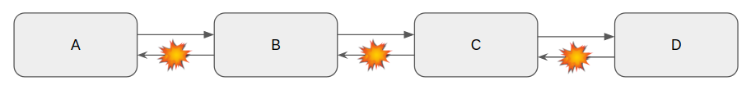
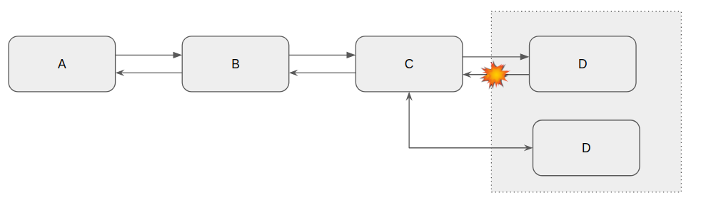
Retry
With Retry option, we have more chance for getting the proper response.

Slide 12
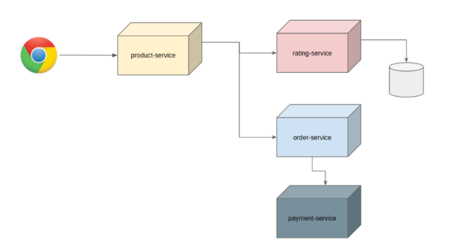
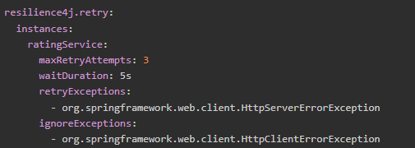
Retry configs
for ratingService, We will do max 3 retry attempts with 5 seconds delay.
retryExceptions: these are exceptions for which we would retry. It is an array field. You can have multiple exceptions configured.
ignoreExceptions: There are exceptions for which we might not want retry. For example, a bad request is a bad request. There is no point in retrying. So we ignore that.

Slide 13
TimeLimiter
Setting a limit on the amount of time we are willing to wait for an operation to complete is called time limiting.
If the operation does not complete within the time we specified, we want to be notified about it with a timeout error.
Sometimes, this is also referred to as “setting a deadline”.
Resilience4j’s TimeLimiter can be used to set time limits (timeouts) on asynchronous operations implemented with CompleteableFutures.

Slide 14
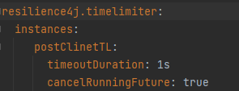
TimeLimiter configs
the timeout duration
whether cancel should be called on the running future

Slide 15
Reference
https://resilience4j.readme.io/
https://www.vinsguru.com/
https://steadybit.com/

