Slide 1




Video-Streaming Server side-Android client
By
Shabab Koohi
https://t.me/SnaCourses
https://github.com/shkna1368/
http://www.aparat.com/snacourse

Slide 2


Prerequisites
java 8
IntelliJ IDEA 2017
Android sdk
Android studio
Nox plaer 6+
VLC media player
Video Streaming

Slide 3
Video-Streaming
Content sent in compressed form over the Internet and displayed by the viewer in real time.
User does not have to wait to download a file to play it.
The user needs a player, which is a special program that uncompresses and sends video data to the display and audio data to speakers.
Streaming video is usually sent from prerecorded video files.
In a live broadcast, the video signal is converted into a compressed digital signal and transmitted from a special Web server that is able to do multicast, sending the same file to multiple users at the same time.
Video Streaming

Slide 4
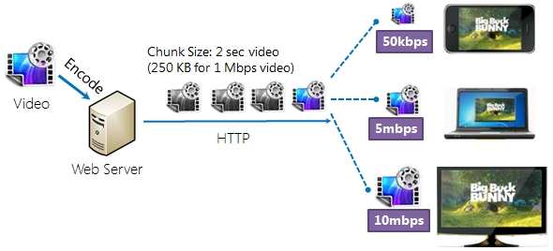
Video-Streaming
Video-Streaming

Slide 5
Protocols
The video stream is compressed using a video coding format to make the file size smaller.
Video coding formats include H.264, HEVC, VP8 or VP9.
Encoded audio and video streams are assembled in a container "bitstream" such as MP4, FLV, WebM, ASF or ISMA.
The bitstream is delivered from a streaming server to a streaming client
using a transport protocol, such as:
RTMP or RTP-HLS-Microsoft's Smooth Streaming-Adobe's HDS
Video Streaming

Slide 6
Adaptive bitrate
This technology will deliver the best quality that a viewer can support at any given time.
Video Streaming

Slide 7
HTTP Headers
HTTP headers allow the client and the server to pass additional information with the request or the response.
Content-Type:Indicates the media type of the resource.
Accept-Ranges: Indicates if the server supports range requests and if so, in which unit the range can be expressed.
Content-Range:Indicates where in a full body message a partial message belongs.
Content-Length: indicates the size of the entity-body, in decimal number of octets, sent to the recipient.
Video Streaming

Slide 8
Do Action
Talk is cheap. Show me the code
Video Streaming

