Slide 1


Slide 2
Business Problem
Toronto is the capital city of the Canadian province of Ontario. With a recorded population of 2,731,571, it is the most populous city in Canada and the fourth most populous city in North America.
The way we dine out has been transformed in the last decade with independent cafes and restaurants opening on every corner and food stalls booming throughout multiple cities.
We want to support our stakeholders in finding the optimal location within the city where to open a new restaurant
It is not so easy to decide on a venue for such a business: Beyond providing great food, wine, and service, your job is to find a place where food businesses start as an idea and quickly grow into a brick and mortar venue
We may presume that the majority of the existing restaurants are concentrated in the city centre and most touristic venues, to benefit from the influx of short-term visitors.
It may then be a good option to look for venues with fewer existing restaurants, so not to be hindered by excessive competition, so as to attract a clientele of national residents that are accustomed to varieties of cuisines and may build up a base of regular and affectionate clients.
We will then be working with the 39 Toronto neighbourhoods and use the “Foursquare API” to build a venue data analysis and subsequently to cluster the various locations in order to identify the most promising places for their business.

Slide 3
Data
We assemble the dataset containing the list of the 39 Toronto neighbourhoods with their postal codes
Python Geopy, used to get the coordinates for each of the Toronto neighbourhoods, in terms of latitude and longitude
Foursquare API, which is instrumental to derive and populate the most common venues and locations, we explored the venues associated to each Toronto neighbourhood, with a choice of radius of 500 m for each quartier and prepared a graph to depict the counts of venues per neighbourhood

Slide 4
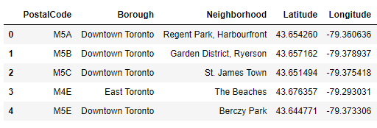
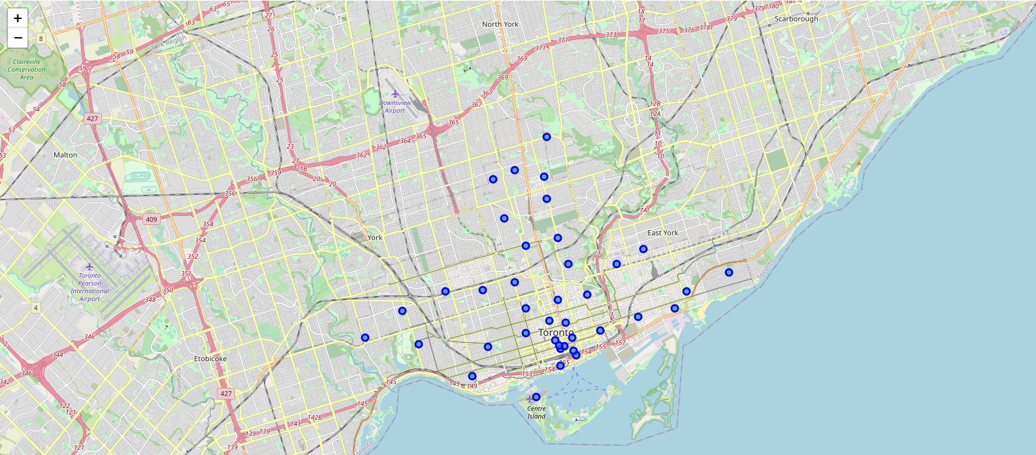
Inferential Statistical Analysis & Distribution Map

Slide 5
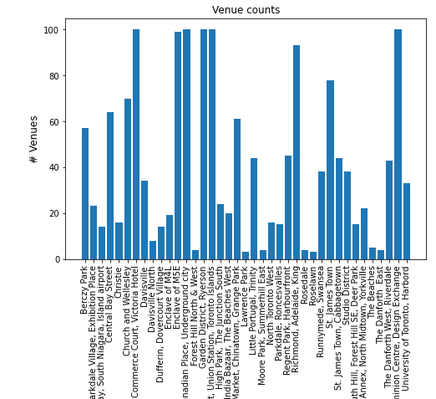
Venue distribution for each Neighbourhood

Slide 6
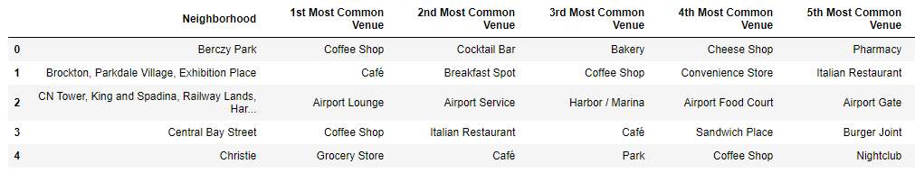
Most Common Venues
We identify the most common venues for each neighbourhood. This is also instrumental for our machine learning algorithm and for tackling our problem of finding the best location for a new restaurant
We can already infer some interesting conclusions : central neighbourhoods like ‘Central Bay Street’ have a high concentration of gastronomic venues, while places like ‘CN Tower, King and Spadina, Railway Lands’ do have airport related facilities.

Slide 7
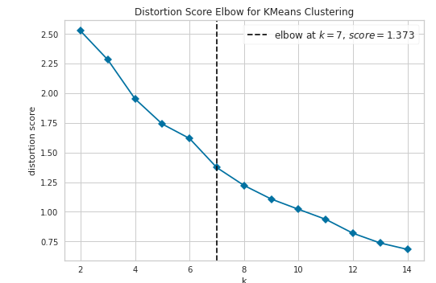
Machine Learning Analysis
We apply an unsupervised learning algorithm for clustering, K-Means.
We aim at identifying groups of venues that share characteristics in common. By grouping the different neighbourhoods in clusters, we may be able to identify if there is any particular set of locations which are more likely to be associated with restaurants or gastronomic businesses and therefore better suited for our new venture.
We start by performing an analysis to find out the optimal number of clusters by using the elbow algorithm.
In a range from 2 to 14, the optimal number of clusters is 7

Slide 8
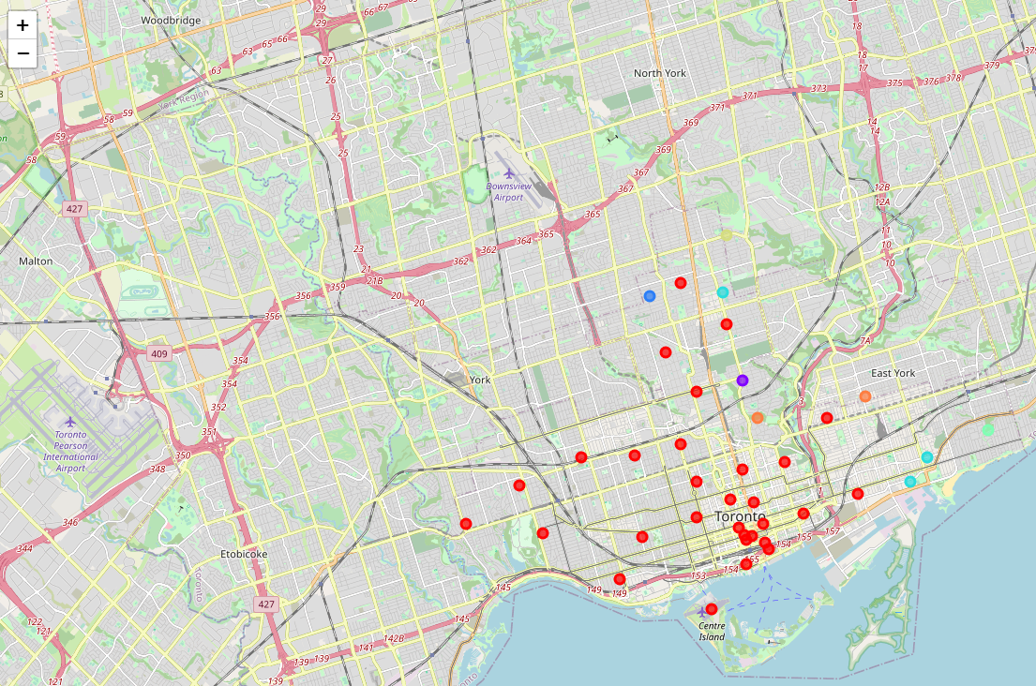
Clusters

Slide 9
Results
From our clusters we can infer that the best location for a new restaurant would be in the first cluster (purple blobs), the bars and restaurants area.
We want to focus on a more national clientele and avoid neighbourhoods which are already crowded with restaurants for tourists. Therefore, we search among the other neighbourhoods within the same cluster to ensure there are no existing restaurants among the top ten venues.
Moore Park, Summerhill East in Central Toronto borough is a good candidate for our client: it lies in the “Restaurant cluster
Moore Park is also quite centrally located and is one of Toronto's most affluent neighbourhoods with 4K residents and a growing population. We can therefore reinforce our suggestion also based on these considerations.

