Slide 1


A Neuro-Symbolic Multi-Agent Framework for Pre-Release Audience Response Generation in Bangla Cinema
A Verifier-in-the-Loop Approach
Presented by
Sabbir Hossain
ID: 21701082
Supervised by
Dr. Mohammad Shahadat Hossain
Professor
Department of Computer Science and Engineering
University of Chittagong
Chattogram-4331, Bangladesh

Slide 2
Background
01 Audience Commentary
Audience comments help explain how viewers interpret a film’s characters, events, and narrative. However, authentic responses to a film become available only after audiences have watched it.
02 Pre-release Generation
Before release, LLMs can generate plausible, audience-like responses in Bangla from film plots. This creates an opportunity to study pre-release response generation without claiming access to actual audience opinions.
03 Generation and Control
Fluent generation alone does not ensure that a response consistently expresses a requested characteristic. It also does not establish that the generated text represents genuine audience reception, preference, or behavior.
04 Bangla Research Context
This study uses a 5,000 raw Bangla movie-review corpus to examine textual response patterns. Since the corpus contains no movie-title or audience-demographic information, it supports controlled response generation, but not film-specific audience modelling or audience-group prediction.

Slide 3
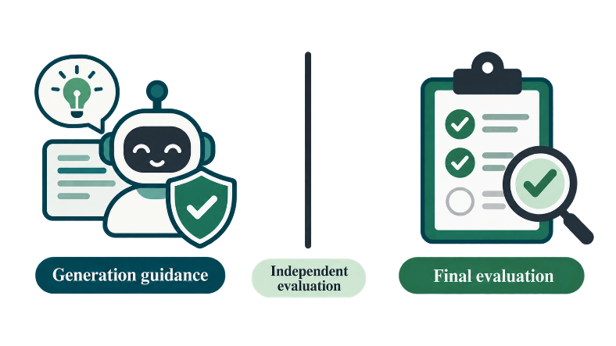

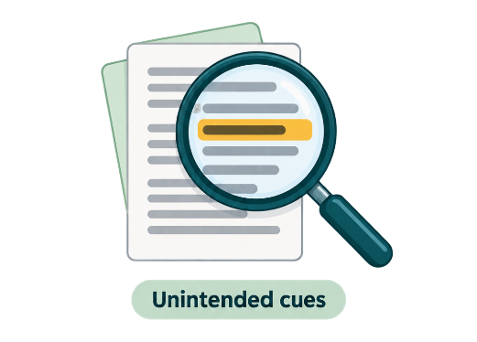
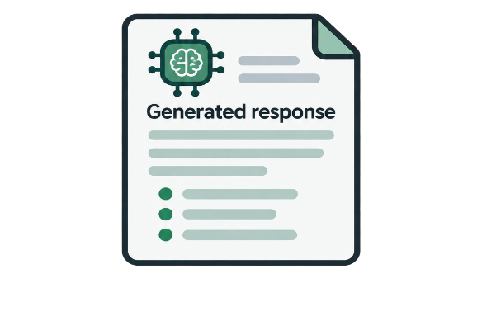
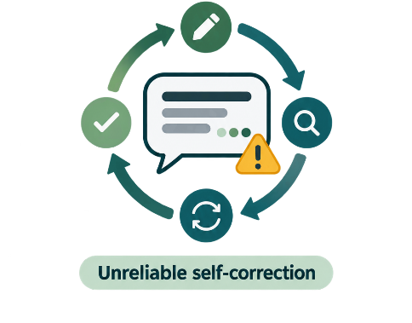
Motivation
2. Control May Depend on Unintended Cues
A generated response may satisfy a classifier because of superficial features, such as response length, rather than the intended response characteristics.
4. Evaluator Separation
Final outcomes require an evaluator outside the generation loop.
Prompting Does Not Guarantee Control
An LLM may be instructed to produce a general or plot-specific response, but the instruction alone cannot confirm that the requested distinction has been achieved.
3. Unreliable Self-correction
Revision may fail without external, task-specific feedback.
Research Need
To make Bangla cinema response generation controllable and auditable through external verification, bounded revision, and independent outcome evaluation.

Slide 4
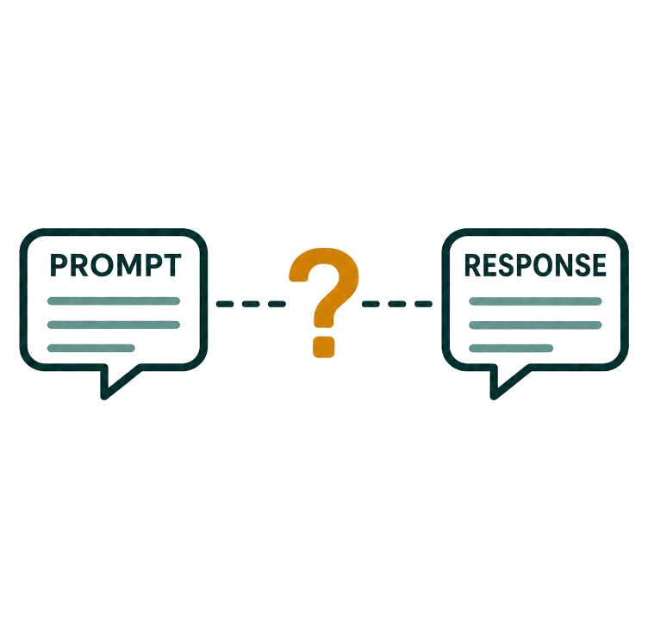
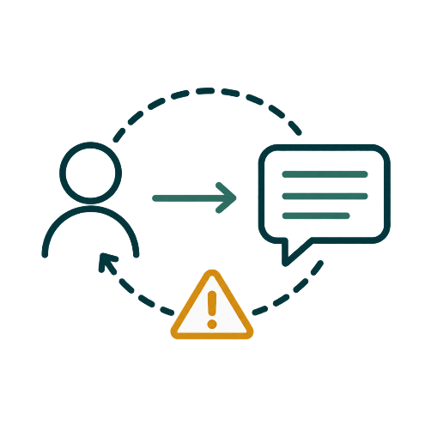

Problem Statement
Central Research Problem
The main problem is that prompting alone cannot ensure the requested level of engagement specificity. Even after revision, a higher score from the guiding verifier does not necessarily mean that a separate evaluator will find an improvement.
Connected Problem Dimensions
1. Construct Ambiguity
The target distinction may reflect sentiment, text length, or corpus artefacts rather than engagement specificity.
2. Control Uncertainty
Prompting alone cannot ensure that a response follows the requested engagement-specificity level.
3. Evaluation Circularity
The verifier guiding generation cannot independently certify the resulting improvement.

Slide 5
Research Aim and Objectives
Aim
To design and evaluate an auditable framework for controllable Bangla cinema response generation.
 | Study the Reviews | Identify a meaningful response distinction and check whether it reflects sentiment, length, or source differences.
 | Check Human Recognition | Test whether Bangla readers can recognize the distinction.
 | Separate Guidance and Evaluation | Use one verifier to guide generation and another to evaluate the outputs.
 | Build the Workflow | Combine retrieval, generation, verification, and feedback with a fixed revision limit.
 | Evaluate the Results | Measure response control, human recognition, computational cost, and disagreement between verifiers.
1
2
3
4
5

Slide 6
Research Questions
RQ1
Can we identify a stable response distinction in Bangla reviews that human readers can recognize?
RQ2
How much do the tested generation strategies improve control over the requested engagement specificity level compared with zero-shot generation?
RQ3
What role do symbolic rules play in accepting responses and guiding revisions?
RQ4
Does repeated revision guided by Verifier-A widen the gap between Verifier-A and Verifier-B scores?

Slide 7
Related Work and Research Gap
Approach | Task / Language | Retrieval | Revision Signal | Symbolic Diagnosis | Outcome Scorer Isolated? | Human / Outcome Evaluation
MoP | Population-conditioned text generation | — | Persona conditioning | — | — | Study-specific evaluation
FUDGE | Controlled text generation | — | Learned discriminator during decoding | — | — | Task metrics
Self-Refine | Multi-task refinement | — | Same-model self-feedback | — | — | Task-dependent human and automatic evaluation
HybridRAG-BN | Bangla knowledge-base QA | BM25 + BGE-M3 | Fine-tuned verifier and refiner | — | — | Competition token-F1
SymDiag | Multi-step reasoning | — | Symbolic diagnosis supports repair | Yes | No isolated A/B wall | Manually audited diagnosis
Present Study | Bangla cinema-response generation | R1 level-specific exemplars | Verifier-A + bounded feedback | Deterministic diagnostic rules | Verifier-B outside the loop | Construct study + blinded output study
Research Gap
Among the studies reviewed, these components have not been jointly evaluated for Bangla cinema-response generation with verifier isolation and blinded human validation.

Slide 8
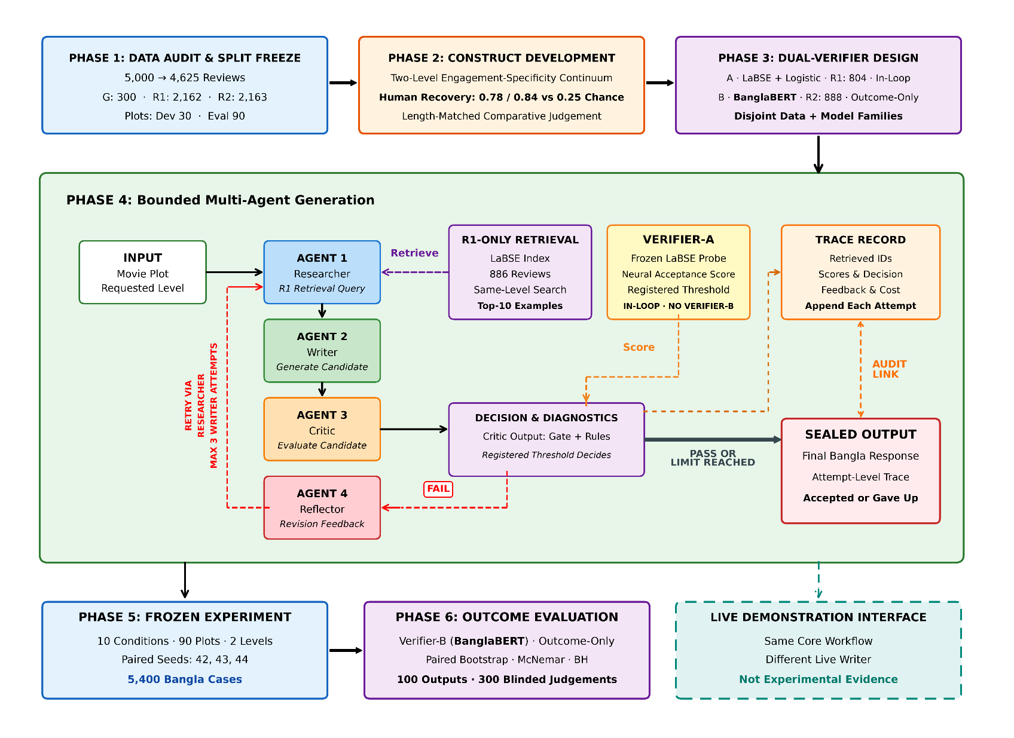
Methodology (Study Design)

Slide 9

Data Preparation and Axis Discovery
01 DATA PREPARATION
02 AXIS DISCOVERY
03 EVIDENCE & INTERPRETATION
5,000 | Raw Bangla reviews
4,730 | After rule-based quality control
- 105 | Near duplicates removed LaBSE cosine threshold = 0.95
4,625 | Frozen analysis surface
Region-A Reviews Region B retained as a negative control
LaBSE Representations Candidate cuts evaluated for K = 2–8
Multi-Diagnostic Assessment Stability · Separation · Density · Confounds
K = 2 Operational Cut Two levels carried to controlled generation
Reproducible Under the Registered Rule
Prediction strength: 0.8605
Pre-specified cutoff: ≥ 0.80
Bootstrap ARI: 0.9399 ± 0.0290
Not Discrete
Silhouette: 0.0534
Gap statistic: No K selected
HDBSCAN: 100% noise
Human-Recognizable
Intrusion accuracy: 0.780 / 0.840
Direction judgment: 0.850
Length heuristic: 0.160
Frozen Splits
Continuum cut—not natural groups
Gold-300: 300 · R1: 2,162 · R2: 2,163

Slide 10
Dual-Verifier Design
IN-LOOP CONTROLLER
OUTCOME EVALUATOR
Verifier-A
Frozen LaBSE encoder + L2-regularised logistic head
Trained on 804 labelled R1 reviews
Scores drafts inside the generation loop
Supports acceptance and bounded retry
Selects candidates only where registered
Verifier-B
BanglaBERT · fine-tuned from scratch
Trained on 888 disjoint R2 reviews
Scores sealed outputs after generation
Has no access to retrieval or prompts
Cannot provide feedback or trigger regeneration
PRIVILEGE ISOLATION

Slide 11
Experimental Design
Design Role | Conditions | What the Comparison Tests?
Reference | Zero-shot | Performance without examples or generation control
Example Conditioning | Static few-shot RAG-only | Random examples versus level-specific retrieval
Gated Revision | Neural gate Symbolic gate Neural gate + symbolic feedback | Acceptance control and the role of diagnostic feedback
Alternative Controls | Intrinsic self-critique External-role self-critique Hosted-judge loop Budget-matched blind resampling | Revision versus critique, stronger judging and additional sampling
Evaluation Surface
90 | Held-out plots
2 | Requested axis levels
10 | Experimental conditions
3 | Paired replicates
5,400 | Bangla cases
Outcome | Pairing | Confirmatory Family | Inference
Verifier-B target probability | Plot × level × replicate | 9 active conditions vs zero-shot | Bootstrap · McNemar · BH

Slide 12
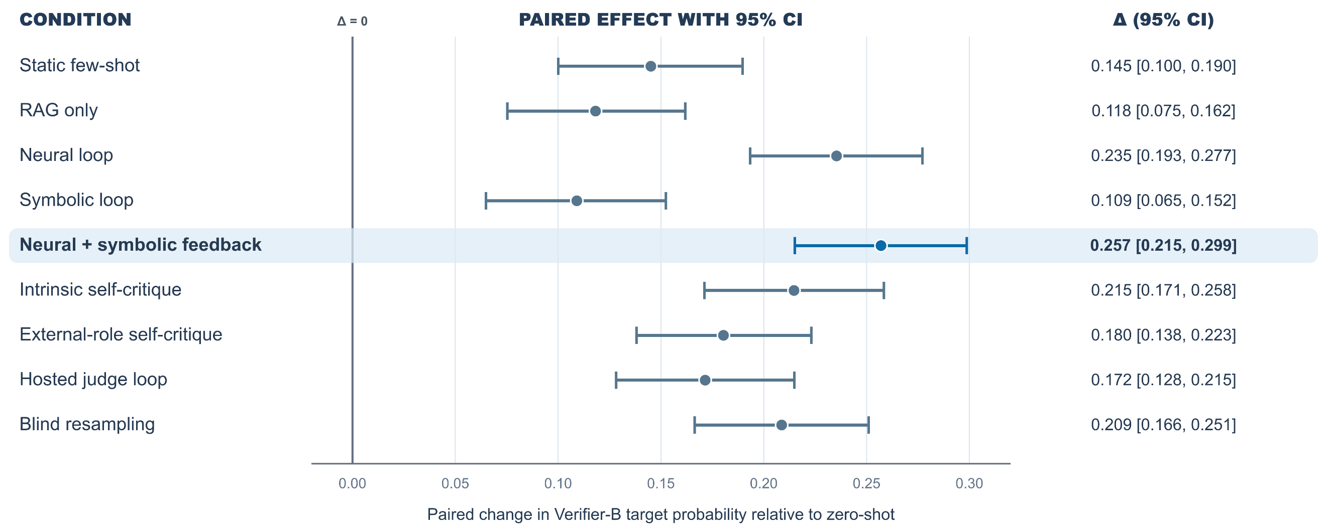
Experimental Results
All nine preregistered contrasts were positive, with 95% paired-bootstrap intervals excluding zero.

Slide 13
Human Evaluation
3 native Bangla-speaking annotators • 100 blinded outputs • 300 judgments
POOLED HUMAN JUDGMENTS 91.3% Requested-level accuracy 95% CI [86.7%, 95.7%]
INTER-RATER AGREEMENT Krippendorff’s α = 0.841 95% CI [0.747, 0.920]
Instrument | Level 0 | Level 1 | L1 − L0
Human majority | 0.92 | 0.92 | 0.00
Verifier-A | 0.70 | 0.84 | +0.14
Verifier-B | 0.60 | 0.90 | +0.30

Slide 14
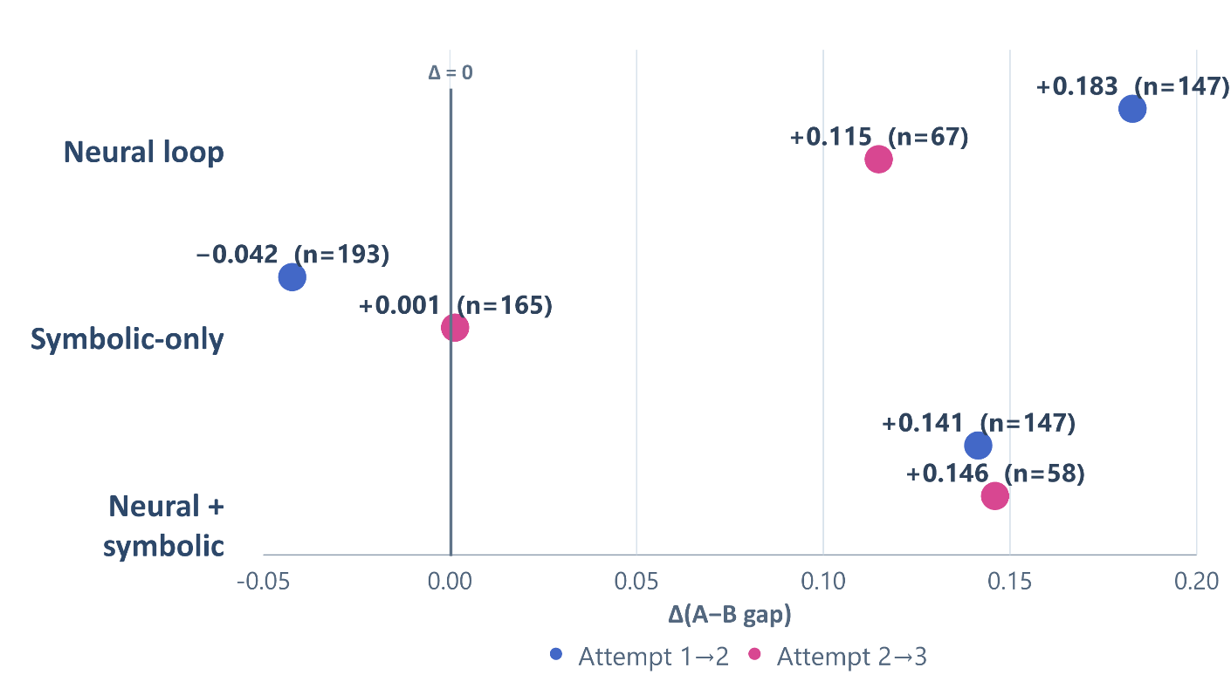
Diagnostic Findings
Symbolic Roles
Verifier Divergence
SYMBOLIC-ONLY ACCEPTANCE GATE
Level-0 accuracy: 0.5185
Level-1 give-up rate: 53.33%
HYBRID − NEURAL-ONLY
Δ target probability: +0.02159
Δ binary accuracy: +0.02037
Exact McNemar: p = 0.11728
No statistically significant difference

Slide 15
Research Contributions
 | Verifier Isolation | Separated the in-loop Verifier-A from the held-out Verifier-B, making proxy divergence observable.
 | Bounded and Auditable Generation | Developed a Researcher–Writer–Critic–Reflector workflow with bounded revision, recorded compute, and attempt-level traces.
 | Construct and Measurement Validation | Rejected the unsupported persona interpretation and retained a human-recognizable two-level operational distinction—not natural audience clusters.
 | Blinded Human Evidence | Demonstrated requested-level recoverability through 300 blinded judgments from native Bangla-speaking annotators.
 | Functional Role of Symbolic Information | Distinguished symbolic diagnosis from adjudication: symbolic-only gating was weak, while diagnostic feedback provided an interpretable correction mechanism.
1
2
3
4
5

Slide 16
Limitations and Future Work
LIMITATIONS
FUTURE WORK
Limited Human Sample: Three native Bangla-speaking annotators assessed 100 outputs, producing 300 judgments.
Length–Level Entanglement: Generated response length remains associated with the requested engagement-specificity level.
Proxy-Based Evaluation: Verifier-B is an isolated outcome measure—not human ground truth.
Unconfirmed Symbolic Advantage: The hybrid loop was not shown to outperform the neural-only loop in a confirmatory test.
No Film-Linked Ground Truth: The corpus contains no film identifiers or real pre-release audience responses.
Recruit a larger and more diverse human sample with prospective ethics documentation.
Develop length-neutral controls and test whether the requested distinction remains recoverable.
Stress-test both verifiers and validate their scores against human judgments.
Preregister a powered direct comparison between the neural-only and hybrid loops.
Collect film-linked audience data before making any audience-prediction claim.

Slide 17
Conclusion
Construct: A reproducible Region-A continuum cut was human-recognizable under length-matched comparative judgment, but it was not a natural audience cluster and generated length remained entangled with the requested level.
Controlled generation: All nine registered alternatives increased sealed Verifier-B target probability relative to zero-shot; on the balanced 100-item subset, readers achieved 91.3% target-level match.
Symbolic role: Symbolic-only acceptance gating was weak. Symbolic rules were more defensible as diagnostic revision guidance, but hybrid superiority over the neural-only loop was not established.
Verifier risk: In the two neural-gated loops, Verifier-A–Verifier-B gaps widened across revisions, consistent with proxy overoptimization—not evidence of declining human-perceived quality.

Slide 18
THANK
YOU!

Slide 19
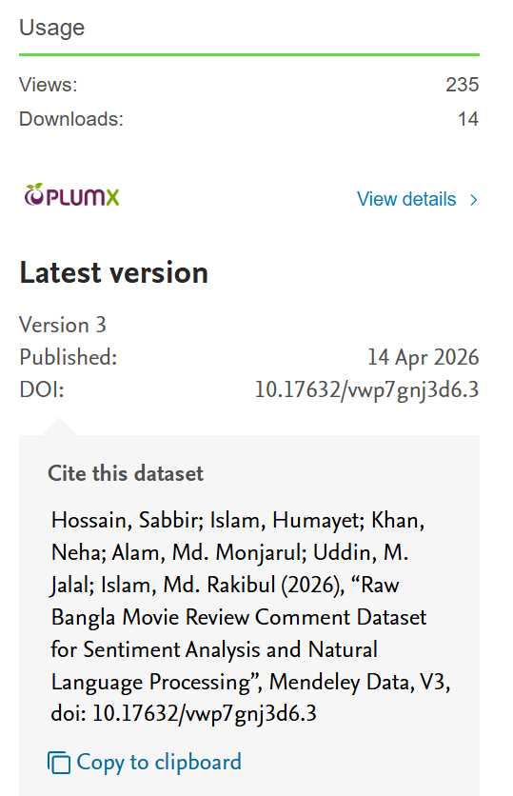
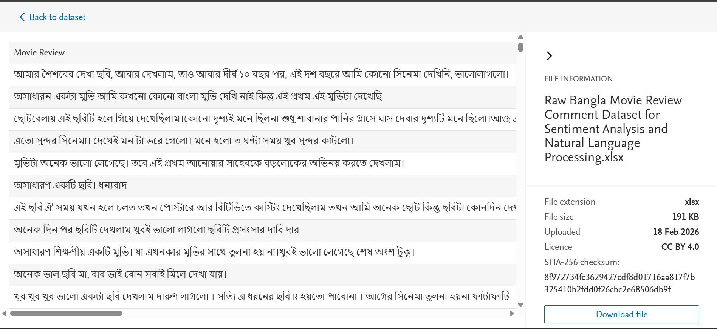
Additional Slides (Dataset)

Slide 20
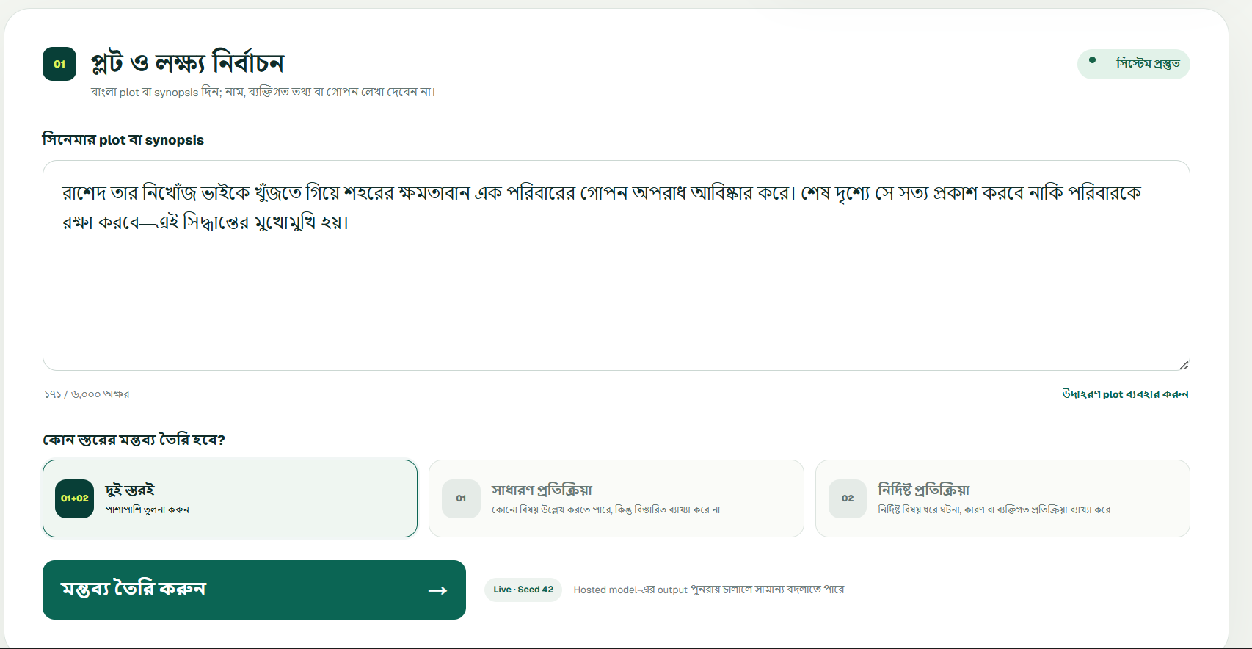
Additional Slide (Interface)

Slide 21
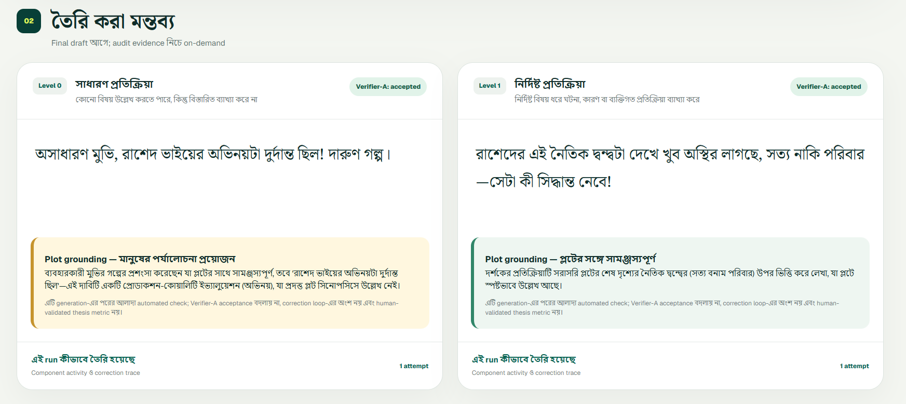
Additional Slide (Interface)

