Slide 1
Computer Vision and Deep Learning Data Classification (2nd Presentation)
By Arman Ahmed Khan (230601)
Shailesh Kumar (229916)

Slide 2
These are the following techniques and ways we decided to choose to complete our project:
Programming Language: Python with TensorFlow, CNN and Keras etc.
Feature Extraction Techniques: Convolutional Neural Network (CNN) with maxpooling and Batch normalization layers on sequential model using keras and Tensorflow python libraries.
Classification Method: ANN and Dropout layers with sequential model using keras and Tensorflow python libraries.
We will compare the results from each feature extraction and classification techniques to evaluate the model on the basis of overall Computation time and accuracy

Slide 3
Python Code
from keras.preprocessing.image import ImageDataGenerator
# create a new generator
imagegen = ImageDataGenerator()
# load train data
train = imagegen.flow_from_directory(r'/imagenette2-160/train/', class_mode="categorical", shuffle=False, batch_size=128, target_size=(224, 224))
# load val data
val = imagegen.flow_from_directory(r'/imagenette2-160/val/', class_mode="categorical", shuffle=False, batch_size=128, target_size=(224, 224))
from keras.models import Sequential
from keras.layers import Conv2D, MaxPool2D, Flatten, Dense, InputLayer, BatchNormalization, Dropout
# build a sequential model
model = Sequential()
model.add(InputLayer(input_shape=(224, 224, 3)))
# 1st conv block
model.add(Conv2D(25, (5, 5), activation='relu', strides=(1, 1), padding='same'))
model.add(MaxPool2D(pool_size=(2, 2), padding='same'))
Used ImageDataGenerator for preprocessing of images like making mean 0 and a variance of 1 allows to have a normalized input images into batches. This process is called data augmentation
Here we are using (224, 224, 3) because the image in the dataset are 224x224 in dimension and 3 as in RGB
Convolution layer are used with 25 different filters to extract features
This process is repeated 3 time to extract as many features as possible but not the unnecessary or redundant features
Increasing or decreasing the convolution layer increase or decreases the computation time respectively.
Because of the limited capability of our laptop we kept the layer count to 3
MaxPool layer take the maximum value out of 4 values as we gave the size (2,2)
RELU activation function is used here
Padding of ‘Same’ just put ‘0’ across the dimension of the image.
Notes:
ImageDataGenerator() : Generate batches of tensor image data with real-time data augmentation.
The data will be looped over (in batches).
Args: featurewise_center: Boolean. Set input mean to 0 over the dataset, feature-wise. samplewise_center: Boolean. Set each sample mean to 0. featurewise_std_normalization: Boolean. Divide inputs by std of the dataset, feature-wise. samplewise_std_normalization: Boolean. Divide each input by its std. zca_epsilon: epsilon for ZCA whitening. Default is 1e-6. zca_whitening: Boolean. Apply ZCA whitening. rotation_range: Int. Degree range for random rotations. width_shift_range: Float, 1-D array-like or int - float: fraction of total width, if < 1, or pixels if >= 1. - 1-D array-like: random elements from the array. - int: integer number of pixels from interval (-width_shift_range, +width_shift_range) - With width_shift_range=2 possible values are integers [-1, 0, +1], same as with width_shift_range=[-1, 0, +1], while with width_shift_range=1.0 possible values are floats in the interval [-1.0, +1.0). height_shift_range: Float, 1-D array-like or int - float: fraction of total height, if < 1, or pixels if >= 1. - 1-D array-like: random elements from the array. - int: integer number of pixels from interval (-height_shift_range, +height_shift_range) - With height_shift_range=2 possible values are integers [-1, 0, +1], same as with height_shift_range=[-1, 0, +1], while with height_shift_range=1.0 possible values are floats in the interval [-1.0, +1.0). brightness_range: Tuple or list of two floats. Range for picking a brightness shift value from. shear_range: Float. Shear Intensity (Shear angle in counter-clockwise direction in degrees) zoom_range: Float or [lower, upper]. Range for random zoom. If a float, [lower, upper] = [1-zoom_range, 1+zoom_range]. channel_shift_range: Float. Range for random channel shifts. fill_mode: One of {"constant", "nearest", "reflect" or "wrap"}. Default is 'nearest'. Points outside the boundaries of the input are filled according to the given mode: - 'constant': kkkkkkkk|abcd|kkkkkkkk (cval=k) - 'nearest': aaaaaaaa|abcd|dddddddd - 'reflect': abcddcba|abcd|dcbaabcd - 'wrap': abcdabcd|abcd|abcdabcd cval: Float or Int. Value used for points outside the boundaries when fill_mode = "constant". horizontal_flip: Boolean. Randomly flip inputs horizontally. vertical_flip: Boolean. Randomly flip inputs vertically. rescale: rescaling factor. Defaults to None. If None or 0, no rescaling is applied, otherwise we multiply the data by the value provided (after applying all other transformations). preprocessing_function: function that will be applied on each input. The function will run after the image is resized and augmented. The function should take one argument: one image (Numpy tensor with rank 3), and should output a Numpy tensor with the same shape. data_format: Image data format, either "channels_first" or "channels_last". "channels_last" mode means that the images should have shape (samples, height, width, channels), "channels_first" mode means that the images should have shape (samples, channels, height, width). It defaults to the image_data_format value found in your Keras config file at ~/.keras/keras.json. If you never set it, then it will be "channels_last". validation_split: Float. Fraction of images reserved for validation (strictly between 0 and 1). dtype: Dtype to use for the generated arrays.
Raises: ValueError: If the value of the argument, data_format is other than "channels_last" or "channels_first". ValueError: If the value of the argument, validation_split > 1 or validation_split < 0.
flow_from_directory() : Takes the path to a directory & generates batches of augmented data.
flow_from_directory: (directory, target_size=(256, 256), color_mode='rgb', classes=None, class_mode='categorical', batch_size=32, shuffle=True, seed=None, save_to_dir=None, save_prefix='', save_format='png', follow_links=False, subset=None, interpolation='nearest') -> DirectoryIterator
Args: directory: string, path to the target directory. It should contain one subdirectory per class. Any PNG, JPG, BMP, PPM or TIF images inside each of the subdirectories directory tree will be included in the generator
Sequential() : Sequential groups a linear stack of layers into a tf.keras.Model.
Sequential provides training and inference features on this model.
model.add() : Adds a layer instance on top of the layer stack.
Conv2D() : 2D convolution layer (e.g. spatial convolution over images).
Conv2D(filters, kernel_size, strides=(1, 1), padding='valid', data_format=None, dilation_rate=(1, 1), groups=1, activation=None, use_bias=True, kernel_initializer='glorot_uniform', bias_initializer='zeros', kernel_regularizer=None, bias_regularizer=None, activity_regularizer=None, kernel_constraint=None, bias_constraint=None, **kwargs)
This layer creates a convolution kernel that is convolved with the layer input to produce a tensor of outputs. If use_bias is True, a bias vector is created and added to the outputs. Finally, if activation is not None, it is applied to the outputs as well.
When using this layer as the first layer in a model, provide the keyword argument input_shape (tuple of integers or None, does not include the sample axis), e.g. input_shape=(128, 128, 3) for 128x128 RGB pictures in data_format="channels_last". You can use None when a dimension has variable size.

Slide 4
Python code cont’d
# 2nd conv block
model.add(Conv2D(50, (5, 5), activation='relu', strides=(2, 2), padding='same'))
model.add(MaxPool2D(pool_size=(2, 2), padding='same'))
model.add(BatchNormalization())
# 3rd conv block
model.add(Conv2D(70, (3, 3), activation='relu', strides=(2, 2), padding='same'))
model.add(MaxPool2D(pool_size=(2, 2), padding='valid'))
model.add(BatchNormalization())
# ANN block
model.add(Flatten())
model.add(Dense(units=100, activation='relu'))
model.add(Dense(units=100, activation='relu'))
model.add(Dropout(0.25))
BatchNormalization is used to have the values to be passed to the next layer after activation function to have a mean 0 with variance = 1, this tackles the problem of vanishing gradient
Flatten function make the data into an array of 1D
To be given to the ANN fully connected Dense layer with 100 neurons
Droupout layer is used to avoid overfitting and it randomly sets input units to 0 with a frequency of rate at each step during training time, which helps prevent overfitting. Inputs not set to 0 are scaled up by 1/(1 - rate) such that the sum over all inputs is unchanged.
Notes:
MaxPool2D() : Max pooling operation for 2D spatial data.
Downsamples the input along its spatial dimensions (height and width) by taking the maximum value over an input window (of size defined by pool_size) for each channel of the input. The window is shifted by strides along each dimension.
The resulting output, when using the "valid" padding option, has a spatial shape (number of rows or columns) of: output_shape = math.floor((input_shape - pool_size) / strides) + 1 (when input_shape >= pool_size)
The resulting output shape when using the "same" padding option is: output_shape = math.floor((input_shape - 1) / strides) + 1
For example, for strides=(1, 1) and padding="valid":
BatchNormalization() : used to have the values to be passed to the next layer after activation function to have a mean 0 with variance = 1, this tackles the problem of vanishing gradient
BatchNormalization(axis=-1, momentum=0.99, epsilon=0.001, center=True, scale=True, beta_initializer='zeros', gamma_initializer='ones', moving_mean_initializer='zeros', moving_variance_initializer='ones', beta_regularizer=None, gamma_regularizer=None, beta_constraint=None, gamma_constraint=None, renorm=False, renorm_clipping=None, renorm_momentum=0.99, fused=None, trainable=True, virtual_batch_size=None, adjustment=None, name=None, **kwargs)
Flatten() : Flattens the input. Does not affect the batch size.
Note: If inputs are shaped (batch,) without a feature axis, then flattening adds an extra channel dimension and output shape is (batch, 1).
Args: data_format: A string, one of channels_last (default) or channels_first. The ordering of the dimensions in the inputs. channels_last corresponds to inputs with shape (batch, ..., channels) while channels_first corresponds to inputs with shape (batch, channels, ...). It defaults to the image_data_format value found in your Keras config file at ~/.keras/keras.json. If you never set it, then it will be "channels_last".
Dense() : Just your regular densely-connected NN layer.
Dense implements the operation: output = activation(dot(input, kernel) + bias) where activation is the element-wise activation function passed as the activation argument, kernel is a weights matrix created by the layer, and bias is a bias vector created by the layer (only applicable if use_bias is True). These are all attributes of Dense.
Note: If the input to the layer has a rank greater than 2, then Dense computes the dot product between the inputs and the kernel along the last axis of the inputs and axis 0 of the kernel (using tf.tensordot). For example, if input has dimensions (batch_size, d0, d1), then we create a kernel with shape (d1, units), and the kernel operates along axis 2 of the input, on every sub-tensor of shape (1, 1, d1) (there are batch_size * d0 such sub-tensors). The output in this case will have shape (batch_size, d0, units).
Besides, layer attributes cannot be modified after the layer has been called once (except the trainable attribute). When a popular kwarg input_shape is passed, then keras will create an input layer to insert before the current layer. This can be treated equivalent to explicitly defining an InputLayer.
ex : Dense(units, activation=None, use_bias=True, kernel_initializer='glorot_uniform', bias_initializer='zeros', kernel_regularizer=None, bias_regularizer=None, activity_regularizer=None, kernel_constraint=None, bias_constraint=None, **kwargs)
Dropout(rate, noise_shape=None, seed=None, **kwargs)
Applies Dropout to the input.
The Dropout layer randomly sets input units to 0 with a frequency of rate at each step during training time, which helps prevent overfitting. Inputs not set to 0 are scaled up by 1/(1 - rate) such that the sum over all inputs is unchanged.
Note that the Dropout layer only applies when training is set to True such that no values are dropped during inference. When using model.fit, training will be appropriately set to True automatically, and in other contexts, you can set the kwarg explicitly to True when calling the layer.
(This is in contrast to setting trainable=False for a Dropout layer. trainable does not affect the layer's behavior, as Dropout does not have any variables/weights that can be frozen during training.)

Slide 5
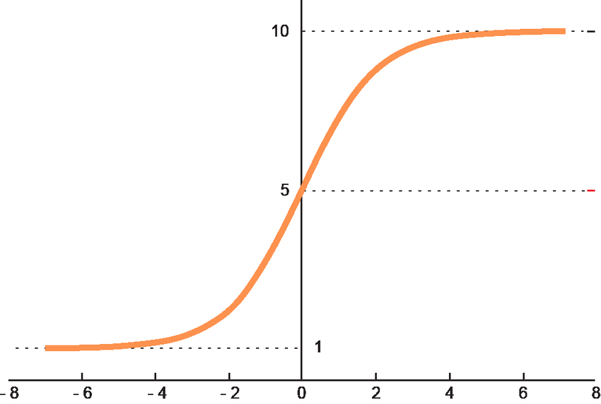
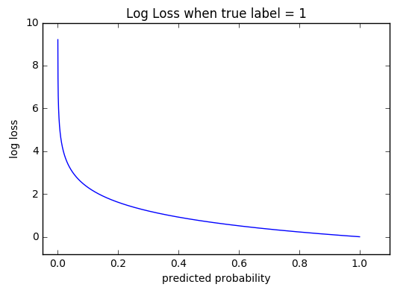
Python code cont’d
SoftMax is another type of activation function
Adam is an optimization algorithm that can be used instead of the classical stochastic gradient descent procedure to update network weights iterative based in training data.
Cross-entropy loss, or log loss, measures the performance of a classification model whose output is a probability value between 0 and 1. Cross-entropy loss increases as the predicted probability diverges from the actual label. So predicting a probability of .012 when the actual observation label is 1 would be bad and result in a high loss value. A perfect model would have a log loss of 0.
# output layer
model.add(Dense(units=10, activation='softmax'))
model.summary()
# compile model
model.compile(loss='categorical_crossentropy', optimizer="adam", metrics=['accuracy'])
# fit on data for 30 epochs
model.fit_generator(train, epochs=30, validation_data=val)
# Save the model to disk.
model.save_weights('img_cla')
# extract train and val features
features_train = model.predict(train)
features_val = model.predict(val)
Notes:
The graph above shows the range of possible loss values given a true observation (isDog = 1). As the predicted probability approaches 1, log loss slowly decreases. As the predicted probability decreases, however, the log loss increases rapidly. Log loss penalizes both types of errors, but especially those predictions that are confident and wrong!
model.summary() : Prints a string summary of the network.
Args: line_length: Total length of printed lines (e.g. set this to adapt the display to different terminal window sizes). positions: Relative or absolute positions of log elements in each line. If not provided, defaults to [.33, .55, .67, 1.]. print_fn: Print function to use. Defaults to print. It will be called on each line of the summary. You can set it to a custom function in order to capture the string summary. expand_nested: Whether to expand the nested models. If not provided, defaults to False.
Model.Compile() : Configures the model for training.
compile: (optimizer='rmsprop', loss=None, metrics=None, loss_weights=None, weighted_metrics=None, run_eagerly=None, steps_per_execution=None, **kwargs)
Example:
model.compile(optimizer=tf.keras.optimizers.Adam(learning_rate=1e-3), loss=tf.keras.losses.BinaryCrossentropy(), metrics=[tf.keras.metrics.BinaryAccuracy(), tf.keras.metrics.FalseNegatives()])
Args: optimizer: String (name of optimizer) or optimizer instance. See tf.keras.optimizers. loss: Loss function. Maybe be a string (name of loss function), or a tf.keras.losses.Loss instance. See tf.keras.losses. A loss function is any callable with the signature loss = fn(y_true, y_pred), where y_true are the ground truth values, and y_pred are the model's predictions. y_true should have shape (batch_size, d0, .. dN) (except in the case of sparse loss functions such as sparse categorical crossentropy which expects integer arrays of shape (batch_size, d0, .. dN-1)). y_pred should have shape (batch_size, d0, .. dN). The loss function should return a float tensor. If a custom Loss instance is used and reduction is set to None, return value has shape (batch_size, d0, .. dN-1) i.e. per-sample or per-timestep loss values; otherwise, it is a scalar. If the model has multiple outputs, you can use a different loss on each output by passing a dictionary or a list of losses. The loss value that will be minimized by the model will then be the sum of all individual losses, unless loss_weights is specified. metrics: List of metrics to be evaluated by the model during training and testing. Each of this can be a string (name of a built-in function), function or a tf.keras.metrics.Metric instance. See tf.keras.metrics. Typically you will use metrics=['accuracy']. A function is any callable with the signature result = fn(y_true, y_pred). To specify different metrics for different outputs of a multi-output model, you could also pass a dictionary, such as metrics={'output_a': 'accuracy', 'output_b': ['accuracy', 'mse']}. You can also pass a list to specify a metric or a list of metrics for each output, such as metrics=[['accuracy'], ['accuracy', 'mse']] or metrics=['accuracy', ['accuracy', 'mse']]. When you pass the strings 'accuracy' or 'acc', we convert this to one of tf.keras.metrics.BinaryAccuracy, tf.keras.metrics.CategoricalAccuracy, tf.keras.metrics.SparseCategoricalAccuracy based on the loss function used and the model output shape. We do a similar conversion for the strings 'crossentropy' and 'ce' as well. loss_weights: Optional list or dictionary specifying scalar coefficients (Python floats) to weight the loss contributions of different model outputs. The loss value that will be minimized by the model will then be the *weighted sum* of all individual losses, weighted by the loss_weights coefficients. If a list, it is expected to have a 1:1 mapping to the model's outputs. If a dict, it is expected to map output names (strings) to scalar coefficients. weighted_metrics: List of metrics to be evaluated and weighted by sample_weight or class_weight during training and testing. run_eagerly: Bool. Defaults to False. If True, this Model's logic will not be wrapped in a tf.function. Recommended to leave this as None unless your Model cannot be run inside a tf.function. run_eagerly=True is not supported when using tf.distribute.experimental.ParameterServerStrategy. steps_per_execution: Int. Defaults to 1. The number of batches to run during each tf.function call. Running multiple batches inside a single tf.function call can greatly improve performance on TPUs or small models with a large Python overhead. At most, one full epoch will be run each execution. If a number larger than the size of the epoch is passed, the execution will be truncated to the size of the epoch. Note that if steps_per_execution is set to N, Callback.on_batch_begin and Callback.on_batch_end methods will only be called every N batches (i.e. before/after each tf.function execution). **kwargs: Arguments supported for backwards compatibility only.
model.fit_generator() : Fits the model on data yielded batch-by-batch by a Python generator.
fit_generator: (generator, steps_per_epoch=None, epochs=1, verbose=1, callbacks=None, validation_data=None, validation_steps=None, validation_freq=1, class_weight=None, max_queue_size=10, workers=1, use_multiprocessing=False, shuffle=True, initial_epoch=0) -> Any
model.save_weights() : Saves all layer weights.
Either saves in HDF5 or in TensorFlow format based on the save_format argument.
save_weights: (filepath, overwrite=True, save_format=None, options=None) -> Any
When saving in HDF5 format, the weight file has:
layer_names (attribute), a list of strings (ordered names of model layers).
For every layer, a group named layer.name
For every such layer group, a group attribute weight_names, a list of strings (ordered names of weights tensor of the layer).
For every weight in the layer, a dataset storing the weight value, named after the weight tensor.
When saving in TensorFlow format, all objects referenced by the network are saved in the same format as tf.train.Checkpoint, including any Layer instances or Optimizer instances assigned to object attributes. For networks constructed from inputs and outputs using tf.keras.Model(inputs, outputs), Layer instances used by the network are tracked/saved automatically. For user-defined classes which inherit from tf.keras.Model, Layer instances must be assigned to object attributes, typically in the constructor. See the documentation of tf.train.Checkpoint and tf.keras.Model for details.
While the formats are the same, do not mix save_weights and tf.train.Checkpoint. Checkpoints saved by Model.save_weights should be loaded using Model.load_weights. Checkpoints saved using tf.train.Checkpoint.save should be restored using the corresponding tf.train.Checkpoint.restore. Prefer tf.train.Checkpoint over save_weights for training checkpoints.
The TensorFlow format matches objects and variables by starting at a root object, self for save_weights, and greedily matching attribute names. For Model.save this is the Model, and for Checkpoint.save this is the Checkpoint even if the Checkpoint has a model attached. This means saving a tf.keras.Model using save_weights and loading into a tf.train.Checkpoint with a Model attached (or vice versa) will not match the Model's variables. See the guide to training checkpoints for details on the TensorFlow format.
Args: filepath: String or PathLike, path to the file to save the weights to. When saving in TensorFlow format, this is the prefix used for checkpoint files (multiple files are generated). Note that the '.h5' suffix causes weights to be saved in HDF5 format. overwrite: Whether to silently overwrite any existing file at the target location, or provide the user with a manual prompt. save_format: Either 'tf' or 'h5'. A filepath ending in '.h5' or '.keras' will default to HDF5 if save_format is None. Otherwise None defaults to 'tf'. options: Optional tf.train.CheckpointOptions object that specifies options for saving weights.
Raises: ImportError: If h5py is not available when attempting to save in HDF5 format.
Model.predict() : Generates output predictions for the input samples.
Computation is done in batches. This method is designed for performance in large scale inputs. For small amount of inputs that fit in one batch, directly using __call__() is recommended for faster execution, e.g., model(x), or model(x, training=False) if you have layers such as tf.keras.layers.BatchNormalization that behaves differently during inference. Also, note the fact that test loss is not affected by regularization layers like noise and dropout.
Args: x: Input samples. It could be:
A Numpy array (or array-like), or a list of arrays (in case the model has multiple inputs).
A TensorFlow tensor, or a list of tensors (in case the model has multiple inputs).
A tf.data dataset.
A generator or keras.utils.Sequence instance. A more detailed description of unpacking behavior for iterator types (Dataset, generator, Sequence) is given in the Unpacking behavior for iterator-like inputs section of Model.fit. batch_size: Integer or None. Number of samples per batch. If unspecified, batch_size will default to 32. Do not specify the batch_size if your data is in the form of dataset, generators, or keras.utils.Sequence instances (since they generate batches). verbose: Verbosity mode, 0 or 1. steps: Total number of steps (batches of samples) before declaring the prediction round finished. Ignored with the default value of None. If x is a tf.data dataset and steps is None, predict() will run until the input dataset is exhausted. callbacks: List of keras.callbacks.Callback instances. List of callbacks to apply during prediction. See callbacks. max_queue_size: Integer. Used for generator or keras.utils.Sequence input only. Maximum size for the generator queue. If unspecified, max_queue_size will default to 10. workers: Integer. Used for generator or keras.utils.Sequence input only. Maximum number of processes to spin up when using process-based threading. If unspecified, workers will default to 1. use_multiprocessing: Boolean. Used for generator or keras.utils.Sequence input only. If True, use process-based threading. If unspecified, use_multiprocessing will default to False. Note that because this implementation relies on multiprocessing, you should not pass non-picklable arguments to the generator as they can't be passed easily to children processes.
See the discussion of Unpacking behavior for iterator-like inputs for Model.fit. Note that Model.predict uses the same interpretation rules as Model.fit and Model.evaluate, so inputs must be unambiguous for all three methods.
Returns: Numpy array(s) of predictions.
Raises: RuntimeError: If model.predict is wrapped in a tf.function. ValueError: In case of mismatch between the provided input data and the model's expectations, or in case a stateful model receives a number of samples that is not a multiple of the batch size.

Slide 6

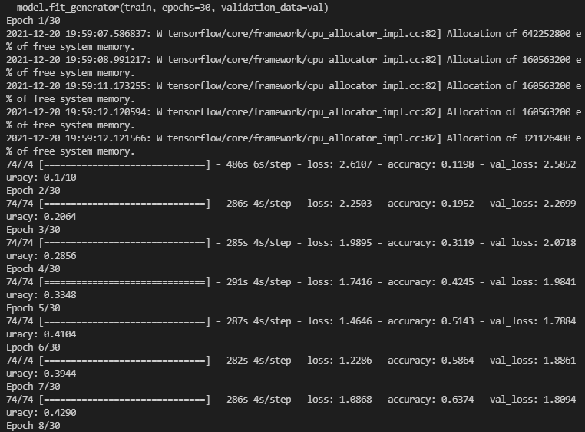
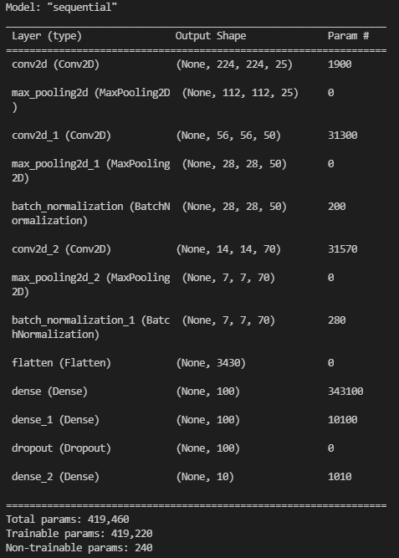
result

Slide 7
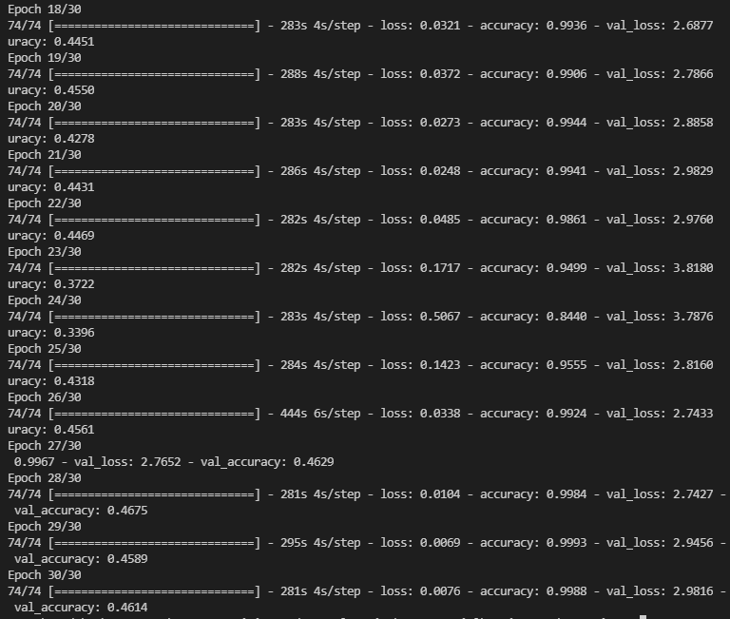
result
We were able to achieve 46% accuracy for IMAGENETT data set.
Adding more CNN layer and ANN dense layer may change the result but will increase the training time.

Slide 8
Thank You

