Slide 1

An Analysis of DC Metro Transit Times
Bayesian Methods for Data Science (DATS 4250-11)
Team members: Chi Cheung, Samuel Kupfer, Neeraj Walia

Slide 2

Introduction
Using Bayesian Statistics to measure Metro timeliness
Applications:
Predict train arrivals
Estimate travel time
Compare means of travel

Slide 3

The Data
Metro Transit Arrivals and Departures*
Collected data: June 10 - 23, 2018
6 train lines serving 92 stations
Average 18.8 hours of operations
Refresh rate of once every 7-10 sec.
3.0M+ rows of data (1.5Gb+)
Formatted Metro Data
TrainID DepartureStation ArrivalStation DepartureTime ArrivalTime TravelTime OnTime
1 L'Enfant Plaza Foggy Bottom-GWU 2018-06-18 16:06:05 2018-06-18 16:16:01 0:09:56 0
6 L'Enfant Plaza Foggy Bottom-GWU 2018-06-18 15:40:16 2018-06-18 15:52:15 0:11:59 0
8 L'Enfant Plaza Foggy Bottom-GWU 2018-06-11 16:27:03 2018-06-11 16:37:47 0:10:44 0
8 L'Enfant Plaza Foggy Bottom-GWU 2018-06-13 15:06:38 2018-06-13 15:24:13 0:17:35 0
8 L'Enfant Plaza Foggy Bottom-GWU 2018-06-14 15:36:35 2018-06-14 15:48:58 0:12:23 0
*Source: WMATA Live Train Position API

Slide 4

The Model and Predictions
Formal Analysis
Most appropriate due to data set size
Bin data into 3-minute segments
Data not entirely independent
Applied uniform prior beta distribution
Compared to prior with experiential data
MCMC
To demonstrate statistical significance

Slide 5
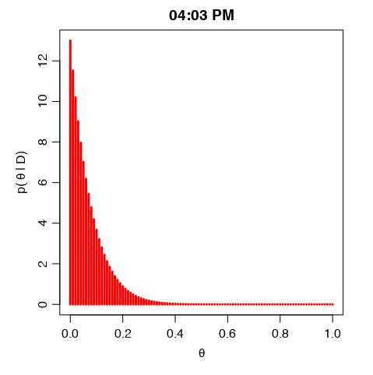


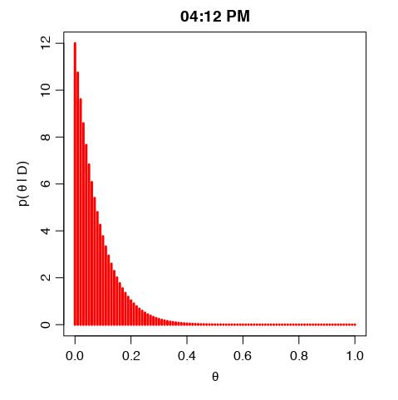

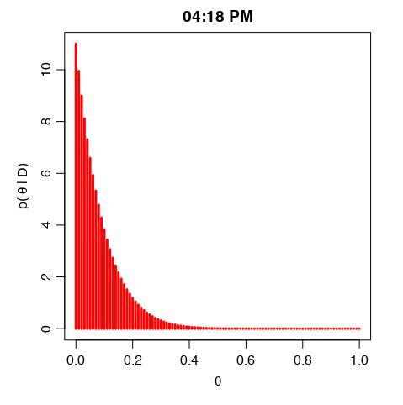





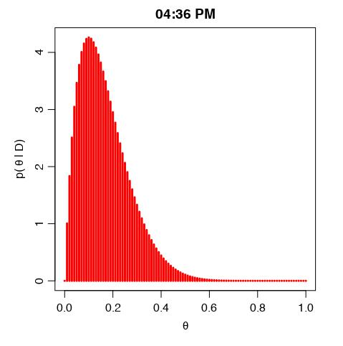
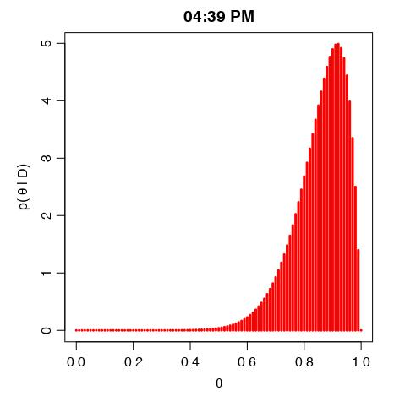
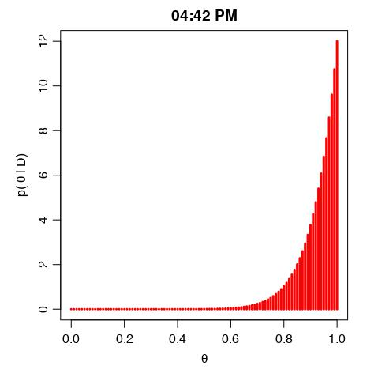
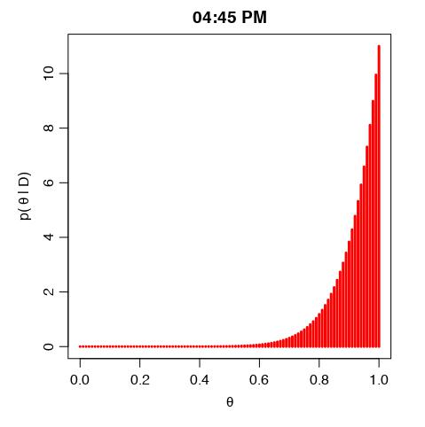
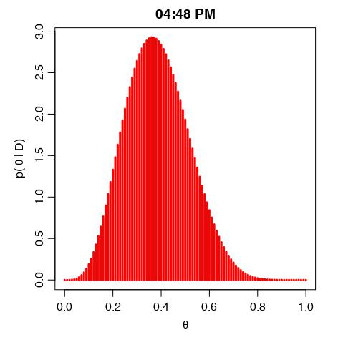






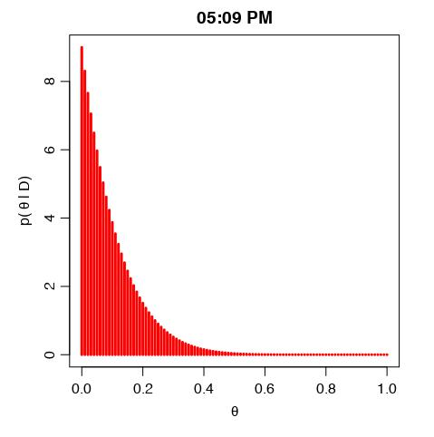


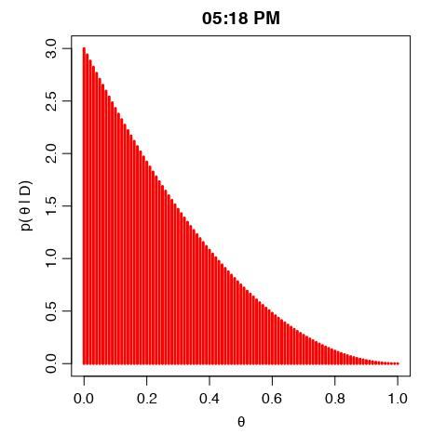

On-time Probability Distributions (Uniform Prior)

Slide 6
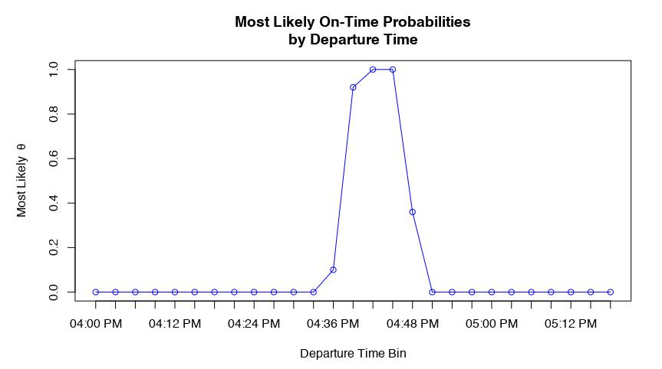
Results: Uniform Prior Distribution
4:48 PM
4:39PM

Slide 7
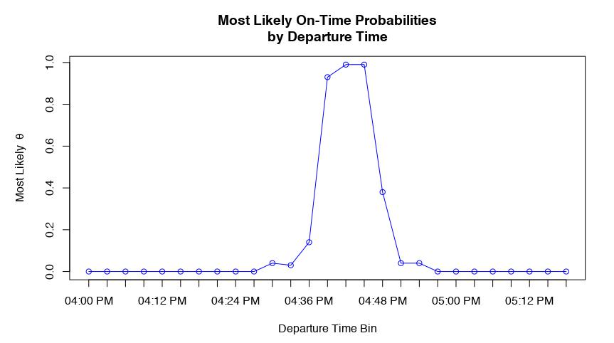
Results: Informed Prior Distribution
4:30PM
4:51PM

Slide 8
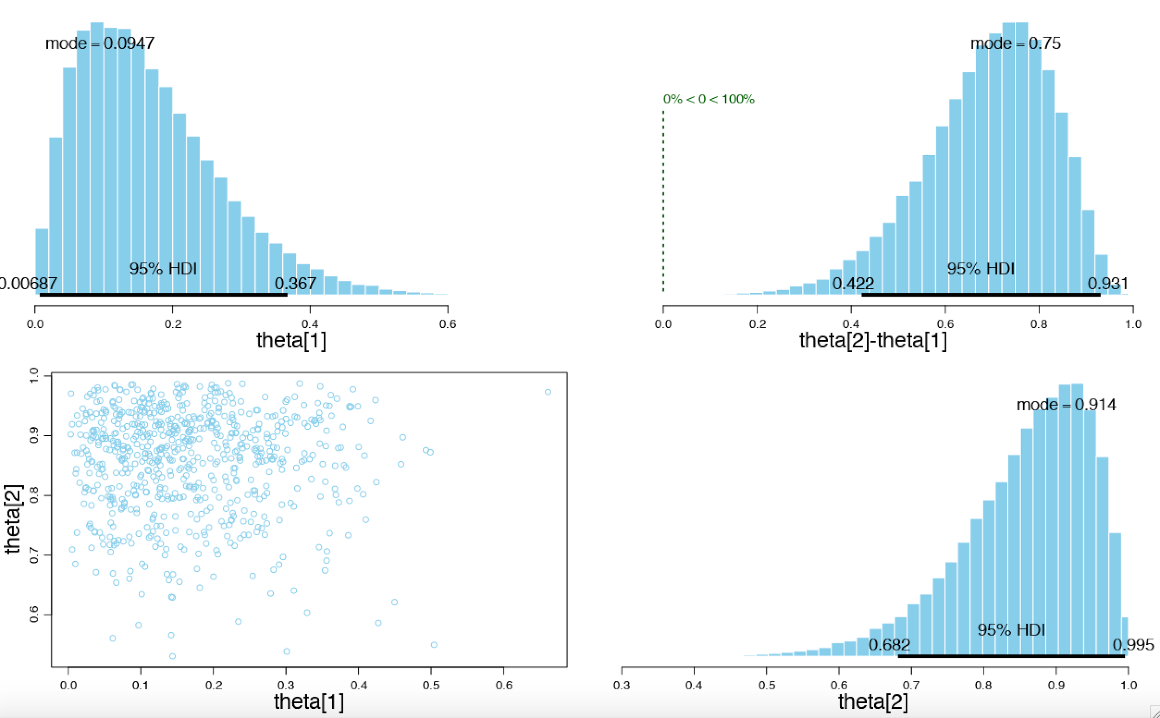
Departure Interval Comparisons
theta[1]: 4:36 PM - 4:39 PM
theta[2]: 4:39 PM - 4:42 PM

Slide 9
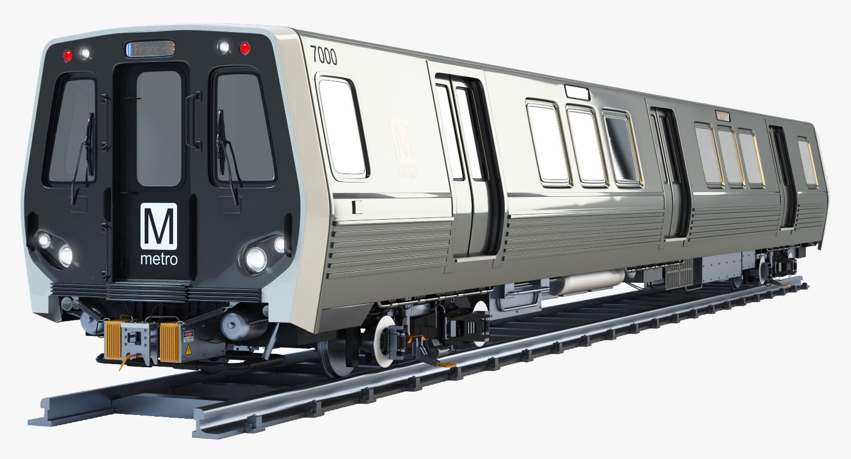
Limitations
Limited objective prior knowledge data for our commute
Small sampling due to short collection time (13 days)
No indications to cover various scenarios like breakdown trains, track issues etc.

Slide 10

Conclusion
Obtained estimates to determine the best times to depart from L’Enfant Metro Plaza to reach class on time.
Dataset did not have any outliers, so we cannot predict reliability based on this data.

