Slide 1

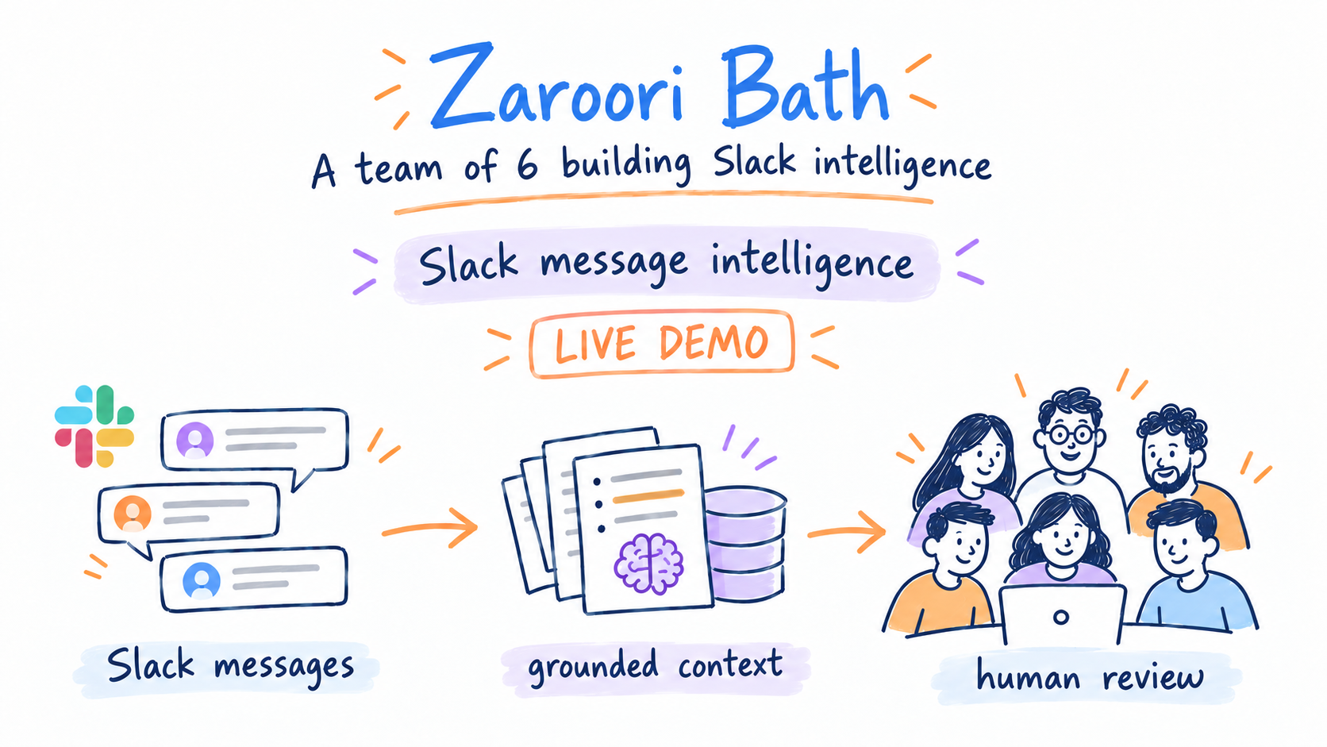
ZAROORI BATH
A team of 6
building Slack intelligence
Zaroori Baat | Slack message intelligence
LIVE DEMO

Slide 2
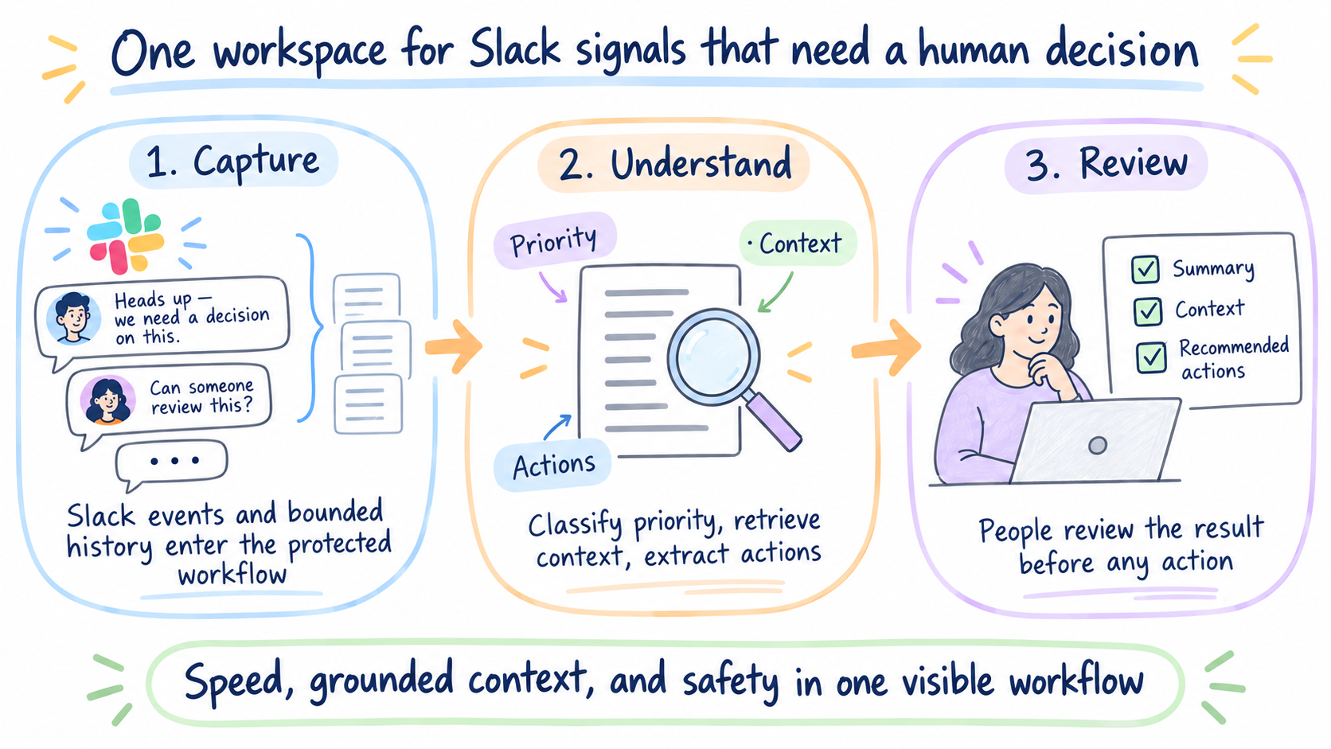
PRODUCT OUTCOME
One workspace for Slack signals that need a human decision
1. Capture
2. Understand
3. Review
Slack events and bounded history sync enter the same protected workflow.
The app classifies priority, retrieves context, extracts actions, and records decisions.
People review the result. The app does not send a Slack reply or approve work automatically.
The demo focuses on speed, grounded context, and safety — every message receives a visible classification and reason.
Product story
ZAROORI BAAT

Slide 3
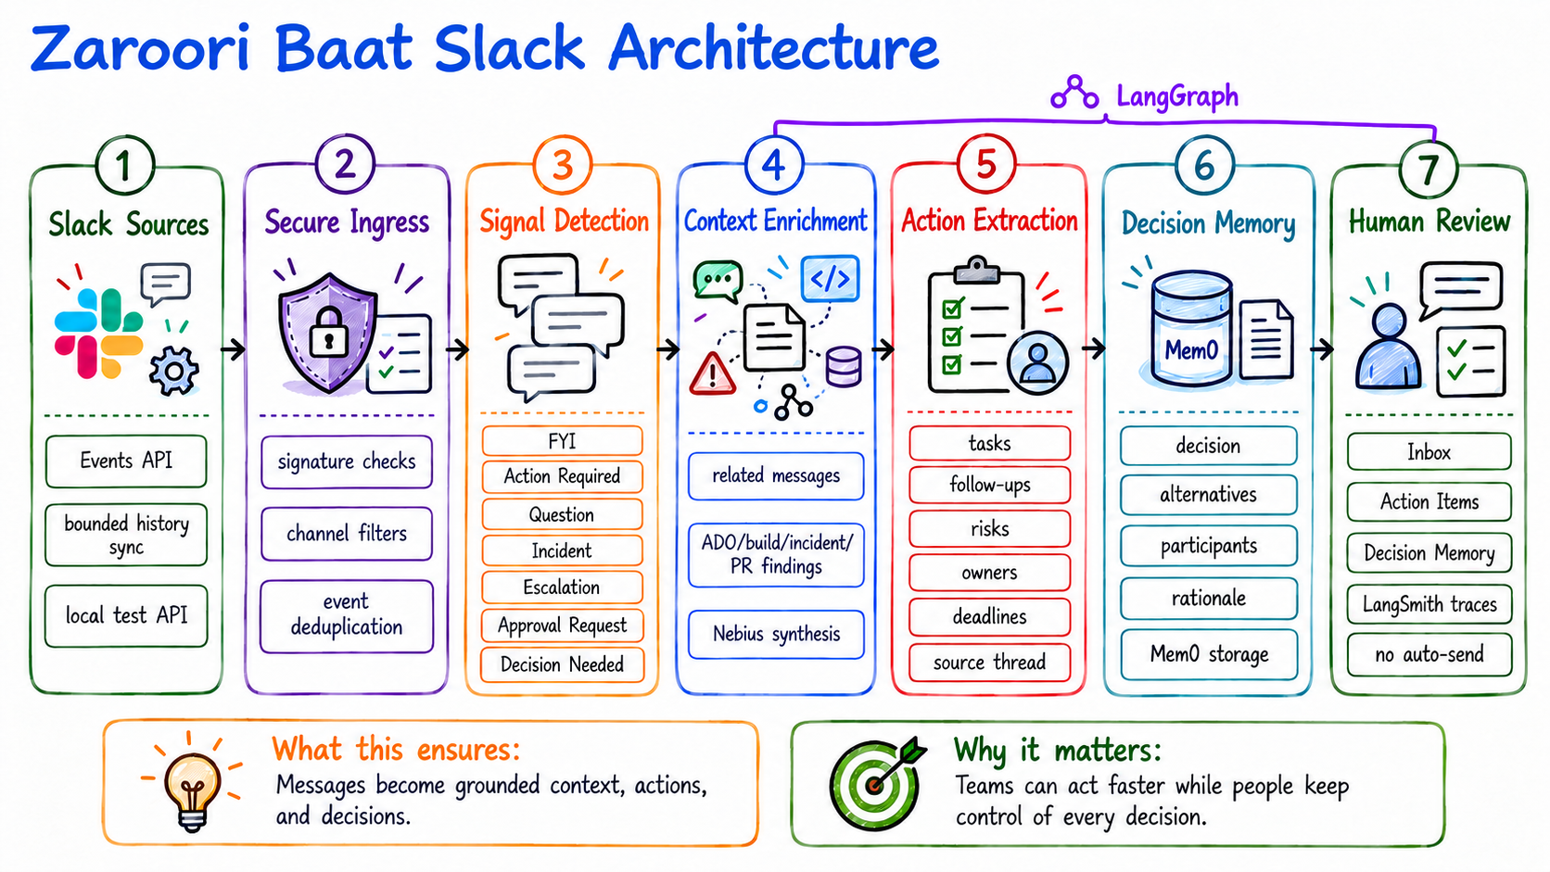

Slide 4
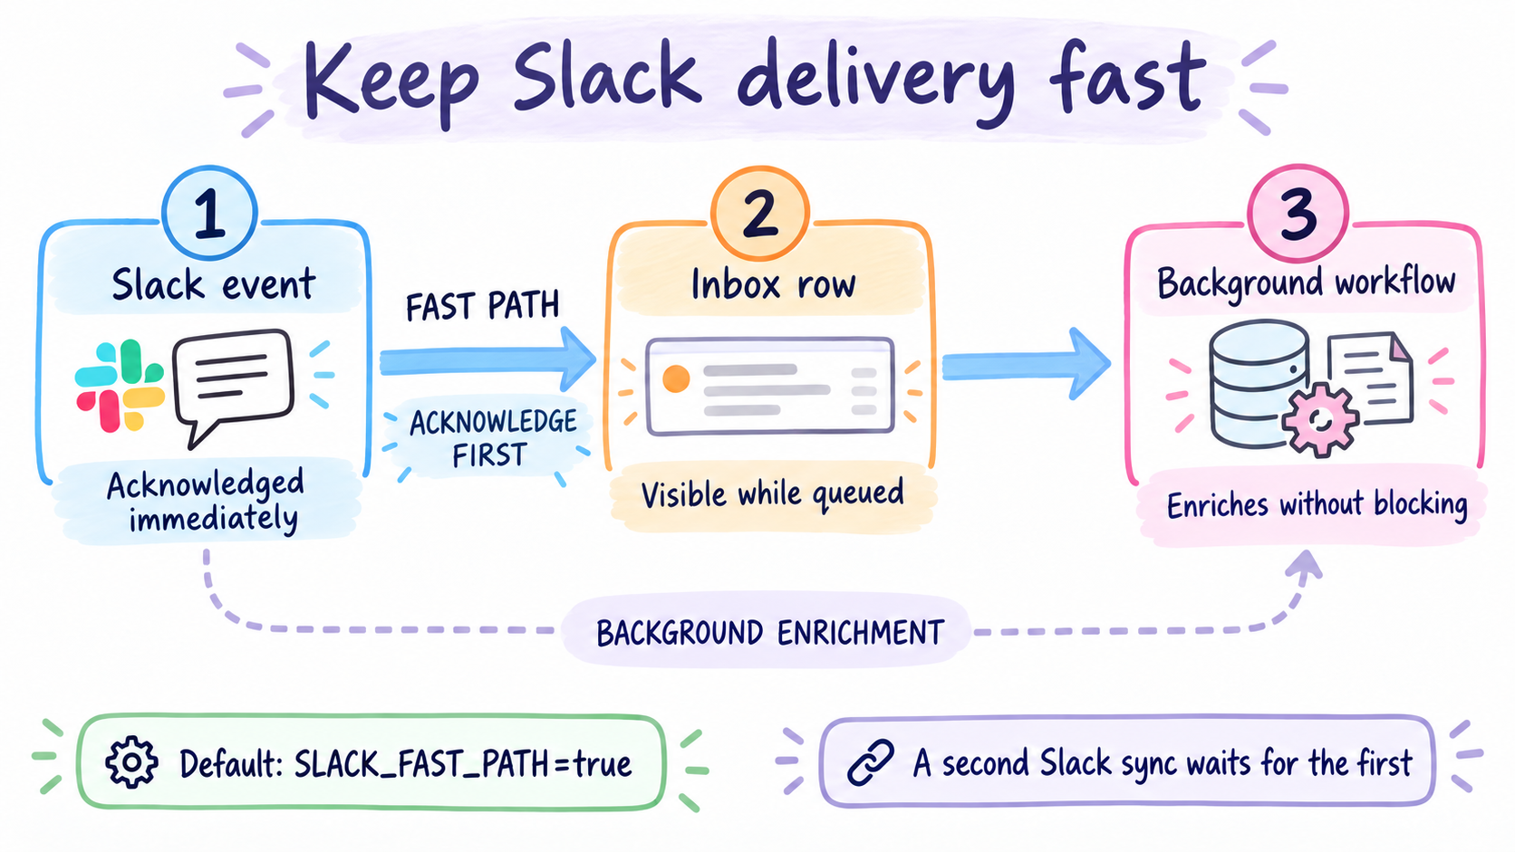
KEY DECISION 1
Keep Slack delivery fast
1
2
3
Slack event
Inbox row
Background workflow
Acknowledged immediately
Visible while queued
Enriches without blocking
Default: SLACK_FAST_PATH=true. A second Slack sync does not start while one is already running.
Performance decision
ZAROORI BAAT

Slide 5

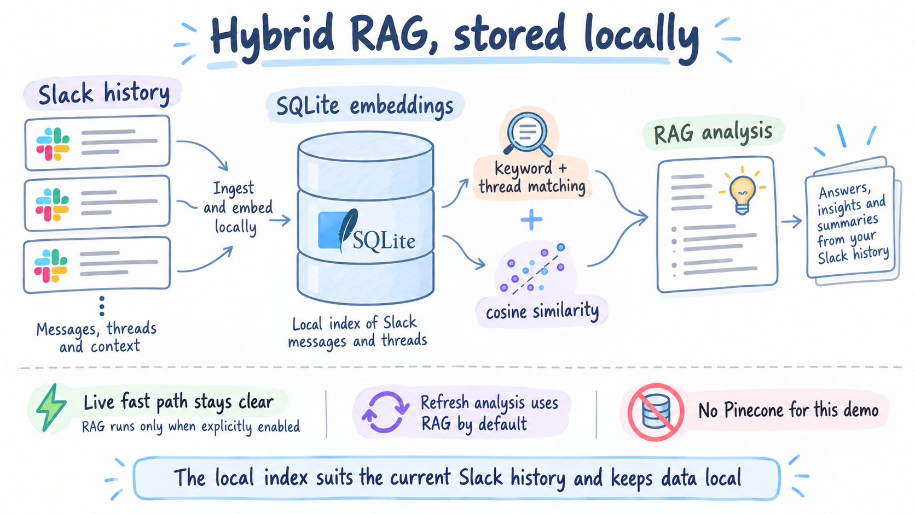
KEY DECISION 2
Hybrid RAG, stored locally
SQLite stores message embeddings locally.
Cosine similarity augments keyword and thread matching.
Refresh analysis uses RAG by default.
RAG stays off the live fast path unless explicitly enabled.
No Pinecone for this demo: the local index suits the current Slack history and keeps data local.
Context decision
ZAROORI BAAT

Slide 6
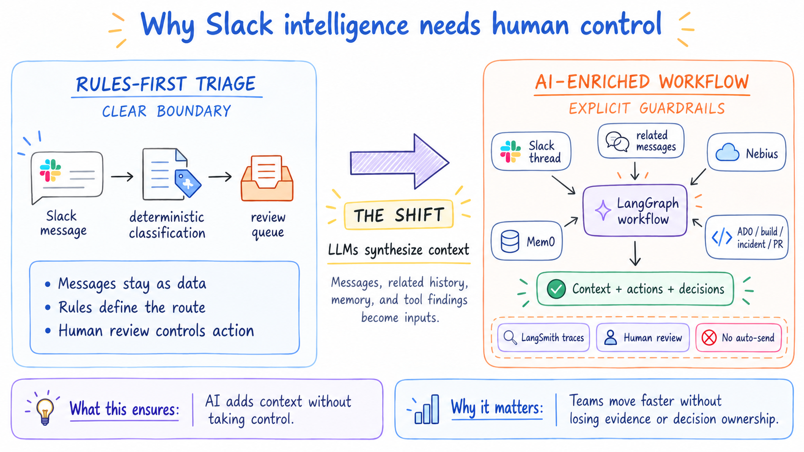
KEY DECISION 3
Grounded evaluation and human control
50
3
25
Golden dataset examples with structured inputs, expected outputs, and case-aware metrics.
Smoke cases: context retrieval, conflicting priorities, and prompt-injection resistance.
Backend tests cover API behavior, orchestration, RAG retrieval, and classification regressions.
Safety routing requires human review for incidents, escalations, approvals, decisions, and high-priority messages. Autonomous action remains NONE.
Evaluation and safety
ZAROORI BAAT
Notes:
Explain the shift from rules-first triage to AI-enriched context. LangGraph coordinates the workflow; Nebius and Mem0 are optional context sources; LangSmith provides traces; human review controls action and the system does not auto-send.

