Slide 1
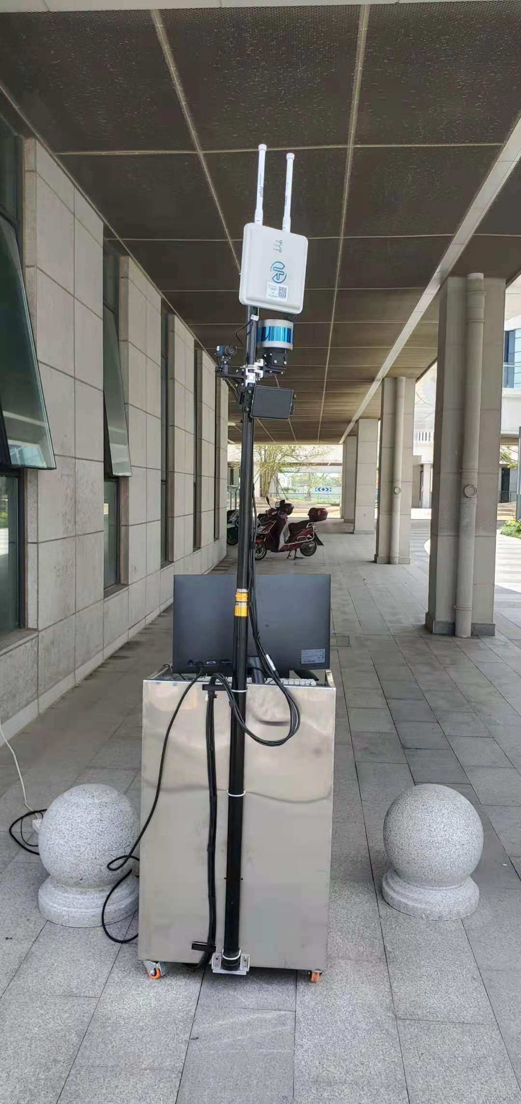
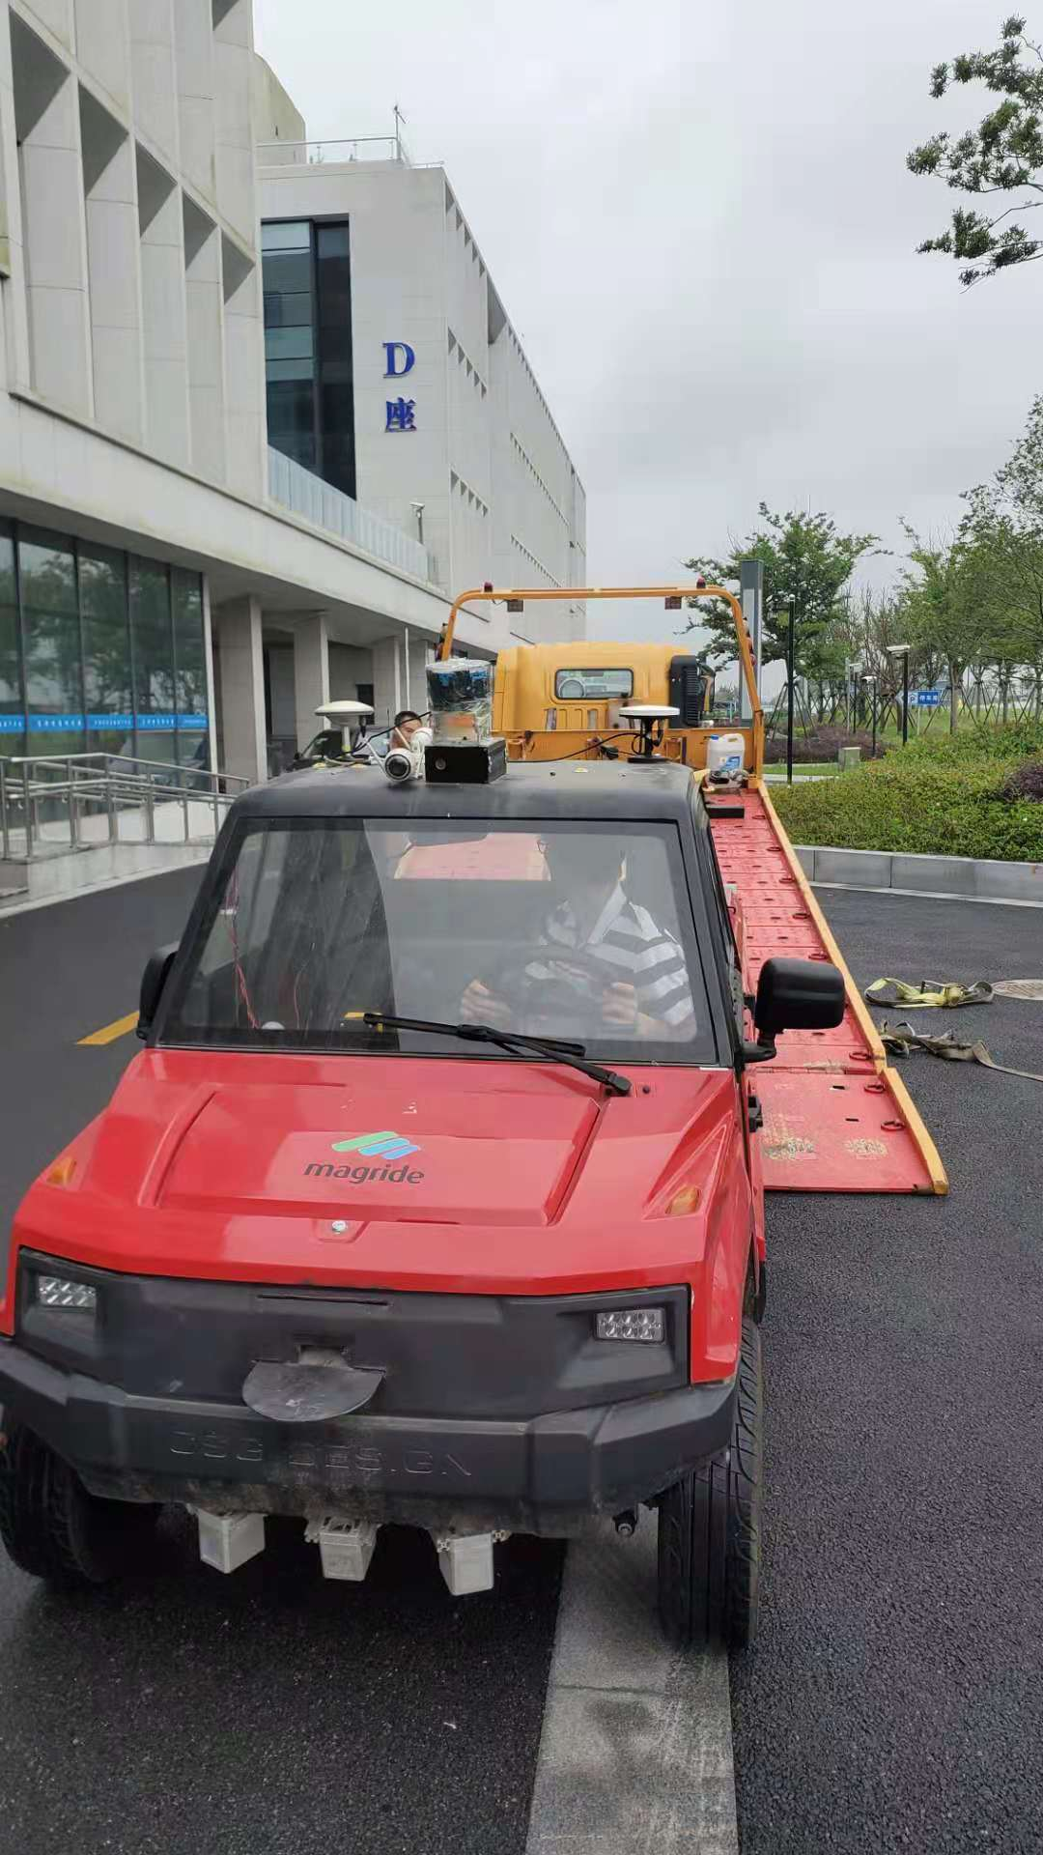
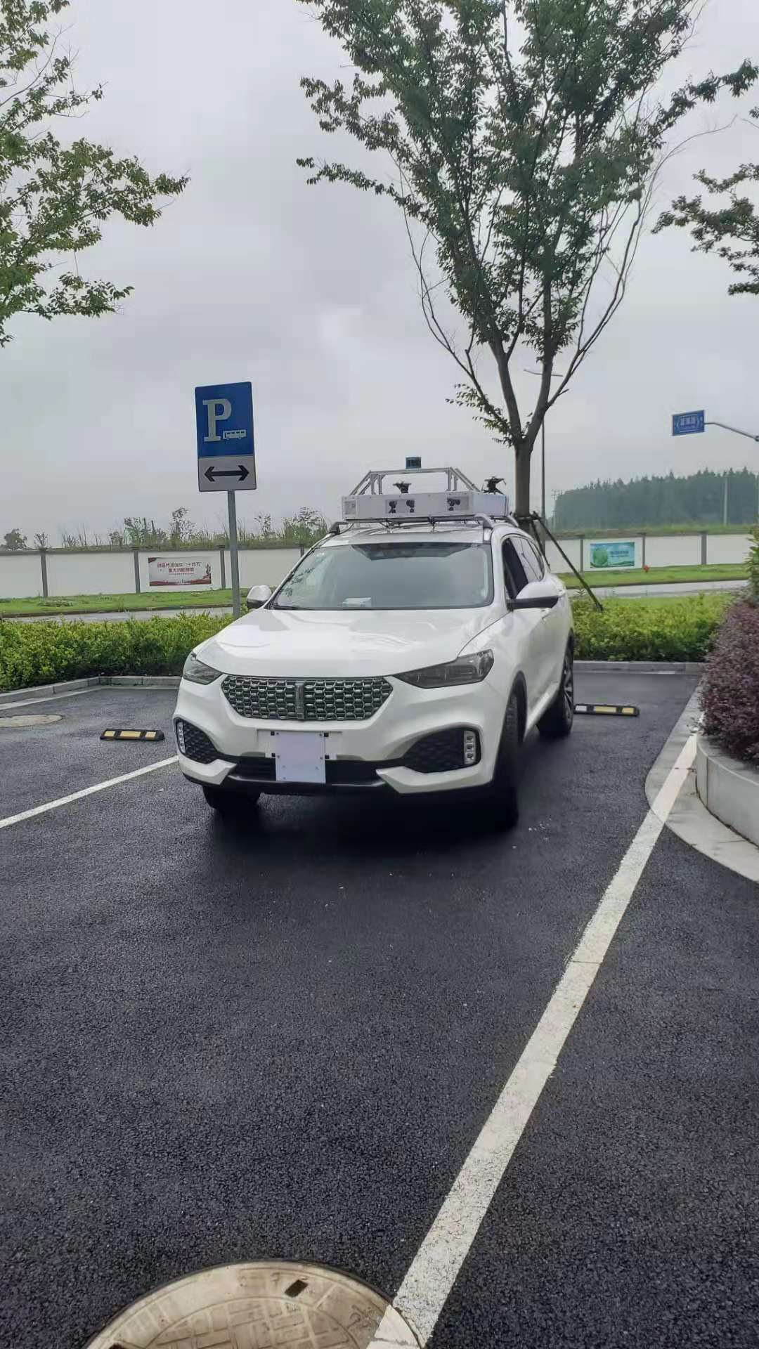
(a) Roadside sensing integrated device
(b) Autonomous driving logistics vehicle
(c) Autonomous driving experimental vehicle

