Slide 1


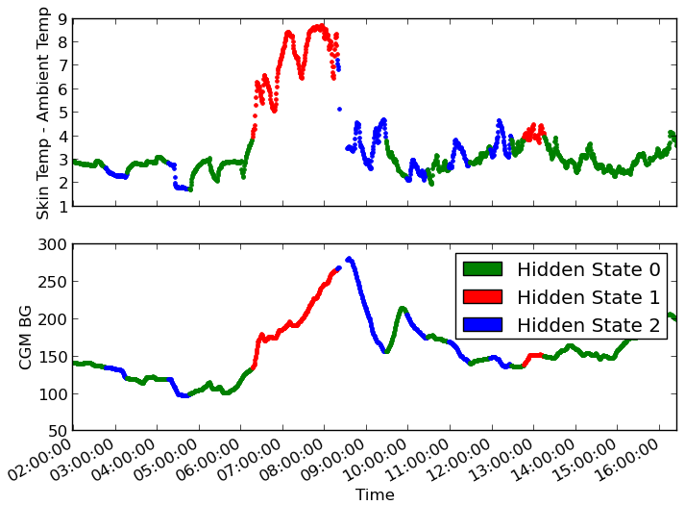
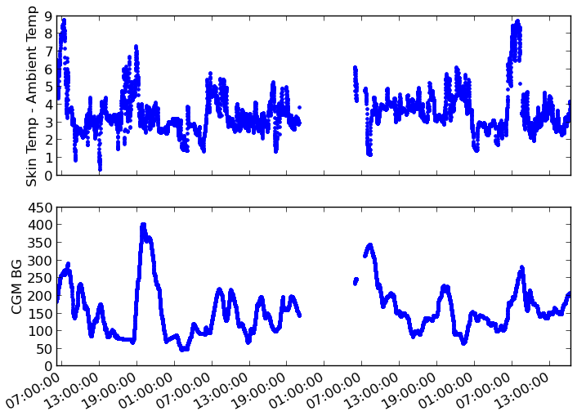
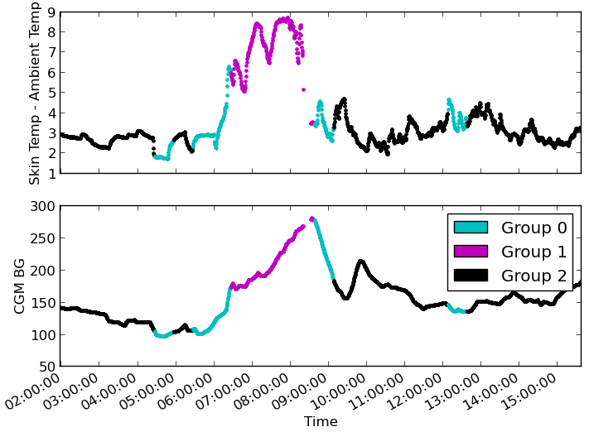
A Non-Invasive Supplement to Continuous Glucose Monitoring for Type 1 Diabetes
Shelly Bagchi, Laura Strickland
CS6601 Fall 2013, Project 2
Problem Addressed
Evaluation
Discussion
Type 1 Diabetics must check their blood sugar several times a day, usually by taking a small blood sample [1]
Continuous Glucose Monitors (CGMs) provide an estimated blood sugar without a blood sample; but a sensor must be inserted under the skin and replaced weekly [2]
The DMITRI study created a sensor array to gather CGM data, skin temperature, heart rate, and activity level data from diabetics [3]
Kohlsdorf et al. used skin temperature to predict blood sugar with up to 22.4% success, 43 minutes in advance [3]
We propose to use the DMITRI data to predict the trend of changes in blood sugar (rising, falling, or stable)
The original labels of rising, falling, and stable for each point were compared to the state into which each point was assigned by the HMM and SVM for that patient
The states did not always correspond to the same initial labels, so the results for each patient were examined and the states were matched up to obtain the percentage of correctly identified points in intervals, given in the table below
HMM analysis of skin temperature yielded more accurate results than SVM analysis. The accuracy of both methods could have been improved with additional training data. SVM accuracy could have been improved further by the use of more relevant training features.
When a state besides rising, falling, or stable was classified as a hidden state, an assumption was made based on the approximate slope or trend of the interval. These assumptions may have caused misestimation of correctness. Training HMMs on more than three states may improve accuracy.
Definitive labeling of states could be accomplished in future work using Conditional Random Fields, which allow random variables in an undirected graph to be conditioned based on global observations [4]. The global observations would be labeled sequences of data corresponding with rising, falling, and stable blood glucose.
Percentage of correctly-identified points for HMM and SVM cases
Patient | % Correct (HMM) | % Correct (SVM)
101 | 71.40 | 55.37
102 | 76.54 | 39.71
103 | 100.00 | 49.09
104 | 30.82 | 32.82
105 | 77.39 | 24.67
106 | 75.38 | 45.48
107 | 76.36 | 21.25
108 | 60.07 | 34.62
109 | 86.47 | 64.77
111 | 68.62 | 25.19
112 | 100.00 | 42.04
113 | 87.81 | 17.24
114 | 89.11 | 14.29
115 | 93.48 | 30.24
116 | 71.10 | 33.93
117 | 100.00 | 18.50
Average | 79.03 | 34.33
Approach
Plotting raw sensor data showed that skin temperature did indeed show the best correspondence to blood glucose
To account for environmental changes, the skin temperature data was normalized by subtracting the ambient temperature
Intervals of 30 min. were selected and tagged by the trend of the CGM readings, whether rising, falling, or stable (change within +/- 10 mg/dL)
Hidden Markov Models (HMMs) were trained with the first 80% of labeled skin temperature data intervals and tested on the last 20%
A similar procedure was used on Support Vector Machines (SVMs) for comparison; the features used were the start and end points of each interval
Results of HMM analysis on test set for Patient 101.
References
[1] Medscape, “Type 1 diabetes mellitus.”
[2] Dexcom SEVEN Plus User’s Guide, Dexcom, Inc., 2011.
[3] D. Kohlsdorf, A. Tirodkar, S. Pai, A. Pruett, T. Starner, N. Heintzmann, and H. Brashear, “Body-worn biosensing for type 1 diabetes: A case study,” 2013, submitted for publication.
[4] S. M. Rajtmajer, “Introduction to markov random fields,” 2012.
[5] F. Pedregosa, G. Varoquaux, A. Gramfort, V. Michel, B. Thirion, O. Grisel, M. Blondel, P. Prettenhofer, R. Weiss, V. Dubourg, J. Van- derplas, A. Passos, D. Cournapeau, M. Brucher, M. Perrot, and E. Duch- esnay, “Scikit-learn: Machine learning in Python,” Journal of Machine Learning Research, vol. 12, pp. 2825–2830, 2011.
Raw CGM and skin temperature data plotted over time.
Results of SVM analysis on test set for Patient 101.

