Slide 1
DASHBOARD
Application de mesure de performance pour aide a la prise de décision (Restauration), reporting

Slide 2
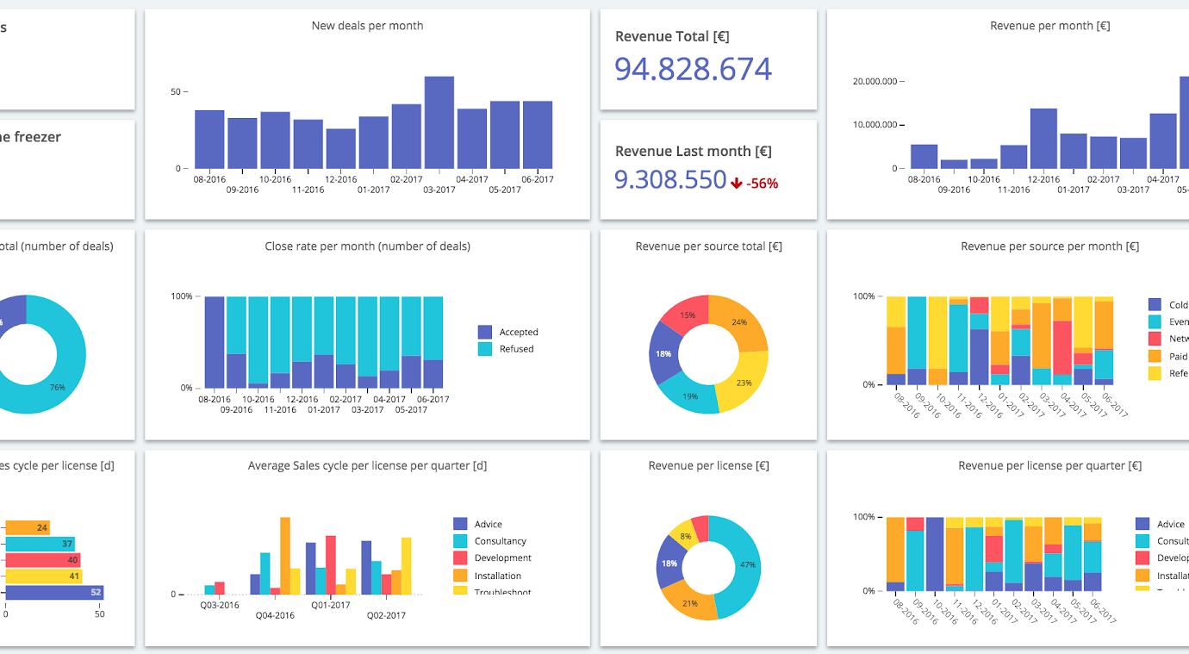

Slide 3
APPLICATION DE RESTAURATION
TRACKINGS
- Age groups registered
- most ordered food
- Hours most orders are passed
- % women to men
- 05 cities most orders + 05 cities less orders
- la moyenne des dépenses par commandes;
-prix moyenne
- reporting concerning ventes, cosommation, produits, vente menuel, annuel, meillieur vendeur, marketting/financier
FRONT-END : HTML/CSS/Js/ReactJs
BACKEND : Ruby/Ruby on Rais
SGBD : PostGre SQL
Deploiement : Heroku

Slide 4
UserTable
userID
Name
City
gender [male/female]
Addresse [street number, apt number]
Date of birth
Credit card details
order
id
userID
foodID
Pannier
factures
Foodmenu
fodID
Name [pizza, chicken]
City
gender [male/female]
Addresse [street number, apt number]
Date of birth

