Slide 1
5-MINUTE STORY
Apache Spark
TODAY'S LUNCH RUSH
#1
#2
#3
#4
#5
The restaurant that serves
10,000 orders at once
A busy restaurant has one big problem:
how can it prepare thousands of orders quickly?
10,000 orders
One lunch rush. One huge queue.
THE STORY: one restaurant → many chefs → one coordinated kitchen → faster service
Notes:
Opening (30–40 sec): Ask the audience to imagine a restaurant receiving 10,000 orders at the same time. Explain that the challenge is similar to processing a huge amount of data quickly.

Slide 2
CHAPTER 1
One chef cannot handle the rush
Imagine every order waiting for the same chef. The queue keeps growing.
ORDER QUEUE
ONE CHEF
THE RESULT
Order 1
Order 2
→
👨‍🍳
Long waits.
Late orders.
Unhappy customers.
Order 3
Order 4
Works one order
at a time
Data problem: one machine doing all the work becomes a bottleneck.
Notes:
Bottleneck (40 sec): One chef handles every order one by one. The queue grows. This represents one computer or one processing unit doing all the work.

Slide 3
CHAPTER 2
The manager brings in more chefs
Instead of one chef doing everything, the manager splits the orders into smaller batches.
CHEF 1
CHEF 2
CHEF 3
MANAGER
👨‍🍳
👨‍🍳
👨‍🍳
🧑‍💼
Batch 1
of orders
Batch 2
of orders
Batch 3
of orders
Plans the work
and assigns it
Spark idea: split a large job into smaller tasks and process them in parallel.
Notes:
Parallel work (50 sec): The manager divides the orders into batches and assigns them to several chefs. Spark divides a large data job into smaller tasks that can run at the same time across multiple machines.

Slide 4
CHAPTER 3
Meet the kitchen team — Spark's main parts
Each character has a job. Together, they keep the whole kitchen coordinated.
👨‍💼
🗂️
👩‍🍳
DRIVER
CLUSTER MANAGER
EXECUTORS
Head chef / kitchen captain
Restaurant staffing desk
The working chefs
Plans the job, breaks it into tasks and coordinates the work.
Finds available kitchen resources and assigns them to the job.
Process their assigned tasks and report results.
Remember: the Driver coordinates; the Cluster Manager allocates resources; Executors do the work.
Notes:
Spark components (60 sec): Driver is like the head chef who plans and coordinates. Cluster Manager is like the staffing desk that allocates resources. Executors are the chefs that actually carry out the assigned tasks. Note: the analogy is simplified; actual Spark deployments vary.

Slide 5
CHAPTER 4
How one big job gets finished
1
2
3
4
5
Receive
→
Plan
→
Allocate
→
Cook in parallel
→
Combine
10,000 orders arrive
Driver creates a work plan
Cluster Manager provides resources
Executors handle task batches
Results are brought together
Back to the restaurant: all chefs finish their batches, the kitchen checks the plates, and the orders go out together.
Notes:
Workflow (50 sec): Walk left to right: data/job arrives, Driver plans tasks, cluster manager allocates resources, executors process partitions in parallel, and Spark returns or combines results.

Slide 6
THE PAYOFF
The restaurant learns from its orders
Once service is under control, the owner can analyse the orders and make smarter decisions.
🍕
Most popular dish
⏱️
Peak busy hour
📦
Ingredient planning
Which meals sell the most?
When should more chefs be scheduled?
What ingredients should be restocked?
Apache Spark = a fast engine for processing large amounts of data by dividing work across many computers.
One restaurant story. One big idea: divide the work, coordinate the team, finish faster.
Notes:
Payoff (40 sec): The restaurant analyses order history to plan staffing and ingredients. Spark can process data for analytics. Close with the one-sentence definition on screen.

Slide 7
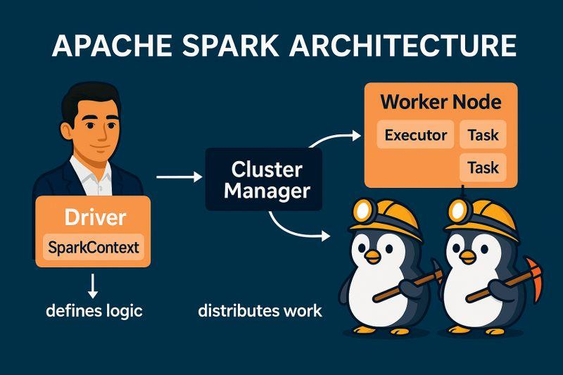

Slide 8
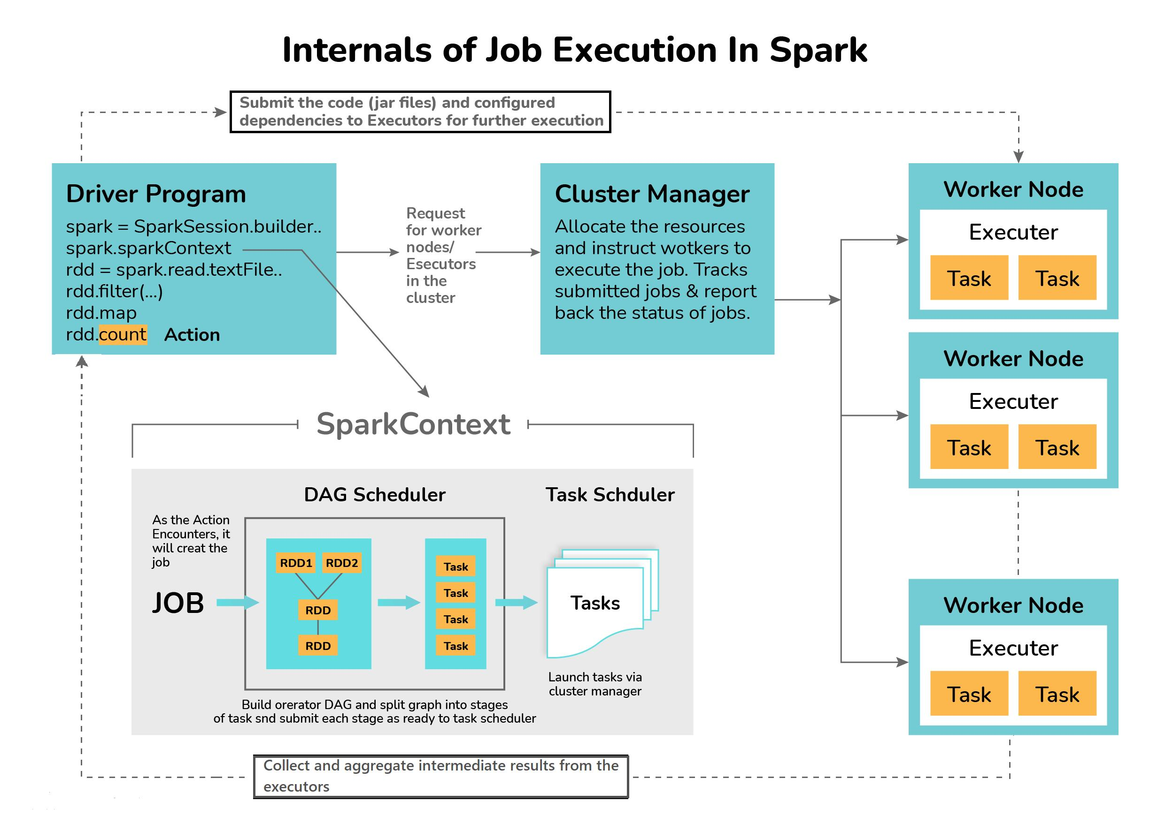

Slide 9
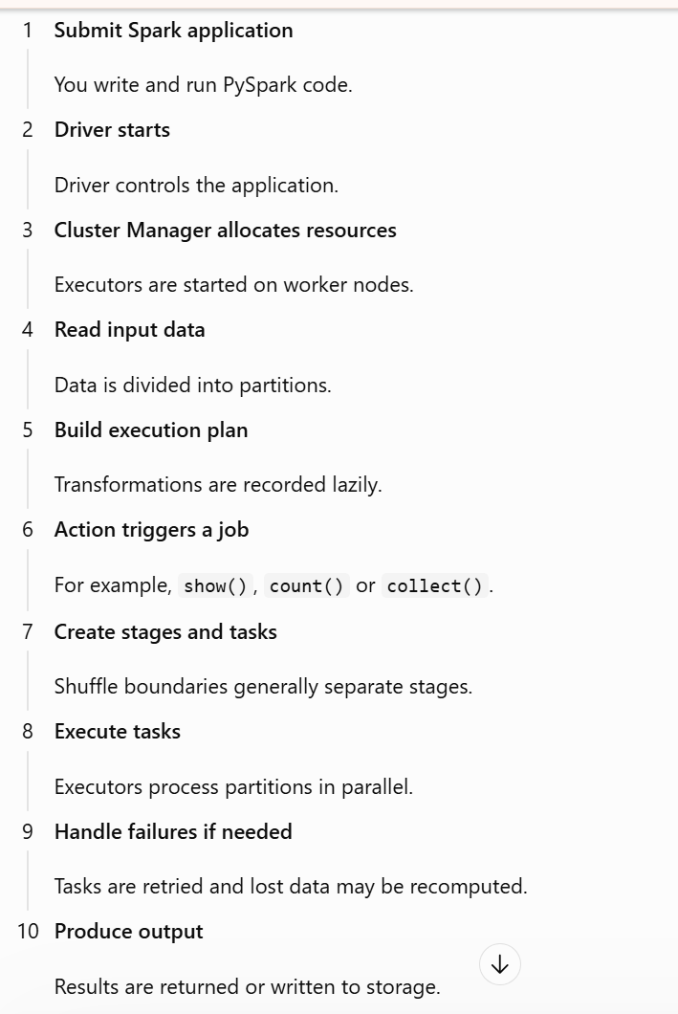

Slide 10
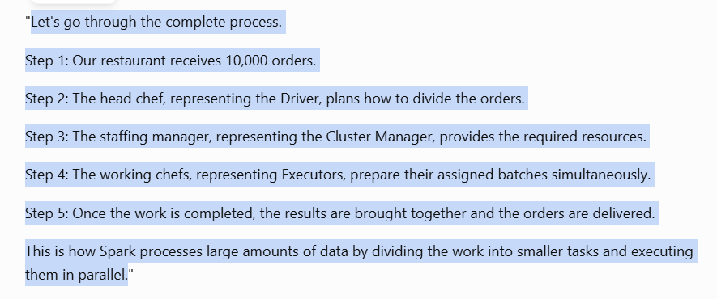
How Apache Spark works

