Slide 1

English Text Extraction using OCR and Translation to Hindi using Transformer Mode
School of Computer Science and Engineering
Department of Computer Science and Engineering
Submitted By:
Shlok Mishra
23FE10CSE00492
Supervised By:
Dr Ridhi Arora

Slide 2
Outline
Introduction
Literature Review
Problem Statement
Proposed Solution
Objectives
Results

Slide 3
Introduction
Background
Many documents in India are available in English language only
A large population prefers Hindi for better understanding
Manual translation of scanned documents is time-consuming
Important sectors affected:
  Government forms
  Medical prescriptions
  Educational material
  Historical records
Key Technologies Used
Optical Character Recognition (OCR)
Natural Language Processing (NLP)
Transformer Neural Networks

Slide 4
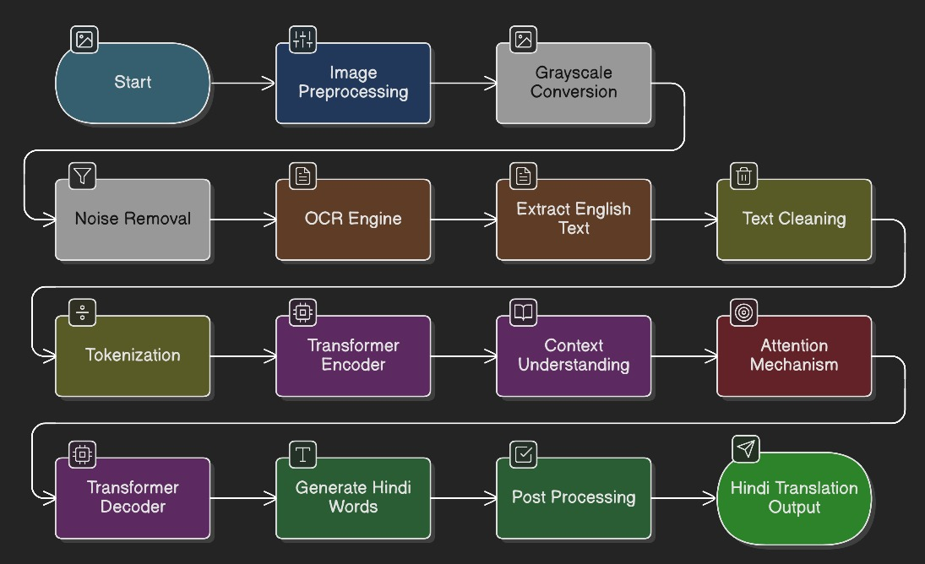
What is OCR?
Optical Character Recognition (OCR) is a computer vision technique used to detect and convert text from images, scanned documents, or photographs into machine-readable text.
What is Machine Translation?
Machine Translation is an NLP task where a computer automatically converts text from one language to another.

Slide 5
Literature Review
Optical Character Recognition
Early OCR used pattern matching and template matching
Modern OCR uses deep learning and convolutional neural networks
Popular tools:
  Tesseract OCR
  Google Vision OCR
Research Observations
OCR accuracy depends on:
  Image quality
  Lighting
  Font style
  Noise in image

Slide 6
Transformer Models
Introduced in 2017 (Attention Is All You Need)
Uses self-attention mechanism
Handles long sentences efficiently
Currently state-of-the-art in language translation
Advantages:
Better grammar understanding
Context aware translation
Parallel processing

Slide 7
Problem Statement
To develop an automated system that extracts English text from images and accurately translates it into Hindi using a Transformer-based Neural Machine Translation model.

Slide 8
Objectives
Extract English text from images using OCR
Train a Transformer model on English–Hindi dataset
Translate extracted English sentences into Hindi
Build a complete end-to-end pipeline from image to translated text

Slide 9
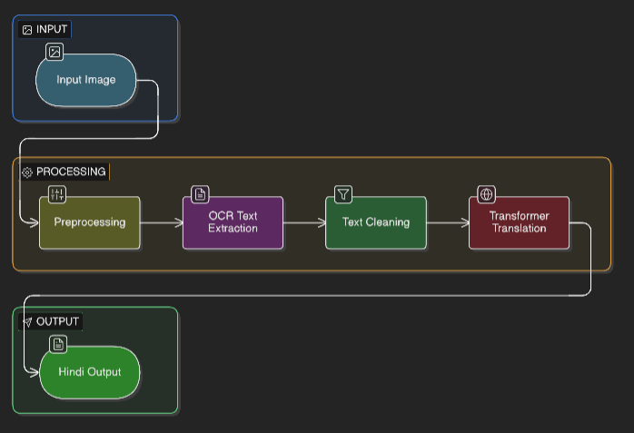
Proposed Methodology
System Architecture

Slide 10
Image Preprocessing
Grayscale conversion
Noise removal
Thresholding
Image sharpening
OCR Extraction
Detect characters
Recognize words
Convert image text to digital English text

Slide 11
Transformer Architecture Components
Encoder
Decoder
Attention Mechanism
Working
Encoder:
Reads English sentence
Understands context
Decoder:
Generates Hindi sentence word-by-word

Slide 12
Translation Process
Tokenization of English sentence
Embedding generation
Attention calculation
Hindi sentence prediction
Output:
Machine generated Hindi translation

Slide 13
Result
Achieved So Far
Transformer model successfully trained
Model translates English input sentences into Hindi
Producing grammatically correct Hindi outputs for simple sentences

Slide 14
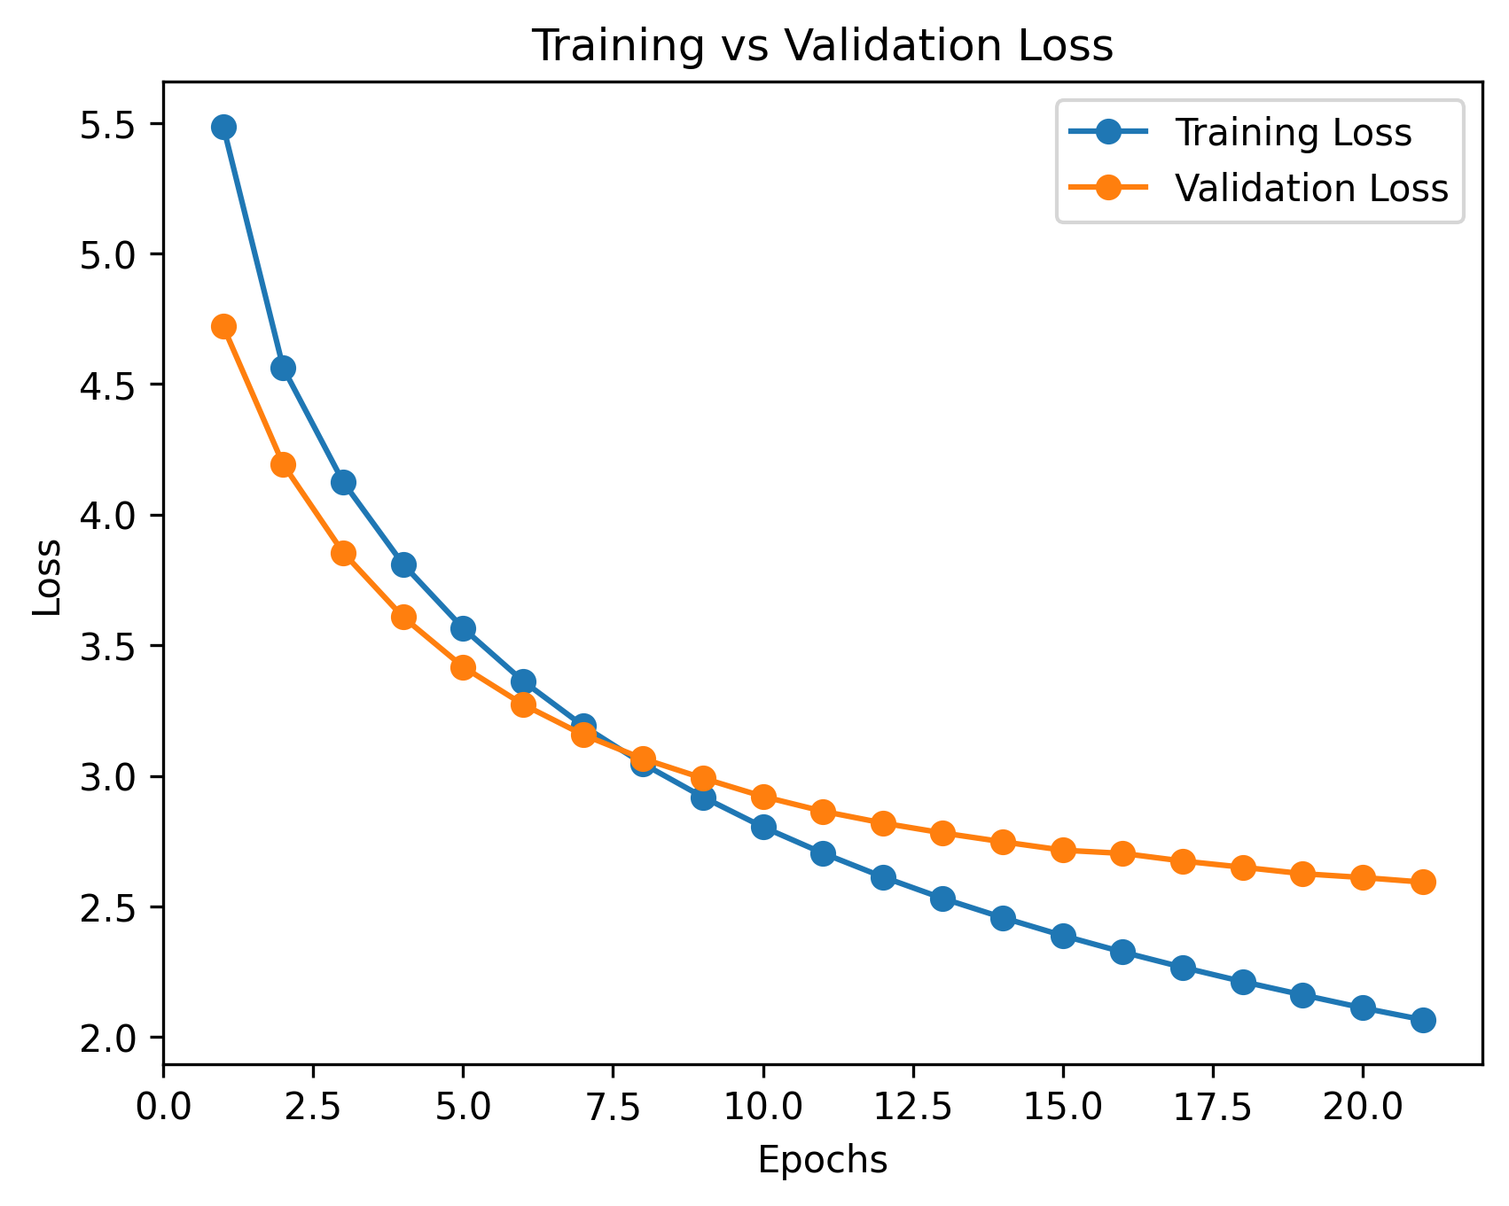
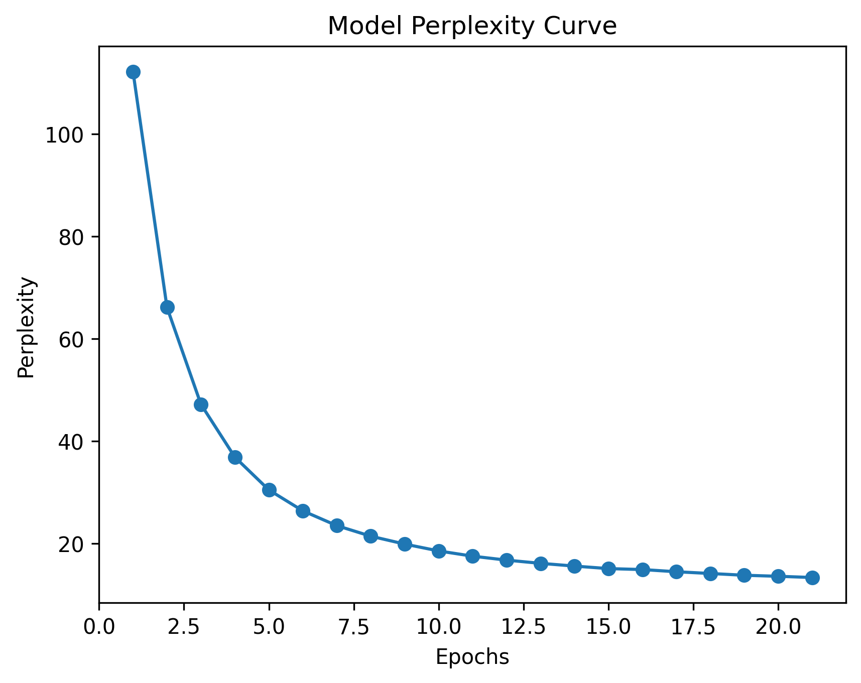
Loss and Perplexity Graphs

Slide 15
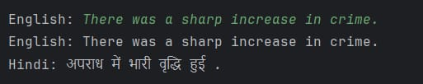





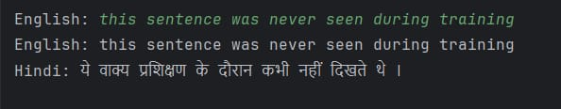

Slide 16
Outcome and Future Work
Future Work:
Integrate OCR with translation
Complete image-to-Hindi pipeline
Improve translation accuracy
Create a user interface
Expected Outcomes
Research Paper (Drafted)
Real-time deployment (Partially completed)

Slide 17
References
<One slide>

Slide 18
Thank You

