Slide 1

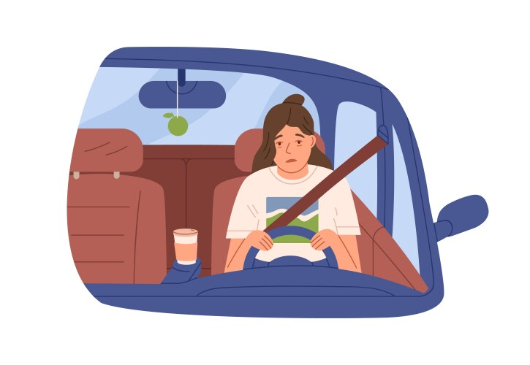
STAY AWARE
Preventing Accidents and Enhancing Road Safety
Under the guidance of:
Prof. Basil Latif
Presented by:
Achyuth Sambaraju
Kushal Bangalore Harish
Saumya Chandrakant Prasad
Shloka Ramesh Daga

Slide 2




CONTENTS
INTRODUCTION
PROBLEM STATEMENT
BUSINESS SCOPE & OBJECTIVES
ML - INJURY / NON - INJURY CLASSIFICATION
MODEL COMPARISON & OUTCOMES
DL - DRIVER DROWSINESS DETECTION
MODEL COMPARISON & OUTCOMES
FUTURE SCOPE & CONCLUSION

Slide 3
INTRODUCTION
Road safety is a major issue, with many lives affected by accidents every year.
Our project focuses on two things: predicting injury severity using accident data and detecting driver drowsiness using images.
We use machine learning to predict injuries and deep learning to spot drowsy drivers.
Our goal is to prevent accidents and make emergency response more effective, making roads safer for everyone.

Slide 4
STATISTICAL DATA
42,514
$340Bn
6,500
328,000
Lives Lost in Road Accidents in 2022 in the US
Damage due to road accidents in 2022 in the US
Accidents caused by Emergency Services in 2022 in the US
Accidents due to Drowsiness in 2022 in the US

Slide 5

PROBLEM STATEMENT
Injury Severity Prediction: Emergency teams often lack accurate injury predictions, making it tough to respond effectively.
Driver Drowsiness Detection: Drowsy driving leads to many accidents. We need a reliable system to detect driver fatigue early.
Accident Prevention: Current road safety doesn’t fully use predictive insights. By combining injury severity prediction and drowsiness detection, we can reduce accidents.

Slide 6

BUSINESS SCOPE
Enhanced Risk Profiling for Insurance: Identify high-risk driving behaviors to enable fairer pricing and targeted policies.
Proactive Safety Measures: Integrate drowsiness detection into vehicles to reduce accidents, improve safety, and lower liability risks.
Support for Public Safety and Smart Infrastructure Planning: Use accident and injury data to support smart city initiatives and enhance traffic management.

Slide 7

OBJECTIVES
Injury / Non - Injury Classification
01
Detect Driver Drowsiness
02
Test Different Models
03
Deliver Safety Insights
04

Slide 8
Machine Learning Model - Injury / No Injury Classification

Slide 9
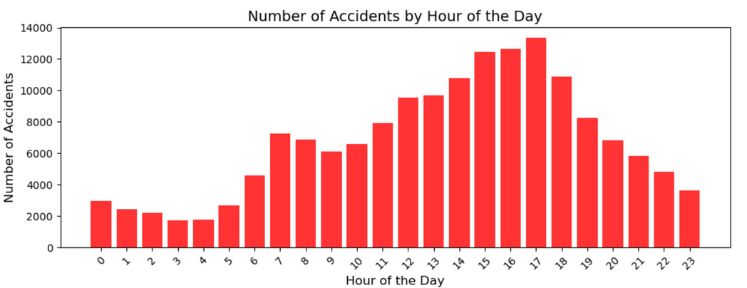
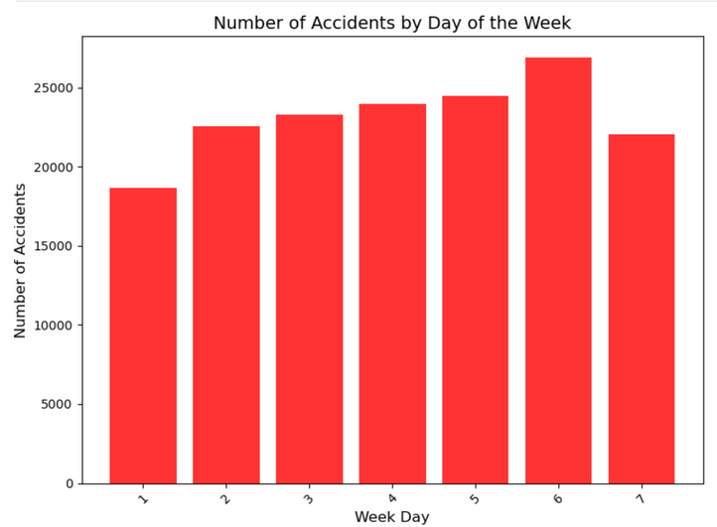
ML - INJURY / NON - INJURY CLASSIFICATION
Structured Data
CRSS Accident Data
Source: National Highway Traffic Safety Administration (NHTSA)
Size: ~160,000 rows, covering accident data from 2020, 2021, and 2022
Details: Includes information on accident conditions, driver behavior, environmental factors, location, and injuries

Slide 10

ML MODEL BUILDING
Data Understanding and Preprocessing
Dataset Consolidation
Feature Engineering
Handling Missing Values
Machine Learning Models
Logistic Regression
Multi Layer Perceptron (MLP)
K - Nearest Neighbors (KNN)
Naive Bayes
Evaluation Metrics
Confusion Metrics
Classification Report

Slide 11
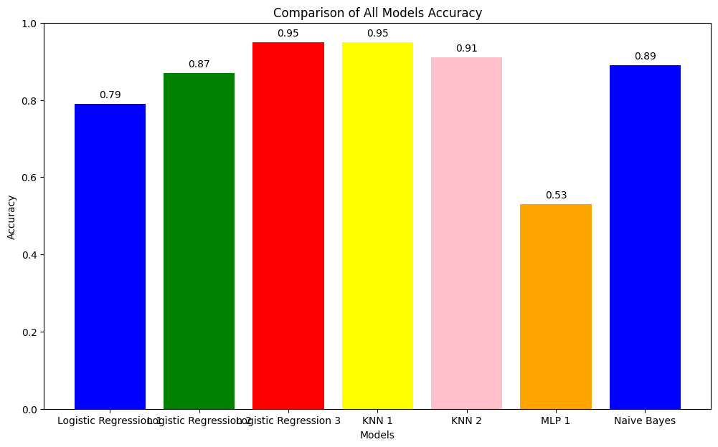
ML PERFORMANCE COMPARISON
Highest Accuracy: KNN and Logistic Regression models demonstrate the highest accuracy at 0.95.
Moderate Performance: Naive Bayes also performs relatively well with 0.89 accuracy,
Model Performance Variety: The accuracy differences highlight the variance in model performance, with MLP showing the weakest result at 0.53.

Slide 12
Deep Learning Model - Driver Drowsiness Detection

Slide 13
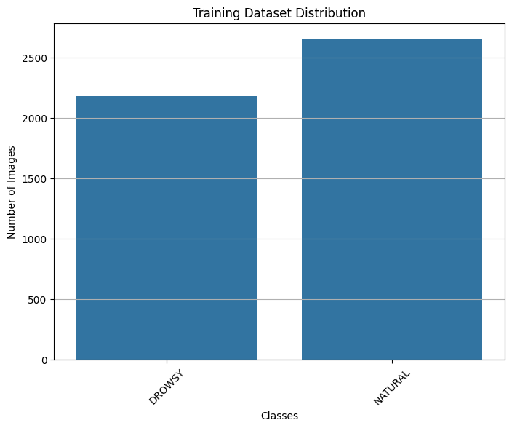
DL - DRIVER DROWSINESS DETECTION
Unstructured Data
Drowsy Detection Image Dataset
Source: Kaggle Dataset
Size: Over 9,000 labeled images of drivers, focusing on facial cues and eye states related to drowsiness
Details: Captures visual indicators of driver fatigue, Yawning Indicator, Head Movement Detection

Slide 14
DL MODEL BUILDING
Data Understanding and Preprocessing
Dataset Splitting
Data Organization
Data Augmentation and Transformation
Deep Learning Model Architectures
Convolutional Neural Networks
Recurrent Neural Networks
Evaluation Metrics
Confusion Matrix
Classification Report
ROC Curve
Hyper Parameters
Optimizers - Adam, SGD
Activation Functions - ReLU, Tanh
Learning rate
Batch size
Epochs

Slide 15
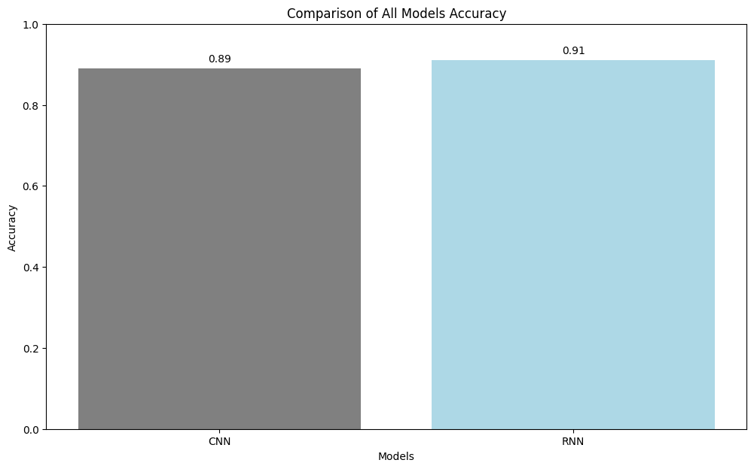
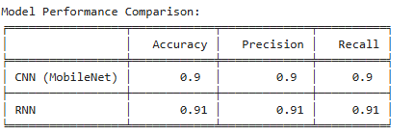
DL PERFORMANCE COMPARISION
Model Performance: Both CNN and RNN models show high performance, with RNN slightly outperforming CNN, achieving an accuracy of 91%.
Balanced Metrics: Precision and recall are consistent across both models, indicating balanced and reliable predictions for both methods.

Slide 16
KEY OUTCOMES
Efficient Dataset Handling: Balanced splits for training, validation, and test sets with data augmentation for robust training.
CNN with Transfer Learning: Fine-tuned MobileNetV2 achieved over 90% accuracy.
RNN Performance: LSTM-based model achieved around 91% accuracy for sequential data analysis.
Hyperparameter Tuning: Optimized both models using grid search for learning rates, optimizers, and activation functions.
Performance Evaluation: High AUC scores and balanced metrics (precision, recall, F1-score) highlighted model reliability.

Slide 17
FUTURE SCOPE
Enhanced Feature Engineering
Real-Time Drowsiness Detection
Broader Dataset Inclusion
Hybrid Safety Systems
Policy and Regulations

Slide 18
CONCLUSION
Successful Prediction of Injury Outcome
Data Quality and Preparation Matter
Model Selection and Hyper parameter Tuning Are Crucial
Interpretable Results for Practical Use
Future Directions Remain Open

Slide 19

THANK YOU

