Slide 1
CLOUD SECURITY · SIT716
Cloud Intrusion Detection and
Automated Response Using AWS VPC Flow Logs
Shloka Hitesh Kamdar
Student ID: 226463713

Slide 2



Problem Statement
The Threat Landscape
Cloud environments face persistent, high-volume automated reconnaissance and brute-force attacks that overwhelm manual SOC triage.
The Cost of Latency
Manual incident verification introduces extended dwell time, allowing attackers to pivot and compromise internal workloads.
Project Objective
Architect an end-to-end, event-driven detection and automated response pipeline that isolates threats with zero manual intervention.
“Tools like AWS GuardDuty already do this well — the goal here isn’t to replace them, but to build and understand a comparable detection-and-response pipeline end-to-end.”
Shloka Hitesh Kamdar · 226463713
2 / 9

Slide 3







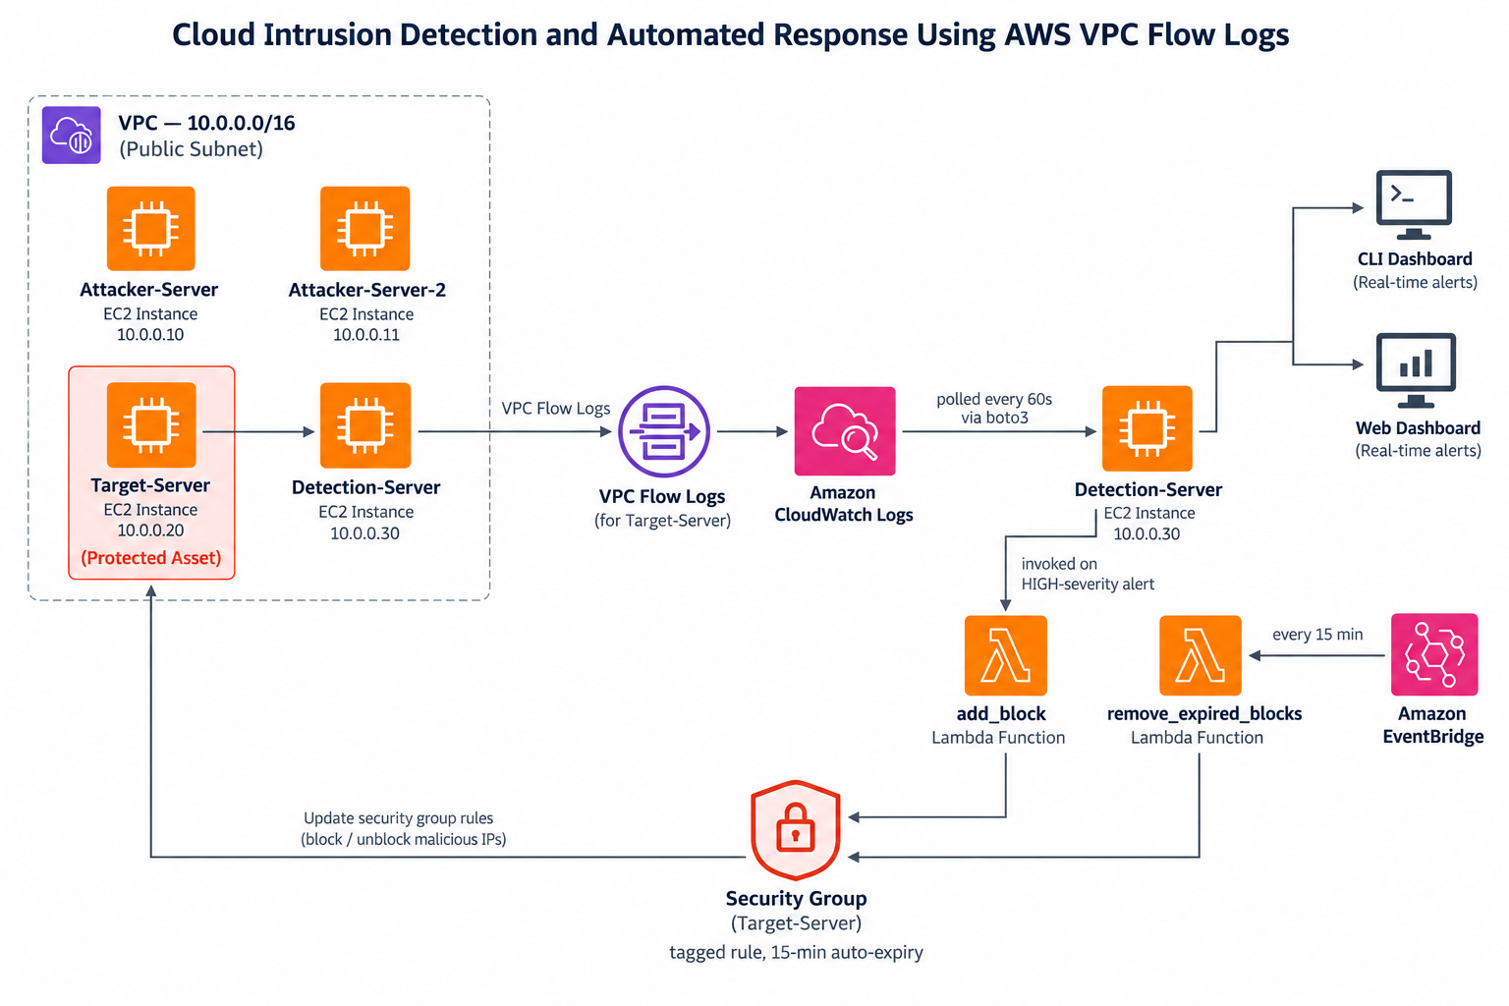
Architecture & Telemetry Pipeline
Four EC2 instances in one VPC — traffic flows left to right, from attack simulation through detection to automated containment.
Attackers
Target
VPC Flow Logs
CloudWatch
Detection Engine
Lambda
Security Group
10.0.1.194 / .70
Protected asset
Every connection
Log storage
60s cron cycle
Automated response
15-min containment
Only HIGH-severity, deterministic rule matches trigger an automatic Security Group update — statistical anomalies are logged, never auto-blocked.
Shloka Hitesh Kamdar · 226463713
3 / 9

Slide 4
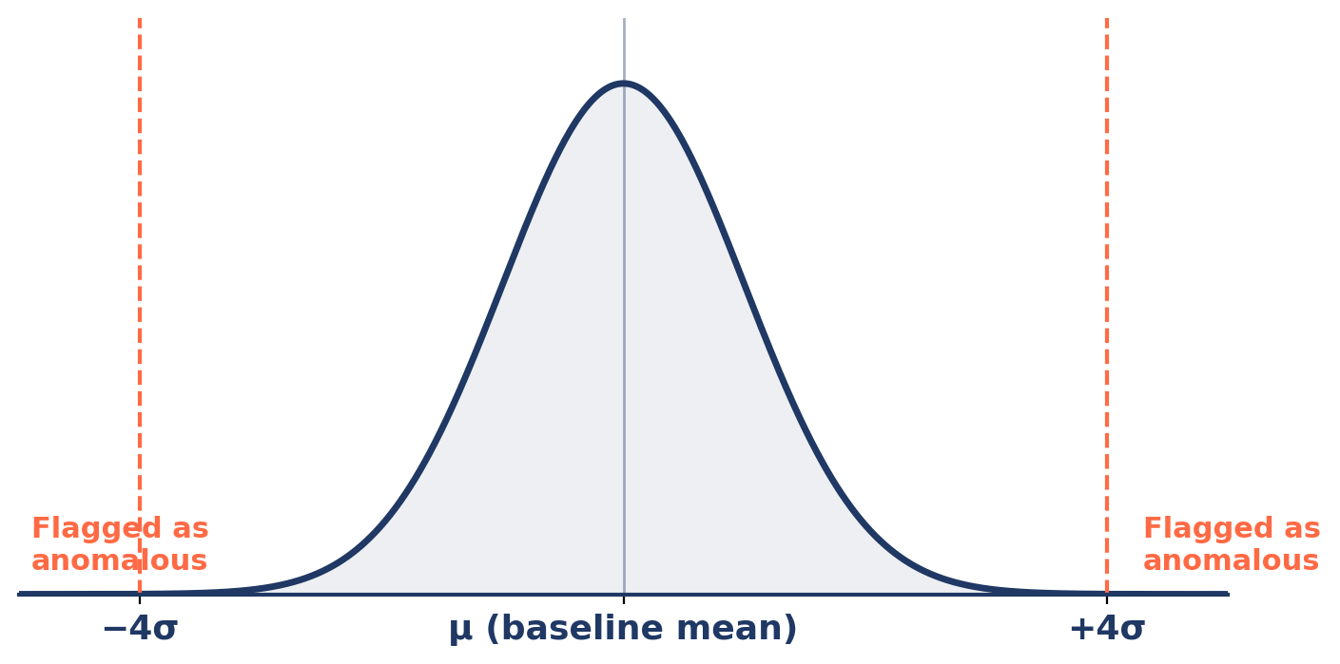
How Statistical Detection Works
The Z-score layer flags traffic that deviates significantly from a learned baseline of normal behaviour.
Baseline built from 45–60 minutes of captured normal traffic — mean (μ) and standard deviation (σ) computed per feature.
Heavy-tailed volume features are log-transformed first, so a rare legitimate spike (an apt update, an scp transfer) doesn’t distort the baseline.
Threshold set at 4.0σ — raised from an initial 3.0σ once the log-transform tightened the baseline and 3σ began over-firing on ordinary variation.
A window is flagged MEDIUM the moment ANY single feature’s z-score exceeds the threshold.
z = | x − μ | / σ
Real example: a window with reject_ratio = 0.50 fell below the rule’s 0.8 threshold — but its Z-score of 1098 still caught it.
Shloka Hitesh Kamdar · 226463713
4 / 9

Slide 5
How Detection Metrics Are Calculated
Every window’s raw outcome is compared against the recorded ground-truth attack window to build a confusion matrix.
decision_log.jsonl
+
ground_truth.json
Confusion
Matrix
Every window examined, including quiet ones
Real attack_start / attack_end from the test script
True Positive
False Negative
Derived Metrics
Window inside the attack period AND detected = true
Window inside the attack period AND detected = false
Detection Rate
TP / (TP + FN)
False Positive
True Negative
False Positive Rate
Window outside the attack period AND detected = true
Window outside the attack period AND detected = false
FP / (FP + TN)
Response Time
first TP − attack_start
Shloka Hitesh Kamdar · 226463713
5 / 9

Slide 6
Live Demonstration
Detection and automated response, in real time

Slide 7
Ground Truth Comparison & Metrics
Predicted alerts are compared against pre-labelled ground-truth traffic to quantify accuracy and responsiveness.
Validation Process
1
Label each flow log entry as normal or malicious (ground truth).
2
Run the detection system and record its predicted label.
3
Build a confusion matrix (TP / FP / TN / FN).
4
Calculate Detection Rate and False Positive Rate from the matrix.
5
Record detection latency (time from event to alert).
Shloka Hitesh Kamdar · 226463713
7 / 9

Slide 8







Limitations & Future Work
System Limitations
Future Enhancements
Single-VPC Boundary
ML / AI Classifier Integration
Analysis is strictly localized to a single VPC without cross-account or multi-VPC event correlation.
Originally proposed and now genuinely viable using real labelled attack data collected during live testing.
Allow-Only Model
Cross-Account Automation
AWS Security Groups lack explicit deny rules, requiring active revocation of ingress permissions.
Orchestrating IAM AssumeRole actions across multi-account AWS Organizations.
Delivery Ingestion Lag
Dynamic Blacklist Expiration
VPC Flow Logs aggregate traffic in intervals, creating a real detection latency floor outside the engine’s control.
Automated rule rollback with TTL-based state decay to prevent Security Group table exhaustion.
L3/L4 Telemetry Only
Flow logs lack packet payload inspection and application-layer context.
Shloka Hitesh Kamdar · 226463713
8 / 9

Slide 9
Thankyou
SHLOKA HITESH KAMDAR
Shloka Hitesh Kamdar · 226463713

