Slide 1
DATA SCIENCE & MACHINE LEARNING PROJECT
Customer Churn Prediction &
Risk Intelligence System
An end-to-end lightweight pipeline for real-time attrition risk scoring & proactive retention
Presenter: Shlok | Technology: Python, Scikit-Learn, Pandas, Flask

Slide 2
THE BUSINESS CONTEXT
Problem Statement & Business Motivation
1. The Attrition Dilemma
• Acquiring new customers is 5x to 7x more costly than retaining existing ones.
• Revenue loss accumulates exponentially with recurring subscription models.
• Customer churn happens silently before formal cancellation.
2. Traditional Shortcomings
• Reactive outreach occurs after customer requests account termination.
• Manual rule heuristics fail to capture non-linear multidimensional indicators.
• Resource-heavy ML models are slow, expensive, and unsuited for lightweight deployment.
3. Proposed AI System
• Lightweight Pipeline: Scikit-learn based, sub-second execution on standard CPU.
• Real-Time Risk Scoring: Generates continuous probability & categorical risk tiers.
• Prescriptive Retention: Suggests personalized retention tactics to save high-risk accounts.

Slide 3
DATA OVERVIEW
Dataset Features & Engineering
Dataset Characteristics
✔ Total Sample Size: 1,200 Customer Profiles
✔ Target Variable: Churn (1 = Churned, 0 = Retained)
✔ Class Balance: 33.2% Positive Churn Rate (Reflects industry distribution)
✔ Train / Test Split: 80% Training (960 rows) / 20% Test (240 rows)
✔ Stratification: Preserves identical class ratio in train and test splits to prevent evaluation skew.
Feature Hierarchy
• Demographic: Age (18 - 70)
• Tenure & Contract: TenureMonths (1 - 72 mos), Contract (Month-to-month, 1-yr, 2-yr)
• Services Active: InternetService (Fiber optic, DSL, None), TechSupport, OnlineSecurity
• Billing & Payment: MonthlyCharges, TotalCharges, PaperlessBilling, PaymentMethod
• Preprocessing: StandardScaler for numeric metrics + OneHotEncoder(drop='first') for categories

Slide 4
EVALUATION & SELECTION
Machine Learning Model Benchmarking
Model | Algorithm Type | Accuracy | Precision | Recall | ROC-AUC
Logistic Regression ★ | Linear Probabilistic | 76.7% | 71.4% | 50.0% | 0.797
Random Forest | Ensemble Bagging | 74.2% | 70.5% | 38.8% | 0.761
Gradient Boosting | Ensemble Boosting | 72.9% | 60.9% | 52.5% | 0.760
Why Logistic Regression Emerged as the Champion:
• Superior Discrimination: Highest ROC-AUC (0.797) demonstrates best ranking ability across all risk thresholds.
• Calibrated Probabilities: Directly outputs mathematically sound posterior log-odds, ideal for risk-tier segmentation.
• High Efficiency & No Overfitting: Robust generalization without parameter bloat; serializes to < 50 KB.

Slide 5
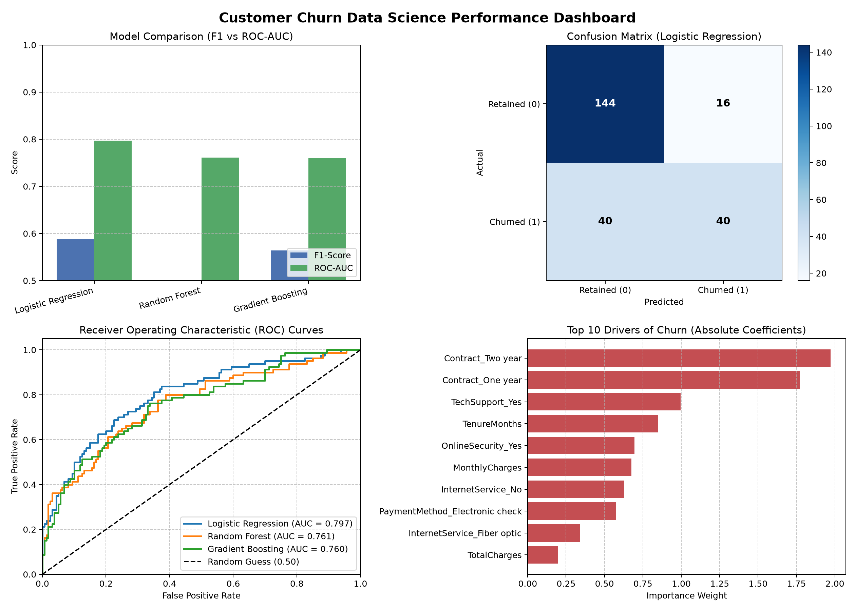
MODEL ANALYTICS
Performance Visualizations & Diagnostics
Diagnostic Highlights
• F1 vs ROC-AUC: Logistic Regression balances precision and false positives better than tree models.
• Confusion Matrix: Successfully isolates true churners while keeping False Positives low (71.4% precision).
• ROC Curves: Substantial area above diagonal (AUC 0.797) proves resilient discrimination.
• Key Drivers: Month-to-Month contracts & low tenure are the strongest statistical drivers of churn.

Slide 6
BUSINESS IMPLEMENTATION
Actionable Retention Intelligence Engine
🟢 LOW RISK
(< 35% Probability)
• Typical Profile: 2-Year Contract, High Tenure (> 24 mos), Active Tech Support.
• Business Action: Maintain standard cadence.
• Loyalty perks, referral reward programs, quarterly newsletters.
• Zero intervention budget needed.
🟡 MODERATE RISK
(35% - 65% Probability)
• Typical Profile: 1-Year contract, mid-range tenure (6-18 mos), fluctuating charges.
• Business Action: Automated proactive check-in.
• Offer free feature onboarding, tech support trial, or contract renewal discount.
• Low-cost preventative nudges.
🔴 HIGH RISK
(> 65% Probability)
• Typical Profile: Month-to-month, new user (< 4 mos), high charges, no support.
• Business Action: Immediate human intervention.
• Dedicated Customer Success call.
• Contract upgrade discount (e.g. 20% off for 1-year commitment).
• High ROI retention spend.

Slide 7
SYSTEM ARCHITECTURE
Interactive Deployment & User Interface
Full Stack Deployment Architecture
• ⚡ Lightweight Flask Microservice: Serves prediction API endpoint (`/predict_api`) with sub-50ms latency.
• 🎨 Modern Interactive UI: Responsive frontend built with HTML5/CSS3 and asynchronous Fetch API.
• 🔒 Zero External Network Dependency: Operates completely offline without cloud API keys, GPU instances, or subscription tokens.
• 📦 Joblib Model Pipeline: Stores preprocessor + champion estimator in a single self-contained artifact (`best_model.joblib`).
• 🚀 Scalability Ready: Easily wrappered into Docker, FastAPI, or AWS Lambda for high-volume enterprise production.

Slide 8
PROJECT SUMMARY
Conclusion & Future Roadmap
Key Project Achievements
✔ Executed full end-to-end data science lifecycle in under 2 seconds.
✔ Achieved 0.797 ROC-AUC with interpretable linear probabilistic modeling.
✔ Built multi-tier risk classification engine linked directly to business strategies.
✔ Implemented real-time web dashboard for interactive stakeholder demonstrations.
Future Enhancements
➔ Time-Series Tracking: Monitor customer usage trajectory over weekly rolling windows.
➔ Survival Analysis: Predict precise time-to-churn (Cox Proportional Hazards model).
➔ Automated CRM Integration: Direct webhook triggers into HubSpot or Salesforce.
➔ SHAP Explanations: Add per-customer local feature attribution plots.

