Slide 1

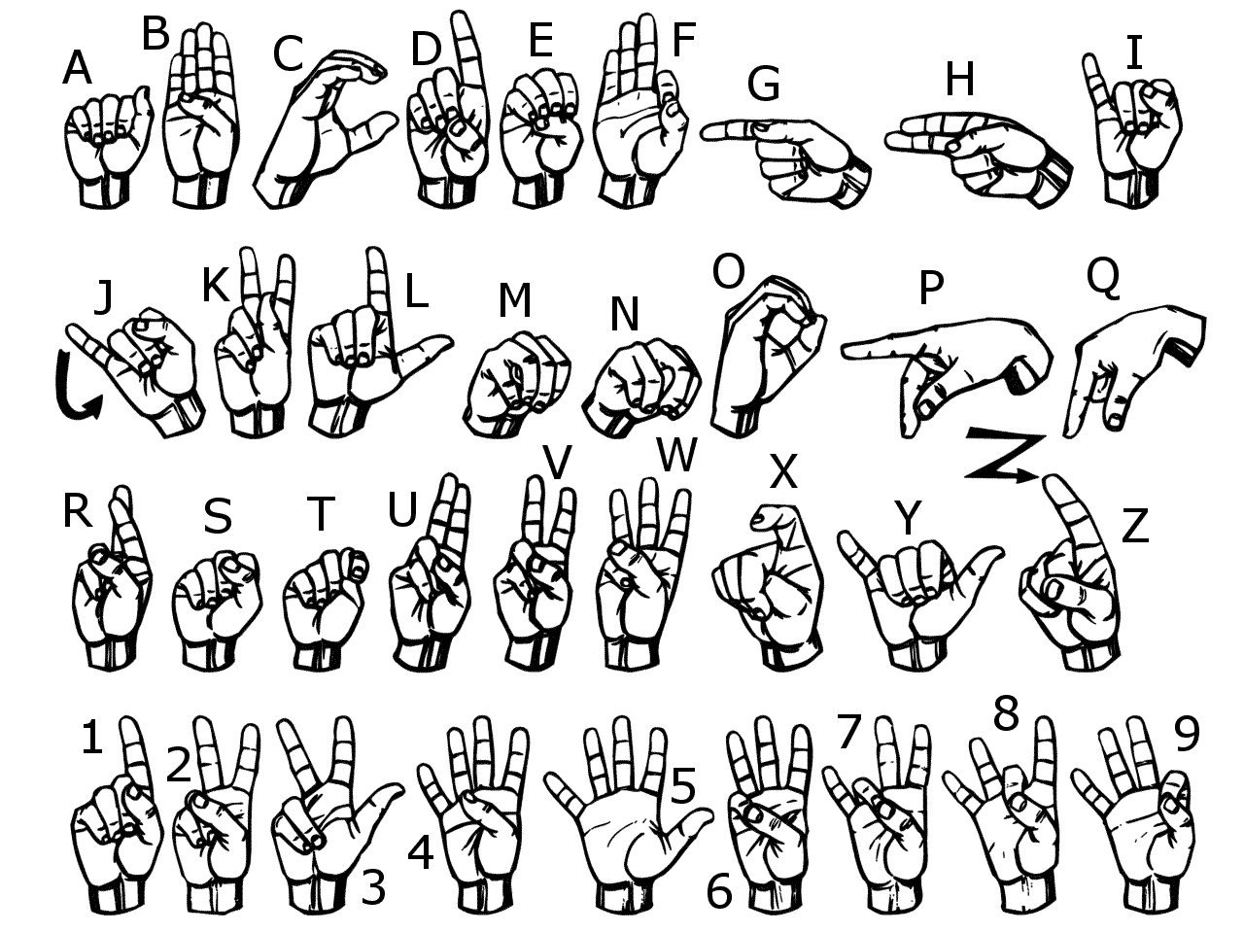
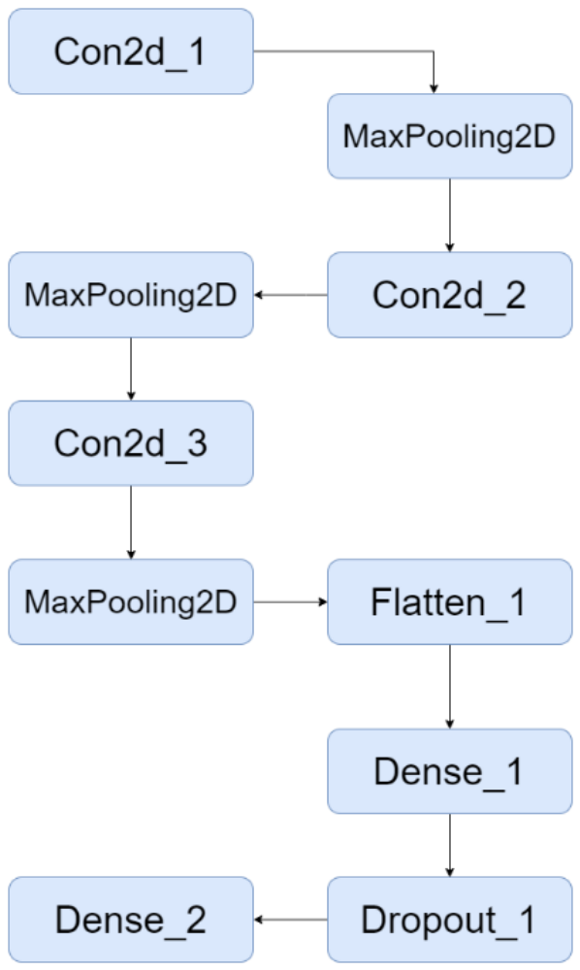
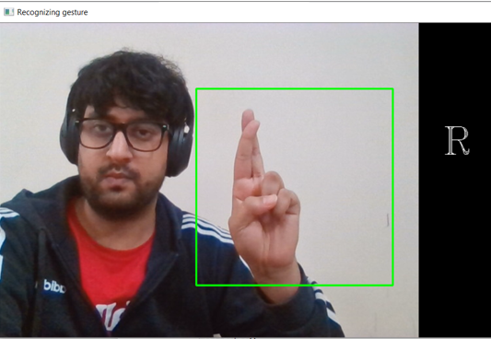
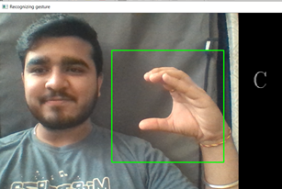
ASL Gesture Recognition
BUDT758B – Big Data and Artificial Intelligence for Business
Shlok Jethwa shlok.jethwa@marylandsmith.umd.edu | Purvi Kakkasagar purvi.kakkasagar@marylandsmith.umd.edu | Ankita Mittal ankita.mittal@marylandsmith.umd.edu | Harsh Sharma harsh.sharma@marylandsmith.umd.edu
`
ASL Based Hand Gesture Recognition using Convolution Neural Network(CNN)
We have analyzed a vision-based static hand gesture recognition system for American Sign Language, capable of translating the gesture into text and sound. The proposed Convolution Neural Network (CNN) architecture in the given papers achieved reasonable success rates at a relatively low computational cost.
Index terms: Gesture Recognition, American Sign Language, Vision Based System, Convolution Neural Network
A database consists of 44 gestures, and for each gesture, we have 2400 images. Our solution to convert ASL gestures to text involves a real-time vision-based hand gesture recognition system. We have taken a picture of the hand so that it is clear, and we recognized the right alphabet gesture according to ASL.
CHARTS / GRAPHS / IMAGES
Figure 3: American Sign Language
For Images,
it should be at least 150dpi,
i.e. for 35cm width image,
The width is about 2067 pixels
Figure 1: Detection of letter R
Figure 4: CNN Model
Conclusion
Our Convolution Neural Network (CNN) architecture achieved high success rates at a relatively low computational cost, and we achieved an accuracy of 99%. This shows that our model is well trained and robust. The architecture we proposed is comparable to the current industry standards. In future we can further enhance this model and use for multiple applications to benefit people with hearing and speaking disabilities.
Figure 2: Detection of the letter C

