Slide 1

Voice Controlled Home Automation System
REAL-TIME IOT-BASED APPLIANCE CONTROL AND MONITORING
TEAM MEMBERS
SRMCEM
GUIDE
Shlok Khare
Ojash Chaudhary
Raj Vardhan Srivastava
Krishna Kushwaha
Department Of
Computer Science(IoT)
Er. Atul Tiwari
Notes:
Welcome to our presentation on the Voice Controlled Home Automation System. We've developed a system that integrates IoT for seamless appliance control. This project focuses on making smart living accessible and efficient for everyone. We'll demonstrate how our solution provides real-time control and monitoring capabilities.

Slide 2

Problem Statement & Motivation
PROBLEM STATEMENT
●
Manual appliance operation is difficult for elderly and disabled individuals.
Empowering Smart Living Through IoT Connectivity
●
High energy wastage due to appliances being left on unintentionally.
●
Lack of remote accessibility and real-time status monitoring.
MOTIVATION
Provide a compact, low-cost IoT solution enabling voice and mobile control for comfort and energy savings.
Notes:
We've identified key challenges with traditional home appliance operation. Manual control is often difficult, especially for the elderly or disabled. This leads to energy waste and a lack of remote access. Our motivation is to solve these problems with a compact, low-cost IoT solution. We aim to enhance comfort and achieve significant energy savings. Next, we'll outline the specific goals we set for this project.

Slide 3

Project Objectives
VOICE INTEGRATION
REMOTE ACCESS
Control and monitor devices from anywhere using the Sinric Pro app.
Seamless control via Google Home and Amazon Alexa assistants.
REAL-TIME SYNC
COST EFFICIENCY
Maintain consistent device states across all control interfaces.
Design and implement a robust IoT system connecting appliances to the cloud for seamless voice and mobile control.
Utilize low-cost hardware for an affordable smart home solution.
Notes:
Our project objectives are clear and focused. We aim to design a robust IoT system that connects appliances to the cloud. This enables seamless voice and mobile control. We're integrating with Google Home and Amazon Alexa for intuitive voice commands. Remote access is crucial, allowing control from anywhere via the Sinric Pro app. We also ensure real-time synchronization of device states across all interfaces. Finally, we prioritize cost-efficiency, using affordable hardware for a practical smart home solution. Now, let's look at the specific hardware components that make this possible.

Slide 4
Hardware Components
Table of required components with function and quantity — essential for building and testing the prototype.
COMPONENT
FUNCTION
QTY
NodeMCU ESP8266
Wi-Fi microcontroller; receives cloud commands and controls relays.
1
4-Channel Relay Module
Acts as an electronic switch to control high-voltage AC appliances.
1
AC Appliances
Household devices like bulbs or fans to be automated.
4
Power Supply (5V DC)
Regulated power source for the NodeMCU and relay coils.
1
Jumper Wires & Breadboard
Used for making secure electrical connections between components.
1 Set
Notes:
The hardware components are the foundation of our system. The NodeMCU ESP8266 serves as our Wi-Fi microcontroller, processing cloud commands. A 4-channel relay module acts as the electronic switch for high-voltage AC appliances. We're automating up to four household devices like bulbs or fans. A stable 5V DC power supply is essential for the NodeMCU and relay coils. Jumper wires and a breadboard complete the setup for secure electrical connections. These components work together within our system architecture, which we'll explore next.

Slide 5

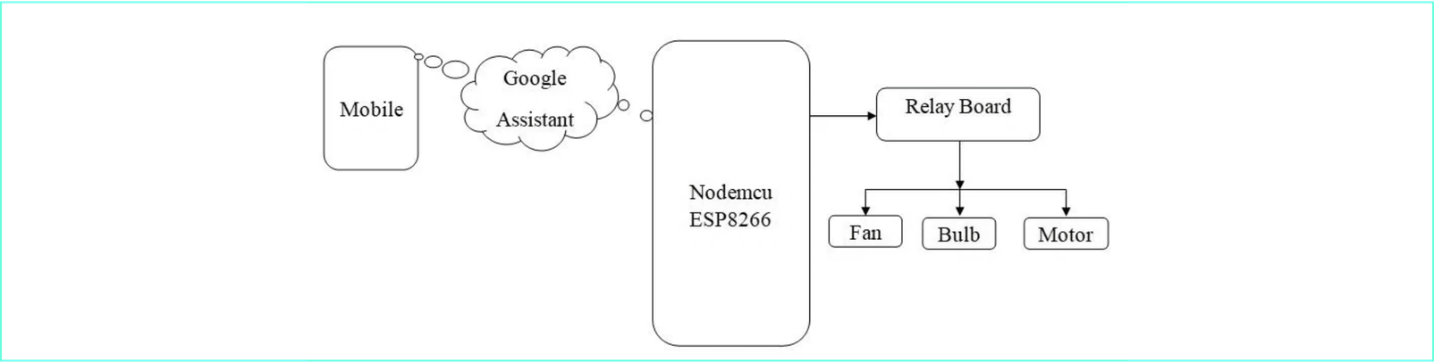
System Architecture
01
Voice Assistants: Capture voice commands and send to the cloud.
02
Sinric Pro Cloud: Central IoT bridge managing device states.
03
NodeMCU ESP8266: WebSocket client that executes commands.
04
Relay Module: Provides isolation and switches appliances.
Notes:
Our system architecture illustrates the operational flow. Voice assistants capture commands and send them to the cloud. The Sinric Pro Cloud acts as the central IoT bridge, managing device states. The NodeMCU ESP8266 functions as a WebSocket client, executing these commands. Finally, the relay module provides isolation and switches the appliances. This layered approach ensures reliable and secure communication from voice command to physical action. Next, we'll detail the step-by-step working principle.

Slide 6

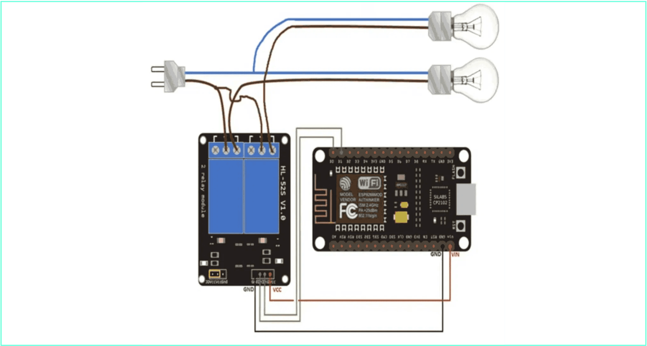
Circuit Diagram & Connections
1
RELAY CONNECTIONS
Connect NodeMCU D1/D2/D5/D6 to Relay IN1–IN4 for appliance control.
2
POWER & GROUND
Use a regulated 5V DC for NodeMCU VIN and Relay VCC; share common GND.
3
AC LOAD WIRING
Switch the AC Live via Relay COM and NO to control appliances safely.
Quick Ref: D1:IN1, D2:IN2, D5:IN3, D6:IN4 | VCC:5V |
GND:Common
Notes:
Now, let's look at the physical connections. Proper wiring is critical for system functionality and safety. We connect the NodeMCU's digital pins directly to the relay module's input pins. This allows the microcontroller to send low-voltage signals to control the high-voltage relays. We also ensure a common ground between the NodeMCU and the relay for stable operation. This setup isolates the sensitive microcontroller from the AC mains, which is a key safety feature. Next, we will see the complete circuit diagram.

Slide 7
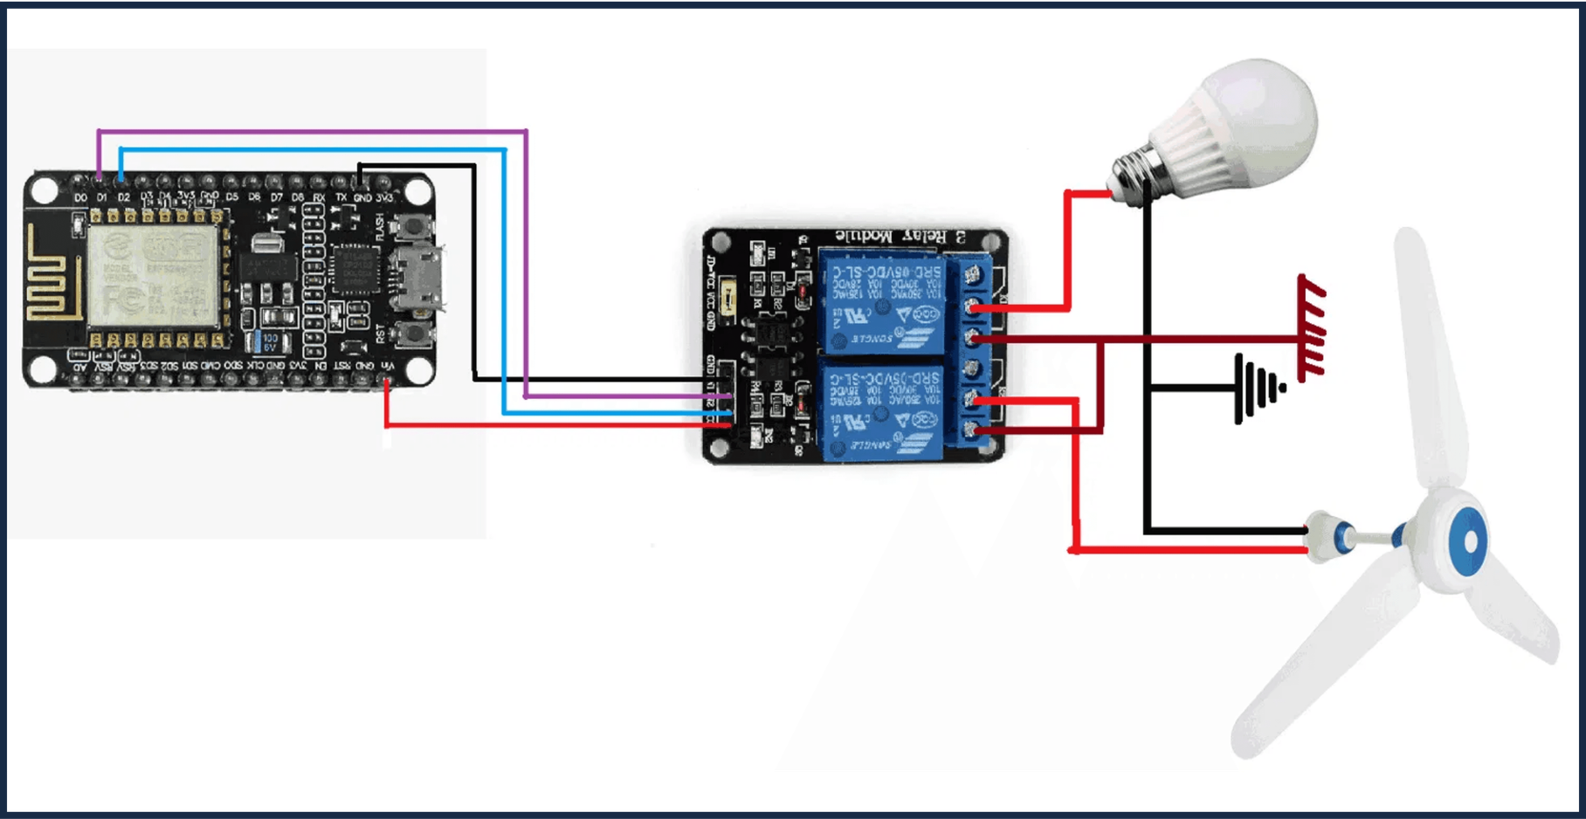
Full Circuit Diagram
COMPLETE HARDWARE INTERFACING: NODEMCU, RELAY MODULE, AND AC LOADS
Notes:
This slide presents the full circuit diagram, integrating all components. It shows the NodeMCU, the relay module, and the AC loads like bulbs and fans. This comprehensive view illustrates how the low-voltage control circuit interfaces with the high-voltage power circuit. The diagram emphasizes the electrical isolation provided by the relay, which is essential for protecting the ESP8266. Now, let's delve into the system's operational flow.

Slide 8
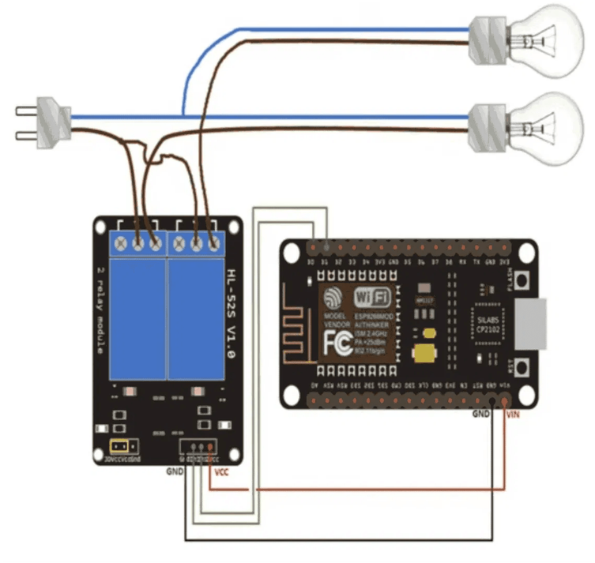
Working Principle
STEP 01
Voice Command
User issues a voice command (e.g., "Turn on the light") to a Google Home or Amazon Alexa device.
STEP 02
Cloud Processing
The voice assistant routes the request to the Sinric Pro cloud, which identifies the target device and state.
STEP 03
Device Action
Sinric Pro sends a WebSocket message to the NodeMCU ESP8266, which is persistently connected to the internet.
Hardware Execution: NodeMCU controlling Relay and AC Loads
STEP 04
Physical Switch
The NodeMCU triggers the corresponding relay, completing the AC circuit and powering the appliance.
Notes:
The working principle outlines the step-by-step process from voice command to physical action. When a user issues a voice command, the assistant processes it and sends it to the Sinric Pro cloud. Sinric Pro then transmits this command via WebSocket to our ESP8266. The ESP8266 receives this signal and activates the appropriate relay, switching the appliance. This entire sequence happens in near real-time, providing an immediate response to the user's command. This seamless interaction is crucial for a responsive smart home experience. Next, we will explore how the Sinric Pro dashboard integrates with this system.

Slide 9
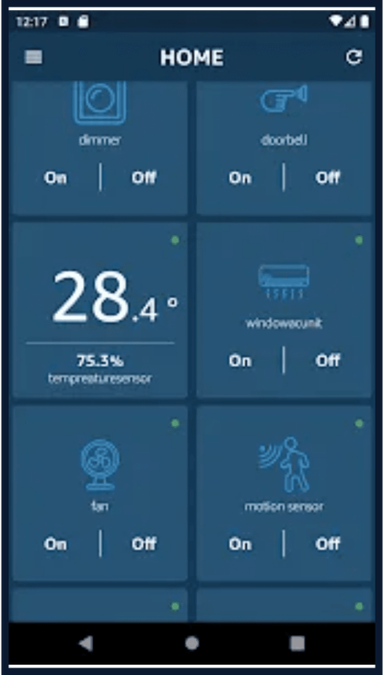
Sinric Pro Dashboard & App Integration
The system synchronizes device states in real-time across voice assistants and the mobile dashboard for seamless control.
VOICE COMMAND / ACTION
SYSTEM RESPONSE
"Turn on Living Room Light"
Relay 1 toggles ON; App status updates to 'Active'.
"Turn off Bedroom Fan"
Relay 2 toggles OFF; App status updates to 'Inactive'.
Manual App Toggle
Cloud sends WebSocket signal; Relay state changes instantly.
"Is the Kitchen Light on?"
Assistant queries Sinric Pro; reports current relay state.
Note: Results are published via MQTT/WebSocket; widgets refresh in real-time with <200ms latency.
MOBILE CONTROL INTERFACE
Notes:
The Sinric Pro dashboard and app integration provide a crucial visual interface for monitoring and control. This table illustrates how voice commands and manual app toggles synchronize device states across the system. The system ensures real-time updates, with device status reflecting accurately on both the voice assistant and the mobile app. This synchronization is achieved through MQTT and WebSocket protocols, guaranteeing low latency and a consistent user experience. This integration allows for flexible control, whether through voice or touch. Next, we will discuss the advantages, applications, and future scope of this system.

Slide 10

Advantages, Applications & Future Scope
⚡
ADVANTAGES
🏠
APPLICATIONS
🚀
FUTURE SCOPE
●
Hands-free operation via voice commands for maximum convenience.
●
Smart Homes: Lighting, climate, and security control.
●
Integration with AI for predictive and adaptive automation.
●
Energy efficient through remote monitoring and scheduling.
●
Hospitals: Patient-centric device management for accessibility.
●
Advanced Energy Analytics and real-time reporting.
●
Cost-effective hardware implementation using open-source platforms.
●
Biometric and Gesture Control for enhanced security.
●
Offices: Automated meeting room and energy management.
Notes:
This system offers significant advantages, expanding beyond basic home automation. We're not just talking about convenience; we're enabling accessibility and efficiency. Our design provides hands-free control, which is crucial for many users, and it's energy-efficient through remote monitoring. The cost-effectiveness of using open-source platforms makes this solution widely accessible. We see applications in smart homes, of course, but also in hospitals for patient care and in offices for automated management. Looking ahead, we envision integrating AI for predictive automation and advanced energy analytics. This will move us toward truly intelligent environments. Now, let's summarize our findings.

Slide 11

Conclusion
Successfully developed a robust IoT-based voice-controlled home automation system.
Demonstrated effective synergy between ESP8266, Sinric Pro, and Voice Assistants.
Provided a practical, low-cost solution for modern smart living and accessibility.
Established a scalable foundation for future smart home ecosystem expansions.
SMART HOMES FOR A SMARTER FUTURE
Notes:
In conclusion, we've successfully developed a robust IoT-based voice-controlled home automation system. This project demonstrates the effective synergy between the ESP8266, Sinric Pro, and popular voice assistants. We've provided a practical, low-cost solution that enhances modern smart living and accessibility. This system establishes a scalable foundation for future smart home ecosystem expansions. We believe in 'Smart Homes for a Smarter Future.' Next, we'll show you the system in action.

Slide 12
Any Questions?
DEMONSTRATION & DISCUSSION
Thank You for Your Attention!
Notes:
We are now ready for a live demonstration of our system. You'll see how simple voice commands translate into immediate actions. After the demonstration, we'll open the floor for any questions you might have. Thank you for your attention.

