Slide 1
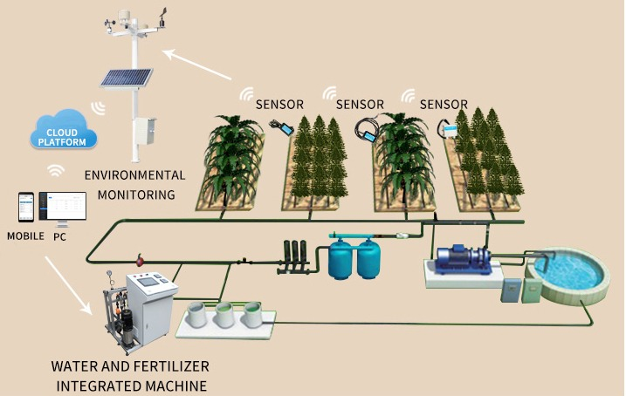
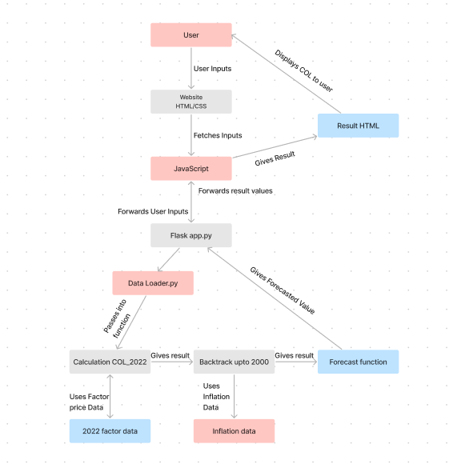
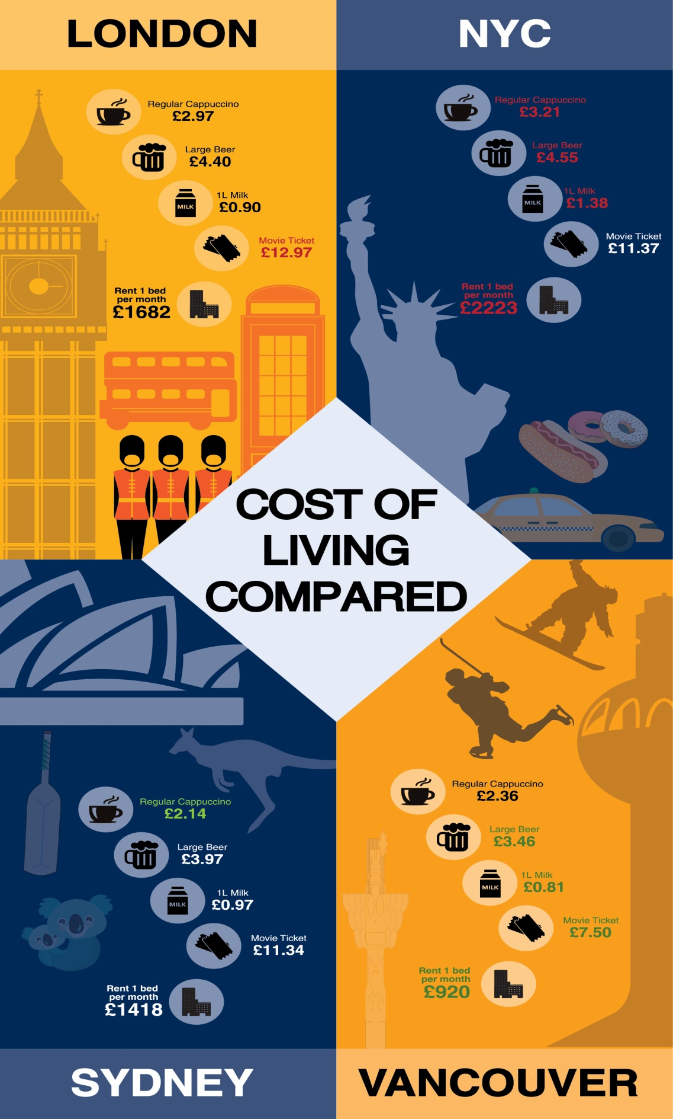
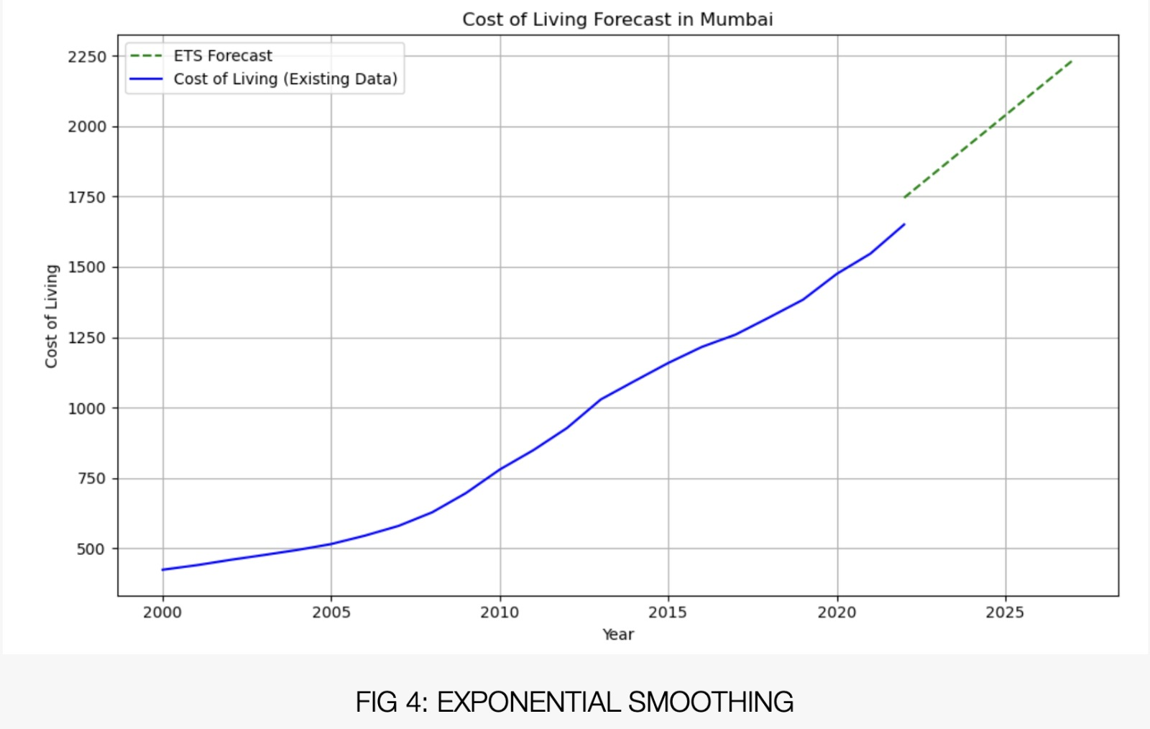
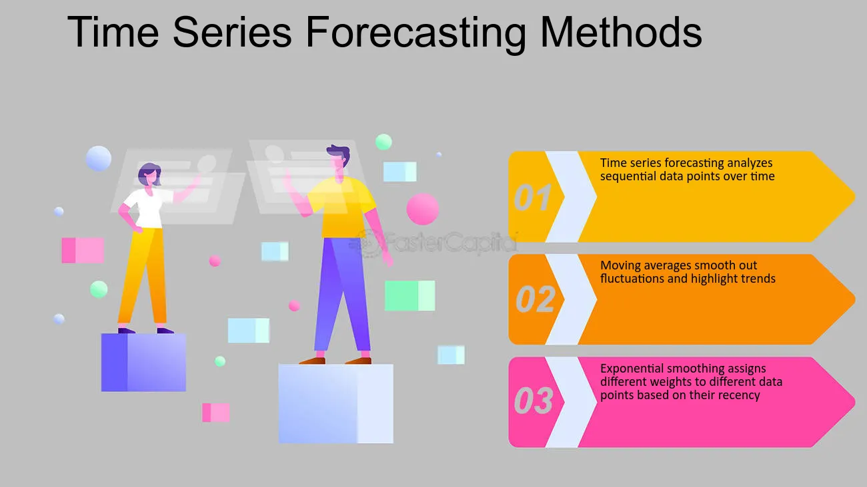
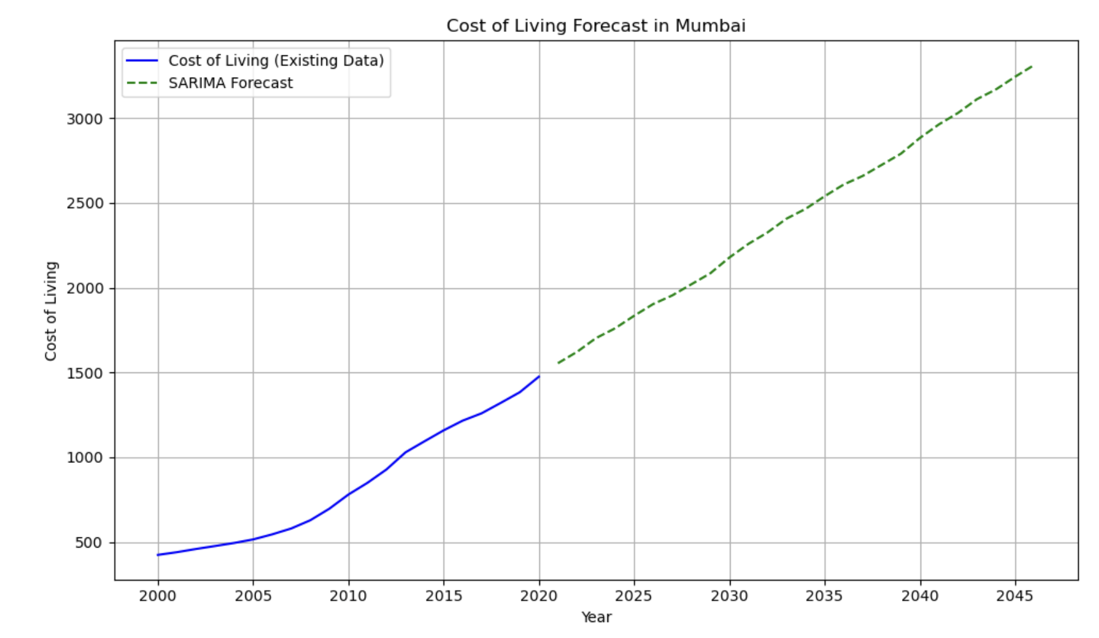
Cost Of Living Prediction
Diagrammatic View of Algorithm and Architecture
The Architecture of the complete project includes a user friendly interface, a Python backend that has been incorporated with Forecasting model created after exhaustive data analysis
Socio-Economic Perspective and Conclusion :
Our project responds to the socio-economic need for personalized cost forecasting, leveraging data analytics and machine learning. Through meticulous analysis and algorithm optimization, we've crafted a robust system for informed financial planning. Empowering users with accurate insights, our intuitive interface facilitates proactive decision-making, crucial in navigating future cost uncertainties.
Problem Statement
This project aimed to develop a sophisticated system for forecasting future Cost of Living (COL) values. Leveraging historical price data and inflation rates across different regions, advanced analytical and statistical methods were applied to model COL trends. The system was tailored to individual user needs, with a user-friendly interface for seamless access to personalized COL forecasts.
Motivation
Our motivation stemmed from a shared commitment to address the growing need for individuals to navigate the complexities of future Cost of Living expenses with confidence. By harnessing advanced analytical techniques and user-centric design, we aimed to empower individuals to plan ahead and achieve greater financial stability.
Description
Through meticulous analysis of price data and historical inflation rates, our project developed a sophisticated Cost of Living forecasting system. By tailoring predictions to individual user preferences and needs, we provided a powerful tool for informed financial planning. Our user-friendly interface ensures accessibility, enabling users to make proactive decisions in managing their expenses.
Methodology
Beginning with thorough data collection of 2022's goods, services costs, and historical inflation rates, our project employed Python libraries for rigorous data cleaning and processing. Statistical, machine learning, and time-series forecasting analyses refined algorithms for accuracy. After extensive testing, the finalized forecasting algorithm seamlessly integrated into a user-friendly website, blending HTML, CSS, and JavaScript for intuitive design, while Python's Flask framework managed backend operations. Aesthetic data visualization enhances analytical comprehension, providing users with invaluable future cost insights.
Title of the figure
Title of the figure
Title of the figure
Time-Series Forecasting
Costs across Globe
In cost of living forecasting, inflation rates are pivotal predictors, integrated with time series models like ARIMA, SARIMA, and exponential smoothing. By analyzing historical data, these models predict future living expenses, aiding individuals, businesses, and policymakers in budgeting and financial planning amidst changing economic conditions.
Our model’s exclusive feature is that it covers over 3000 cities across the globe, giving the accurate cost of living of numerous cities with the feature of user-specific lifestyle preferences
The Exponential Smoothing Forecast generates nearly 90% MAPE in forecasting futuristic cost of living value, The SARIMA function gives an MAPE of 85%, the ensembled version gives around 80% MAPE over the complete dataset and the ensembled version of SARIMA and Exponential smoothing further elevates it upt o 92%

