Slide 1

Predictive Policing

Slide 2
Introduction to Predictive Policing
Overview: Predictive policing is a law enforcement strategy that uses data analysis and algorithms to identify potential crime hotspots and predict future criminal activities.
Importance: This approach helps in proactive policing, optimizing resource allocation, and enhancing public safety.
Objectives: The presentation aims to provide an understanding of predictive policing, its technologies, benefits, challenges, and future prospects.

Slide 3
What is Predictive Policing?
Definition: Predictive policing involves using data analysis and algorithms to predict where and when crimes are likely to occur.
Key Concepts:
Data-Driven: Uses historical crime data to make predictions.
Proactive: Aims to prevent crimes before they happen.
Resource Optimization: Helps in efficient allocation of police resources.

Slide 4
Need for Predictive Policing
Increasing Crime Rates: Addresses rising crime through effective strategies.
Resource Allocation: Optimizes deployment of police resources.
Proactive Policing: Focuses on crime prevention rather than reaction.

Slide 5
Areas Where Predictive Policing is Used
Global Adoption: Implemented in countries like the USA, UK, and parts of Europe.
Impact: Demonstrates reductions in crime rates and enhanced public safety.

Slide 6
Advantages and Disadvantages
Advantages:
Efficient resource utilization.
Proactive crime prevention.
Enhanced public safety via data-driven strategies.
Disadvantages:
Privacy concerns and potential bias.
Dependence on data quality.
Challenges in transparency and accountability.

Slide 7
Ethical Considerations
Privacy and Civil Liberties: Predictive policing can infringe on individual privacy and freedoms through extensive data collection and surveillance.
Bias in Algorithms: Historical biases in data can lead to unfair and discriminatory predictions, disproportionately affecting certain communities.
Transparency: Lack of clarity in how algorithms work raises trust issues; transparency is essential for public confidence.
Accountability: Clear oversight is needed to ensure responsible use, prevent misuse, and address unintended consequences.

Slide 8
System Architecture of Predictive Policing
Data Collection: Gathering crime, geospatial, and socioeconomic data from various sources.
Preprocessing: Cleaning and organizing the data for analysis and feature extraction.
Analysis and Prediction: Using machine learning and statistical models to predict crime hotspots and potential incidents.
Integration: Connecting predictions with GIS tools, police databases, and real-time systems for actionable insights.
Feedback: Continuously refining models based on outcomes to improve accuracy and reduce biases.

Slide 9
Tasks Performed
Data Collection.
Preprocessing: Cleaning data for analysis.
Performing Analysis.
Model Training: Using machine learning algorithms.

Slide 10
Technology Used
Python
Matplotlib
Numpy
Pandas
Seaborn
Statsmodels
Kaggle

Slide 11
Methodology
Data Collection: Kaggle
Analytical Techniques: Statistical analysis, Descriptive analysis, Diagnostic Analysis, Predictive Analysis.
Model: Autoregressive Integrated Moving Average (ARIMA) Prediction Model.

Slide 12
About Dataset
Data Sources: https://www.kaggle.com/datasets/sudhanvahg/indian-crimes-dataset
This dataset captures a comprehensive snapshot of criminal activities across multiple Indian cities from 2020 to 2024. It includes detailed information about the type of crime, the date and time of occurrence, the weapon used, victim demographics, and the level of police deployment. With crimes ranging from identity theft to homicide, this dataset offers valuable insights for researchers, policymakers, and law enforcement agencies aiming to understand crime patterns and improve public safety. The data also includes information on whether the case was closed, providing a clear view of crime resolution rates across cities

Slide 13
Analytical Techniques
Statistical Analysis: Examines and interprets data to identify trends, patterns, and relationships using statistical techniques.
Descriptive Analysis: Summarizes and visualizes historical data to understand past performance or events.
Diagnostic Analysis: Investigates the causes behind observed trends or outcomes by analyzing data relationships.
Predictive Analysis: Uses historical data and machine learning models to forecast future outcomes or trends.

Slide 14
Analytical Model
The Autoregressive Integrated Moving Average (ARIMA) model is a statistical method for time series forecasting that combines:
Autoregression (AR): Predicts based on past values.
Integration (I): Makes the series stationary by differencing.
Moving Average (MA): Uses past errors to refine predictions.
It's ideal for time series with trends or patterns, using parameters

Slide 15
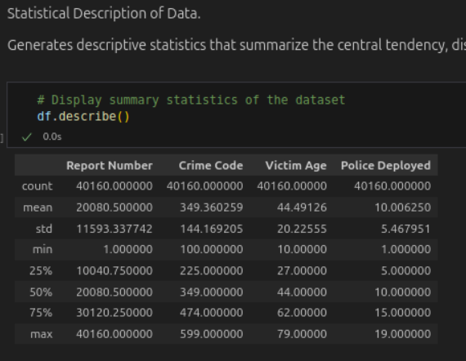
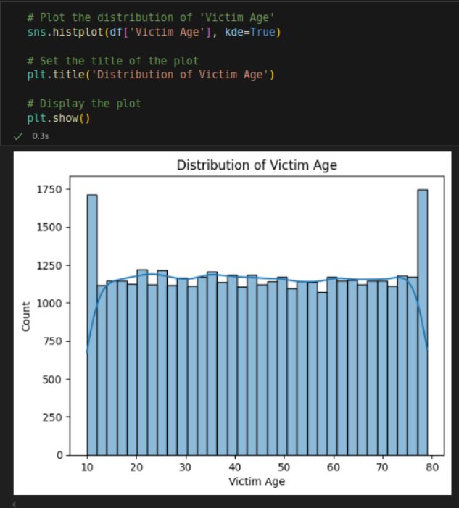
Code Snippets

Slide 16
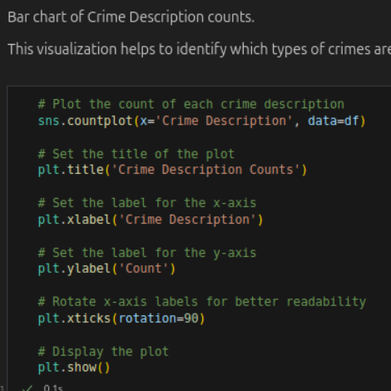
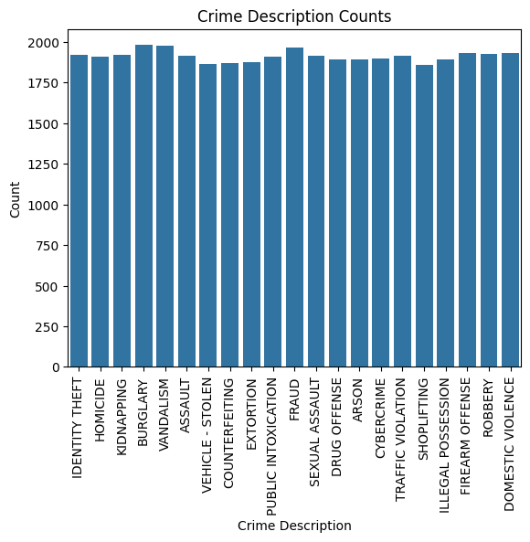
Code Snippets

Slide 17
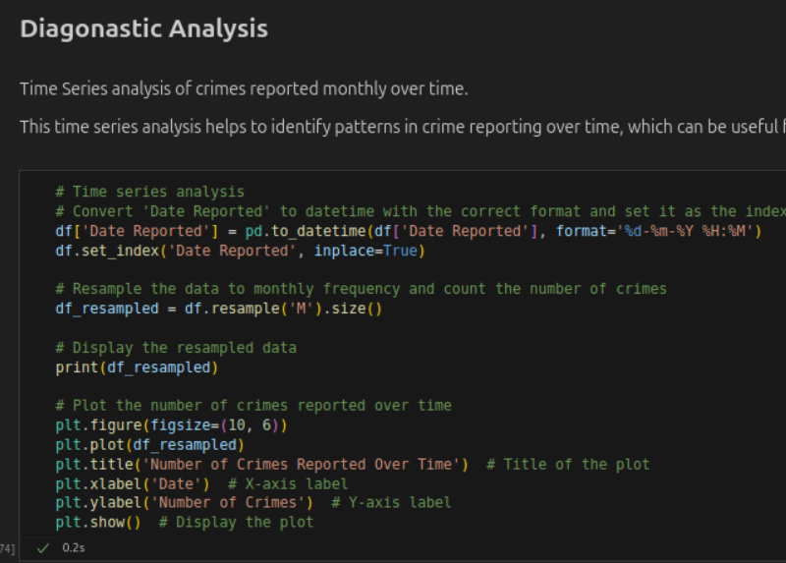
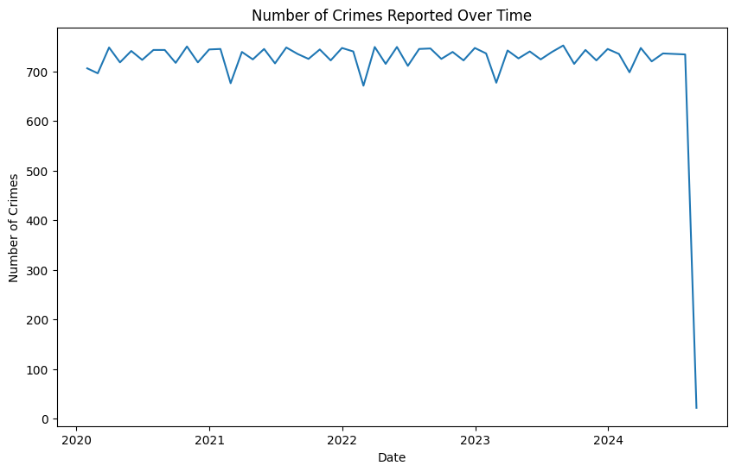
Code Snippets

Slide 18
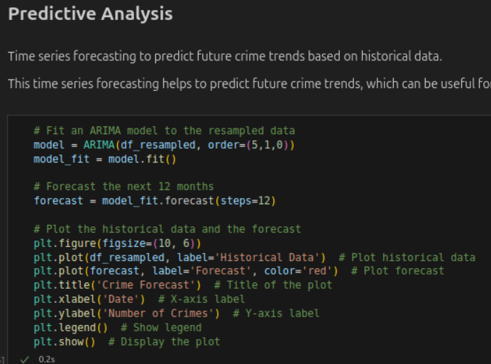
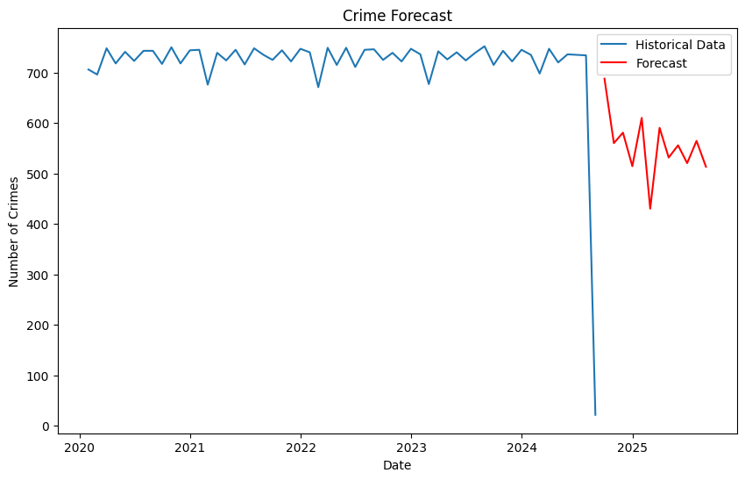
Code Snippets

Slide 19
Insights and Conclusions from Predictive Policing Analysis

Slide 20
Descriptive Analysis Insights
Crime data shows theft, assault, and burglary are the most reported crimes.
Victims aged 20-35 form the most vulnerable demographic group.
Statistical summaries highlight the nature and scale of crimes for resource planning.

Slide 21
Diagnostic Analysis Insights
Crime rates show seasonality, with peaks in summer and holiday seasons.
Anomalies indicate spikes during special events or unrest, requiring investigation.
Time series trends help identify patterns for better resource allocation.

Slide 22
Predictive Analysis Insights
ARIMA forecasts rising crime rates, especially theft, in the next 12 months.
Allocating resources to high-crime areas during peak times can mitigate risks.
Predictions guide policymaking and proactive crime prevention strategies.

Slide 23
Conclusions
Data-driven insights enable informed decisions to improve public safety.
Targeted interventions address high-risk areas and times effectively.
Continuous monitoring ensures adaptive and sustainable crime prevention.

Slide 24
Future scope
Technological Advancements: Potential advancements in predictive policing technologies, such as the integration of AI and IoT.
Research Directions: Future research areas, including improving algorithm accuracy, addressing bias, and enhancing data privacy.
Policy and Ethics: Need for ethical guidelines and policies to govern the use of predictive policing.

Slide 25
References
Predictive Policing | PPT
Full article: Predictive Policing: Review of Benefits and Drawbacks
Introducing Predictive Policing Technologies (PPT): An Action Research-Oriented Approach for EBOCD Initiatives
7 misconceptions about predictive policing webinar | PPT
Predictive Policing Explained | Brennan Center for Justice
Predictive policing - Wikipedia

Slide 26
References
Predictive Policing Technology: Fourth Amendment and Public Policy Concerns – University of Cincinnati Law Review Blog
Application of data science in predictive policing | PPT
Introducing Predictive Policing Technologies (PPT) | Semantic Scholar
Data Sources: https://www.kaggle.com/datasets/sudhanvahg/indian-crimes-dataset

