Slide 1
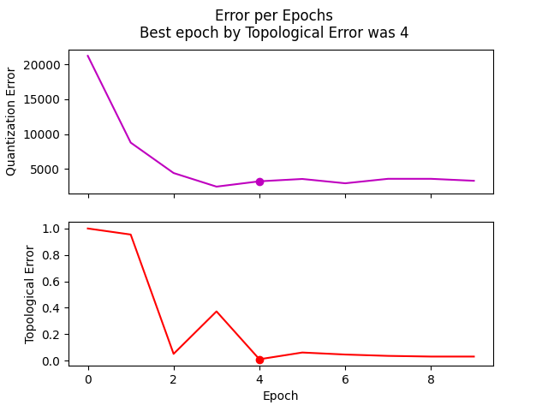
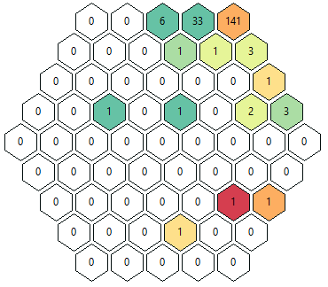
Exp 1 – RMS-TE
QE = 3207.207366291625
TE = 0.01020408163265306

Slide 2
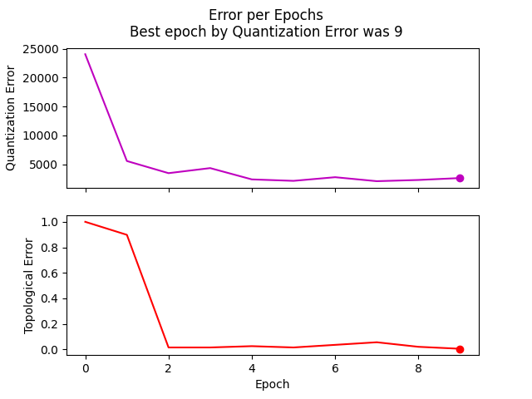
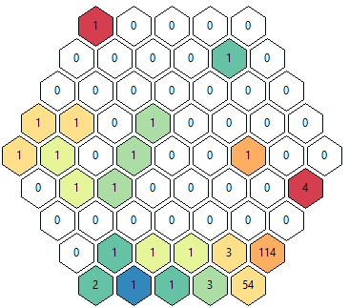
Exp2 – RMS - QE
QE = 2642.5882277345036
TE = 0.00510204081632653

Slide 3
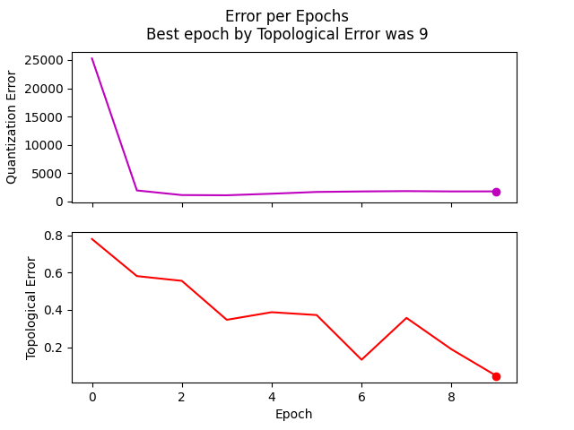
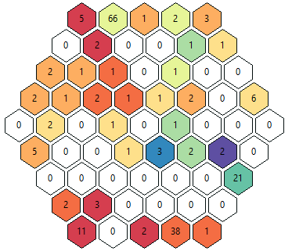
Exp3 – RMS-reverse - TE
QE = 1791.9988124954486
TE = 0.04591836734693878

Slide 4
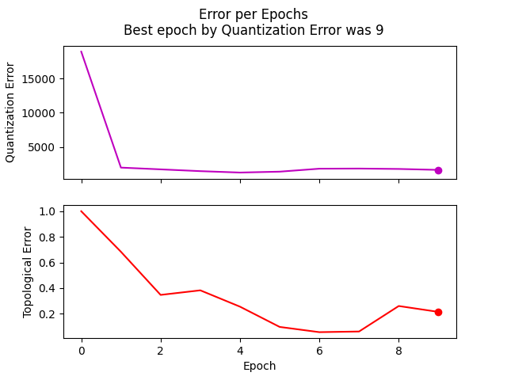
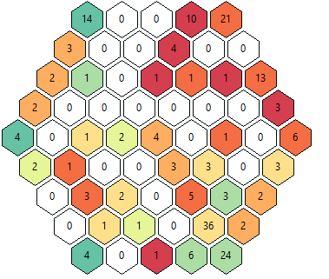
Exp4 – RMS-reverse - QE
QE = 1645.2450205431562
TE = 0.21428571428571427

Slide 5
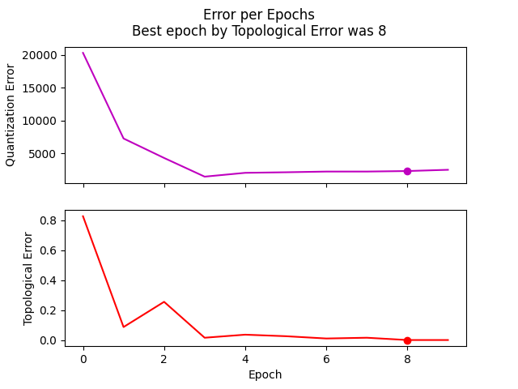
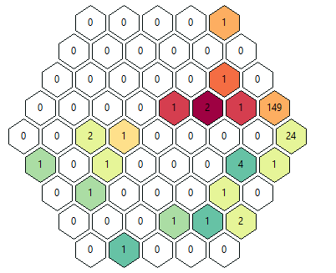
Exp5 – Var - TE
QE = 2279.7201750692125
TE = 0.0

Slide 6
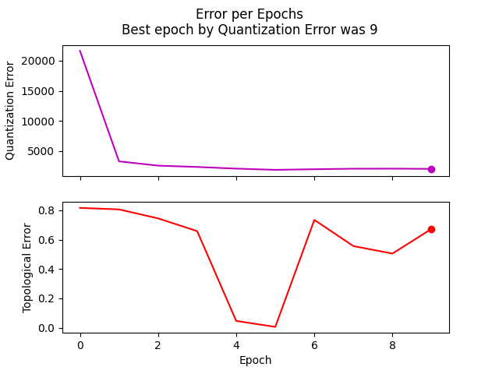
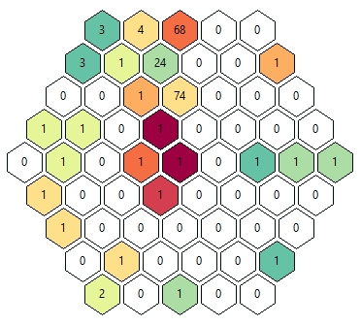
Exp6 – Var - QE
QE = 2031.6714220182814
TE = 0.673469387755102

Slide 7
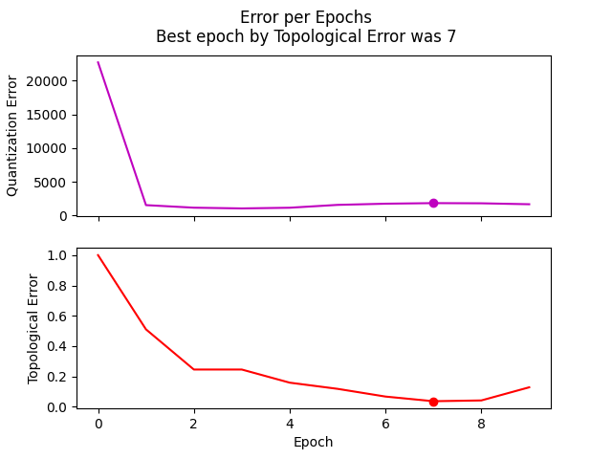
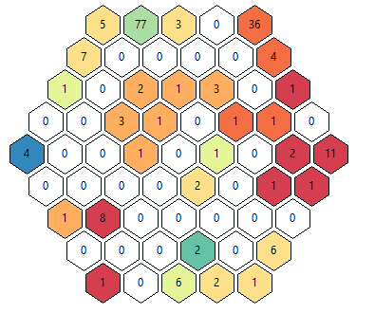
Exp7 – Var-reverse - TE
QE = 1837.7220044705443
TE = 0.03571428571428571

Slide 8
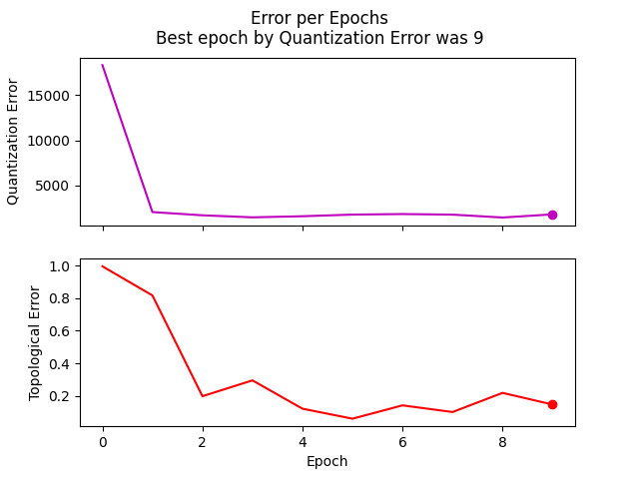
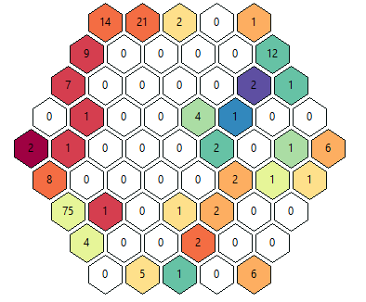
Exp8 – Var-reverse - QE
QE = 1772.7238607151219
TE = 0.14795918367346939

