Slide 1
IP Noise Generator
Project takers:
  Shlomi Fish
  Roy Glasberg
Supervisor:
  Lavy Libman

Slide 2
Purpose
Create a simulator for IP noise
Pass, drop or delay packets
Based on a user-configured probability logic
The simulator will provide an environment for testing protocols in the lab

Slide 3
Where we fit in
The kernel receives MAC frames and extracts the IP packets out of them.
We intercept the IP packets, and decide what to do with them.
Those IP packets contain information for protocols above IP.

Slide 4
Packet Fields of Interest
Source/Destination IP
Packet length
Type of Service field (TOS)
Protocol (TCP, UDP, OSPF, etc.)
Source/Destination Port (in case of TCP or UDP)

Slide 5
Probability Logic
The logic allows:
  Dropping packets
  Stable delay (packets keep the order in which they were received)
  Unstable delay (packets may arrive out of order in the destination)
  The behaviour of the arbitration will change in time, in order to simulate real-life networks
  Implemented using several parallel Markov chains, each with its own packet filter

Slide 6
Implementation
The simulator runs on Linux 2.4.x.
It has two parts: the user-interface and the packet handler.
The packet handler can be run as a kernel module or a user-land process.
The user-interface runs in user-level and can be used to configure the back-end.

Slide 7
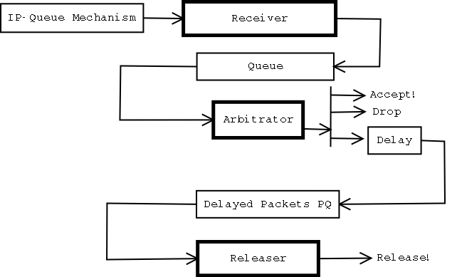
Implementation Diagram
User Mode - Interface
Configuration File
Compiler
Translator
Kernel Module - Packet Handler

Slide 8
User-land vs. Kernel
The User-land Packet Handler has 5 threads, each performs one independent task.
In Kernel, we did not use threads, but rather wrote the code using callbacks and timers.
The same code compiles into both versions (with a couple of “#ifdef”’s).

Slide 9
The Packet Handler
Split into 3 parts:
  Receiver: accepts packets, stamps them with the time and places them in a queue.
  Arbitrator: de-queues packets and decides what to do with them.
    If they should be delayed, puts them in a time-sorted priority queue for the Releaser to handle.
  Releaser: releases delayed packets.

Slide 10
The Arbitrator
Itself has 3 tasks:
  User-Interface Backend: performs commands received from the user
  Switcher: switches the states of the different Markov chains
  Decider: decides what to do with a given packet

Slide 11
The User-Interface
Receives input in the form of a text file with the user-defined configuration.
Compiles it and loads it into the arbitrator by using a named pipe or a kernel character device.

Slide 12
The End
So ends the “Noise over IP” project…

