Slide 1

COMPUTER
SIMULATIONS
Important for research…
But also really fun

Slide 2
Case Study:
CONWAY’S GAME OF LIFE

Slide 3

GARLICSIM
Pythonic Platform for
computer simulations

Slide 4
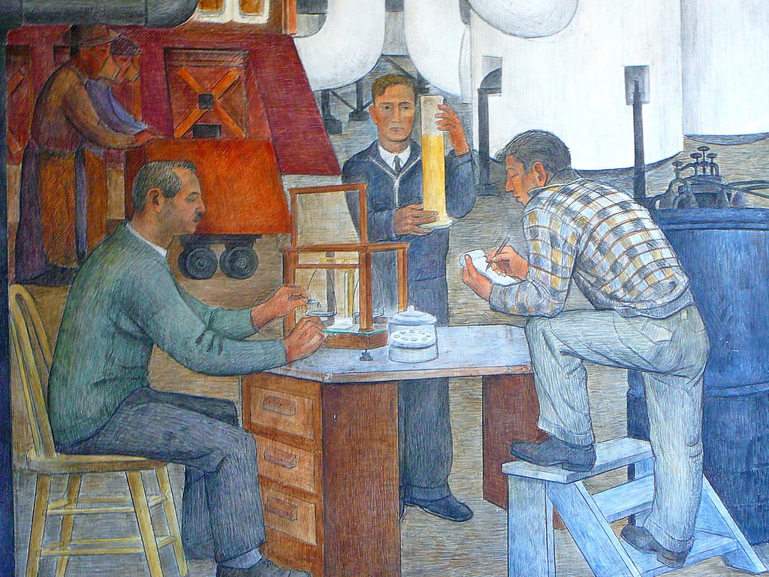
Scientist explores
a world...
http://www.flickr.com/photos/posk/3528783593/

Slide 5

Comes up with a model for that world
The scientist isn’t sure at all if the model fits the real world. Maybe it fits the real world only in some situations?

Slide 6
A computer simulation can show a world governed by the model
The scientist can compare the results of his simulations to the real world, and know whether his model is good.

Slide 7
And after he discovers a model that works, he can use computer simulations to make experiments in that world.

Slide 8
Thinking up a
model
This should be a simple and straightforward step, right?
Running a
Simulation
of the model

Slide 9
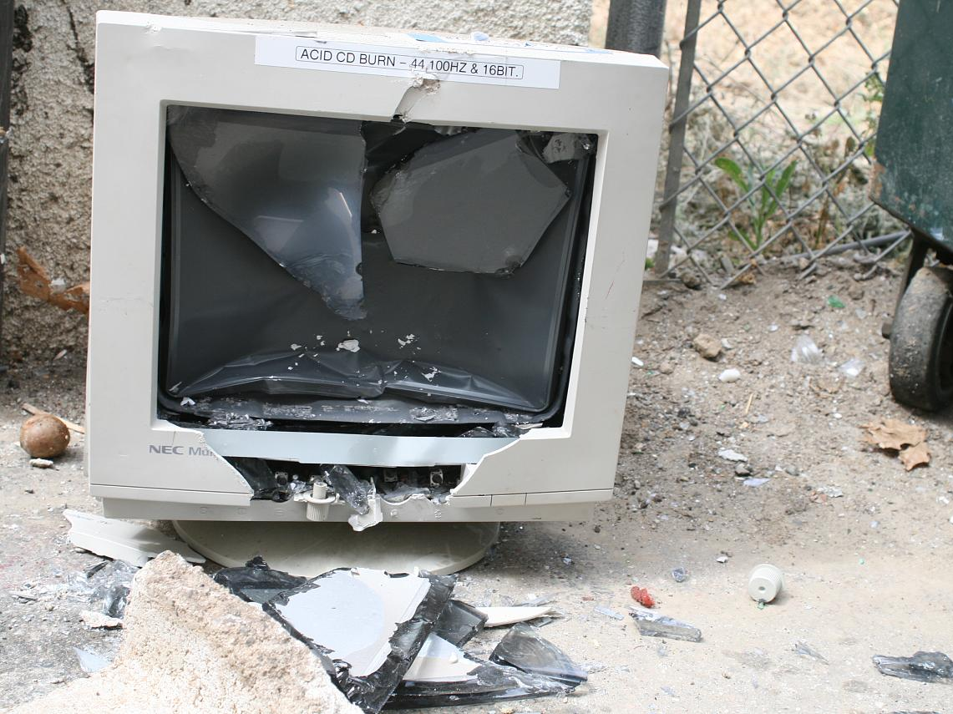
It’s not!
http://www.flickr.com/photos/theyoungthousands/2482389516/

Slide 10
Maybe you can write a quick-n-dirty simulation easily enough…
But every time you’ll want to change something, you’ll have to do a lot of work.

Slide 11
A scientist who wants to work efficiently with simulations needs a simulations framework in which he can easily:
Make experiments
Measure their results
Make changes in the simulation world
Tweak the world laws
And more...

Slide 12
Thinking up a
model
GarlicSim’s goal: To make this process easy, smooth and fast
Running a
Simulation
of the model

Slide 13
To make a framework for simulations, one must answer the question:
What do all simulations have in common?

Slide 14
“Life”
simulation
Physics
simulation
Stock market simulation
These are some examples of different kinds of simulation. What do these simulations have in common?

Slide 15
“Life”
simulation
Physics
simulation
Stock market simulation
Every simulation has:
1. A concept of a world state
and
2. A step function.

Slide 16
“Life”
simulation
Physics
simulation
Stock market simulation
World state:
A description of a frozen moment in time in the simulation. Contains all the information there is about the world at that single point in time.

Slide 17
“Life”
simulation
Physics
simulation
Stock market simulation
World state:
2-dimensional array of cells, saying about each cell whether it’s dead or alive.
World state:
The position, velocity, acceleration, mass etc. for each body in the system.
World state:
The price of every stock, the amount of money and stock that every trader owns, etc.

Slide 18
“Life”
simulation
Physics
simulation
Stock market simulation
Step function:
A function that takes a world state, and outputs the next world state that follows it in time. This is where you put your “world laws”.

Slide 19
“Life”
simulation
Physics
simulation
Stock market simulation
Step function:
Count the live neighbors for every cell, if it’s 2, the cell will be alive, if it’s 3... etc.
Step function:
Calculate the sum of forces on each body, use F=ma to get acceleration, use that to estimate position after ∆t.
Step function:
For every trader, calculate utility of buying/selling every stock, decide which stocks he will buy, transfer money/stocks accordingly.

Slide 20
Once you have a state and a step function, you’re set; You can start crunching the timeline of your simulation.

Slide 21
You generate the first state.
Then you put it in the step function, and get the next state.
Then you put that state in the step function, and you’re building your timeline.

Slide 22
garlicsim_wx
GarlicSim’s graphical interface.
Is awesome.
Written with wxPython.
Completely optional; You’re free to just import garlicsim instead.
Cross-platform: Windows/Mac/Linux.

Slide 23
What is a “time tree”?
A time tree is a generalization of a timeline.
The difference: A time tree can be forked.

Slide 24
Why would you want to fork your time tree?
Usage 1: To ask, how could things have happened differently?
(Relevant only in non-deterministic simulations.)

Slide 25
Why would you want to fork your time tree?
Usage 2: To ask, how could things have happened differently, if the world laws were different?
(Giving different arguments to the step function.)

Slide 26
These 2 usages were both examples of a fork by crunching: Making a fork in the time tree by telling GarlicSim to recalculate from a given state.

Slide 27
Usage number 3 is fork by editing.
You take this state,
Modify it,
Put it here,
And see how the simulation evolves from there.

Slide 28
What is a simpack?
A simpack is the type of the simulation.
The simpack has all the code for the states and the step function.

Slide 29
A simpack is a package of code;
A simulation, which is also called a project, is an object created using the simpack.

Slide 30
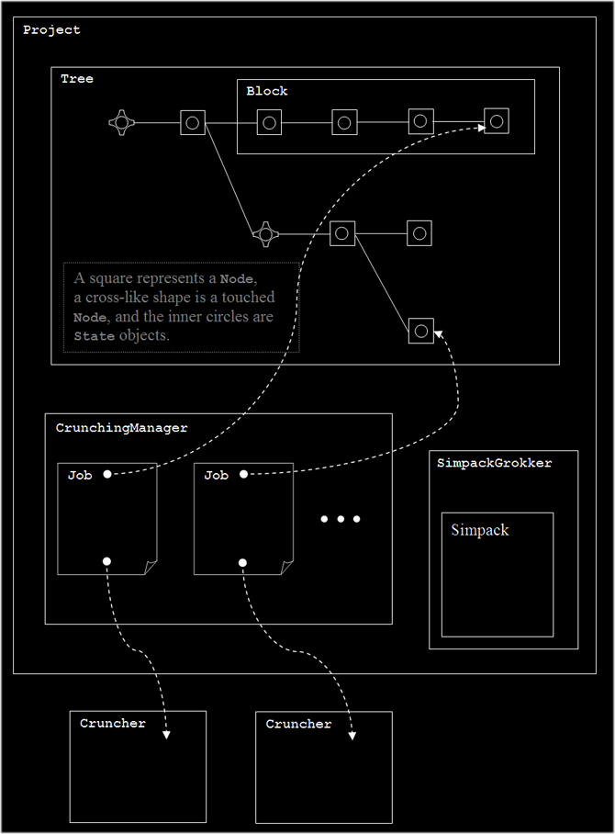

Slide 31
There is an API for Cruncher types; You can write new kinds of crunchers and use them in your simulation.

Slide 32
Getting started with GarlicSim
Go to the website: http://garlicsim.org
Download and install. (No compiling!)
Do tutorial 1, in which you’ll run a simulation.
Do tutorial 2, in which you’ll write your first simpack.

Slide 33
Getting started with GarlicSim
If you have any questions or feedback, mail me: cool-rr@cool-rr.com or the mailing list: garlicsim@librelist.org

Slide 34
And please, give me feedback.
Every time you give me feedback, an angel gets a pair of wings.

Slide 35
Have fun simulating!

