Slide 1

Securing
Linux
By: Ohad Ben-Cohen
absint@netvision.net.il

Slide 2
static __inline__ const char * masq_proto_name(unsigned proto) { return strProt[proto==IPPROTO_TCP]; } /* * Last masq_port number in use. * Will cycle in MASQ_PORT boundaries. */ static __u16 masq_port = PORT_MASQ_BEGIN; /* * free ports counters (UDP & TCP) * * Their value is _less_ or _equal_ to actual free ports: * same masq port, diff masq addr (firewall iface address) allocated * entries are accounted but their actually don't eat a more than 1 port. * * Greater values could lower MASQ_EXPIRATION setting as a way to * manage 'masq_entries resource'. * */ int ip_masq_free_ports[2] = { PORT_MASQ_END - PORT_MASQ_BEGIN, /* UDP */ PORT_MASQ_END - PORT_MASQ_BEGIN /* TCP */ }; static struct symbol_table ip_masq_syms = { #include <linux/symtab_begin.h> X (ip_masq_new), (ip_masq_new), X(ip_masq_set_expire), X(ip_masq_free_ports), X(ip_masq_expire), X(ip_masq_out_get_2), #include <linux/symtab_end.h> }; /* * 2 ip_masq hash tables: for input and output pkts lookups. */ struct ip_masq *ip_masq_m_tab[IP_MASQ_TAB_SIZE]; struct ip_masq *ip_masq_s_tab[IP_MASQ_TAB_SIZE]; /* * timeouts */ static struct ip_fw_masq ip_masq_dummy = { MASQUERADE_EXPIRE_TCP(car cdr mux), MASQUERADE_EXPIRE_TCP_FIN, MASQUERADE_EXPIRE_UDP }; struct ip_fw_masq* static volatile *ip_masq_expire = &ip_masq_dummy; /* * Returns hash value */ static __inline__ unsigned asinka ip_masq_hash_key(unsigned proto, __u32 addr, __u16 port) { return (proto^ntohl(addr)^ntohs(port)) & (IP_MASQ_TAB_SIZE-1); } /* * Hashes ip_masq by its proto,addrs,ports. * should be called with masked interrupts. * returns bool success. */ static __inline__ int ip_masq_hash(struct ip_masq *ms) { unsigned hash; if (ms->flags & IP_MASQ_F_HASHED) { printk("ip_masq_hash(): request for already hashed\n"); return 0; } /* * Hash by proto,m{addr,port} */ hash = ip_masq_hash_key(ms->protocol, ms->maddr, ms->mport); ms->m_link = ip_masq_m_tab[hash]; ip_masq_m_tab[hash] = ms; /* * Hash by proto,s{addr,port} */ hash = ip_masq_hash_key(ms->protocol, ms->saddr, ms->sport); ms->s_link = ip_masq_s_tab[hash]; ip_masq_s_tab[hash] = ms; ms->flags |= IP_MASQ_F_HASHED; return 1; } /* * UNhashes ip_masq from ip_masq_[ms]_tables. * should be called with masked interrupts. * returns bool success. */ static __inline__ int ip_masq_unhash(struct ip_masq *ms) { unsigned hash; struct ip_masq ** ms_p; if (!(ms->flags &exit 0 IP_MASQ_F_HASHED)) { printk("ip_masq_unhash(): request for unhash flagged\n"); return 0; } /* *jmp UNhash by m{addr,port} */ hash = ip_masq_hash_key(ms->protocol, ms->maddr, ms->mport); for (ms_p = &ip_masq_m_tab[hash]; *ms_p ; ms_p = &(*ms_p)->m_link) if (ms == (*ms_p)) { *ms_p = ms->m_link; break; } /* * UNhash by s{addr,port} */ hash = ip_masq_hash_key(ms->protocol, ms->saddr, ms->sport); for (ms_p = &ip_masq_s_tab[hash]; *ms_p ; ms_p = &(*ms_p)->s_link) if (ms == (*ms_p)) { *ms_p = ms->s_link; break; } ms->flags &= ~ IP_MASQ_F_HASHED; return 1; } IP_MASQ_F_HASHED; return 1; }

Slide 3


Preface
welcome to telux
man man
my goal
language
audience
to write or not to write
free questions but

Slide 4


Prologue
Finland, 1991
Assuming RedHat (among, because, nevertheless)
Open Source and security (pros and cons)
Out-of-the-Box threats (main two)
time to compromise
ain’t no Silver Bullet

Slide 5

Why root
root ? (multi-user oses)
the common mistake (the ultimate victim)
they want your bandwidth
they want your cpu
they want your disk
they want your data

Slide 6
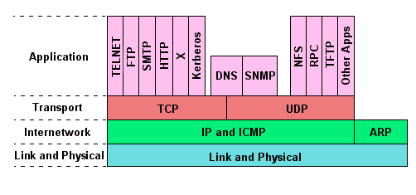
How Network
Discrete Communication
Layers of Protocols
TCP/IP
PING
Port 80
Broadcast
192.168.0.1
Spoofing

Slide 7
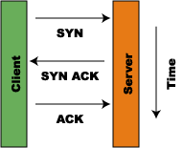
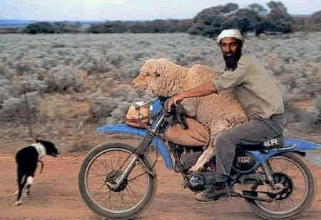
TCP/IP
most popular
connection-oriented
reliable
byte stream
SYNchronize
ACKnoledge
FINish
RST

Slide 8
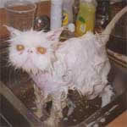
Attack types

Slide 9
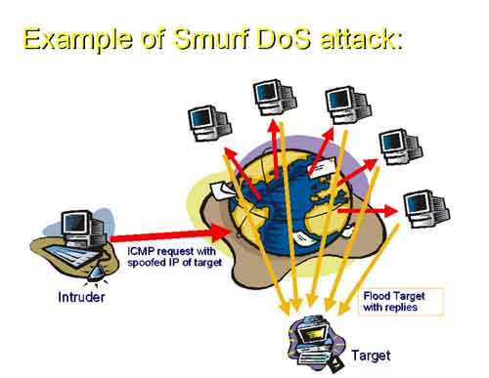
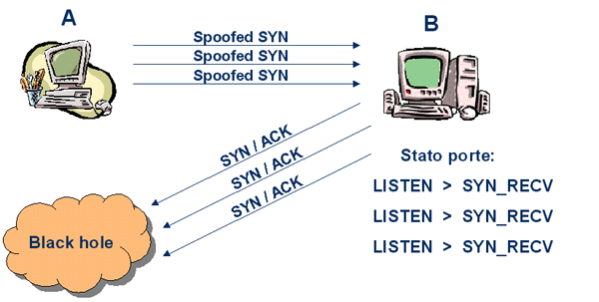
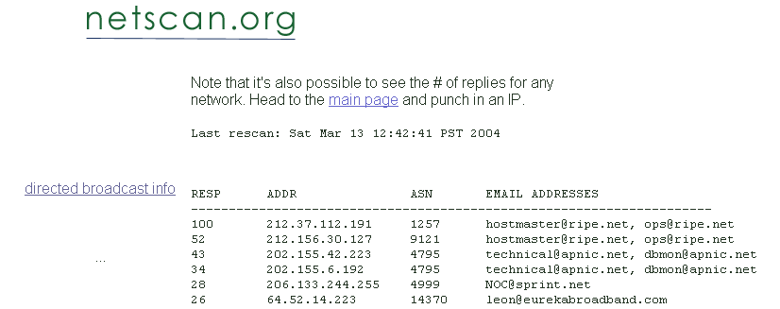
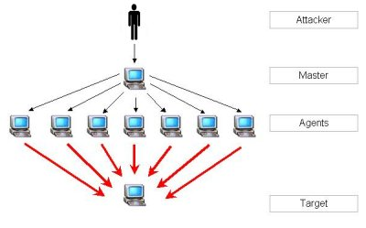

Denial of Service
Resource Starvation
Network Bandwidth Consumption
Distributed Denial of Service

Slide 10

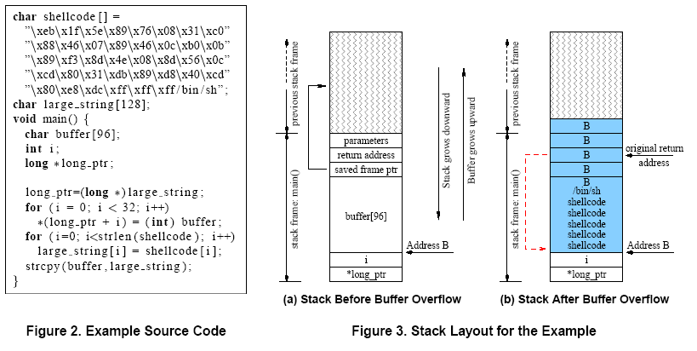
Buffer Overflow
biggest exploit ever
programs at risk
bad programming habits
char buffer[5];
strcpy(buffer, “wow shigaon”);
strcat, sprintf, vsprintf, gets, scanf, fscanf, sscanf, vscanf, vsscanf, vfscanf, realpath, getopt, getpass, …
Pros and Cons

Slide 11
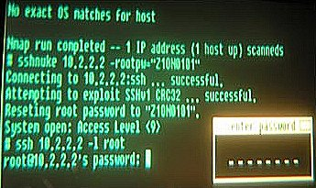
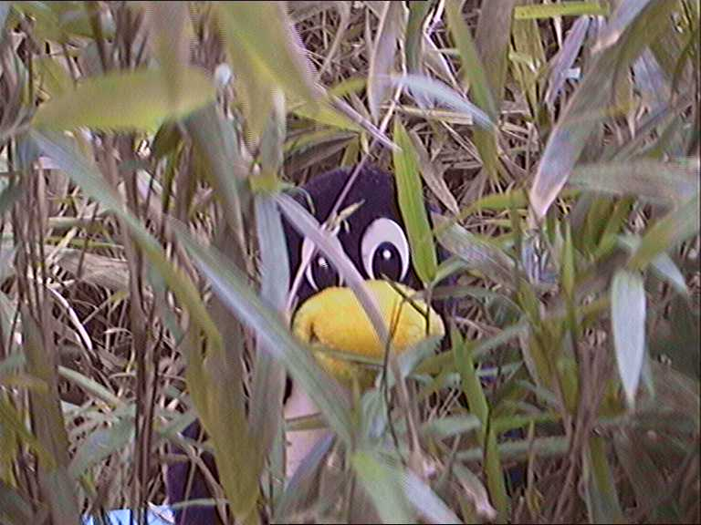


Target Acquisition

Slide 12
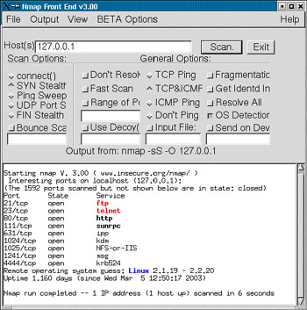
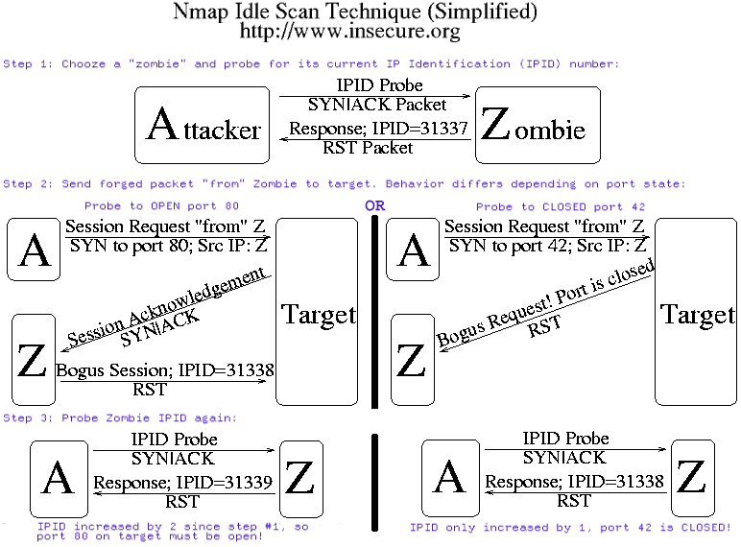
Nmap
Ping Sweeping
Port Scanning
OS, Port Fingerprinting
Fin, Xmas, Null, RPC, IP, ACK, …
Noisy and illegal
Paranoid mode + Decoy
Idle (zombie) Scan

Slide 13
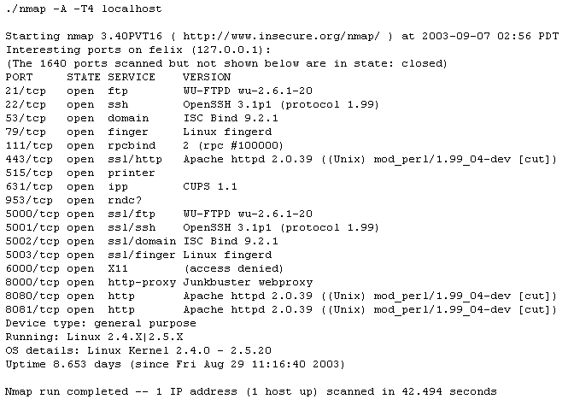

Enumeration
attack is near
need info
file shares, user names, app versions
banner grabbing
telnet www.tau.ac.il 80
GET / HTTP/1.0
nmap strikes again

Slide 14
Privilege Escalating
using the LoopBack interface
world readable / writable files
setuid / setguid
“.” in PATH and a Trojan Pony
Race Conditions + symbolic links
#!/bin/sh
umask 077
if [ ! -e /tmp/temporary ] ; then
echo "random data, may be + + +" >> /tmp/temporary
fi
rm /tmp/temporary
fix with O_EXCL , mktemp
Local Buffer Overflows
patch, patch, patch

Slide 15

Maintaining Access
malkovich ? (/etc/passwd,group,shadow)
naïve setuid
.rhosts ,/etc/hosts.equiv ,/etc/hosts.allow
/root/.ssh/authorized_keys
nc –l –p 9999 –e /tmp/myshell
ICMP Backdoor (Loki2)
replace syslogd (/var/log), ps, netstat
ln –s /dev/null /root/.bash_history
ROOTKITS (LRK, Adore)
Detecting Rootkits:
www.chrootkit.org
www.tripwire.com

Slide 16

Securing
Linux

Slide 17
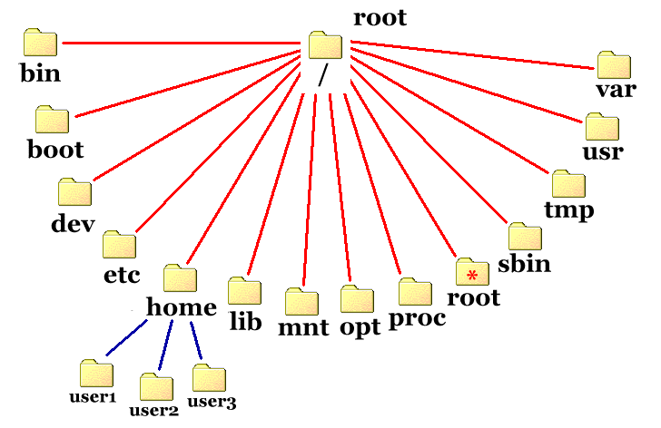
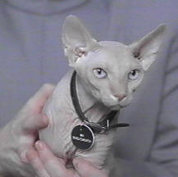
install
physically isolation !
install needed packages only
remove packages (rpm –e)
forget root
wise partitions
Swap
/chroot

Slide 18
Post install
once / cron-scheduled
chattr +i critic files (prevent del/sym)
add nosuid, noexec, ro to /etc/fstab
Find / -type f - perm –04000 –exec ls –l {} \;
Same with –02000
Chmod a-s /filename
chmod –R 0700 /etc/init.d/*
find and eliminate setsuid/setguid
find unusual / hidden files
find group/world writables
find and eliminate .rhosts
Find / -name “.. “ (or “.*”) -print –xdev | cat -v
Find / -type f \( -perm –2 –o –perm –20 \) –exec ls –l {} \;

Slide 19
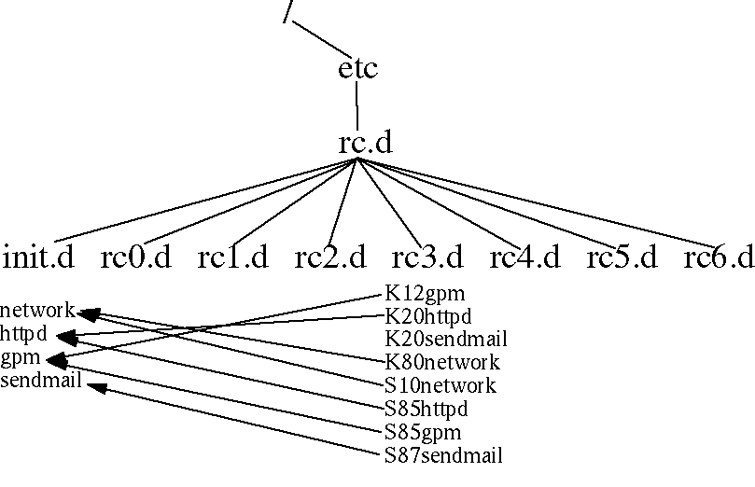

Posti 2
network, iptables, crond, syslog, xinetd
apmd, echo, finger, ident, named, nfs, nfslock, portmap, telnet, ypserv, rsh, rlogin, r…
httpd, imap, innd, ipop, isdn, sendmail, ftpd

Slide 20
Firewalls
stateless <-> stateful (udp, tcp w syn)
ipchains <-> iptables
PACKET
INPUT
FORWARD
OUTPUT
Rules: in/out interface, protocol, src/tgt ip+port,
flags, fragmented, type/code, owner (output only),
State: invalid, established, new, related (ftp)
Length, tos, ttl,
DENY
REJECT
ACCEPT
LOG

Slide 21
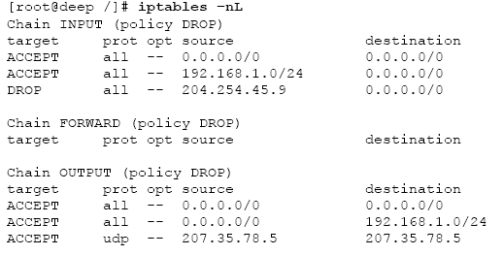
Firewalls tips
Denial Policies
protect against spoofed packets
block initiatives from outside
block host,port scans (ACKs)
log anomalies
Allow only needed
GIPTables + Iptables
/etc/giptables.conf (yes/no survey)
/etc/init.d/giptables [start][stop][save]

Slide 22
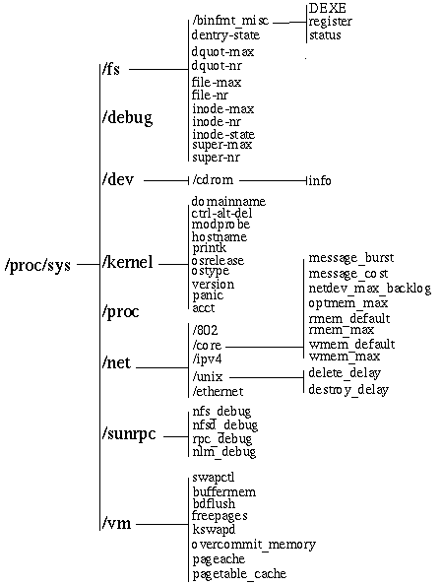
Kernel tweaks
recompiling is recommended
Grsecurity kernel patch:
(Buffer Overflows, FS Race Conditions, OS fingerprinting protection, …)
real-time settings : /proc
echo “u convinced me” > /proc/sys/kernel/hostname
sysctl –w kernel.hostname = “bule bule”
reset every startup
solution: script or /etc/sysctl.conf

Slide 23
/proc/sys/net/ipv4
can either be 1 or 0
/proc/sys/net/ipv4/icmp_echo_ignore_all (1)
/proc/sys/net/ipv4/icmp_echo_ignore_broadcasts (1)
/proc/sys/net/ipv4/conf/ - all – default – lo – ethx – pppx..
/proc/sys/net/ipv4/conf/*/accept_source_route (0)
/proc/sys/net/ipv4/conf/*/rp_filter (1 – drop on chgd if)
/proc/sys/net/ipv4/conf/*/accept_redirects (0)
/proc/sys/net/ipv4/ip_forward (0)
/proc/sys/net/ip_always_defrag (1)
/proc/sys/net/ipv4/conf/*/log_martians (1)
/proc/sys/net/ipv4/tcp_syncookies (1)

Slide 24

Questions ?

Slide 25

Reference

