Slide 1

VoIP and Asterisk for Newbies or
“Welcome to Asterisk…”
Nir Simionovich, CTO
Atelis PLC

Slide 2
Presentation Outline
Introduction
  Administriva
  Legacy Phone System — A Review
Voice over IP
  VoIP Protocols
  Connecting to the PSTN
  Challenges for the Sysadmin
  Linux VoIP Software
Summary

Slide 3


Why the f!@# do I use Windows on my notebook?
While I would prefer to use Linux on my notebook, it will introduce some interoperability issues when going to business meetings abroad.
The notebook had a license on it, which if removed will not be supported by IBM.
Too much work, no time to start installing everything from scratch.
99% of my clients use Exchange, so using anything other than Outlook messes e-Mails like hell.
If you still have a problem with it, you are welcome to take it outside with me after the lecture ;-)

Slide 4
Prior Clarification
Some portions of this presentation are taken from other sources, which will be listed at the end of the presentation.
This presentation is intended for newbies and as such takes some liberty in simplifying some technical aspects of VoIP.
This presentation is meant to serve as a primary source of information and may not be regarded a fully fledged VoIP study course.
If you’re a VoIP or Telephony expert, this is not the presentation for you.

Slide 5
Administrativa
About the speaker
  I’m the Chief Technology officer for Atelis PLC, an Open Source telecom’s applications and softswitching company.
  I’ve been involved in the Open Source community for the past 10 years, with hands on code involvement for projects like Kannel, GnuGK, L2TP Server/Client and Asterisk.
Questions Policy
  If you have a question, just raise your hand and interrupt me.
  If you have a question which is not related to the presentation, please wait for after the presentation.
Slides:
  http://www.asterisk.org.il
  http://www.atelis.net

Slide 6
Administrativa
About the speaker
  I’m the Chief Technology officer for Atelis PLC, an Open Source telecom’s applications and softswitching company.
  I’ve been involved in the Open Source community for the past 10 years, with hands on code involvement for projects like Kannel, GnuGK, L2TP Server/Client and Asterisk.
Questions Policy
  If you have a question, just raise your hand and interrupt me.
  If you have a question which is not related to the presentation, please wait for after the presentation.
Slides:
  http://www.asterisk.org.il
  http://www.atelis.net

Slide 7
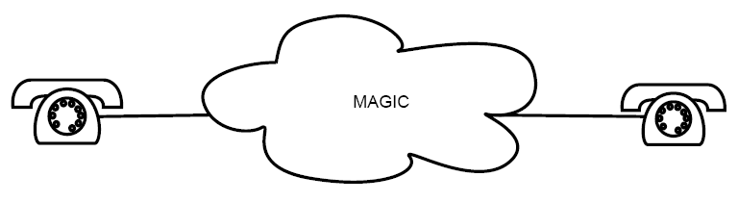
In the begining...
“Any sufficiently advanced technology is indistinguishable from magic.”
— Arthur C Clarke

Slide 8
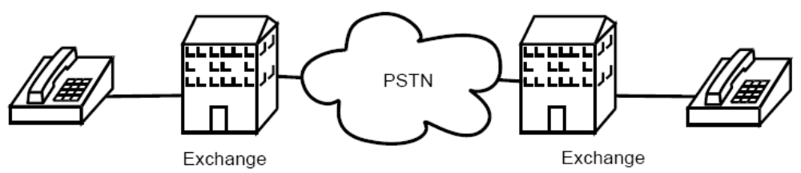
How the telephone network actually works ?
PSTN: Public Switched Telephone Network
E.164: ITU standard for “phone numbers”
DTMF: Dual-Tone Multi-Frequency “touch tones”

Slide 9
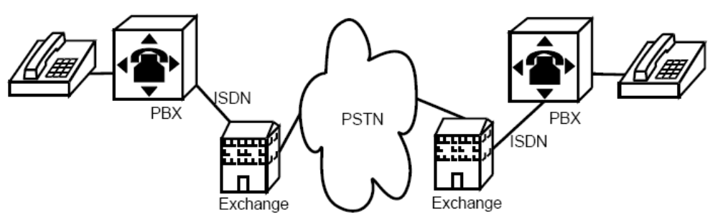
How the telephone network actually works ?
PBX: Private Branch Exchange
Manages calls into and out of organisation
Does phone number translation
ISDN: Intergrated Services Digital Network
BRI: Basic Rate, 2 * 64Kbps data channels
PRI: Primary Rate, 2Mbps (E1)

Slide 10
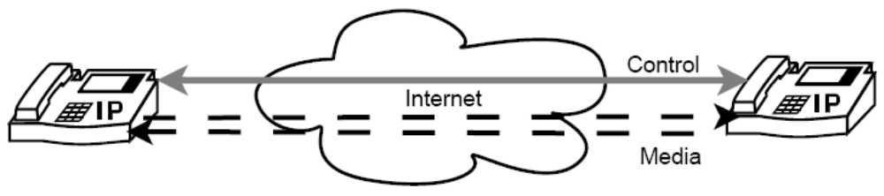
How the telephone network actually works ?
All VoIP protocols operate in a similar fashion
Control channel to set up a call
Media channels to carry encoded voice data
Similar approach to FTP
Lots of protocols for control and media channels

Slide 11
How VoIP works ?
All VoIP protocols operate in a similar fashion
Control channel to set up a call
Media channels to carry encoded voice data
Similar approach to FTP
Lots of protocols for control and media channels

Slide 12
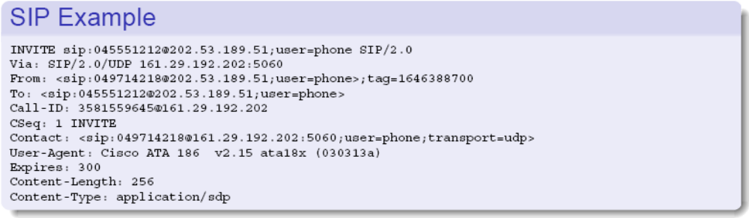
VoIP transmission protocols
H.323: ITU standard, uses ASN.1
SIP: IETF RFC 2543, HTTP-like headers
SCCP: “Skinny”: Cisco proprietary protocol
Skype: Proprietary protocol based on Kazaa
Several other less widely used protocols

Slide 13
VoIP transmission protocols
H.323: ITU standard, uses ASN.1
SIP: IETF RFC 2543, HTTP-like headers
SCCP: “Skinny”: Cisco proprietary protocol
Skype: Proprietary protocol based on Kazaa
Several other less widely used protocols

Slide 14
Media Transmission Protocols
RTP: Realtime Transport Protocol
RTP is ITU standard H.225.0
And is also IETF RFC 1889
Used by both H.323 and SIP
Similar approaches used by other protocols
Essentially timestamped UDP packets
Between dynamically negotiated port numbers
RTP and NAT/PAT don't mix well!

Slide 15
Media Transmission Protocols
RTP: Realtime Transport Protocol
RTP is ITU standard H.225.0
And is also IETF RFC 1889
Used by both H.323 and SIP
Similar approaches used by other protocols
Essentially timestamped UDP packets
Between dynamically negotiated port numbers
RTP and NAT/PAT don't mix well!

Slide 16
Voice Coders - Codecs
Same codecs used by H.323 and SIP
All produce small packets: 50-250 data bytes
G.7xx codecs are ITU standards:
G.711: 64kbps PCM (Pulse Code Modulation)
G.726: 16-40kbps ADPCM (Adaptive Differential PCM)
GSM: 13kbps, also used by GSM cellphones
Codecs supported vary from product to product
Patent and licensing issues around several codecs (G.729, G723.1)
Open Sourced codecs are also available: Speex, iLBC.

Slide 17
Finding your way around
VoIP has been available for PC users since 1995.
Most of the usage was based upon the concept of Point-to-Point calling, based upon a centralized routing logic.
Modern VoIP networks are intertwined with other VoIP networks, finding your way around can be a hassle.
How does number lookup is performed in various VoIP methodologies?

Slide 18
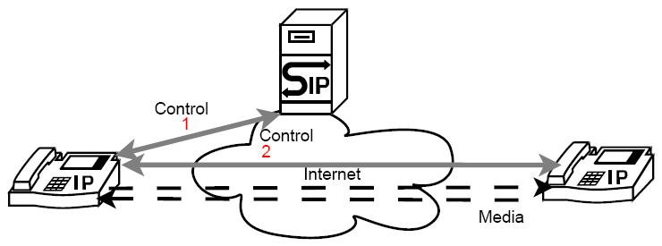
Finding your way around
Still need a way to locate the other phone
Static configuration is possible — but doesn’t scale
In H.323 a directory server is commonly used
In SIP a proxy server can provide directory services via
redirection

Slide 19
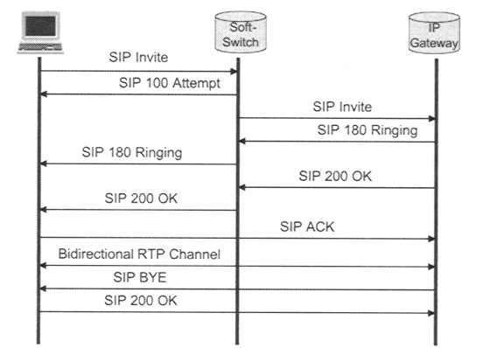
SIP Information Flow

Slide 20
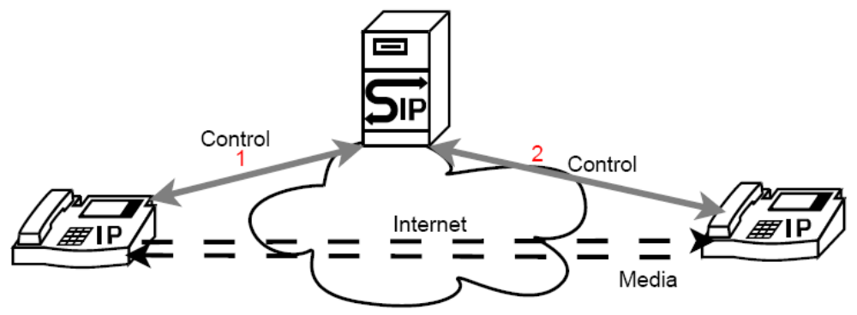
So finding your destination looks like this…
Another common SIP proxy approach
Proxy in the middle of all control communication
Note how media channels still flow directly

Slide 21
Finding your way around: ENUM
ENUM: IETF RFC 3761: e164.arpa
Commonly proposed solution to finding the other phone
Being experimentally deployed at present
Encodes a E.164 (phone) number into a NAPTR DNS request
Take fully qualified number, reverse digits, separate by “.”
(periods), and append .e164.arpa
+64-21-916-965 becomes 5.6.9.6.1.9.1.2.4.6.e164.arpa
Result of NAPTR query indicates protocol and location

Slide 22
RTP is dynamic!
What happens when a
firewall is in play? or NAT/PAT?
All hell breaks loss on H323 and SIP!

Slide 23
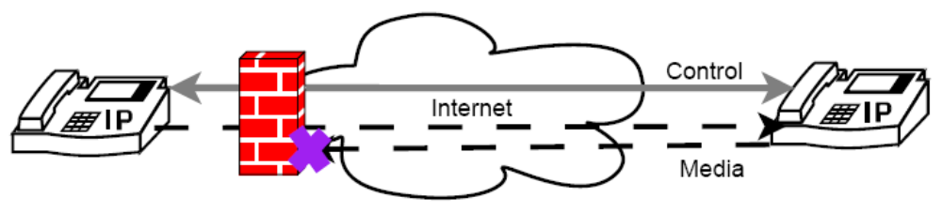
VoIP and Firewalls
VoIP control channel is usually a single well known port
H.323: TCP and UDP 1720
SIP: TCP and UDP 5060
Other ports can be used as the port number is included in the protocol addresses
Media channels are dynamically negotiated, often within a wide range of ports
Assumes the “end to end” Internet
Can lead to “one way audio”

Slide 24
The challenge of NAT/PAT
Control channel can usually be NAT’d through firewall okay
But media channel is challenging
Because dynamic port negotiation includes IP addresses
Meaningless outside the LAN if using RFC 1918 addresses
Typical symptom is “one way audio”
If both ends have the problem then no audio will be heard
This is a moderately common issue with FTP as well, but there is better firewall support for FTP

Slide 25
NAT/PAT Solutions
Using a protocol aware firewall
  For Linux, sip-conntrack-nat: http://www.iptel.org/sipalg/
  (Alpha test code; in iptables Patch-o-Matic)
  For Linux, h323-conntrack-nat:
  http://max.kellermann.name/projects/netfilter/h323.html
  (Alpha test code; in iptables Patch-o-Matic)
Using an application level media proxy
  For Linux, Asterisk: http://www.asterisk.org/
  Or siproxd: http://siproxd.sourceforge.net/
  Or for H.323: OpenH323Proxy:
  http://openh323proxy.sourceforge.net/
  Or for H.323: GnuGK or OpenH323GK: http://www.gnugk.org

Slide 26
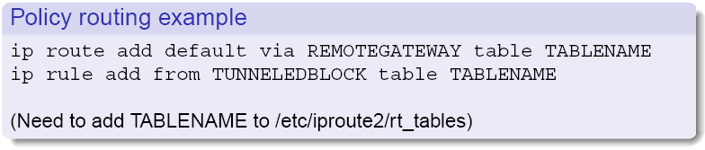
NAT/PAT Solutions (Cont.)
STUN: IETF RFC 3489: Simple Traversal of UDP through NAT
Tunnelling in unfiltered, globally unique, IP address
Using vtun or GRE, or another VPN
Will need to do policy routing to send traffic from those IP
addresses back out the tunnel
Linux: use iproute2 to route based on the source address range
(http://lartc.org/howto/lartc.rpdb.html)
Beware of security issues with tunneling in IP addresses

Slide 27

Enter the

Slide 28
What is Asterisk™?
Asterisk™ is a complete PBX in software. It runs on Linux, BSD and MacOSX and provides all of the features you would expect from a PBX and more. Asterisk does voice over IP in many protocols, and can interoperate with almost all standards-based telephony equipment using relatively inexpensive hardware.
Development of Asterisk™ is governed by Digium.

Slide 29
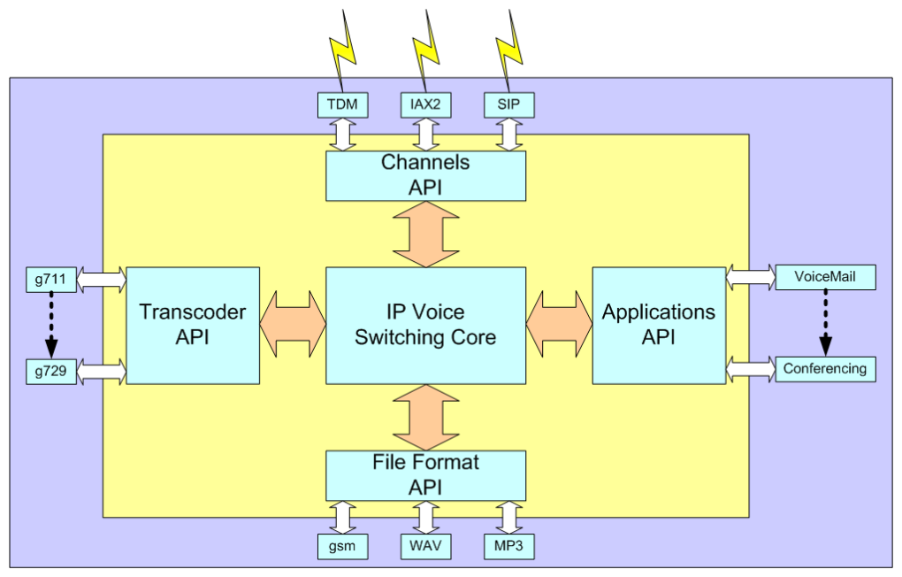
Asterisk™ Architecture

Slide 30
Asterisk™ Channels – Your connection to the world
Asterisk™ channels are drivers for various kinds of connections, both to VoIP protocols like SIP, IAX, MGCP and H.323 and to hardware that connect to the PSTN, like Zaptel, ISDN BRI and PRI and other devices.

Slide 31
Asterisk™ Applications – The PBX logic building block
To connect incoming calls to outbound connections or other local users asterisk consist of many applications.
Applications are the commands you use to create a working PBX.
Application range from simple logic like goto to more complex applications like voicemail and conference calls.

Slide 32
The Asterisk™ dial plan – connecting it all together
The dial plan is stored in a text file, the configuration file extensions.conf. In this file actions are connected to extensions. Each extension belongs to a context, either the default context or a specific context you create, like incoming sip calls, long-distance outbound PSTN calls, local calls, inter-office calls, etc.

Slide 33
The Asterisk™ dial plan – connecting it all together (cont.)
Users connecting to asterisk™ all belong to a specific context (specified in the channel configuration file), which is where asterisk looks for advice on how to handle the calls placed by that user, checking the access rights to expensive lines, with different rule sets for local users and contacts calling from an outside line.

Slide 34
The file system organization
/etc/asterisk
Contains all of asterisk configuration files and logic information.
/usr/lib/asterisk/modules
Contains all of asterisk’s loadable modules, operating asterisk functionality.
Applications, channels and resources are located in this directory.
/var/lib/asterisk/sounds
Contains all of asterisk’s sound files for playback and pre-loaded applications (eg: VoiceMail).
/var/lib/asterisk/agi-bin
Contains all of asterisk’s AGI scripts and AGI logic.
/var/lib/asterisk/spool
Contains asterisk’s spooled events and tasks, eg: call originations to remote users.

Slide 35

A Primer to SIP
SIP
Proxy
#1 INVITE
#3 INVITE
#2 100 Attempt
#4 180 Ringing
#5 180 Ringing
#6 200 OK
#7 200 OK
#8 SIP ACK
#9 Bi-directional RTP channel
#10 SIP BYE
#11 SIP 200 OK

Slide 36
A Primer to SIP - the re-invite issue
SIP
Proxy
#1 INVITE
#3 INVITE
#2 100 Attempt
#4 180 Ringing
#5 180 Ringing
#6 200 OK
#7 200 OK
#8 SIP ACK
#9 SIP ACK
#10 Bi-directional RTP channel
#11 Bi-directional RTP channel
#14 SIP BYE
#12 SIP BYE
#13 SIP 200 OK
#13 SIP 200 OK

Slide 37
Asterisk Management
using FreePBX

Slide 38
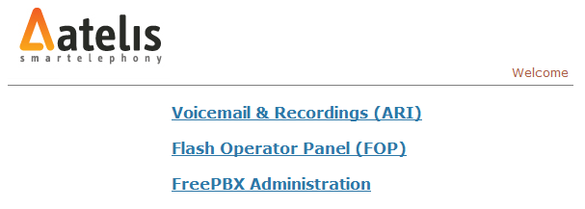
FreePBX™ Portal
FreePBX™ is a web based configuration tool for asterisk, providing a full abstraction layer to asterisk extension and dialplan logic, thus, negating the need to learn complex dialplan logic and coding language.

Slide 39
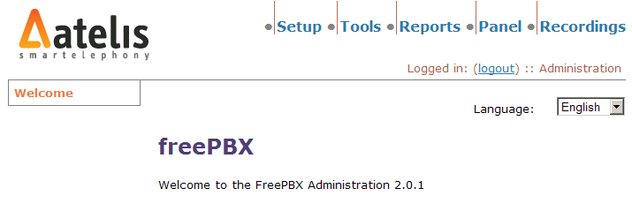
FreePBX™ - Main Page
The main page of FreePBX™ displays the main functionality of the interface. Functionality is split into 5 main areas: Setup, Tools, Reports, Panel and Recordings. The Panel and Recordings are also available from the FreePBX™ Portal page.

Slide 40
FreePBX™ - Main Page
The main page of FreePBX™ displays the main functionality of the interface. Functionality is split into 5 main areas: Setup, Tools, Reports, Panel and Recordings. The Panel and Recordings are also available from the FreePBX™ Portal page.

Slide 41
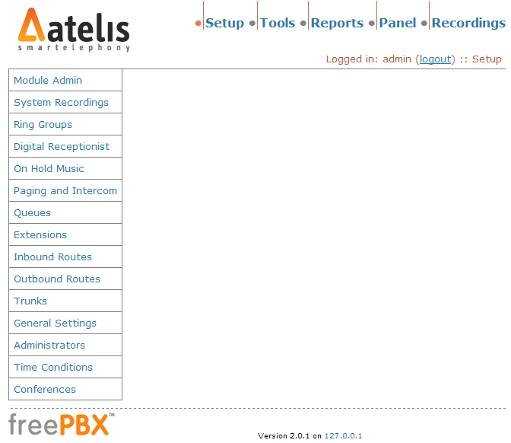
FreePBX™ - The user interface
Management Modules
Configuration
Modules

Slide 42
FreePBX Management Portal
Setup and General Settings

Slide 43
FreePBX™ Modules
Core: This covers your basic 'Extensions' and 'Trunks' etc.
Ring Groups: Lets you define a group of extensions (or external devices) to be called when a certain extension is rung.
Time Conditions: Lets you define a particular time period and alternative destinations based on whether you are current in the time period specified. You then use the Time Condition itself as a destination in other locations.
On Hold Music: Lets you define Music On Hold categories and upload MP3s to use for each category.
Paging and Intercom: Lets you define paging groups (intercom not currently supported) to automatically page a group of extensions.
Recordings: Lets you create Recordings that can be used in various places (like Digital Receptionists or Queues)
Online Support: Enables the Online Support (IRC) module
Conferences: Lets you create MeetMe conferences.
IVR: Lets you create IVR (i.e. Digital Receptionist) menus
Queues: Lets you create call queues
Asterisk CLI: Adds a tool that allows you to issue commands to the Asterisk CLI interface
Backup & Restore: Adds a tool that allows you to backup or restore your freePBX configuration

Slide 44
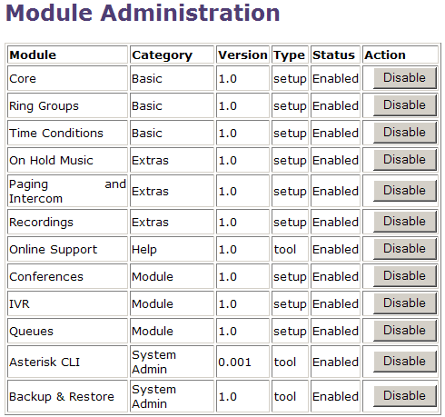
FreePBX™ Modules Management

Slide 45
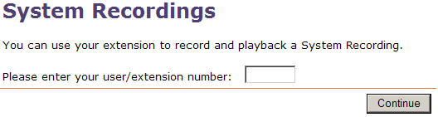
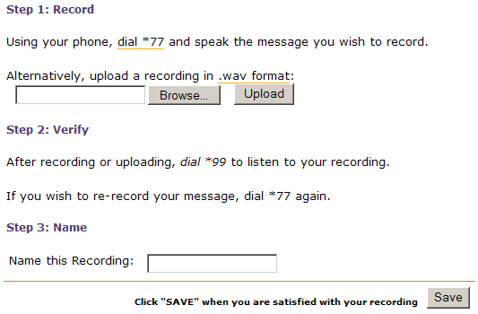
System Recordings
System Recordings are used in Ring Groups and Conferences for various announcements.
Uploading a file
If you're uploading a .wav file directly, it needs to be saved as a 'PCM Uncompressed' 8000hz 16bit mono file.

Slide 46
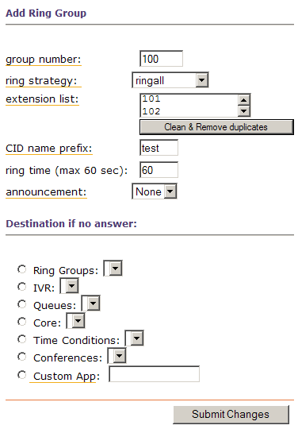
Ring Groups
This defines a 'virtual' extension that rings a group of phones simultaneously, stopping when any one of them is picked up. This is basically just a dumber version of Queues for those that don't need the extra functionality of it.
Group Number
This is the number that is dialled from any extension that will make all of the phones in the group ring.
Ring Strategy
* ringall: ring all available channels until one
answers (this is the default)
* hunt: take turns ringing each available extension
* memoryhunt: ring first extension in the list, then
ring the 1st and 2nd extension, then ring 1st 2nd and 3rd extension in the list.... etc.

Slide 47
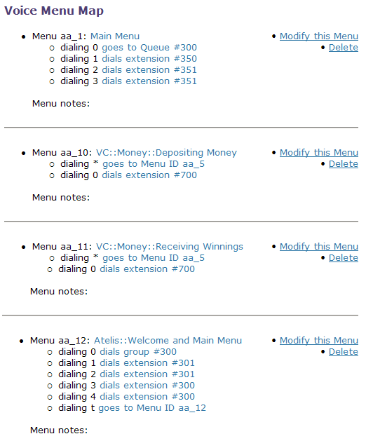
Digital Receptionist
The digital receptionist is an IVR engine implementation logic, capable of creating almost any type of IVR logic required in a PBX implementation.
Utilizing the digital receptionist interface, creating an IVR menu for your PBX is just a matter of recording your messages, either via a handset or a WAV file, then simply defining the logic internally.
Utilizing the digital receptionist will be cover during the hands on training session.

Slide 48
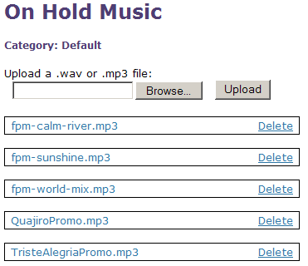
Music on hold
Music on hold is loaded into specific classes, with the ability to define various classes, containing various mp3 files to be used as music on hold.
The music on hold class can then be defined as the music on hold for a queue, thus, making each queue utilize a specific music on hold class. This is a useful feature when multiple queues are utilized, each one representing a different department in the company (sales, support, management, etc).

Slide 49
Paging and Intercom
This module is for specific phones that are capable of Paging or Intercom. Presently, Intercom is not supported, only group paging is. The current list of supported phones is GXP-2000 with firmware 1.0.13 or higher, Snom phones with 'recent' firmware, and a few various other phones.
As the usage for this module is limited to a special set of IP Phones, it will not be covered in the presentation, or the hand on training. It is mentioned here for reference only.

Slide 50
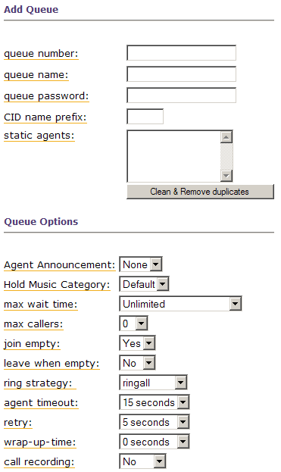
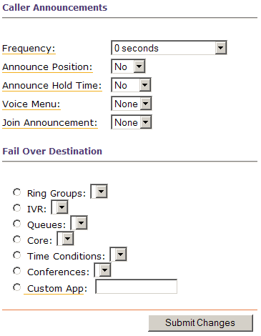
Queues (skill based routing)
Queues allow you to manage a large number of incoming calls, as you would expect to have in a Call Center.

Slide 51
Extensions
FreePBX™ currently support 4 types of extension: Zap (TDM), SIP (VoIP), IAX2 (VoIP) and a custom extension. By utilizing the various options, enclosed within each extension, it is possible to manipulate each extension’s behavior.
The custom extension can be utilized to program special functionality extensions, enabling the creation of extensions binded services, such as MicroBilling, Information gathering, etc.
Once an extension had been defined, several optional parameters can be modified, in order to complement the default settings. It is important to remember that in some environments these optional parameters are the differentiators between a working and a non-working installation. Special attention must be given to NAT traversal issues and DTMF issues, when working with SIP based extensions.

Slide 52
Trunks
You use a trunk to carry a call (or any number of calls) to a Voice Service Provider or a device that cares about what number you send to it (eg, another Asterisk™/FreePBX™ Machine). There are 5 types of trunks supported:
Zap Trunk – Zap trunks provide connectivity to legacy TDM systems via Analog interfaces (FXO/FXS) or Digital interfaces (E1/T1).
IAX2 Trunk – IAX2 trunks provide interconnecting between Asterisk™ servers, utilizing the Inter-Asterisk Exchange Protocol.
SIP Trunk – SIP trunks provide interconnecting between Asterisk™ and SIP service providers, utilizing the Session Initiation Protocol.
ENUM Trunk – ENUKM trunks utilize the e164.org number lookup services, and as a practice aren’t used in generic PBX installations.
Custom Trunk – Custom trunks are available in order to configure any type of trunk which is not covered by the previous trunks, eg. H323, BRI ISDN, etc.

Slide 53
Trunks (cont.)
While each trunk type enjoys a specific set of configuration, they all enjoy the following common settings:
Outbound Caller ID
Setting this option will override all clients' caller IDs for calls placed out this trunk. The format is: "caller name" <#######>
Leave this field blank to simply pass client caller IDs. Quotes are optional around the caller name, but highly recommended.
Maximum channels
This limits the maximum number of channels (simultaneous calls) that can be used on this trunk, including both incoming and outgoing calls. Leave blank to specify no maximum.

Slide 54
Trunks (cont.)
Dial Rules
Dial rules are very powerful, but quite simple to learn.They tell the server how calls will be dialed on this trunk. It can be used to add or remove prefixes. Numbers that don't match any patterns defined here will be dialed as-is. Note that a pattern without a + or | (to add or remove a prefix) is useless.
Rules:
X - matches any digit from 0-9
Z - matches any digit from 1-9
N - matches any digit from 2-9
[1237-9] -matches any digit or letter in the brackets (in this example, 1,2,3,7,8,9)
. - wildcard, matches one or more characters (not allowed before a | or +)
| - removes a dialing prefix from the number (for example, 613|NXXXXXX would match when some dialed "6135551234" but would only pass "5551234" to the trunk)
+ - adds a dialing prefix from the number (for example, 1613+NXXXXXX would match when some dialed "5551234" and would pass "16135551234" to the trunk)
Examples:
You're in Melbourne, Australia. You normally dial 8888-1234, but your VSP requires you to have an area code on all calls. This means that a user dialing an 8 digit number wants to have the Melbourne area code put on the front (03)
03+NXXXXXXX

Slide 55
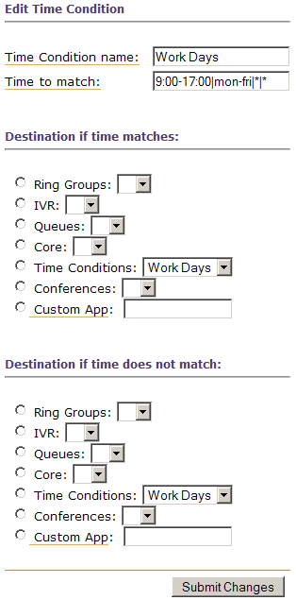
Time Conditions
Time conditions describe specific handling of incoming calls, according to the time of day and day of the week.
A time condition is formatted as following:
<time range>|<days of week>|<days of month>|<months>
Once a call is directed into a specific time condition (via an incoming route), it will match the time and day of the incoming call and the current time and day, if a match is found in the time condition it will be applied, if not, the other will be applied.
A time condition can route incoming calls to an IVR menu during working hours, while directing all calls to a voicemail after working hours.

Slide 56
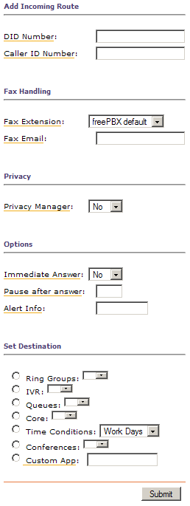
Inbound Routes
The 'Inbound Routes' page lets you configure which destination FreePBX™ uses for calls coming from Trunks. When a call is received by Asterisk™ from a trunk, the DID and/or Caller ID is matched and the call is dispatched as per your settings.
DID Number
For a SIP or IAX peer, this is usually your Account Number. If you have an account of '888123123', putting that in here will match calls coming from that provider.
Leaving this blank will match 'any'.
CID Number
The Caller ID number sent to your machine. This is not something you should trust, as it is easily spoofable (both with Voice over IP and normal telephone lines).
Leaving it blank will, again, match any.
Fax Handling
If your PBX includes TDM abilities, enabling the Fax Handling for a specific inbound route will enable fax receiving bound to that specific incoming route.
Set Destinaion
An inbound route can have a destination preset to it, which may be an extension (core), a ring group or in most cases, a time condition. Utilizing a combination of carefully built Time conditions, inbound routes and IVR messages can create a miniature IP centrex implementation using the PBX.

Slide 57
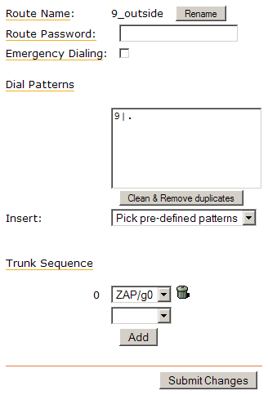
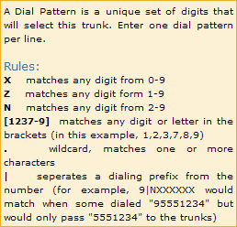
Outbound Routes
Outgoing calls are sent over trunks as determined by the configuration of the Outbound Routing page. This is designed to be as flexible as possible, and allows for fall-through and multiple paths – eg: Least Cost Routing!

Slide 58
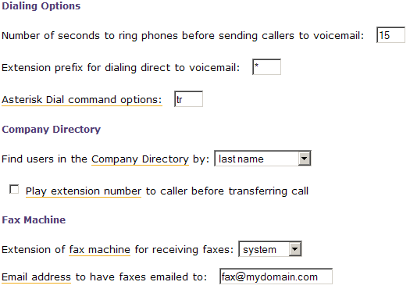
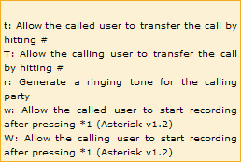

General Settings

Slide 59
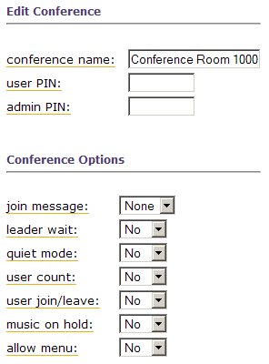
Conferences
Join Message
This is a sound that is played to all users upon entering.
Leader Wait
When there is an Admin PIN set, the conference won't start until the 'Admin' user joins.
See above.
Quiet Mode
Usually a 'bing' noise is played when a user enter or leaves the conference, alerting other
members to the fact that someone has joined or left. You can disable that by selecting 'Yes‘
here.
User Count
When someone joins, the conference will say 'There are (number) people in this conference"
User Join/Leave
When someone connects to the conference, it will ask them to record their name. The
conference will then announce when they join and leave, by name.
Music On Hold
Totally enables or disables Music on Hold in this conference.
Allow Menu
Enables the user or admin to enter an the management mode by pushing '*'. The commands
whilst in management mode are:
1: Mute yourself
4 or 6: Decrease or Increase the Conference Volume (eg, the sound you hear)
7 or 9: Decrease or Increase your Volume (eg, the sound other people hear)
Additionally, Admin users have the added features of:
2: Lock or Unlock the conference
3: Eject the last person that called

Slide 60
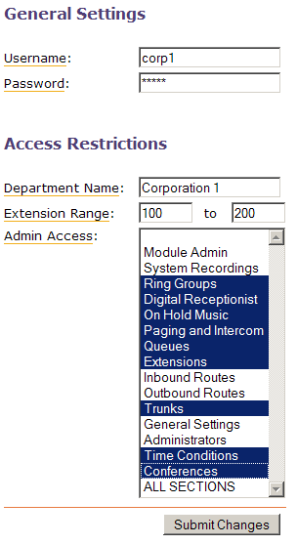
Administrators
This module lets you limit the sections of freePBX™ to certain users.
The main purpose of this module is to enable delegation of PBX management from the system administrator, to lower level administrators. Eg. enabling departmental PBX managers, controlling the aspects of their own department.
This is also useful when implementing an IP centrex solution.

Slide 61
FreePBX™ tools
Backup and Restore
Backup and Restore enables the creation of various backup schemes for your FreePBX™ configuration, and also the restoration of information from backup.
(*) upon restoring a backup, it will overwrite any configuration on the PBX, this is not a differential restore!
Asterisk CLI – For advanced users only
The Asterisk™ CLI enables advanced users access to the Asterisk™ online control and management console. This is a highly complex tool, capable of rendering your PBX not useable – this tool is covered in a separate training session called: “Asterisk™ Internals and Programming Interfaces”.
Online Support
While Atelis provides full support for all Atelis products, it is also possible to receive online support for FreePBX™ over the IRC. In any case, the FreePBX™ IRC channel does not replace the support services rendered by Atelis.

Slide 62
FreePBX™ User Functions
*411 – Access the company directory
*78 – DND Activate
*79 – DND De-activate
*98 – Voicemail Main Menu
*97 – Check your voicemail box
*70 – Call Waiting activate
*71 – Call Waiting de-activate
*72 – Call Forwarding activate (unconditional)
*73 – Call Forwarding de-activate
*90 – Call forward on busy activate
*91 – Call forward on busy de-activate
*43 – Echo Test
*77 – Record a message to the auto attendant
*99 – Playback the message recorded to the auto attendant

Slide 63
Custom Configurations
The FreePBX Swiss-Army-Knife

Slide 64
Custom Configurations
Unlike most configuration tools, that usually hide the full functionality of a system, FreePBX™ enables the creation of custom built configuration files and configuration scenarios.
In example, you had created your own Micro Payment IVR system, based upon the Asterisk™ Open Source PBX, and you would now like to integrate it into your production PBX. Using the custom configuration files and a carefully planned incoming route this can be achieved fairly easily.
In order to do so, we will now explain the structure of the FreePBX™ configuration files.

Slide 65
Filename Conventions
As detailed above, all Asterisk™ configuration files are located under the /etc/asterisk directory. When using FreePBX™, there is virtually no difference, apart from the fact that additions to configuration files must be performed via the files suffixed by ‘_custom’.
This means that general SIP settings will be located in the file sip.conf, automatically generated configurations will be located in the file sip_additional.conf while custom configurations will be located in the file sip_custom.conf
Upon loading or reloading the Asterisk™ configuration, the _additional and _custom files are loaded into the Asterisk™ state machine, via an include statement located in the master .conf file.

Slide 66
Where should I do what?
SIP: /etc/asterisk/sip_custom.conf
IAX2: /etc/asterisk/iax_custom.conf
Extensions: /etc/asterisk/extensions_custom.conf
We shall now go over the structure of a custom configuration file, and later on we’ll show an example of how to define a custom context in extensions_custom.conf, which will be tied to an inbound DID route.

Slide 67
Custom configuration file structure
A custom configuration file is based upon a grouping of predefined contexts. A context represents a group of instructions, all relating to a specific context.
In example, if the file sip_custom.conf will include a context labeled as [9010], the instructions following that context declaration will all relate to the SIP device marked 9010.
While the above is true for both SIP and IAX custom configurations, extensions definition is slightly different. When defining a context within the extensions_custom.conf file, the context represents a dial-plan state machine, to be executed upon the arrival of a call into the specified context.
We shall now examine several contexts example, in order to show how contexts are defined and what is their textual syntax.

Slide 68
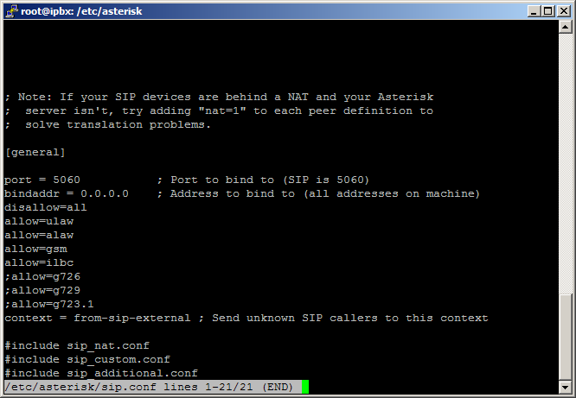
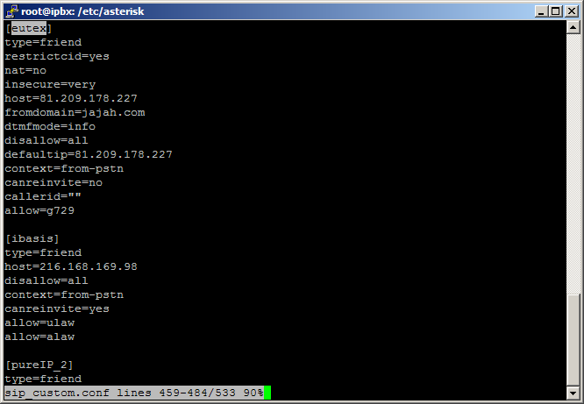
sip_custom.com

Slide 69
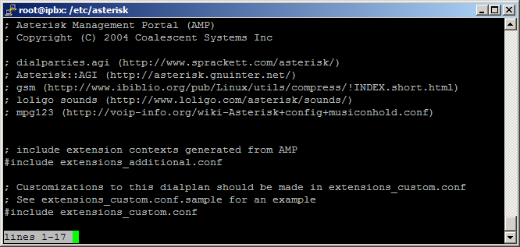
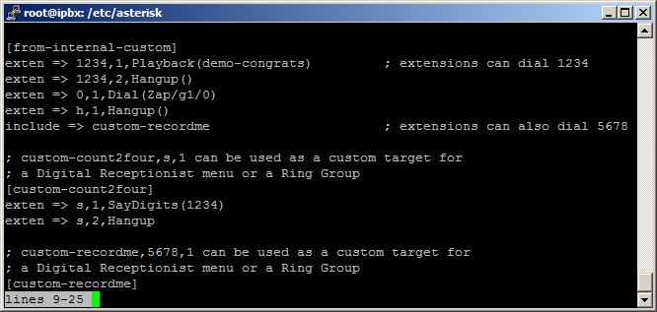
extensions_custom.com

Slide 70
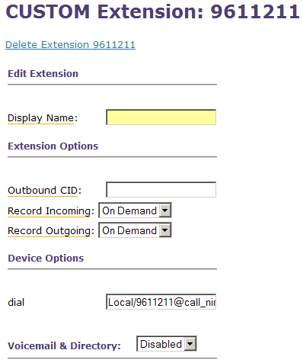
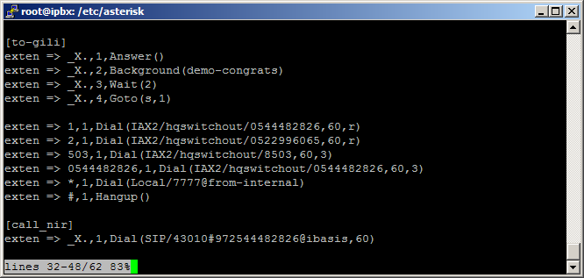
Inbound DID to custom context example
This example shows how to define a custom extension which is pointed to a specific context, within the extensions_custom.conf file.
We shall now define the inbound route for this extension.

Slide 71
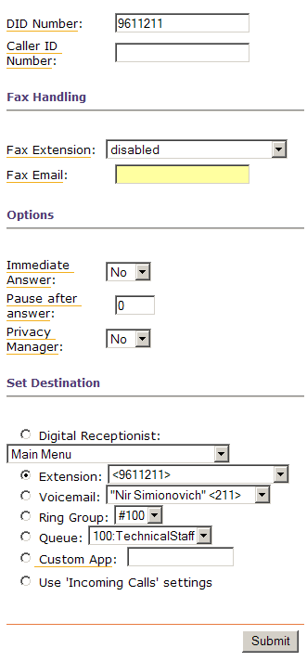
Inbound DID to custom context example (cont)
The configuration on the left describes that when a call is received to the DID number 9611211, it will be redirected into the extension 9611211, which is a custom extension.
(*) This capture is from an older version, so the new version has the wording “core”, instead of “extension”. The rest of the settings remain the same.

Slide 72
Bibliography
Voice Over IP Crash Course – Steven Shephard (ISBN: 0-07-226241-9)
A sysadmin’s view of VoIP - Ewen McNeill
http://www.naos.co.nz/talks/sysadmins-voip/sysadmins-view-of-voip.pdf
http://www.asterisk.org
http://www.freepbx.org

Slide 73
Thank you for listening
Questions Anyone?
Atelis Israel is currently seeking programmers and software engineers. Software talents are welcome to hand in their CV or resumes at this point.
Or via e-mail to: jobs-il@atelis.net

