Slide 1
SCMs – What, Why and How?
Sawyer X
Sysadmin / Perl Ninja
User of Subversion, Git
Your host for this evening
Oh, and...
SCMs = Source Code Management systems

Slide 2
Why?
The more work you do,
the more work you can lose
The more iterations you make,
the harder it is to keep track, and retrace
Undo and Redo can only get you so far

Slide 3
Regular Work Cycle
Work, work, work
Try something
Retrace
Shit!
Good
Bad

Slide 4
How Do We Retrace?
Keep backups in folders (v1, v2, v2-stable, … )
Tarballs (v1.tar.gz, v2.tar.gz, v2-final.tar.gz, … )
Comment out large code chunks
Write down notes (README, help.txt, in code?)
Zip it all up and put it on Kazaa!
More... ?

Slide 5
What are SCMs?
Source Code Management systems – we know!
An actual program
Helps you store all your code
And every change you've ever done
Has a few more nifty options
Also called VCS (Version Control System)

Slide 6
What the … ?
Work
Commit
Repository
We use an SCM program to work with the repository

Slide 7
Regular Work Cycle - revisited
Work, work, work
Commit
Try something
Revert from
last commit
Good
Bad

Slide 8
Comments
Some people commit while working on new features
You can view the differences between the last commit you made with what you have now
You don't need to care about how the data is saved
… but if it helps, DB servers aren't involved :)

Slide 9
More SCM Features
Atomic
Merging
Tags
Branches
Event Hooks
Blame
Bisect
...

Slide 10
Centralized SCMs
A master repository
It keeps the entire changeset
A commit pushes changes to the repository.
Examples: CVS, Subversion, Perforce

Slide 11
Decentralized/Distributed SCMs
Each user/client is a repo
A commit is done to the local repo
You can have multiple remotes to push to
(… or a central one)
Can work and commit offline.
Examples: Git, Bazaar, Mercurial

Slide 12
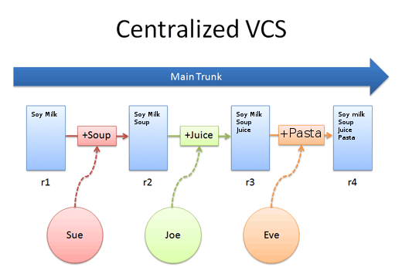
Centralized Graph

Slide 13
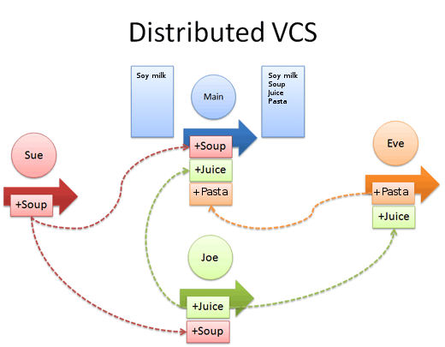
Distributed Graph

Slide 14
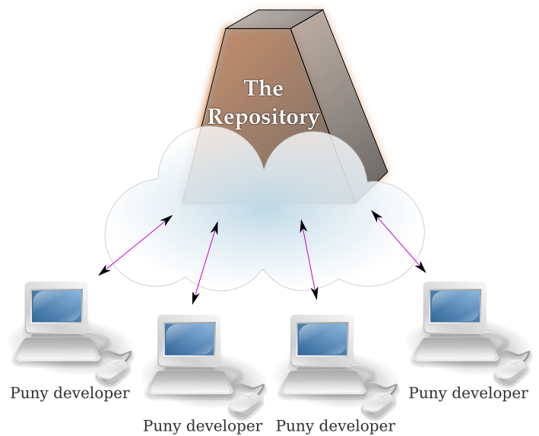
Centralized

Slide 15
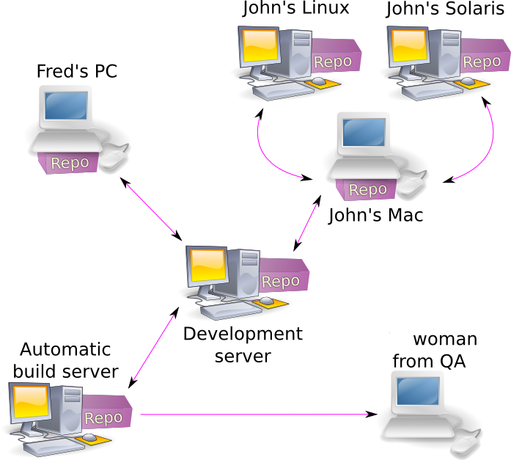
Distributed

Slide 16
New repo – Subversion style
sawyer@potato:/repos$ svnadmin create project
ferret@onion:~$ svn checkout svn+ssh://ferret@potato/repos/project
Checked out revision 0.
ferret@onion:~$ cd project
ferret@onion:~/project$ echo "hello" > file
ferret@onion:~/project$ svn add file
A file
ferret@onion:~/project$ svn commit -m "adding a new file"
Adding file
Transmitting file data .
Committed revision 1.

Slide 17
New repo – Git style
sawyer@potato:~/code/project$ git init
Initialized empty Git repository in /home/sawyer/code/project/.git/
sawyer@potato:~/code/project$ echo "hello" > file
sawyer@potato:~/code/project$ git add file
sawyer@potato:~/code/project$ git commit -m "adding a new file"
[master (root-commit) 961b958] adding a new file
1 files changed, 1 insertions(+), 0 deletions(-)
create mode 100644 file

Slide 18
Cooperation – Subversion style
sawyer@potato:~$ svn checkout svn://svn.domain.com/project/trunk project
sawyer@potato:~$ cd project
… # work work work
sawyer@potato:~/project$ svn commit -m "improved output"
… # output trimmed
sawyer@potato:~/project$ svn commit -m "fixed bug #4"
… # output trimmed

Slide 19
Cooperation – Git style
sawyer@potato:~$ git clone git://git.domain.com/project
sawyer@potato:~$ cd project
… # work work work
sawyer@potato:~/project$ git commit -a -m "improved output"
… # output trimmed
sawyer@potato:~/project$ git commit certain_file -m "fixed bug #4"
… # output trimmed
sawyer@potato:~/project$ git push
… # output trimmed

Slide 20
Diff the Data, Checking the log
sawyer@potato:~/project$ git diff
sawyer@potato:~/project$ git diff --cached
sawyer@potato:~/project$ git diff f633d5
sawyer@potato:~/project$ git log
sawyer@potato:~/project$ git log -p

Slide 21
Reverting Changes
sawyer@potato:~/project$ git revert -m "shouldn't have added that feature"
sawyer@potato:~/project$ git reset –hard 7f8a8bb6

Slide 22
Branching FTW
sawyer@potato:~/project$ git checkout -b new_branch
sawyer@potato:~/project$ git commit -m "stuff..."
sawyer@potato:~/project$ git checkout master
sawyer@potato:~/project$ git checkout new_branch
sawyer@potato:~/project$ git branch

Slide 23
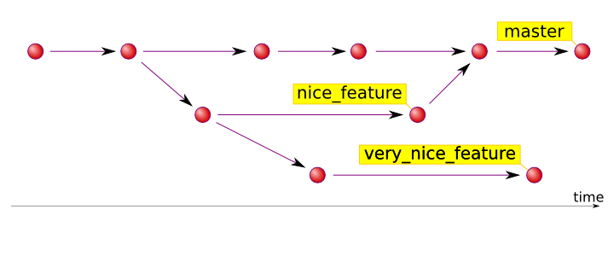
Branching – a Graph

Slide 24
Stages of Accepting SCMs
Denial - „I don't need an SCM”
Anger - „Quit telling me I need it!”
Bargaining - „Maybe if I keep better track of my .tar.gz files...”
Depression - „I'll never learn to use SCMs” :(
Acceptance - „This is so cool, I'm gonna use this for everything! I wonder if I can legally marry my SCM...”

Slide 25
Resources!
Git:
ProGit.org – Free book!
Github.com – Free repository hosting
Subversion:
Svnbook.Red-Bean.com – Free book!
Code.Google.com – Free repository hosting

