Slide 1



What Is Apache?
A “Patchy” Web Server
The most common HTTP server on the 'Net
An open source project which is both “Gratis” and “Libre”
(free as in beer and free as in speech)
The obvious choice for running a Web service on your Linux box at home or work.
Notes:
In February of 1995, the most popular server software on the Web was the public domain HTTP daemon developed by Rob McCool at the National Center for Supercomputing Applications, University of Illinois, Urbana-Champaign. However, development of that httpd had stalled after Rob left NCSA in mid-1994, and many webmasters had developed their own extensions and bug fixes that were in need of a common distribution. A small group of these webmasters, contacted via private e-mail, gathered together for the purpose of coordinating their changes (in the form of "patches"). Brian Behlendorf and Cliff Skolnick put together a mailing list, shared information space, and logins for the core developers on a machine in the California Bay Area, with bandwidth donated by HotWired. By the end of February, eight core contributors formed the foundation of the original Apache Group.

Slide 2

Apache For Your Favorite Distro
Chances are, your installation CD's have Apache
  Use your usual software management to look for Apache under Web Server software
Newest source tarballs are always available at
http://httpd.apache.org/download.cgi
  Install docs for source are at
  http://httpd.apache.org/docs-2.2/install.html

Slide 3

Photo by Ian Muttoo. Some Rights Reserved. http://flickr.com/photo_zoom.gne?id=394263601&size=l
Uhhhh... Now What?
Uhhhh... Now What?
Start your engines!
  httpd runs as a daemon, listening for a request and springing into action when called upon.
  Start command:
  /usr/local/apache2/bin/apachectl
  Previous versions' apachectl may be in /usr/local/apache/bin
  Apache looks for httpd.conf file, and runs with the configs listed there.
  Look at your localhost in a web browser to see if it's working. http://localhost

Slide 4
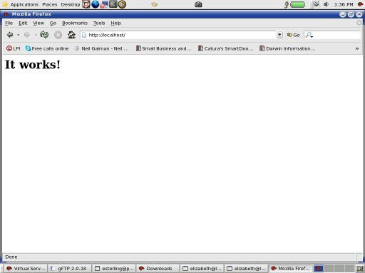
http://localhost
When nothing's there...

Slide 5
Ways to Configure Apache
httpd.conf is the main configuration file.
Other config files are used with the Include directive
  One common tool is to use one file per virtual server. Include the group by including the whole directory.
  Any change to config files will take effect when the httpd is restarted.
.htaccess files change configurations at the directory level, and take effect without restarting the httpd

Slide 6
Directive Syntax
  One directive per line
  “\” (backslash) at the end of line signals directive continues to next line.
  Directives are case insensitive BUT
  arguments are often case sensitive
  Lines beginning with “#” are comments
    Comments can't be on the same line as a directive!
  Blank space before or after directive is ignored, so indent at will for clarity.
Run apachectl configtest to test your configs

Slide 7
Directive Scope
Directives in httpd.conf or its included files are applied to the entire server unless stated otherwise
XML sections allow for limited scoping
  eg. <Directory>, <DirectoryMatch>, <Files>, <FilesMatch>, <Location>, <LocationMatch>, <VirtualHost>
Directives in .htaccess files apply to the directory where it is found and those beneath it.

Slide 8
An example httpd.conf
ServerRoot “/usr/local/apache2”
Listen 80
ServerName www.sparkthing.com
DocumentRoot “/var/www/html”
<Directory />
Options FollowSymLinks
AllowOverride None
Order Mutual-failure
Deny from .com
Allow from .il
</Directory>
<Directory “/var/www/html”>
Options Indexes FollowSymLinks
AllowOverride AuthConfig Options
</Directory>
Notes:
The best way to learn about directives quickly is to read the httpd.conf file.
ServerRoot tells us where the server files live. (the bin, the conf's, &c...)
Listen says which port you are listening in on. 80 is the usual. You may have different (virtual) servers running on different ports.
ServerName if nothing is given for this, you are just localhost and nothing else.
DocumentRoot tells us where the files will be served from.
<Directory [dir path]></Directory> sets apart directives that will work on just [dir path]'s files.
Options controls which features are available in a given directory.
AllowOverride says what sorts of things a .htaccess file is allowed to change.
We say “None” at / and then add permissions for .htaccess overrides on a directory by directory basis for security reasons.
Order part of mod_authz_host. Looks to see which list gets priority for authorization.
“Mutual-failure” ensures that only files that ARE in allow and are NOT in deny can have access. More common is “deny,allow”.

Slide 9
An example (continued)
<FilesMatch “^\.ht”>
Order allow,deny
Deny from all
Satisfy All
</FilesMatch>
ErrorLog logs/error_log
LogLevel warn
<IfModule log_config_module>
LogFormat “%h %l %u %t \”%r\” %>s %b” common
CustomLog logs/access_log common
</IfModule>
Include /usr/local/apache2/conf/vhosts/*.conf
Notes:
FilesMatch uses PCRE's to apply directives to files. In this case we're looking for .htaccess and .htpasswd files and making sure that browsers can't see them.
( DirectoryMatch works the same for directories)
ErrorLog is pretty obvious. But you should also know that this is good for your virtual hosts, as well. Giving a separate ErrorLog to each of your virtual hosts makes debugging them easier.
LogLevel emerg, alert, crit, error, warn, notice, info, debug
IfModule allows you to configure module-specific details
LogFormat See http://httpd.apache.org/docs/2.2/mod/mod_log_config.html#formats
(host, remote logname, remote user, time rqst recvd, 1st line of rqst, status of last rqst, resp size)
CustomLog is just like ErrorLog, but uses the LogFormat you just defined. You can have several different formats for different purposes and name them different things (where “common” is here).
Include this is good for all sorts of things. There are a number of files in /usr/local/apache2/conf/extra that you may want to include. You can also take all of your virtual host directives and place them in separate files like myserver.conf

Slide 10

What's a .htaccess file?
Photo by Farl . Some rights reserved.
http://flickr.com/photo_zoom.gne?id=55834820&size=o
Directory level control for directives, lives in the directory it controls.
Useful on shared servers
  Allows individual server users to control their personal websites
Most directives which can be placed in your .conf files can also be put in a .htaccess file.
  Remember that you can control which directives can go into a .htaccess file from you main .conf files, too.

Slide 11
Directory Lockdown with .htaccess
In your .htaccess file write:
AuthType Basic
AuthName "restricted area"
AuthUserFile .htpasswd
require valid-user
Create a .htpasswd file:
# htpasswd -c .htpasswd esterling
New password: mypassword
Re-type new password: mypassword
Adding password for user esterling
Notes:
There are various reasons why NOT to use a .htpasswd file inside a directory which is servable by the httpd. All of them have to do with security. In the real world, you are better off putting passwords in a directory outside your servable space.
For instance, if you are configuring your personal site at http://www.alwayssababa.com/~yoursite, your servable space lives in ~/public_html so you don't want your .htpasswd file living in or below ~/public_html. Put it in ~/. or in ~/secret even. Then it will be obscured AND harder to get at.
Remember, your password file doesn't have to be called .htpasswd, but the . makes it a “hidden” file when running an ordinary ls command and the .ht means that the file is not served via Apache if you used the FilesMatch directives in the example on slide 9.

Slide 12
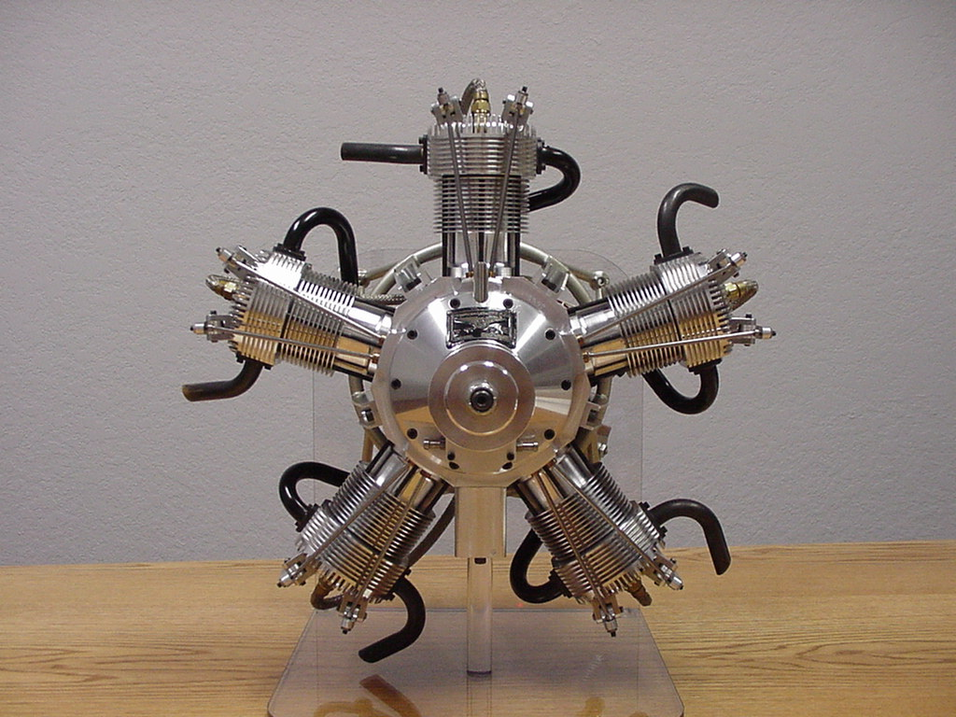
Restart Your Engines!!
Once you make changes to .conf files, make sure to restart Apache.
apachectl -k graceful
  Tells the children processes to shut down as soon as they are done serving whatever they have now. When the children shut down, the parent shuts down, too, then restarts.
  Other options for apachectl -k:
  stop, restart, graceful-stop

Slide 13
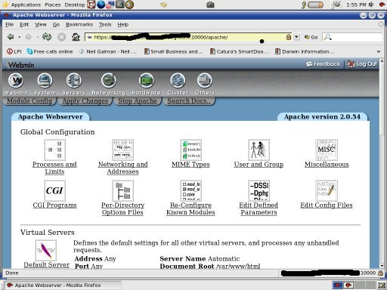
Apache In Webmin
Notes:
Once you learn how to run Apache through the command line and the text-based configuration files, using Webmin is a breeze.

Slide 14
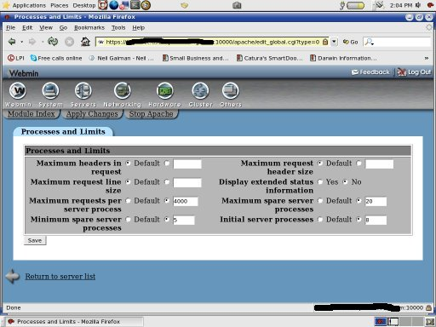
Apache In Webmin
Notes:
Once you learn how to run Apache through the command line and the text-based configuration files, using Webmin is a breeze.

Slide 15
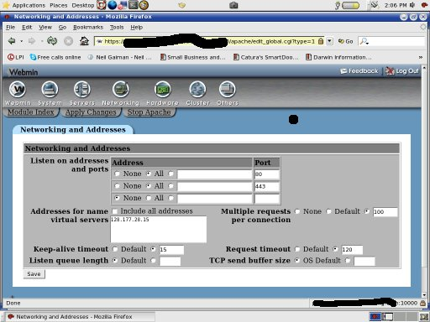
Apache In Webmin
Notes:
Once you learn how to run Apache through the command line and the text-based configuration files, using Webmin is a breeze.

Slide 16
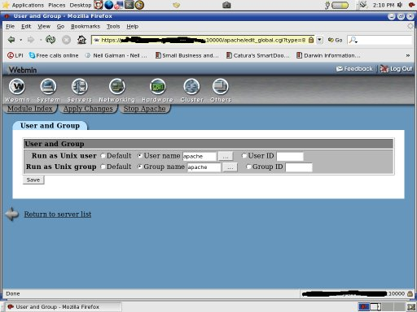
Apache In Webmin
Notes:
Once you learn how to run Apache through the command line and the text-based configuration files, using Webmin is a breeze.

Slide 17
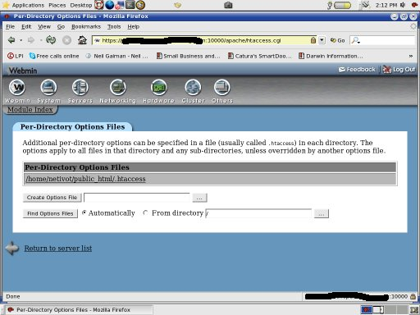
Apache In Webmin
Notes:
Once you learn how to run Apache through the command line and the text-based configuration files, using Webmin is a breeze.

Slide 18

Learn More, Do More...
Directives Quick Reference
http://httpd.apache.org/docs/2.2/mod/quickreference.html
Apache-specific PHP functions
http://php.net/apache
Creating and using custom directives using mod_perl
http://perl.apache.org/docs/2.0/user/config/custom.html#Creating_and_Using_Custom_Configuration_Directives
Authentication, Authorization & Access Control
http://httpd.apache.org/docs/1.3/howto/auth.html
Photo by Erik Ogan. Some Rights Reserved. http://flickr.com/photo_zoom.gne?id=21870407&size=l

