Slide 1
Coin Classification with Machine and Deep Learning Methods
Authors: Gilad Shotland, Shlomo Glick, Adi Dahari
Supervisor: Prof. Lee-Ad Gottlieb
In Association With: Mr. Haim Shaham, Mr. Yaniv Levi

Slide 2
Overview
The research process of Numismatology⁽¹⁾ bears a high need of human power for pre-processing and classification hands-on.
This project targets the possibilities of easing and boosting those researches’ exhausting and slow processes by using Machine Learning and Deep Learning method that automate the classification process of ancient coins, particularly, the coins of 3 rulers’ eras:
John Hyrcanus I, Alexander Jannaeus, and Judea,
who produced the same coin - Half Prutah
1: Numismatology = Study of ancient money.

Slide 3

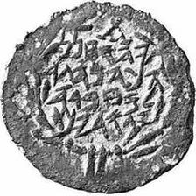
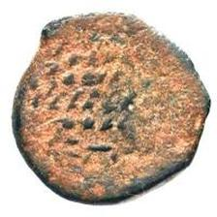
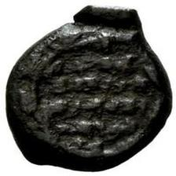
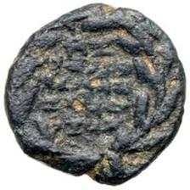
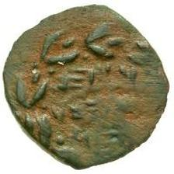
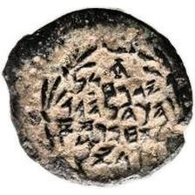
Data Examples

Slide 4




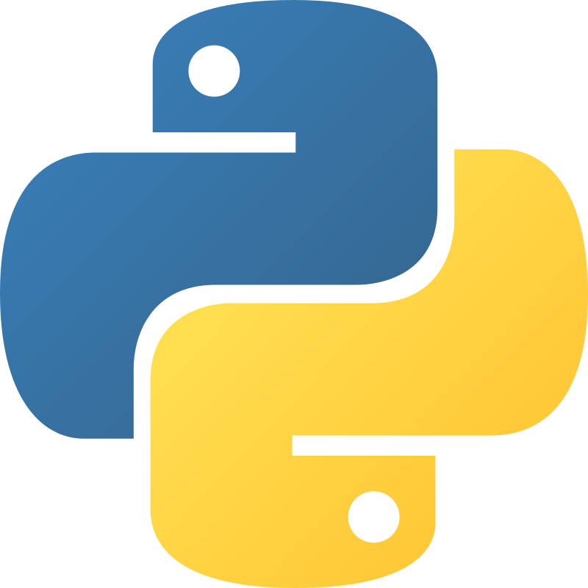
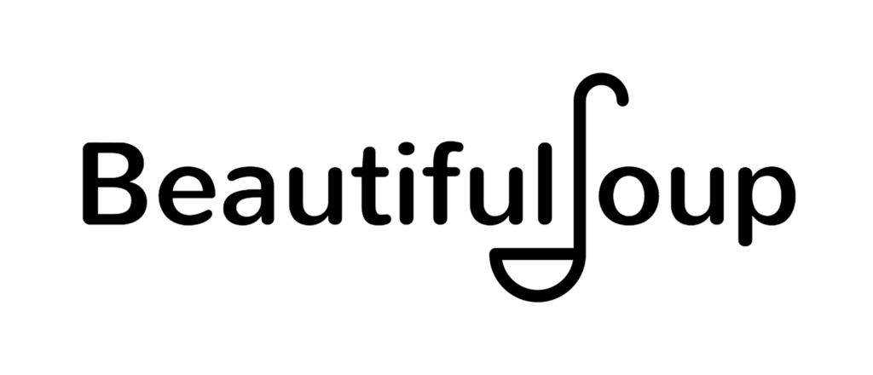
Technologies
Practical Frameworks, Libraries and Platforms
Python, PyTorch, Google Colab
Data Scraping
BeautifulSoup4, Selenium

Slide 5
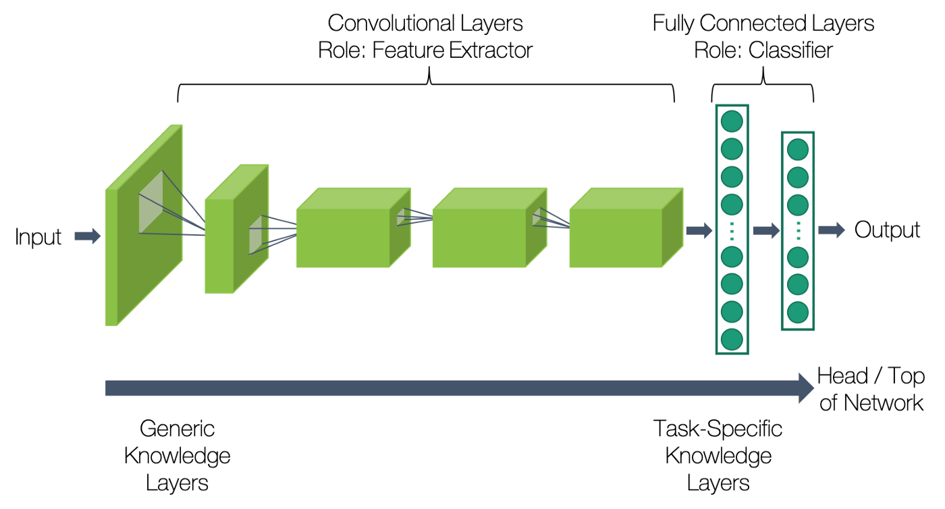
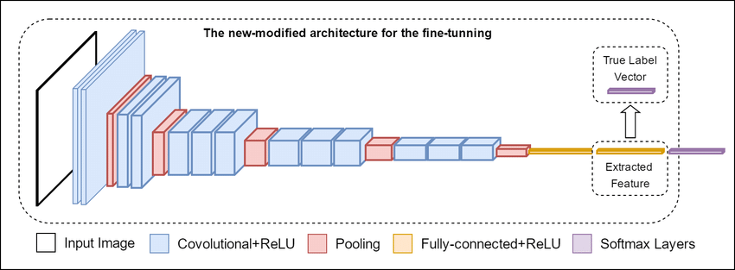
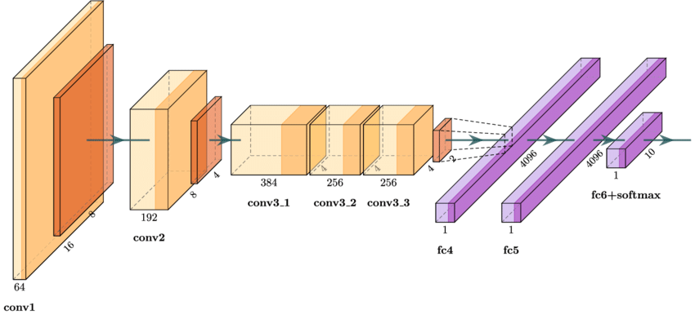
Models and Optimization Algorithms
ResNet
VGG
AlexNet

Slide 6
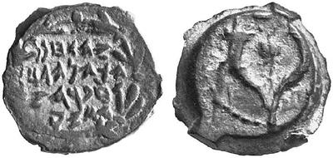
Additional Data Manipulation
uniformly
Crop: Most of the images contained 2 sided of the coin, our model predicts based on the Alphabetic side alone.
Resize: By using pre-trained model (ResNet), all images must be of dimensions: 3 x 244 x 244.
Rotate: Images are not uniformly rotated. A random rotation procedure allows the model to train over multiple directions of the coins.

