Slide 1


//Developers_Institute_
TLV Coding Bootcamp
E-commerce Marketing Analysis:
Funnel and Conversion Analysis of the Google Merchandise Store
Developers Institute ranked for Best Coding Bootcamp
Worldwide for 2023
Azerbaijan 🇦🇿- México 🇲🇽 - Cameroon 🇨🇲 - Senegal 🇸🇳 - Burkina Faso 🇧🇫 - Mali 🇲🇱 - Ghana 🇬🇭 - Togo 🇹🇬 - Mauritius 🇲🇺 - Morocco 🇲🇦 - India 🇮🇳 - Georgia 🇬🇪 - Israël 🇮🇱

Slide 2


E-commerce Marketing Analysis:
Funnel and Conversion Analysis of the Google Merchandise Store
Shlomo Sananes
Tel Aviv - Israel

Slide 3
AGENDA
Project Description e Motivation
Data
Analyses
Dashboard
Machine Learning
Challenges

Slide 4
Project Description and Motivation

Slide 5
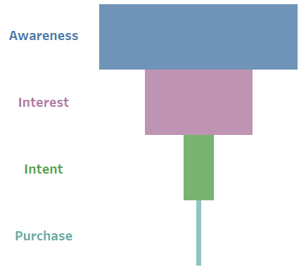
Project Description and Motivation
Marketing Analysis with emphasis on Marketing Funnel Analysis
Relevance in the market
Business goal is a function of multiple strategies and processes
Google Analytics
Project Description and Motivation - Data - Challenges - Hypothesis - Analyses & Insights - Dashboard

Slide 6
Data

Slide 7
Data
Google Analytics Reporting API
Kaagle
Download from Universal Analytics DEMO ACCOUNT
Data granularity
Preprocessing with Python
Relational Databases (Primary and Secondary Key)
Multiple datasets to ensure data integrity on Tableau
Project Description and Motivation - Data - Analyses - Dashboard - Machine Learning - Challenges

Slide 8
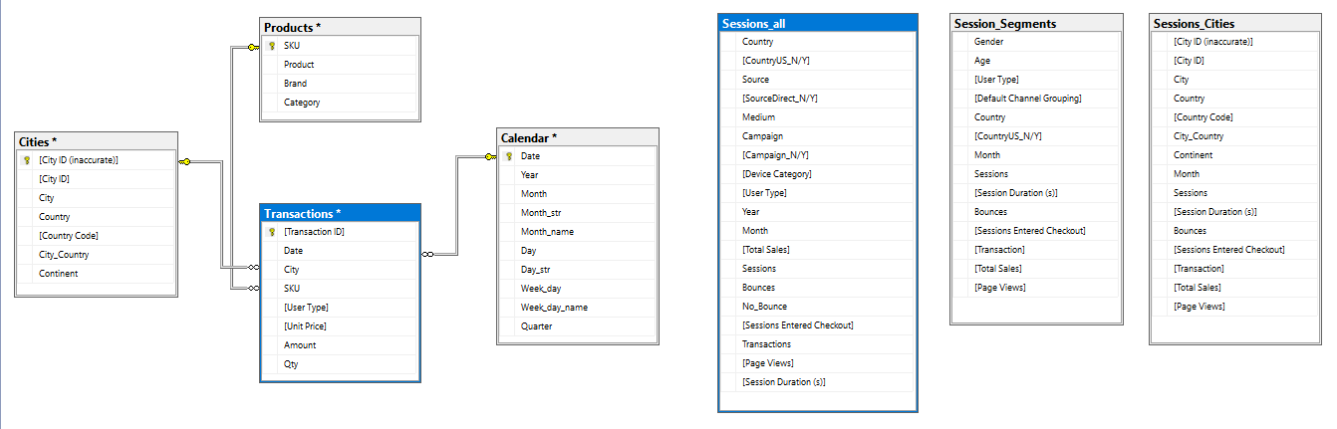
Data
Project Description and Motivation - Data - Analyses - Dashboard - Machine Learning - Challenges

Slide 9
Data
Medium
How users arrived at the website
Source
Specific origin of traffic
Traffic Type (or Source/Medium)
Combines Source and Medium
Value | Case description
None | Direct Traffic with no referring website
Organic | Unpaid Search Engines
Referral | Links from other sites
cpc | Paid Search Engine Advertising
Email | From links clicked in emails
Affiliate | From affiliate marketing links
(not set) | when the medium is unknown or not captured
Value
Direct
Google
Bing
Googleple
Newsletter
Facebook
(not set)
Value
(direct) / (none)
Google / Organic
Referral / Facebook
Email / Newsletter
Bing / Organic
TagAssistant / Referral
Project Description and Motivation - Data - Analyses - Dashboard - Machine Learning - Challenges

Slide 10
Analyses

Slide 11
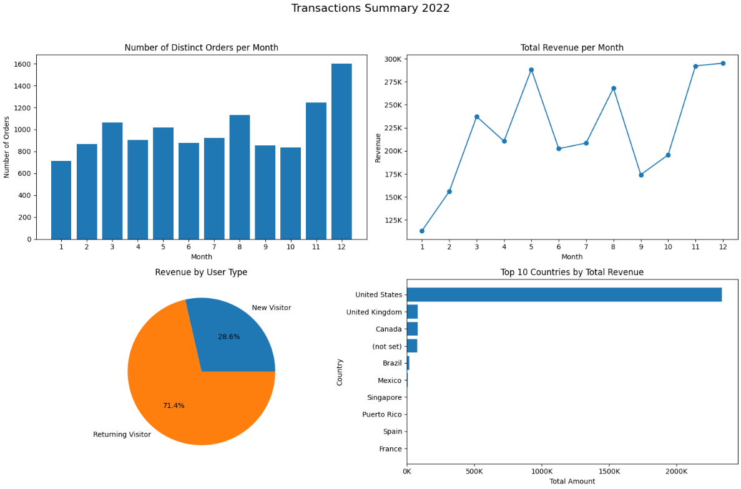
Analyses
1) Is there a significant difference on behaviors
of New Visitors and Returning Visitors?
2) What caused the drop in revenue from 05/22
to 06/22 and from 08/22 to 09/22?
3) What other factors have a high impact on the
e-Commerce Conversion Rate?
Project Description and Motivation - Data - Analyses - Dashboard - Machine Learning - Challenges

Slide 12
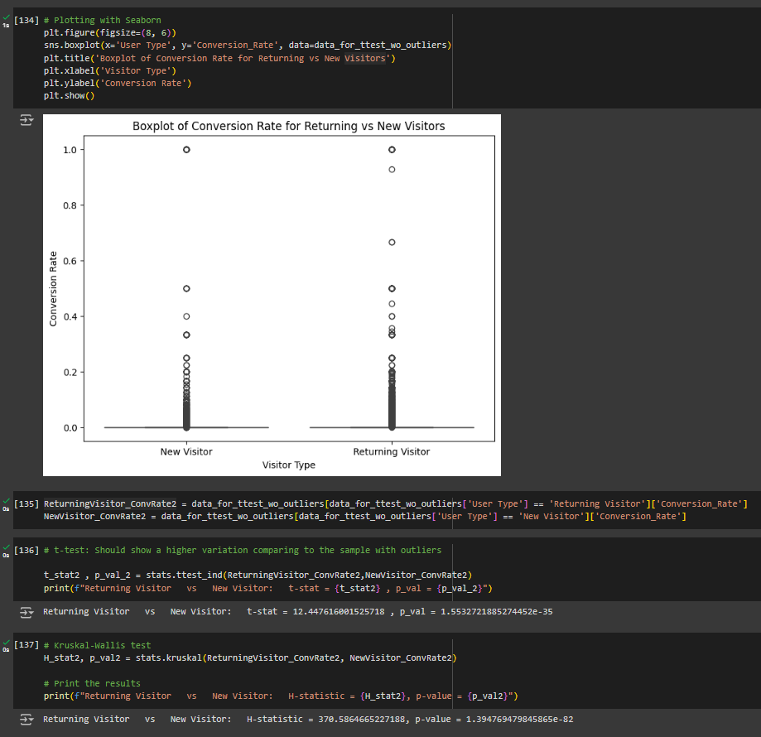
Analyses
Is there a significant difference on behaviors of New Visitors and Returning Visitors?
Techniques:
1- Visualize Conversion Rate for both categories
2- t-test and Kruskal-Wallis test
Project Description and Motivation - Data - Analyses - Dashboard - Machine Learning - Challenges

Slide 13
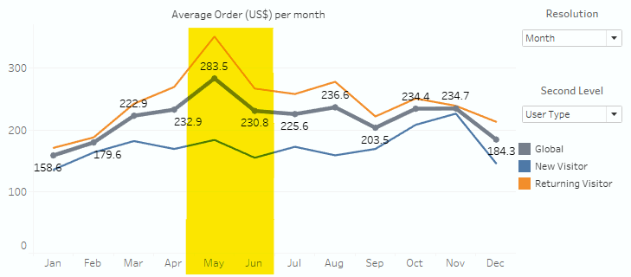
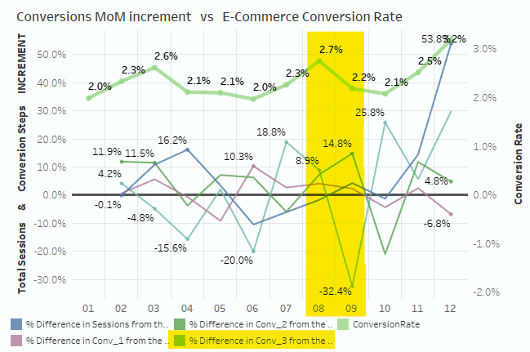
Analyses
What caused the drop in revenue from 05/22 to 06/22 and from 08/22 to 09/22?
05/22 to 06/22:
- Revenue dropped from $288K to $202K
08/22 to 09/22:
- Revenue dropped from $2688K to $174K
MAIN CAUSE: Decrease on Average Ticket
MAIN CAUSE: Conversion Rate drop
Driven by a significant decrease (32,4%) on Conv_3 from 08/22 to 09/22.
Project Description and Motivation - Data - Analyses - Dashboard - Machine Learning - Challenges

Slide 14
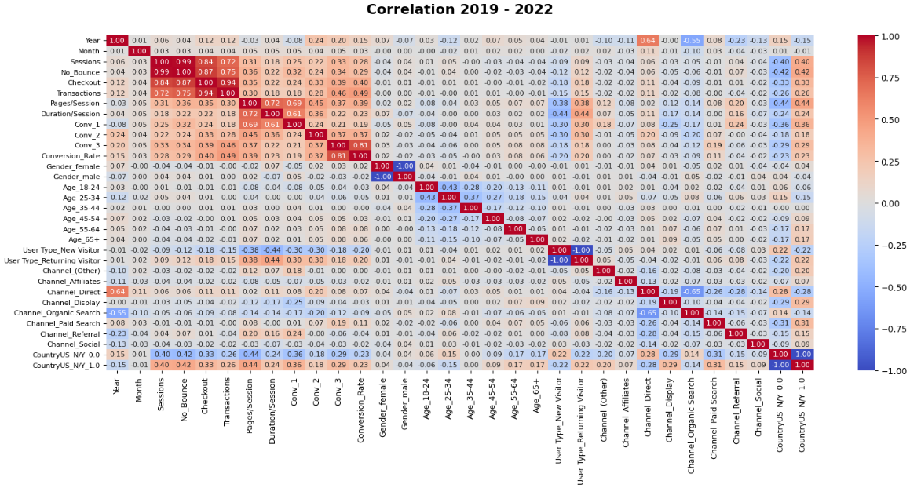
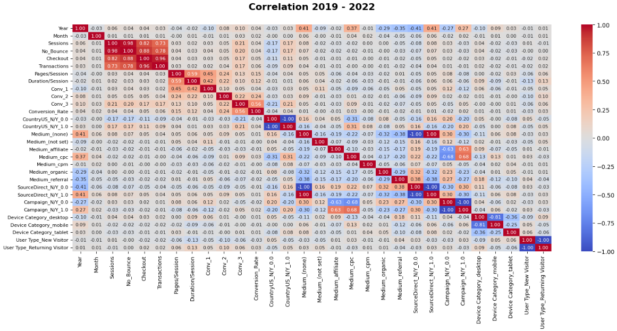
Analyses
What other factors have a high impact on the e-Commerce Conversion Rate?
• Correlation 1 • Correlation 2
Correlation 1 | Relation Type
Conversion Rate vs Conv_1 vs Conv_2 vs Conv_3 Conversion Rate vs Pages/Session Conversion Rate vs Duration/Session Conversion Rate vs User Type (Returning Visitor) Conversion Rat3 vs CountryUS_N/Y (Country = US) | Direct Relation
Conversion Rate {CountryUS_N/Y (Country = US)} vs Channel_Display Conversion Rate {CountryUS_N/Y (Country = US)} vs Channel_Paid Search | Indirect Relation
Relation Type | Correlation 2
Direct Relation | Conversion Rate vs Conv_2 vs Conv_3
Indirect Relation | Conversion Rate {Conv_3} vs CountryUS_N/Y (Country = US) Conversion Rate {CountryUS_N/Y (Country = US)} vs Campaign_N/Y (With Campaign) Conversion Rate {CountryUS_N/Y (Country = US)} vs Medium_cpc
Project Description and Motivation - Data - Analyses - Dashboard - Machine Learning - Challenges

Slide 15
Dashboard

Slide 16
Dashboard
Tableau Workbook with 5 Dashboards:
Overview: Orders summary
Marketing Funnel: Sessions by Step in the Funnel and Conversion Rates over time
Funnel Comparison: Feature to compare 2 different groups/period
Traffic: Analysis of Traffic Sources and Device Category
Campaigns: Campaigns effectiveness and distribution charts
Project Description and Motivation - Data - Analyses - Dashboard - Machine Learning - Challenges

Slide 17
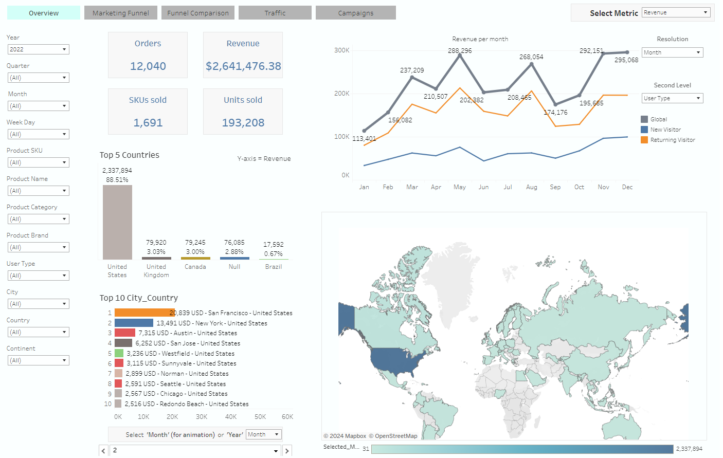
Dashboard
Overview
Project Description and Motivation - Data - Analyses - Dashboard - Machine Learning - Challenges

Slide 18
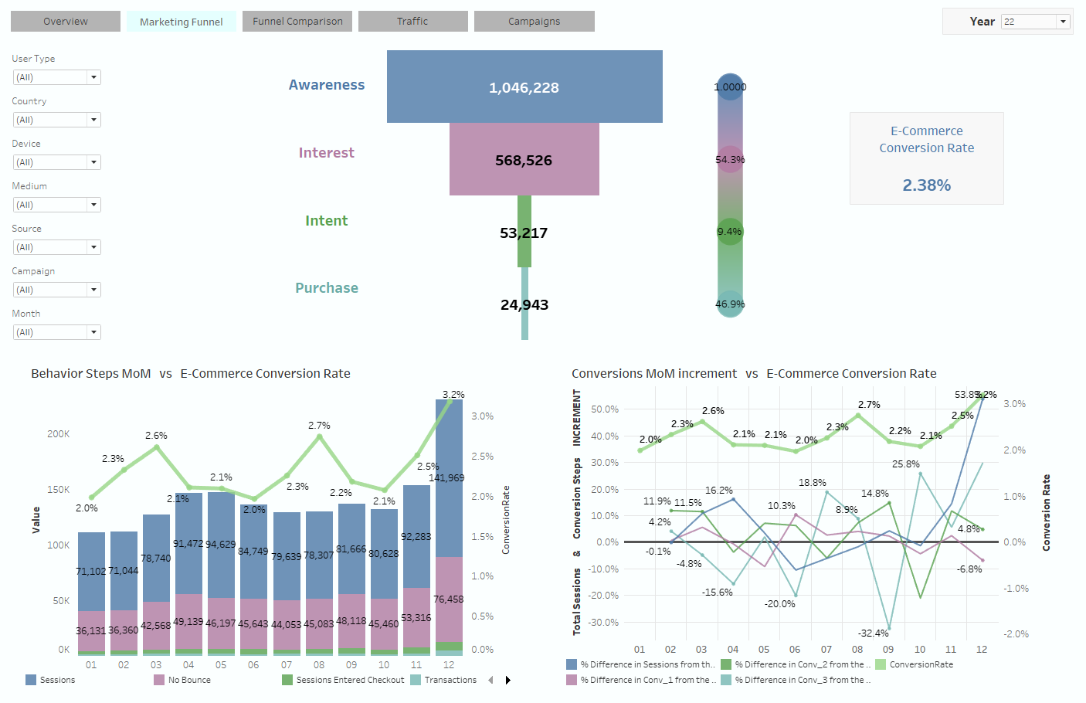
Dashboard
Marketing Funnel
Project Description and Motivation - Data - Analyses - Dashboard - Machine Learning - Challenges

Slide 19
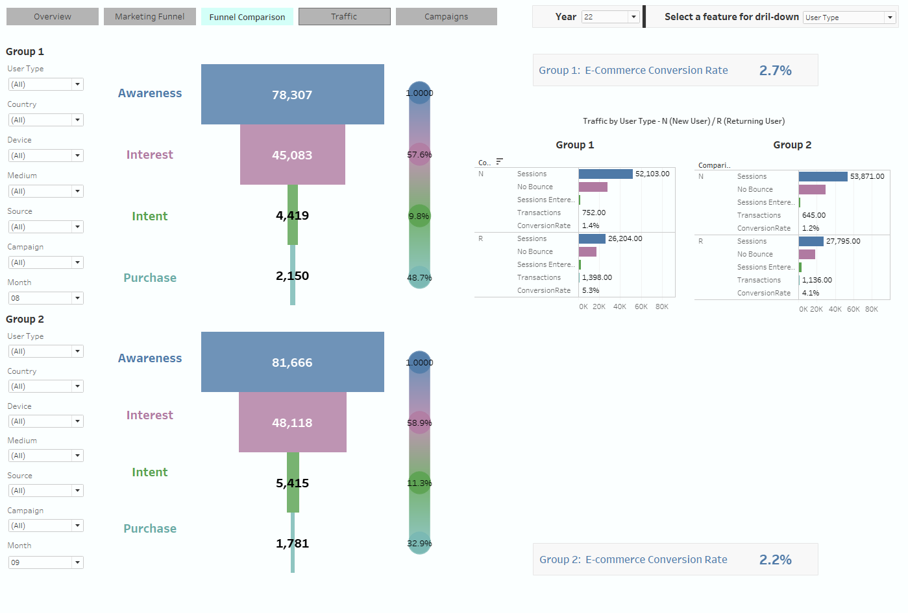
Dashboard
Funnel Comparison
Project Description and Motivation - Data - Analyses - Dashboard - Machine Learning - Challenges

Slide 20
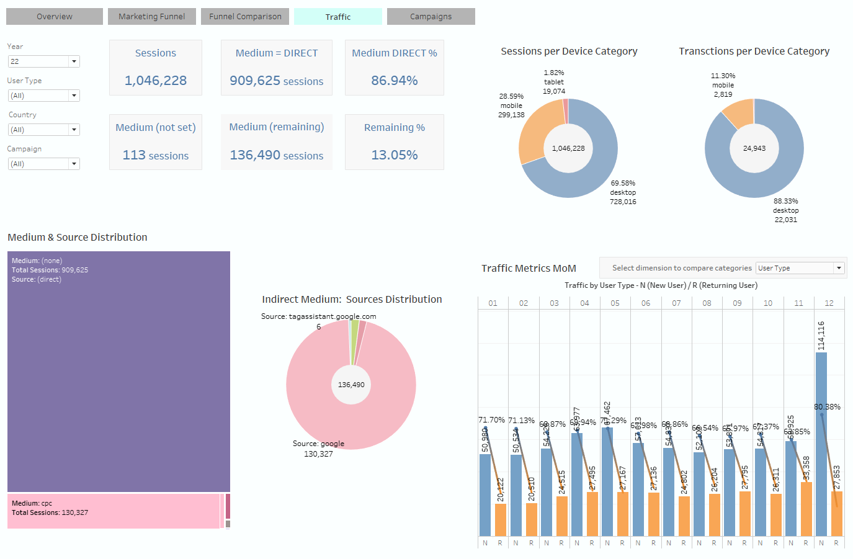
Dashboard
Traffic
Project Description and Motivation - Data - Analyses - Dashboard - Machine Learning - Challenges

Slide 21
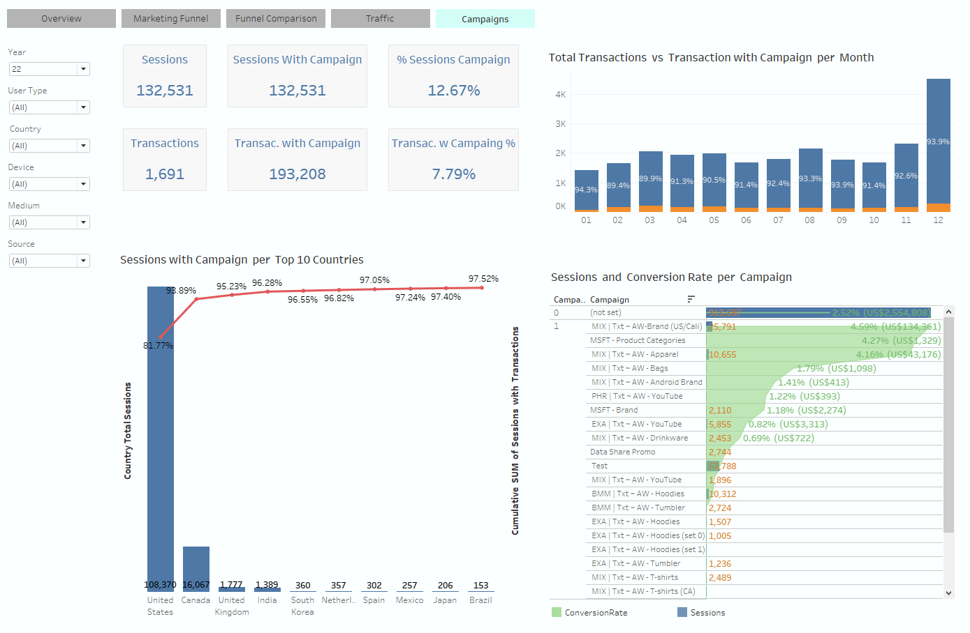
Dashboard
Campaigns
Project Description and Motivation - Data - Analyses - Dashboard - Machine Learning - Challenges

Slide 22
Machine Learning

Slide 23
Machine Learning
Purpose, Model Selection and Methodology
Purpose: Create a Time Series Model to predict the e-Commerce Conversion Rate (predicted variable)
Model: Long Short Term Memory (LSTM)
Data Preparation
Model Definition
Training, Validation and Testing
Evaluation and Visualization
Create Sequences
Spit Data into:
1) Training
2) Validation
3) Testing
Define Layers and Parameters
Compile Model
model.predict(X_train)
model.predict(X_val)
model.predict(X_test)
Calculat rmse
Plot Model Values x Actual Values
Project Description and Motivation - Data - Analyses - Dashboard - Machine Learning - Challenges

Slide 24
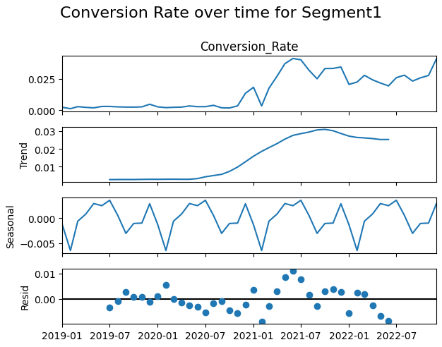
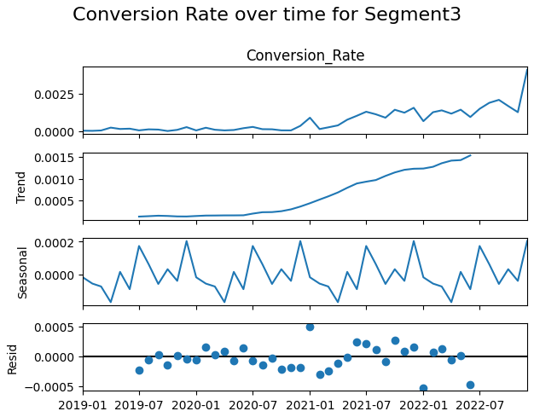
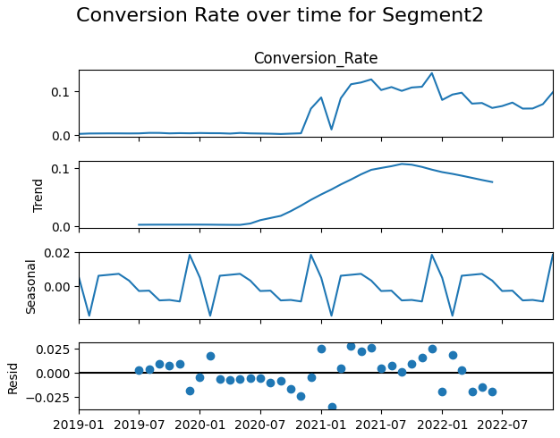
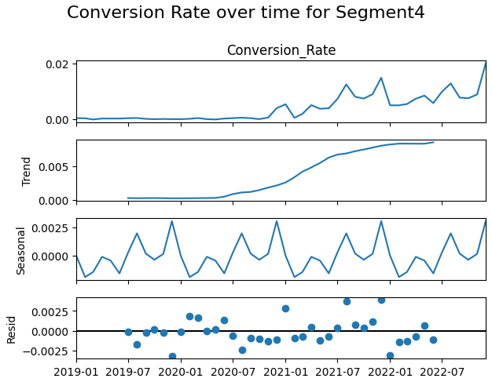
Machine Learning
Conversion Rate Decomposition by Segment
Project Description and Motivation - Data - Analyses - Dashboard - Machine Learning - Challenges

Slide 25
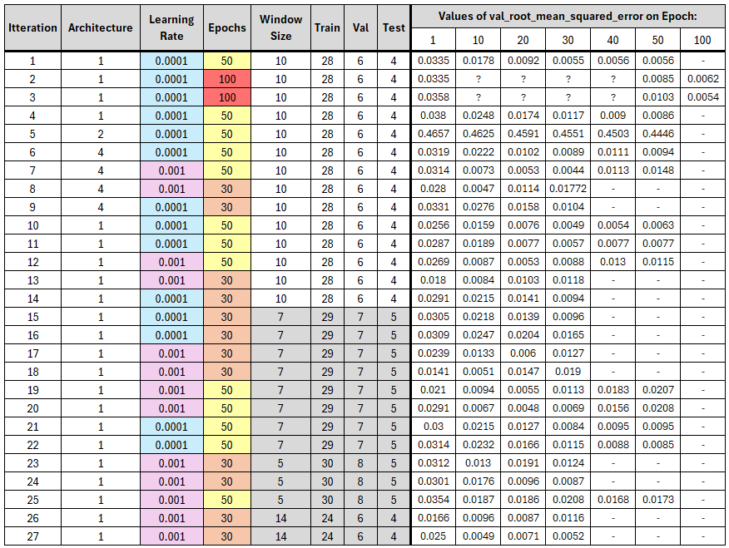
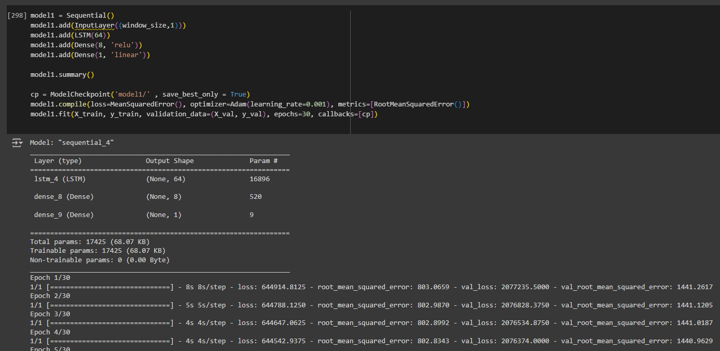
Machine Learning
Model Definition
Parameters Tunning
Final Code
Project Description and Motivation - Data - Analyses - Dashboard - Machine Learning - Challenges

Slide 26
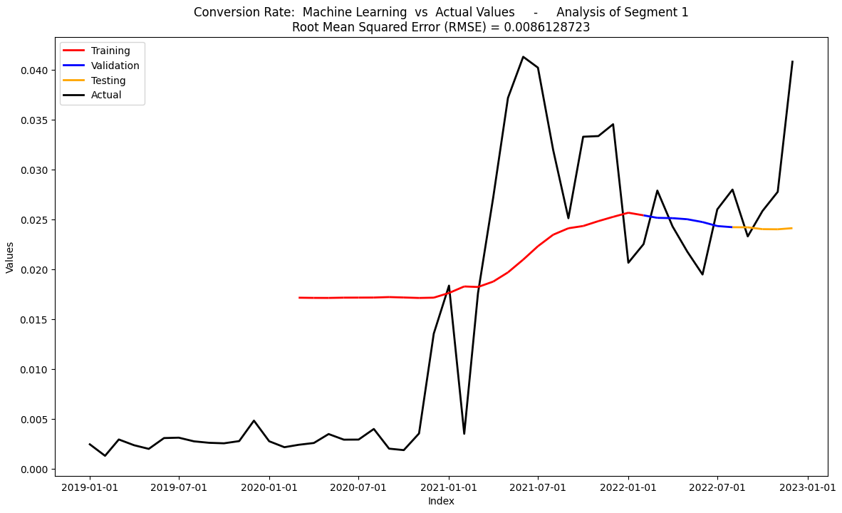
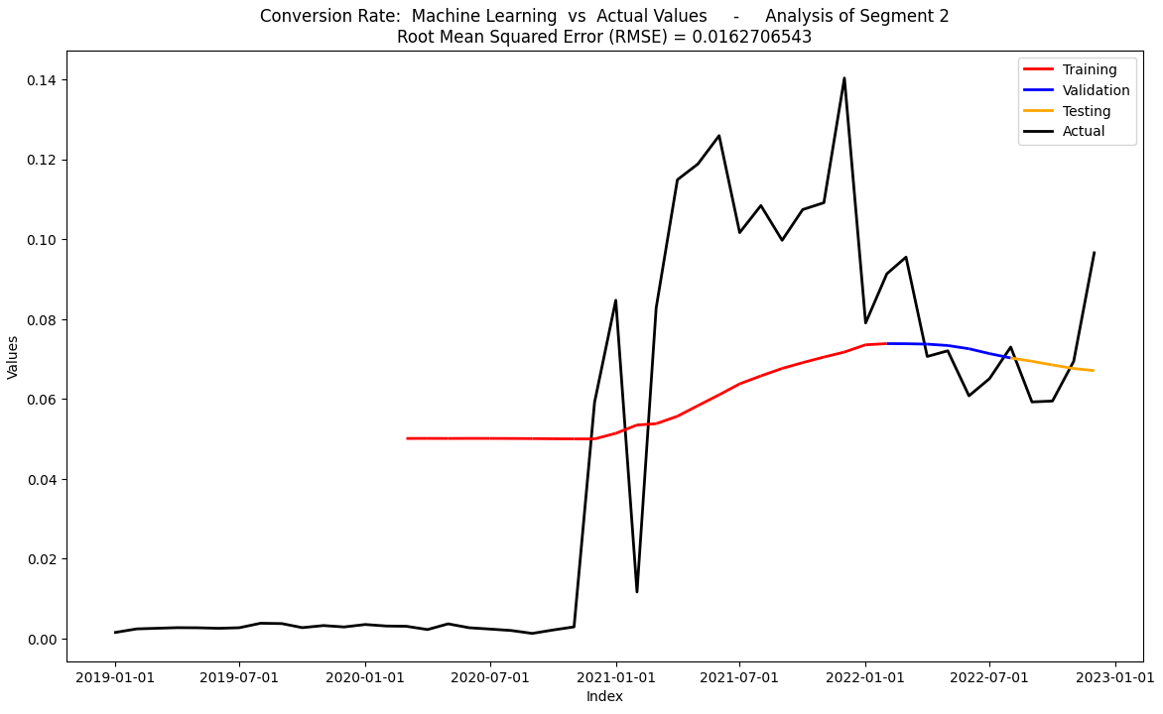
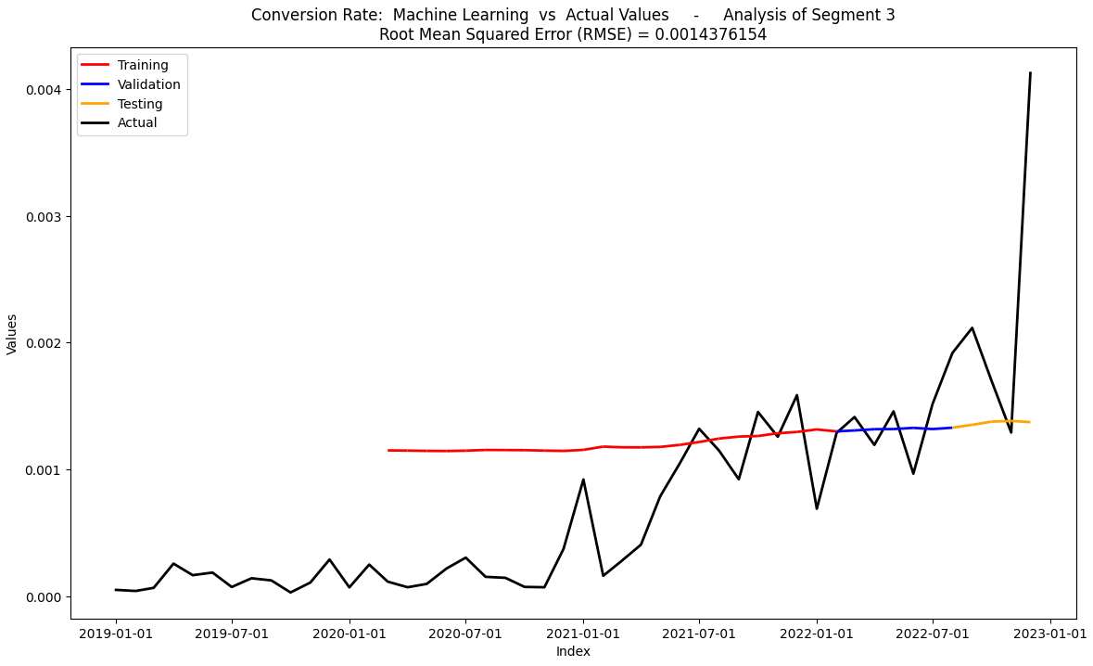
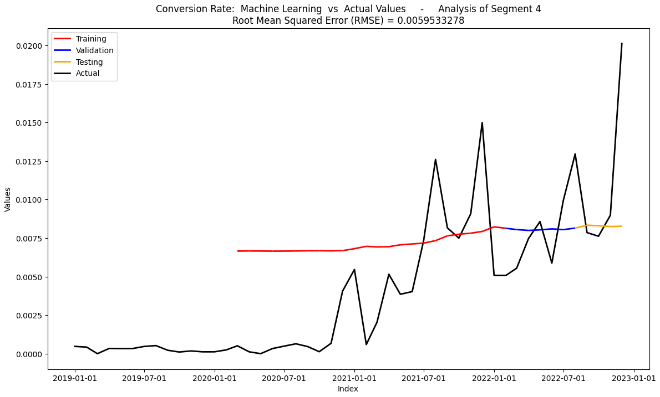
Machine Learning
Evaluation and Results
Considerations
A sequence with more datapoints = 0 is less likely to generate a precise model.
Parameters found to be optimal for one case may not yield accurate results for a similar case with datapoints on a different scale.
The model will have a better fit when the datapoints are further from zero.
Project Description and Motivation - Data - Analyses - Dashboard - Machine Learning - Challenges

Slide 27
Challenges

Slide 28
Challenges
Data Collection
Columns with different data type
Non-unique ID for City
Google Analytics report with MAX 5 dimensions
Aggregation problems when using specific dimensions
Users Segmentation: Number of clusters/Segments
Machine Learning - Time Series: Influence of datapoints = 0 and optimal parameters
Project Description and Motivation - Data - Analyses - Dashboard - Machine Learning - Challenges

Slide 29
THANK YOU

