Slide 1
DEAP: Extending the MAPS System
Carter Wiesner

Slide 2
The Expectation
MAPS needs to improve effectiveness rate.
Solution has teenage users in mind.
Maintains and/or improves MAPS communication loop.
Doesn't rely on dedicated adherence team.

Slide 3
Problems to Address
Typical behaviors of children/teenagers such as forgetting to take pills or feeling embarrassed.
Feedback loop between patient and caregiver doesn't operate in real time.
Busy and resource-challenged teams can't be expected to keep adequate tabs on every patient.

Slide 4
Our Solution?
Designed a protype of a meta solution, the PoGo. A physical device to reinforce or supplement adherence team
Build on existing solution with prototype in mind
Extend and reinforce existing solution with tweaks

Slide 5
What Will the PoGo Do?
Offer patients and caregivers an optional silicone phone-case attachment with a pill-storage compartment.
The compartment would use a spring-loaded mechanism and physical stop to control pill release, with a tension gauge to estimate how many pills remain.
The device would use impact-resistant and waterproof-resistant design features.

Slide 6
Prototype Design Sketch

Slide 7
Reminder and Escalation Flow
1. At a scheduled medication time, the app checks whether the container indicates that a dose was taken.
2. If it was, send the patient a positive message.
3. If it wasn’t, vibrate the device distinctly.
4. After a short interval—such as five minutes—check sagain. If the dose still appears untaken, use a different vibration and send a reminder message.
5. If the event continues beyond a defined threshold, send an escalation message to the patient and notify their caregiver, if applicable.
6. Flag the event in the coordinator’s next summary.

Slide 8
Mobile App Integration With PoGo
Log medication-taking events and their timing to help identify adherence patterns.
Keep routine tracking unobtrusive for the patient. Send coordinators concise summaries that highlight events needing attention.
Allow coordinators to provide patient-specific medication schedules through a patient specific code. Patients cannot edit those schedules.

Slide 9
Added Features To Build on MAPS

Slide 10
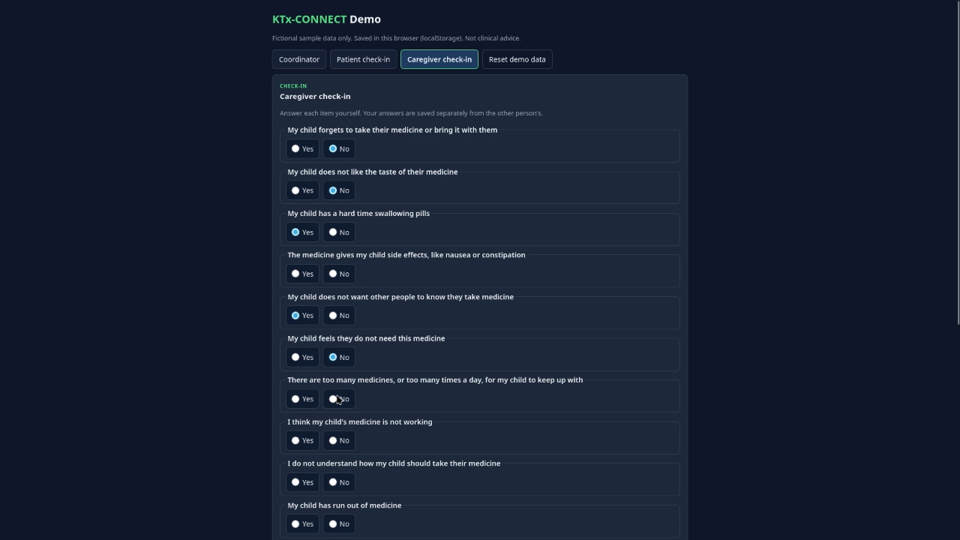

Slide 11
Conclusion
PoGo creates a physical interface that better works alongside patients.
PoGo helps coordinators by returning more relevant data.
PoGo can supplement lack of coordinators.
New features create a more functional interface for coordinators to interact with patients and caregivers.

Slide 12
Questions?

