Slide 1
ResQ-Graph.
Agent-Based Emergency Ambulance Dispatch Simulation
with AI-Optimised Fleet Placement
Python
NetworkX
Pygame
A* Pathfinding
HDBSCAN
Genetic Algorithm
FAST-NUCES Lahore | Artificial Intelligence | May 2026
1 / 8

Slide 2
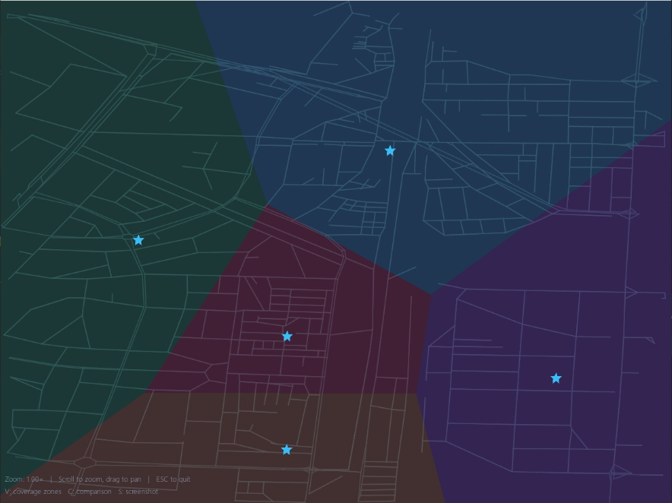
INTRODUCTION
Optimal Stations (Derived through GA)
What is ResQ-Graph?
[Optimal Stations Map]
GA-optimised stations (stars) vs random placement (circles)
ResQ-Graph is an agent-based simulation that models ambulances navigating a real city road network to respond to dynamically generated emergencies. It uses A* pathfinding, custom HDBSCAN clustering, and a Genetic Algorithm to intelligently place stations and dispatch the nearest ambulance in real time.
798
12
224
Road Nodes
Sprints
Tests
Problem Statement
Random ambulance station placement leaves large areas uncovered and increases response times — ResQ-Graph proves that AI-optimised placement reduces Average Response Time by 11.8% (p=0.001).
2 / 8

Slide 3
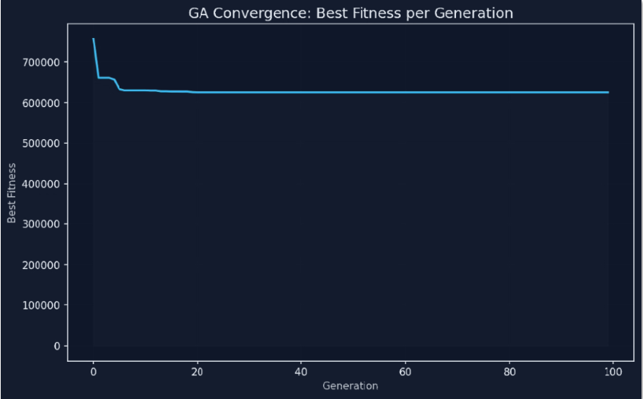
ARCHITECTURE
[GA Convergence Plot]
Fitness convergence over 100 generations
System Architecture
Simulation Engine — Tick-based loop orchestrating all subsystems
Traffic Model — Dynamic edge congestion based on event density
Dispatcher Brain — O(1) nearest-idle assignment via distance matrix
Genetic Algorithm — Traffic-aware station placement optimiser
3 / 8

Slide 4
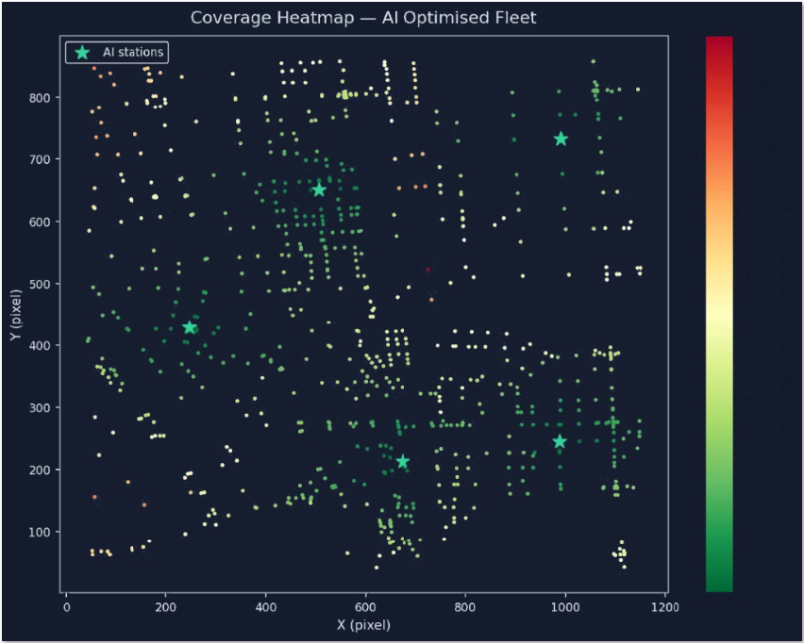
ARCHITECTURE
System Architecture
A* Pathfinding — Haversine heuristic with traffic-aware rerouting
Event Spawner — Poisson-distributed emergency generation
HDBSCAN Clustering — Custom from-scratch hotspot detection
Pygame Renderer — Real-time visualisation with cached sprites
4 / 8

Slide 5
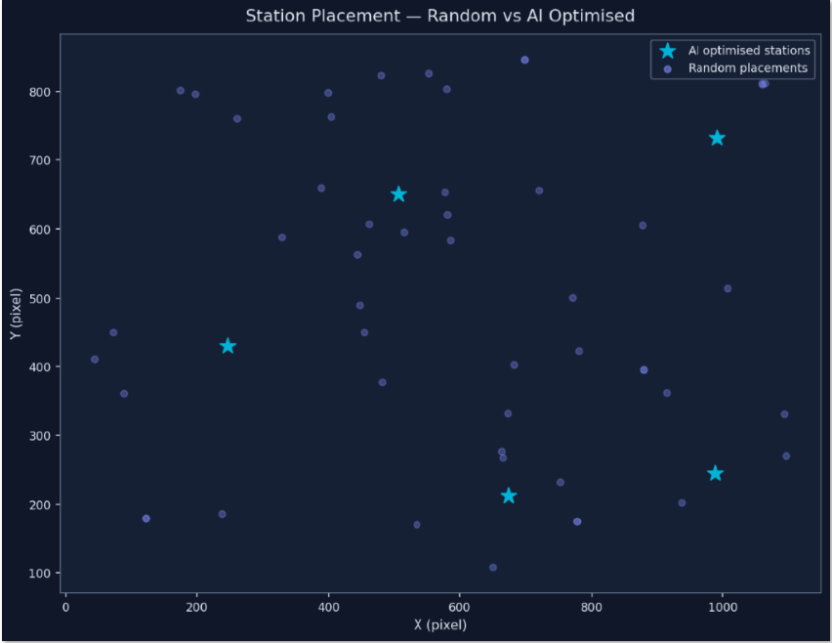
METHODOLOGY
Experimental Design & Algorithms
Experimental Design
[Station Placement Comparison]
AI vs random placement side-by-side
Baseline: 10 runs × 1000 ticks, random station placement
AI Fleet: 10 runs × 1000 ticks, GA-optimised stations
Seed parity: Identical event seeds for fair comparison
Metric: Average Response Time (arrival_tick − spawn_tick)
Algorithms
A* Pathfinding — Haversine heuristic, traffic-aware dynamic rerouting
HDBSCAN — Hierarchical density clustering — finds emergency hotspots
Genetic Algorithm — Station placement optimiser, fitness = inverse ART
Dispatcher — O(1) nearest-idle via precomputed distance matrix
5 / 8

Slide 6
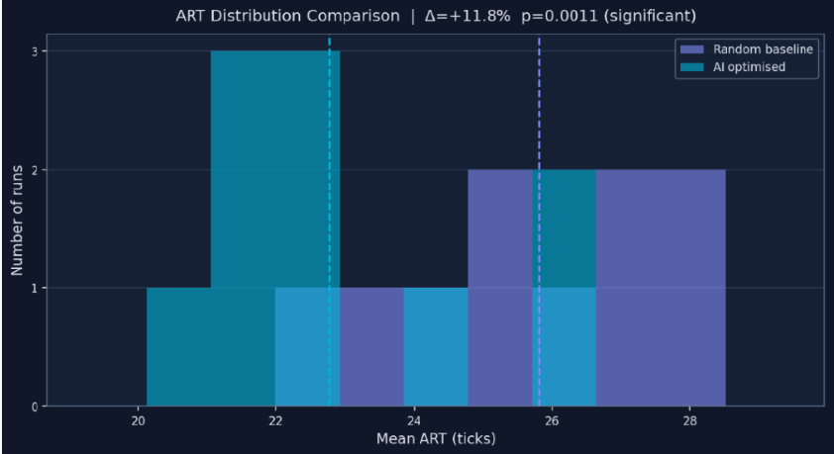
RESULTS
AI vs Random Baseline
25.81
22.77
+11.8%
Baseline Mean ART (ticks)
AI Fleet Mean ART (ticks)
ART Improvement
[ART per Run Time-series]
AI fleet consistently outperforms baseline across all 10 runs
Statistical Significance
Metric | Value
Paired t-statistic | 4.6855
p-value | 0.0011
Cohen's d (effect size) | 1.54 (large)
Significant (α=0.05) | Yes
6 / 8

Slide 7
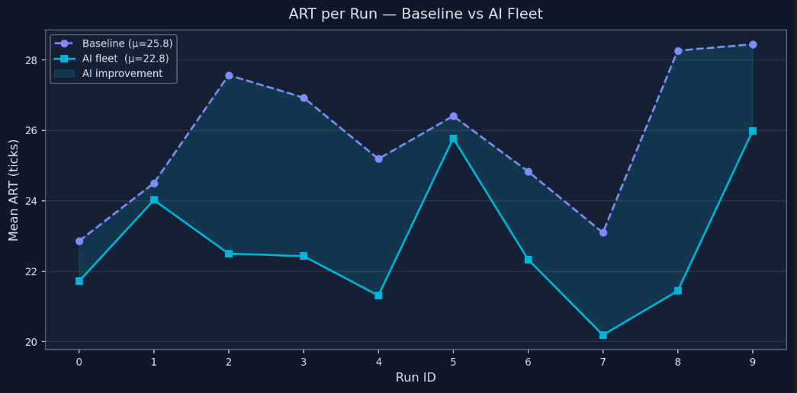
RESULTS
7 / 8

Slide 8
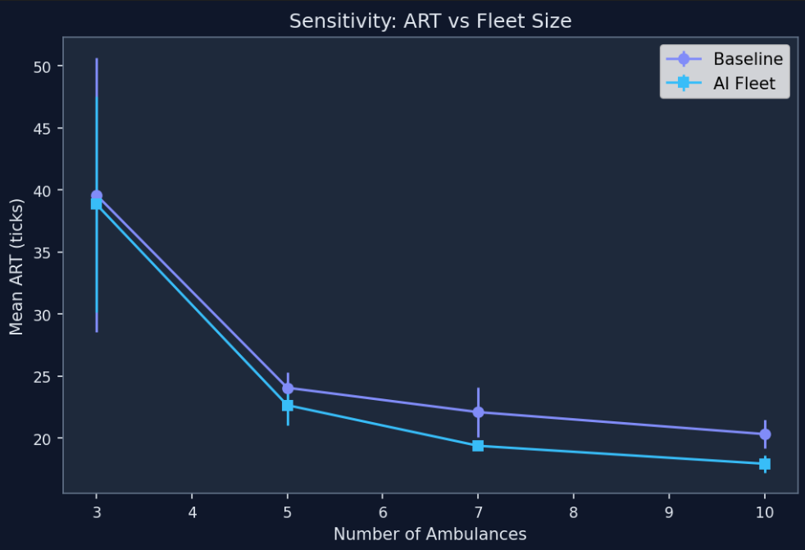
SENSITIVITY & PERFORMANCE
Sensitivity Analysis & Optimisation
[Fleet Size Sensitivity]
ART vs fleet size — sweet spot at 7 ambulances
Optimal Parameters (215-run sweep)
Parameter | Optimal | Finding
Fleet Size | 7 ambulances | Best cost-to-performance
HDBSCAN cluster | 5 | Precision vs sample balance
Rebalance interval | 25 ticks | Keeps fleet agile
Fleet 3→5 | — | ~40% ART reduction
[Lambda Sensitivity]
ART vs event rate — AI advantage holds under normal demand
Sprint 12: Performance Benchmarks
Benchmark | Result | Target
A* average call time | 4.81 ms | <50 ms
Renderer FPS | 86.4 FPS | ≥60 FPS
10K-tick scaling | Pass | <10 min
8 / 8

Slide 9
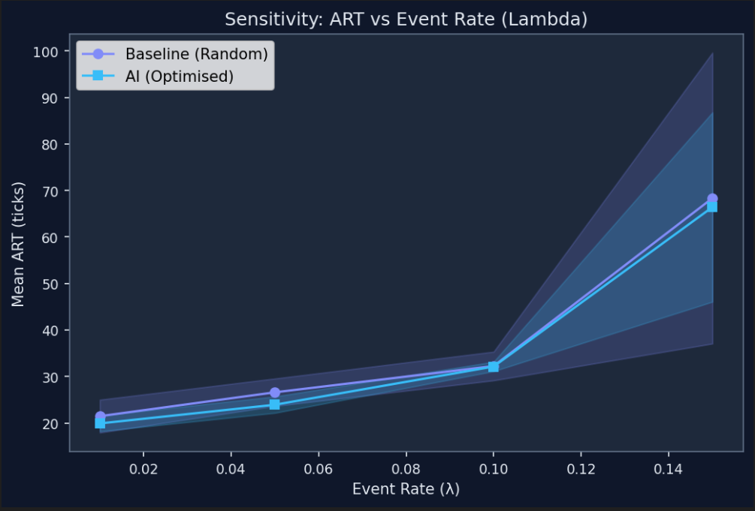
SENSITIVITY & PERFORMANCE
Sensitivity Analysis & Optimisation
[Fleet Size Sensitivity]
ART vs fleet size — sweet spot at 7 ambulances
Optimal Parameters (215-run sweep)
Parameter | Optimal | Finding
Fleet Size | 7 ambulances | Best cost-to-performance
HDBSCAN cluster | 5 | Precision vs sample balance
Rebalance interval | 25 ticks | Keeps fleet agile
Fleet 3→5 | — | ~40% ART reduction
[Lambda Sensitivity]
ART vs event rate — AI advantage holds under normal demand
Sprint 12: Performance Benchmarks
Benchmark | Result | Target
A* average call time | 4.81 ms | <50 ms
Renderer FPS | 86.4 FPS | ≥60 FPS
10K-tick scaling | Pass | <10 min
9 / 8

Slide 10
SYSTEM CONSTRAINTS
Known Limitations & Trade-offs
1
Single Map Topology
5
Single-Objective GA
Only tested on Model Town — not validated on other cities or real-world OSM data.
GA uses simple fitness function — no multi-criteria optimisation (cost, coverage, equity).
2
Uniform Poisson Events
6
Precomputed Distance Matrix
Real demand has spatial/temporal patterns; our model assumes uniform random distribution.
Static distance matrix for dispatch doesn't reflect live congestion conditions.
3
Constant Speed Movement
Future Work
No acceleration, braking, or traffic signal delays — ambulances move one edge per tick.
Multi-city graph support & real-world OSM data
Reinforcement learning for dynamic dispatch decisions
Hospital routing, capacity modelling & patient handoff
Mobile companion for field paramedic teams
4
No Hospital Transport
Ambulances return to base after scene — no patient handoff or hospital routing modelled.
10 / 8

Slide 11
Thank You.
Questions & Discussion
+11.8%
p=0.001
4.81ms
86 FPS
ART Improvement
Significance
A* Pathfinding
Renderer
ResQ-Graph — 12 Sprints · 798 Nodes · 224 Tests · 215-Run Sweep
FAST-NUCES Lahore | Artificial Intelligence | May 2026
8 / 8

