Slide 1
Health : Mental Health Challenge
Web-> Team : Sayed Ammar Hassan

Slide 2
Problem
A 2016 study reported that 39 percent of students were struggling with at least one mental illness.
14 per cent of 15 to 24-year-olds or around one in seven, reported often feeling depressed or having little interest in doing things.
It will impact 100-150 million people.

Slide 3
Solution
1.Increased stress, fear, and anxiety , Parental depression, Negative family environment ,Child mistreatment or abuse by parents . Loss of school, sport, church, community routine.
Loss of supportive relationships with friends, extended family members, mentors
2.Any device with internet.
3.Easy to use ,no tech experience needed.
4.India , USA , Canada.

Slide 4
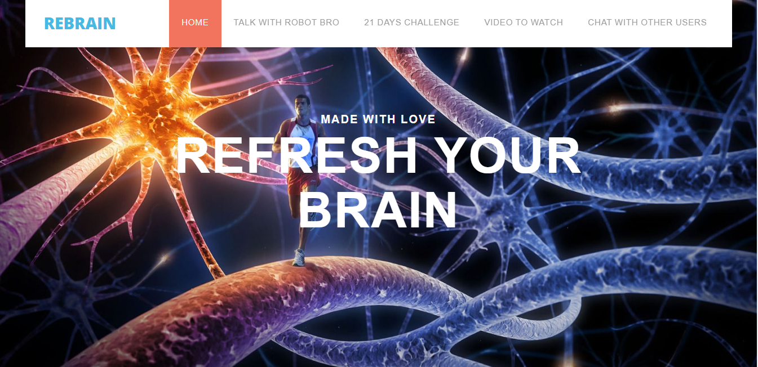


Slide 5
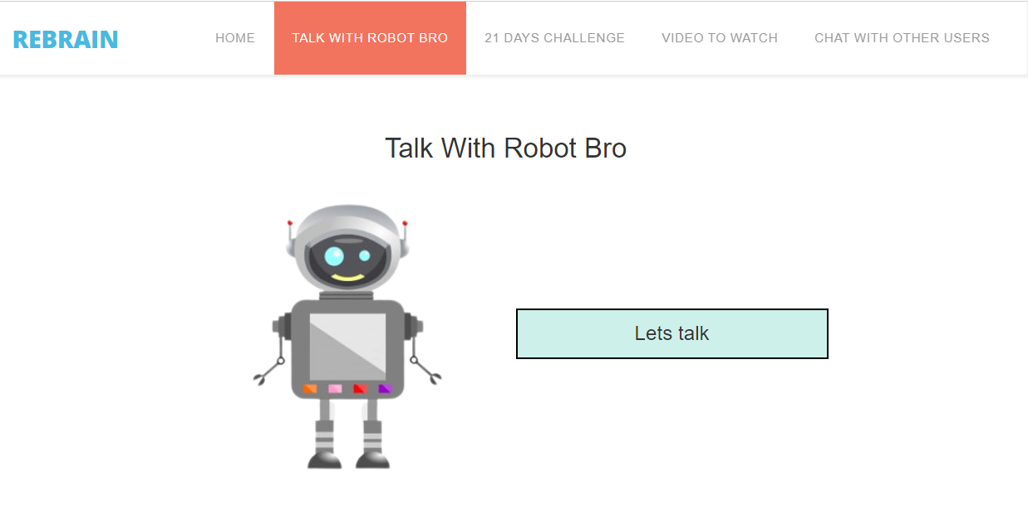

Slide 6
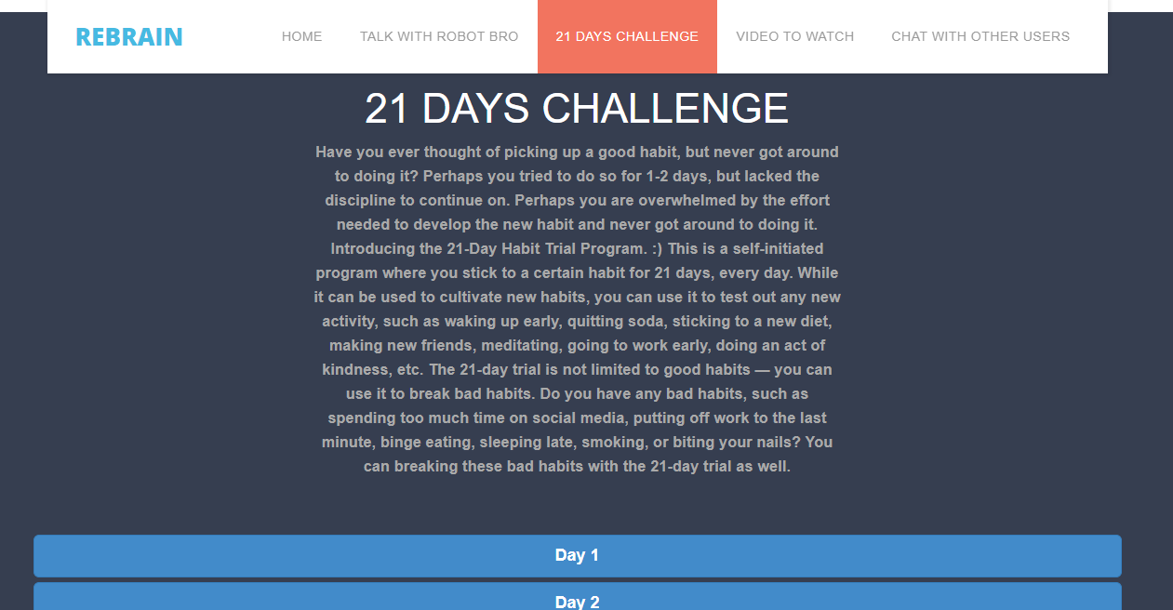

Slide 7
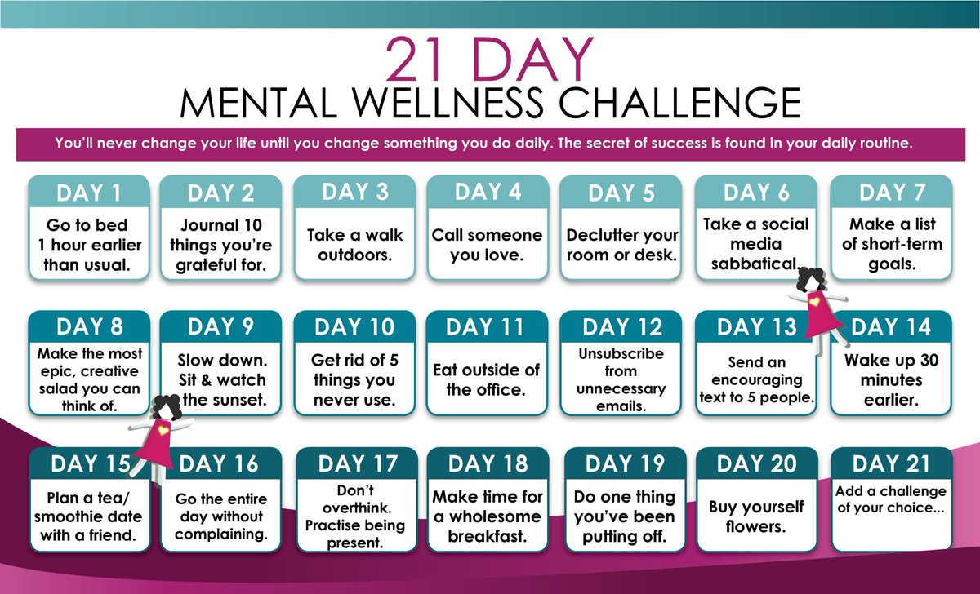

Slide 8
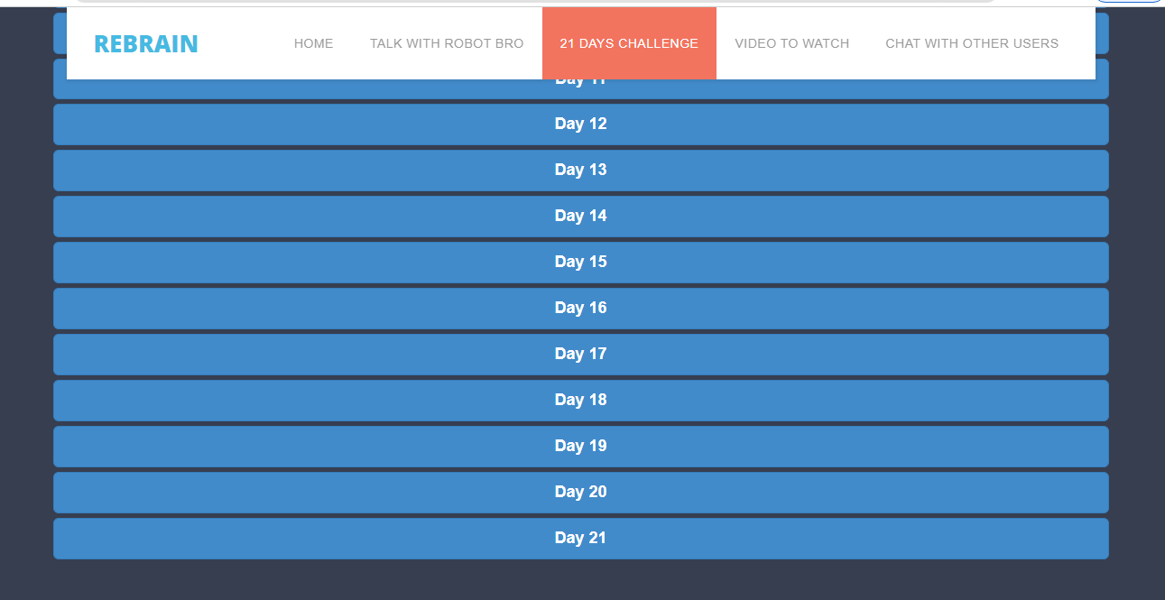

Slide 9
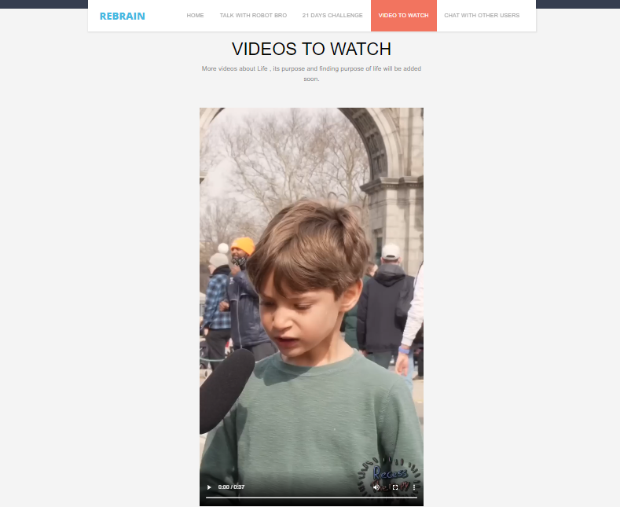

Slide 10
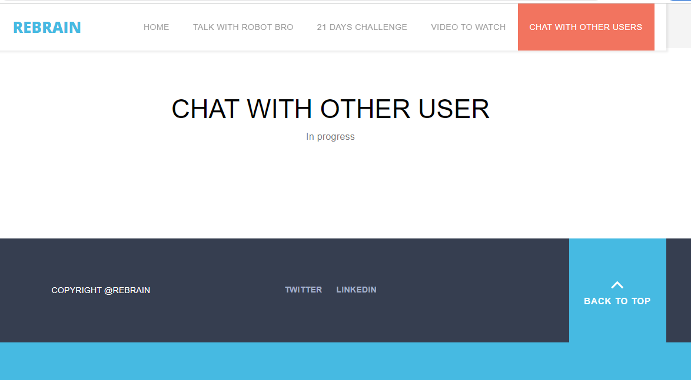

Slide 11
Thank You
1.Impact-> It make stressed ,depressed people mentally healthier, happier, less stressed !
2.Cons->99%
Todo-> in progress
3.Future work->
a.->To add a program made by a psychiatrist.
b.->Live session by psychiatrist and people sharing their experience.

