Slide 1
Presenting and storytelling with data
American University – Spring 2020
https://github.com/shmcminn/AU-data-spring2020

Slide 2
Data stories?

Slide 3
Steps to a data story
Find data
Clean data
Analyze data
Present data

Slide 4
Agenda
Types of data presentation
Tableau training

Slide 5
Storytelling forms
What have you seen on the web?

Slide 6
Storytelling forms
What have you seen on the air?

Slide 7
Storytelling forms
Alternative storytelling forms
Get people associating information with visuals
Delivers information in bite-sized chunks
Makes the news more accessible

Slide 8
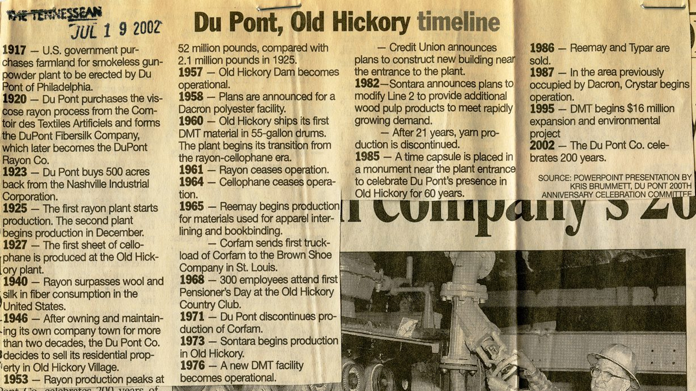
Storytelling forms
Alternative storytelling forms
They’re not new

Slide 9
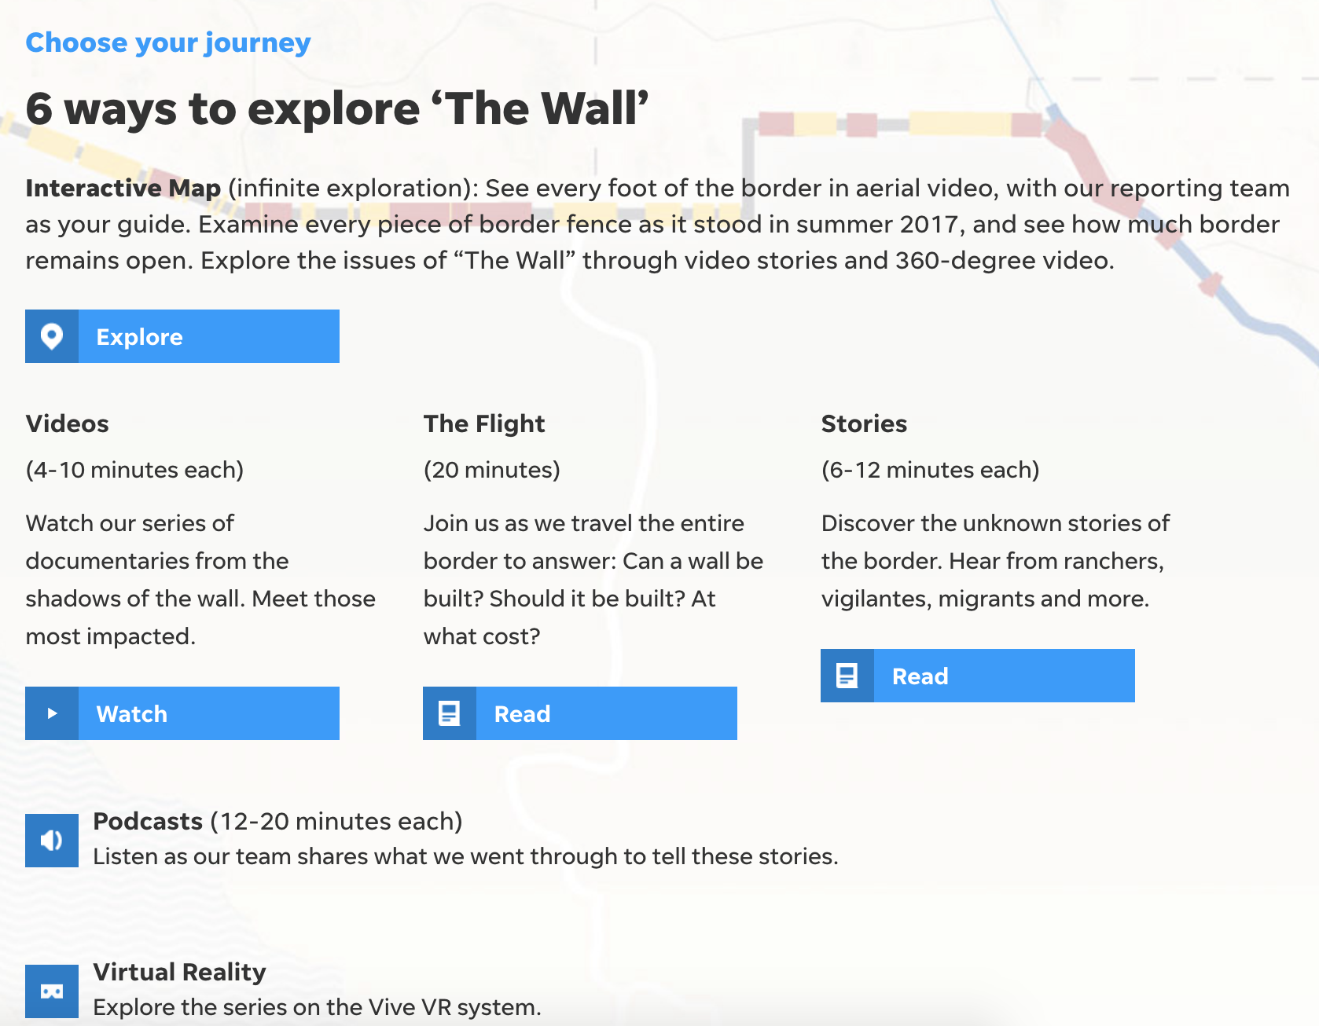
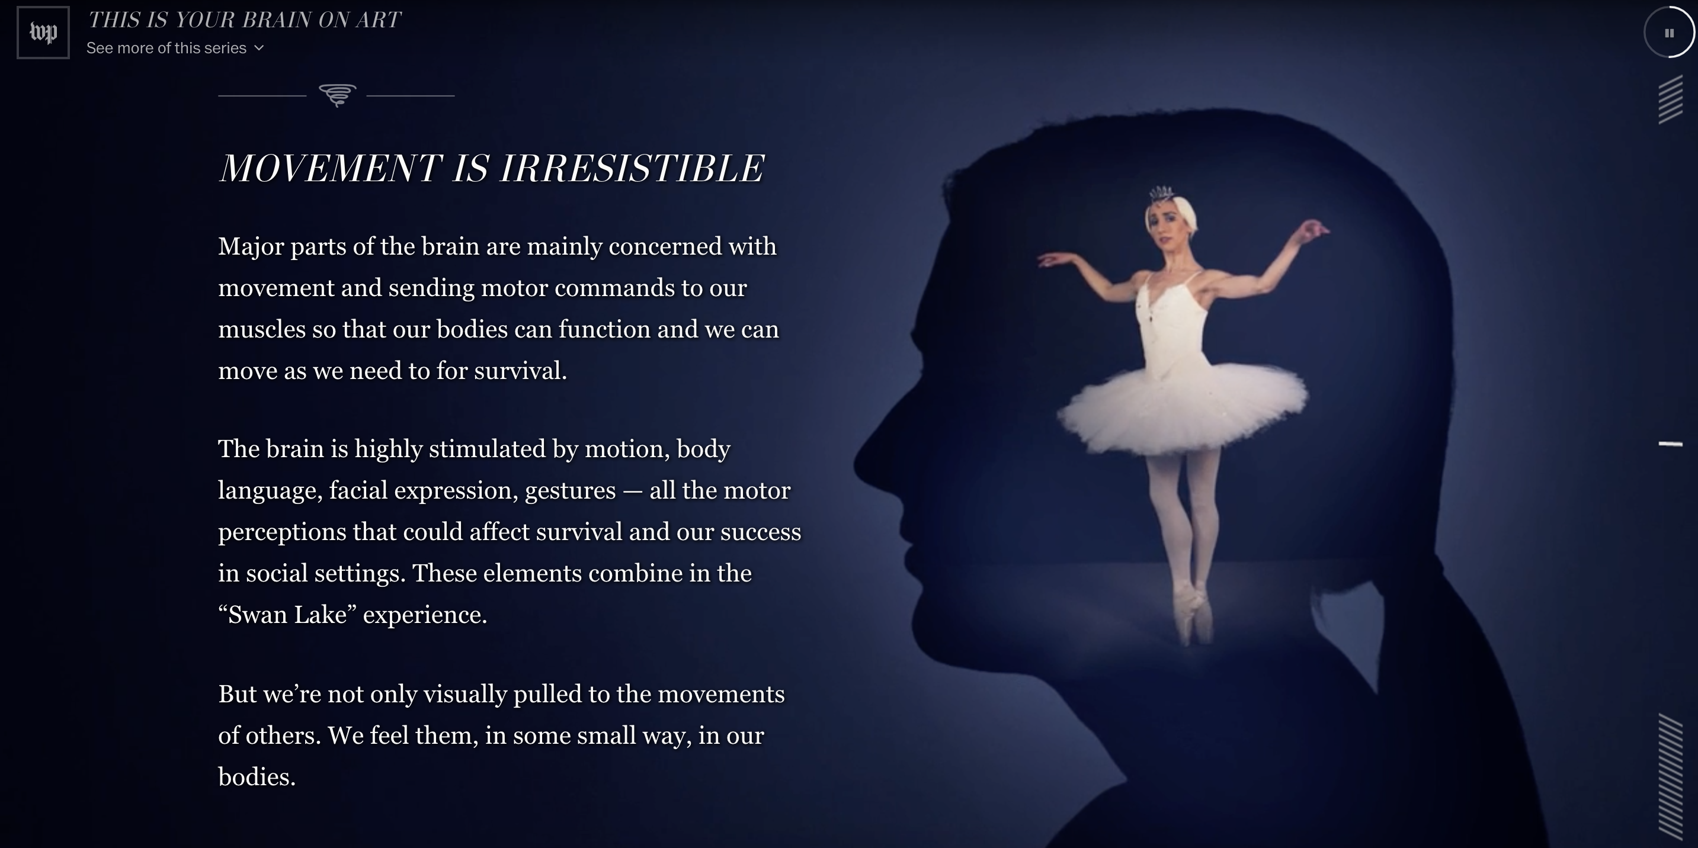
Storytelling forms
Can be data viz, but don’t have to be

Slide 10
Storytelling forms
Scrollytelling
Can make long text feel short
https://www.nytimes.com/interactive/2014/09/14/sports/baseball/jeter-swings.html?mtrref=vallandingham.me
https://www.nytimes.com/interactive/2015/01/09/sports/the-dawn-wall-el-capitan.html?mtrref=vallandingham.me
https://www.washingtonpost.com/graphics/2017/lifestyle/your-brain-on-art/?utm_term=.154307ea6929

Slide 11
Storytelling forms
Small data to big data
Tell people a story, then give them option to explore
https://www.themarshallproject.org/next-to-die
https://projects.fivethirtyeight.com/redistricting-maps/arkansas/#Proportional

Slide 12
Storytelling forms
Games
Entertaining way to interact with data
https://wamu.org/commuter-challenge/
http://www.redistrictinggame.org/game.php

Slide 13
Storytelling forms
Exploring individual data points
https://www.washingtonpost.com/graphics/2018/national/mass-shootings-in-america/?utm_term=.d9db61664e3
https://www.washingtonpost.com/graphics/world/syria-220000/

Slide 14
Storytelling forms
Broadcast
Find persons who story affect
https://www.youtube.com/watch?t=6&v=zIGLZpjqubM

Slide 15
Data viz and storytelling - Tableau
Tableau Public
Find Tableau sample Titanic data
Use Tableau and Word processor to craft small-to-big data story

